Slide 1
Audit & Risk Analytics Dashboard (2022)
Interactive Power BI–Driven Internal Audit & Risk Assessment

Slide 2
Executive Overview
Audit & Risk analytics using Power BI dashboards
Focus on risk exposure, audit effectiveness, and remediation
Dataset: Food Chain Audit (2022)
Supports risk-based audit and management decisions

Slide 3
Data & Methodology
Audit period: Jan–Dec 2022
Data cleaned and transformed using Power Query
DAX measures used for risk significance and KPIs
Analysis structured around risk-based audit principles

Slide 4
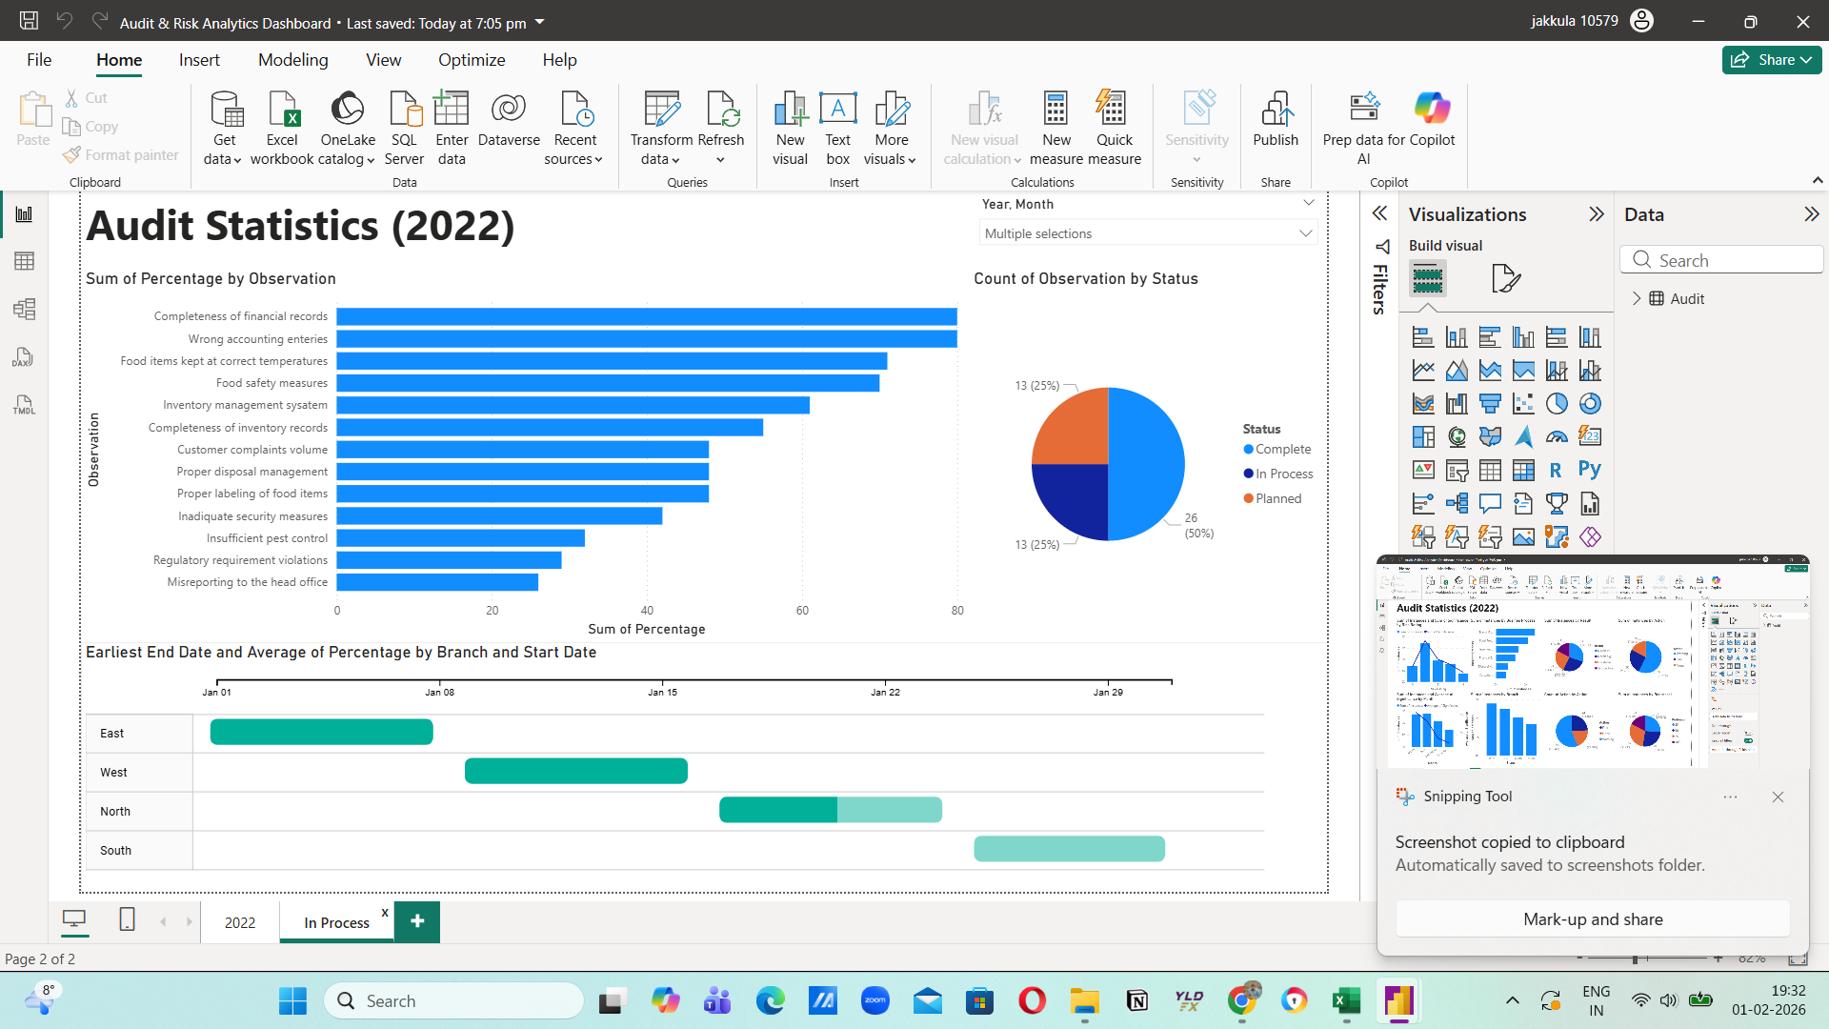
Dashboard 1: Audit Statistics Overview
Risk rating distribution, business process exposure, enforcement actions

Slide 5
Risk Rating Insights
Low–medium risks occur most frequently
High-risk items carry disproportionately high significance
Indicates reactive risk handling
Opportunity for preventive controls and KRIs

Slide 6
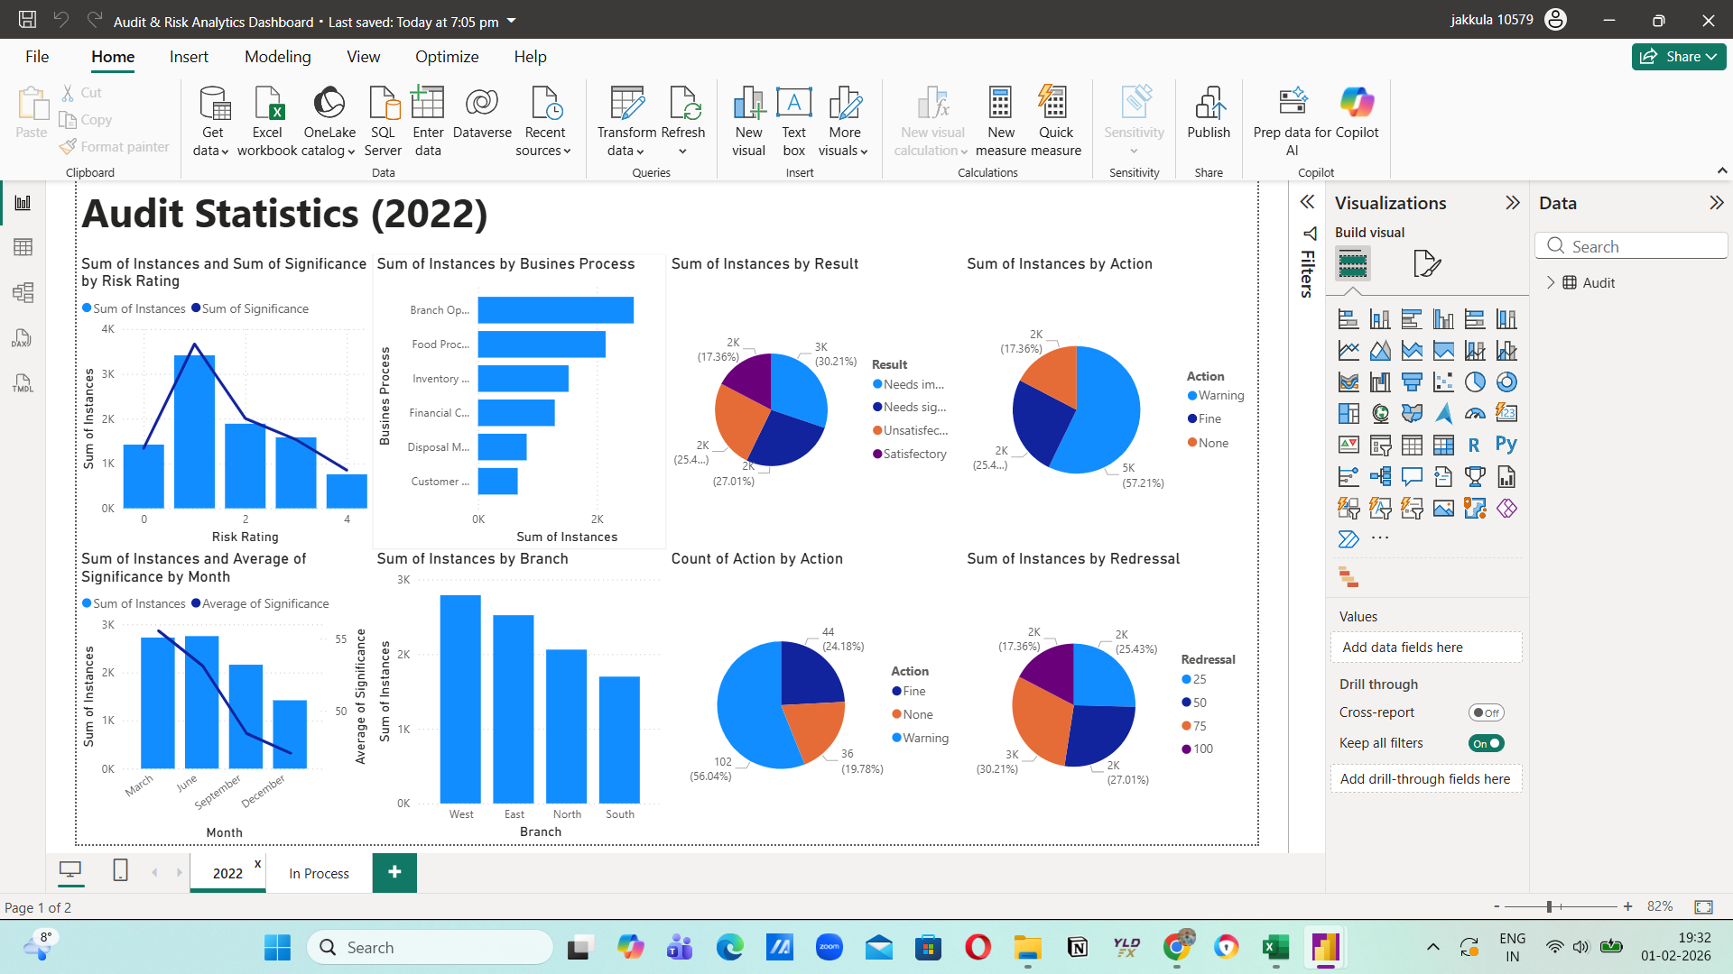
Dashboard 2: Risk Results & Actions
Audit results, enforcement actions, and redressal levels

Slide 7
Business Process Risk Exposure
Highest exposure: Branch Operations & Food Processing
Inventory and financial controls show recurring issues
Upstream control failures create downstream compliance risks

Slide 8

Dashboard 3: Observation-Level Risk & Status
Observation severity, audit status, and branch timelines

Slide 9
Audit Status & Regional Performance
50% audits completed; remainder in progress or planned
Extended remediation timelines in certain branches
Indicates uneven control maturity and resource allocation

Slide 10
Key Risks & Recommendations
Financial misreporting and food safety compliance risks
Delayed remediation increases residual risk
Adopt risk-based audit prioritisation
Introduce continuous audit analytics dashboards

Slide 11
Conclusion & Business Value
Demonstrates analytics-led internal audit capability
Improves governance transparency and risk visibility
Suitable for audit, risk, compliance, and regulatory roles

