Slide 1
Global E‑Commerce Sales Analysis
Power BI Interactive Business Intelligence Project

Slide 2
Executive Summary
• Analysis across 147 countries and 1,094 states
• Total Sales: $12.64M | Profit: $1.47M | Cost: $11.18M
• Objective: Identify revenue drivers and growth opportunities

Slide 3
Business Performance Overview
• Profit margin of ~11.6% indicates healthy but optimizable performance
• Cost structure review can improve margins
• Strong global sales footprint

Slide 4
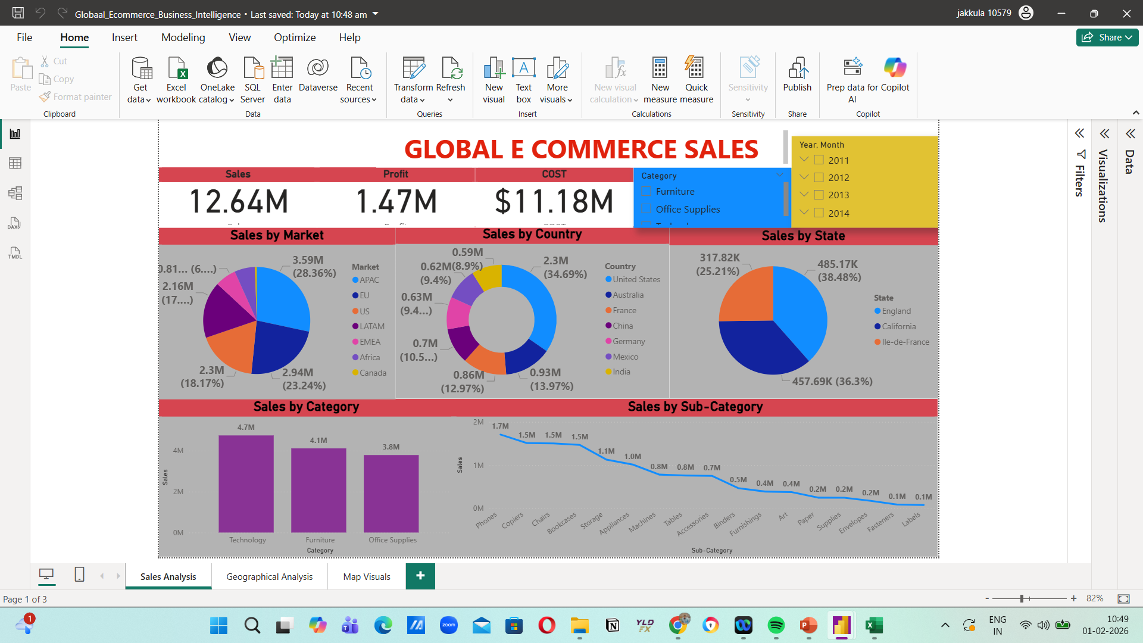
Global Sales Dashboard
Overall sales KPIs, market split, country & category performance

Slide 5
Market-Level Performance
APAC leads (~28%), EU & US show stable demand, emerging growth regions identified

Slide 6
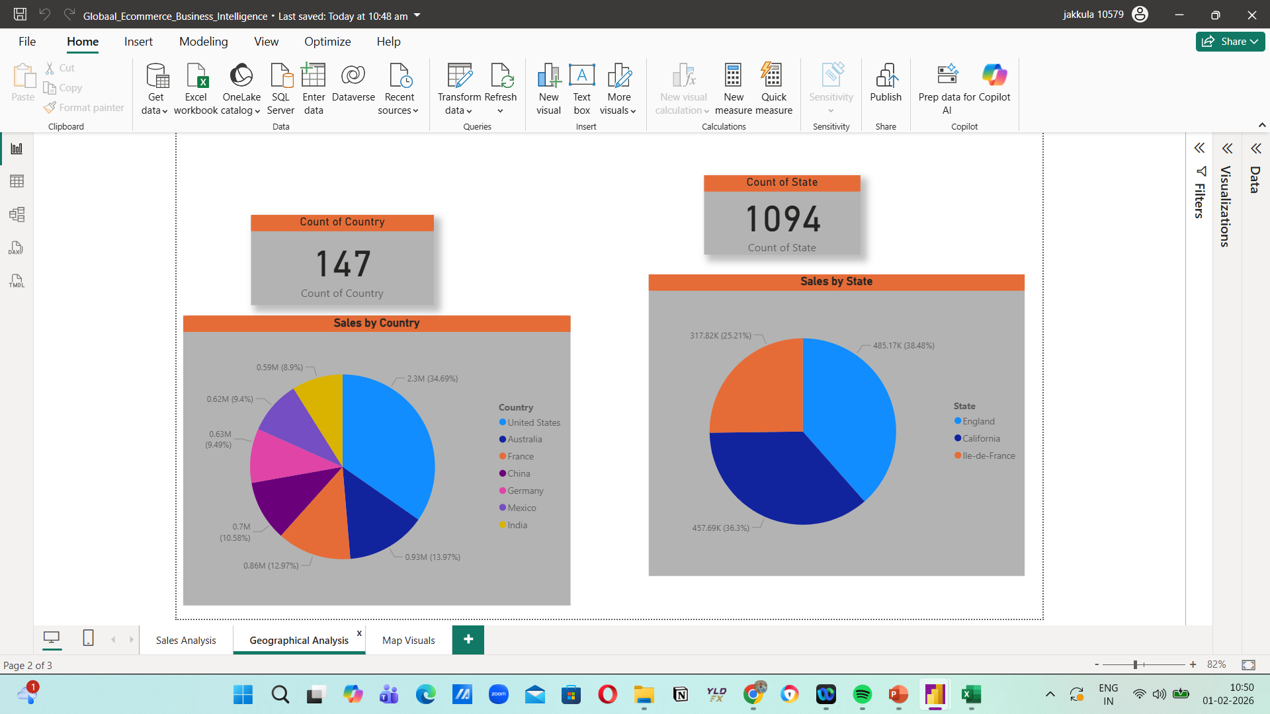
Country-Level Analysis
United States contributes ~35% of total sales followed by Australia, France, China, Germany

Slide 7
State-Level Performance
Top states: England (~38%), California (~36%), Île-de-France (~25%)

Slide 8
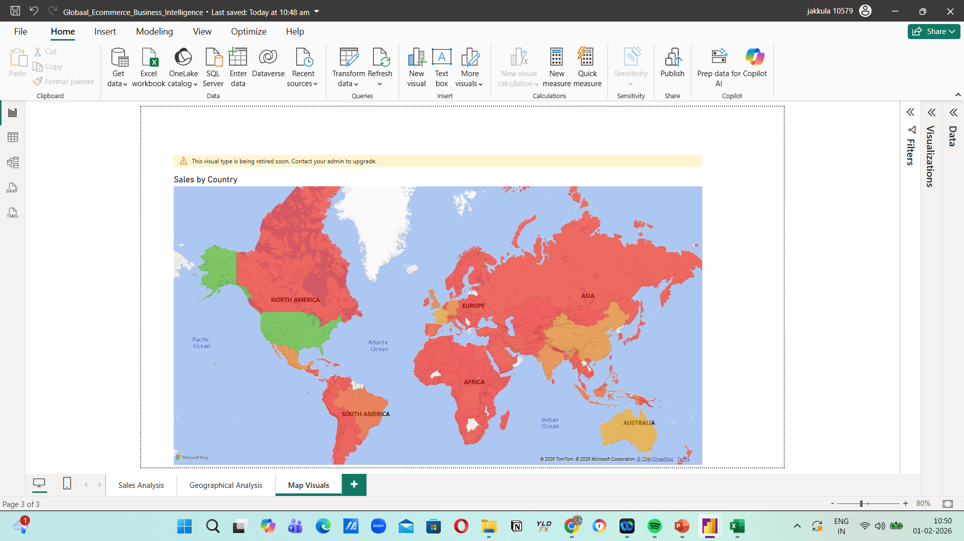
Geographical Sales Map
Global sales distribution highlighting high and low penetration regions

Slide 9
Category Performance
• Technology leads with ~$4.7M revenue
• Furniture (~$4.1M) and Office Supplies (~$3.8M) ensure stability

Slide 10
Sub-Category Trends
• Top: Phones, Copiers, Chairs, Storage
• Low performers: Labels, Fasteners, Envelopes
• Long-tail revenue pattern observed

Slide 11
Strategic Recommendations
• Expand technology category in emerging markets
• Optimize logistics and low-margin sub-categories
• Pilot expansion in Africa & LATAM

Slide 12
Conclusion
• Dashboard provides decision-ready insights
• Strong core markets with clear growth opportunities
• Supports executive-level strategy and planning

