Slide 1



Antal Jakovác
A Novel Approach to
Artificial Intelligence
MT Kurbucz
P Pósfay
A Telcs
TS Biró
AIME 2024
Bu­dapest, Hun­gary, No­vem­ber 21-22, 2024

Slide 2
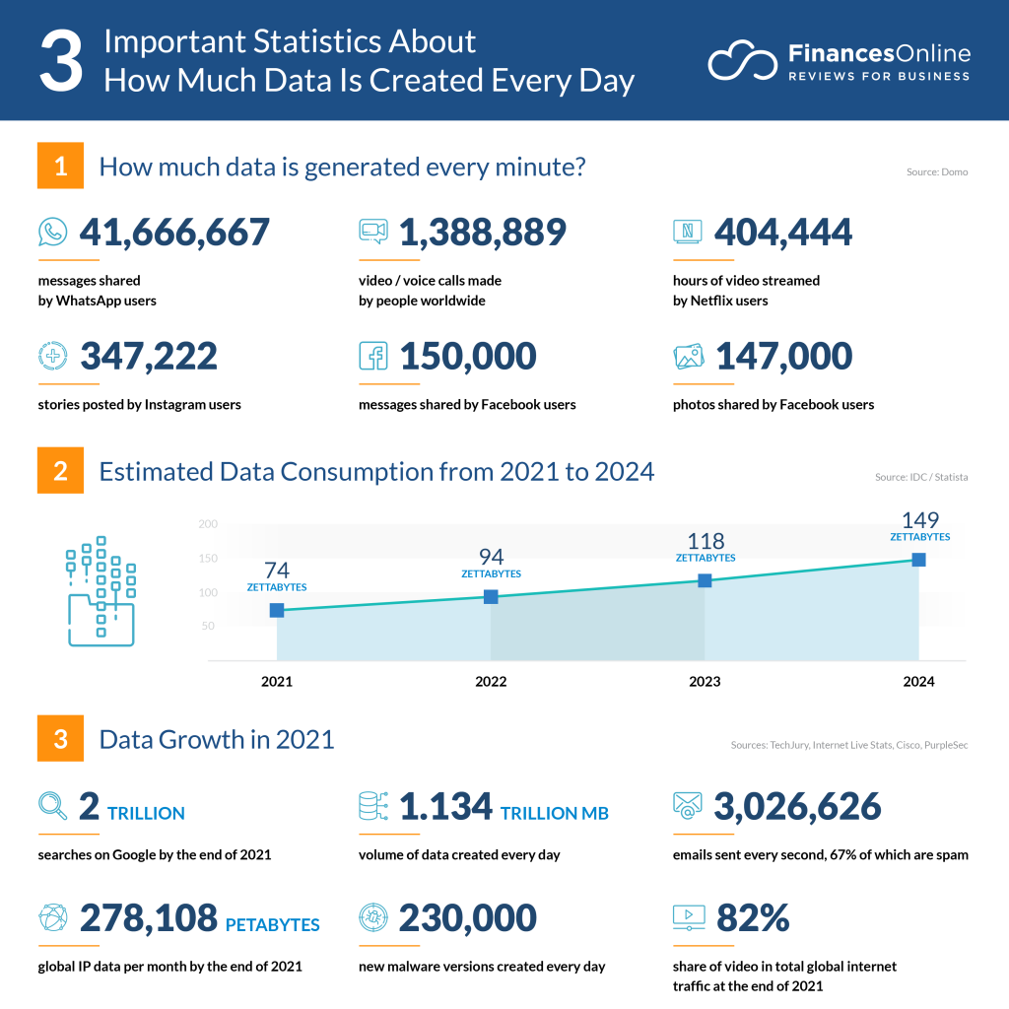
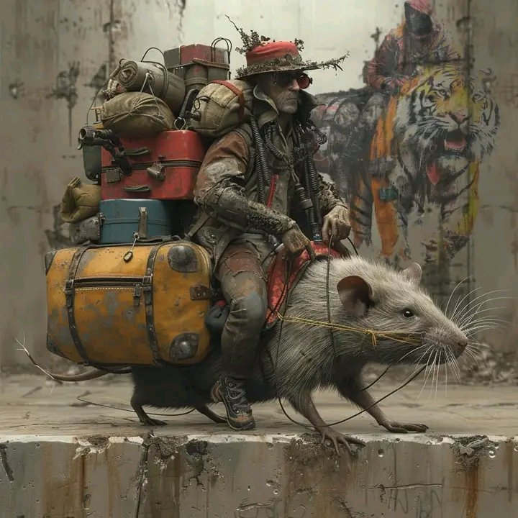

Introduction: successes of AI
Neural networks provided a lot of magnificent achievements
classification (dog breeds, faces, birdsong, flowers, etc.)
text generation (chatGPT, Bing, Bard, Vicuna23B, etc.)
image generation (midjourney, Dall-E, Dreamstudio, etc.)
autonomous cars / AI driving assistants
etc.
Billion USD business (2023: ~ 200 bUSD)
dangerous or advantageous?
(jobs, information access and safety, decision making,… )
cultivate or regulate?

Slide 3

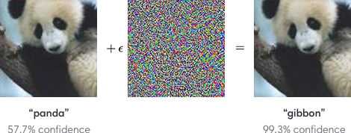
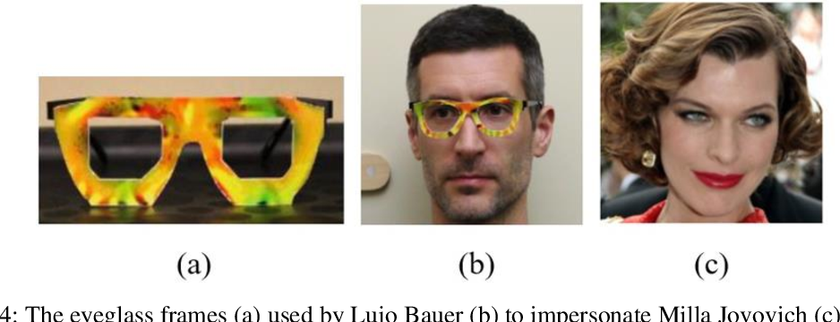

Introduction: AI challenges
We can not address certain problems…
pen or not pen; “I don’t know” (they need balanced datasets)
generalization (“catastrophic forgetting”)
error control (prone to adversarial attacks, hallucinations)
planning
Intelligent from certain points of view, but certainly not “thinking machines”

Slide 4
Introduction: AI challenges
We can not address certain problems…
pen or not pen; “I don’t know” (they need balanced datasets)
generalization (“catastrophic forgetting”)
error control (prone to adversarial attacks, hallucinations)
planning
Intelligent from certain points of view, but certainly not “thinking machines”
How can we approach “thinking” – what was the question, if the answer is human intelligence? (Turing test, classification task, … )

Slide 5

Introduction: back to the origin…
What is the intelligence good for?
Motto:
Motto:
πάντα ῥεῖ
(Ἡράκλειτος)
πάντα ῥεῖ
(Ἡράκλειτος)
panta rhei: everything flows
(Heraclitus)
panta rhei: everything flows
(Heraclitus)

Slide 6
Introduction: what is a pen?
Motto:
We get all information in time, but …
nothing remains the same in time:
(example: a pen)
move position
change shape
change matter content
change microstate or quantum state
πάντα ῥεῖ
(Ἡράκλειτος)
panta rhei: everything flows
(Heraclitus)
What we refer to as “a pen” is in fact a set of states.
The important question is: what defines this set?

Slide 7
Introduction: what is a pen?
What defines this set? the question to approach intelligence
present day (DNN) approach:
we need someone to tell what a pen is (training, supervised learning)
image recognition: we use universal function approximator (neural networks)
seek a function that tells apart e.g. pens and pencils
technically: adjust parameters of trial function until appropriate accuracy
Leads to the aforementioned problems

Slide 8
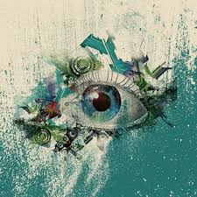
Persistent concepts
Is there another way?
everything flows, but we want to ensure our existence for a longer time period
we have to do predictions → need some stability!
we need quantities that are the same in the future as in the past
We need to find conserved quantities (laws) in the observed data!

Slide 9
Persistent concepts
We need to find conserved quantities (laws) in the observed data!
Remarks:
The important (relevant) information is what remains stable
→ laws (rules) are the relevant features of a phenomenon
We characterize an item with a lot of laws
(e.g. small, four-legged, furry, round eared, squeaking, etc. animal)
laws are inherent properties of the data (data driven), no need to annotate (unsupervised → supervised learning, when the label is part of the time series)

Slide 10
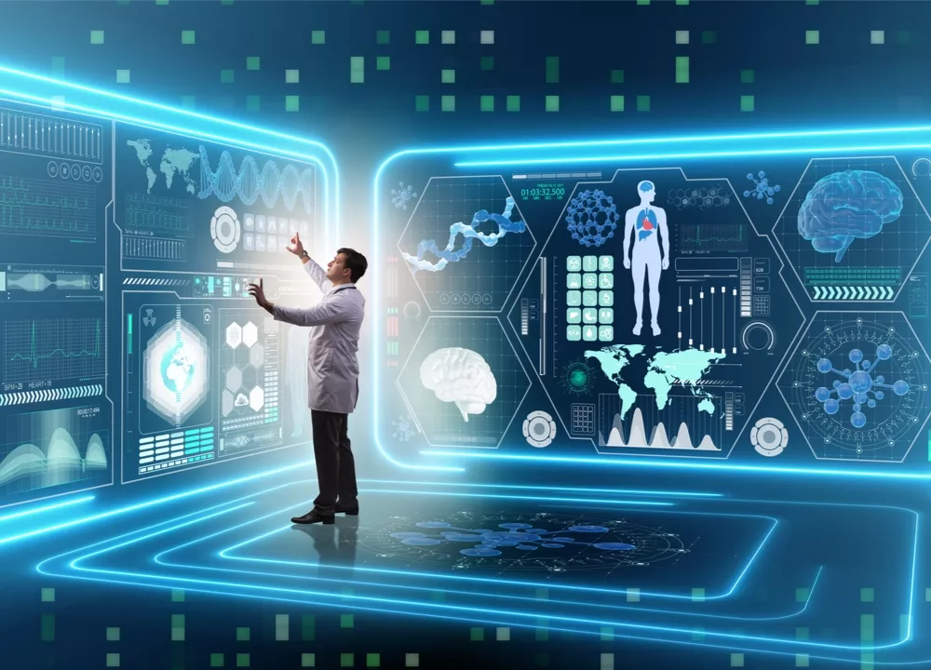
Persistent concepts: science
Surprisingly robust – in fact all of our concepts come from conservation laws!
In science:
objects: we observe solid states with definite shape → remains constant while changing place, time, rotate, etc. → in a gaseous environment, ”object” concept would be useless
angle: consider two lines, observers see it in different position, rotation; the invariant property is the angle
physics laws: persistent relation between measurable quantities:
e.g. Newton law: is true for all times
gas molecules take different configurations, but what matters macroscopically are the
(quasi) conserved quantities: volume, temperature, particle number, etc

Slide 11


Persistent concepts: finance
All of our concepts come from conservation laws:
Finance: fluctuating prices make predictions difficult;
the goal is to find some persistent concepts
  price distribution is more stable → market model
  to achieve persistency we combine assets → hedging, indexes
  lack of arbitrage, extensive hedging → risk neutral market, martingales and pricing
  for better predictive power we need to find more conserved quantities!
to characterize animals we consider persistent properties → species, breeds
taxonomy collects these properties in a hierarchical system

Slide 12
Laws and classification
Classification strategies:
neural networks
using laws
dogs
dogs
cats
cats
System 1: few (but complicated) laws, fast evaluation, specific, not controlled
System 2: more (but simpler) laws, slower evaluation, not specific, control each other
Daniel Kahneman: Thinking, fast and slow – System 1,2 in human psychology

Slide 13

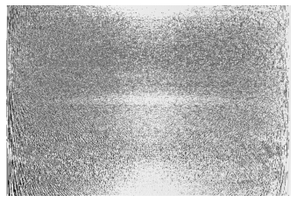
Persistent concepts: representation
mathematically a persistent concept or conservation law can be expressed as
how can we find the appropriate law? assume digital input, i.e.
then the number of possible functions is : impossible to explore!
we single out some functional space:
  shapes, textures → humans are good
  equivalent representations can be not recognizable → AI may help

Slide 14
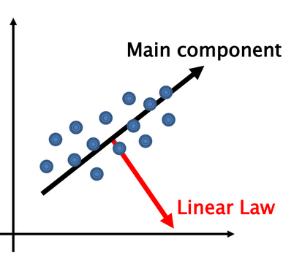
Laws in time series: training
Mathematical procedure: LLT MT Kurbucz, P Pósfay, A Jakovác - Scientific Reports, 2022
find rules in sub-samples, e.g. linear relation
  database: samples from time series with uniform steps
  for subsamples: best linear relation
representation of nonlinear laws:
  locally linear
  multiple laws
  continue finding local laws until the training set can be
  represented appropriately
result: each element of the training set is represented by
some of the laws

Slide 15
Laws in time series: classification
Dataset | Accuracy | Training time | Benchmark
Ford A | 97.5% | 916 sec | 97-98%
Ford B | 94.3% | 3070 sec | 83-92%
AReM | 100% | 10 sec | 99.6%
Gun_Point | 96.7% | 8 sec | 100%
Mathematical procedure:
new sample arrives
  try the laws of both classes
  keep the bests (top 5%)
  predicted class that performs the best
  use standard classifiers (SVM, KNN)
  if no laws work: none of the classes→ outlier analysis (e.g. ECG signal analysis)
benchmarking: publicly available databases
applications: mechanical motions, ECG signal processing, Bitcoin price prediction, etc.

Slide 16

Persistent concepts: thinking
relevant concepts serve as coordinates: we characterize the observed items with concepts (e.g. small, four-legged, furry, round eared, squeaking, etc. animal)
often used combinations promote to standalone concepts (e.g. chair)
concepts are related
  coexistence, consecutiveness, causality → new laws (e.g. “fire – hot = 0” or “[rain now] – [wet street later] = 0”)
  humans tend to establish these relations easily → not always correct, needs later refinement! (e.g. “[wet street now]-[rain earlier]=0” not necessarily true)
context: relevant concepts depend on the environment (e.g. scale, or role) → change relevant concepts (renormalization group)
model: net of concepts form a dynamical model of the reality → thinking

Slide 17
Conclusions
we need to maintain ourselves (give predictions) in an ever flowing environment, thus we need persistent quantities (laws, relevant features)
thus we need to find persistent phenomena (laws): these are our concepts
  DNN: a single law for each class, fast, uncontrolled, specific → System 1
  generic laws: data driven, not specific, slower, controlled → System 2
we need a functional space to seek laws → LLT: multilinear feature transformation
generic laws allow abstract, general, structured, dynamic modeling → thinking

Slide 18
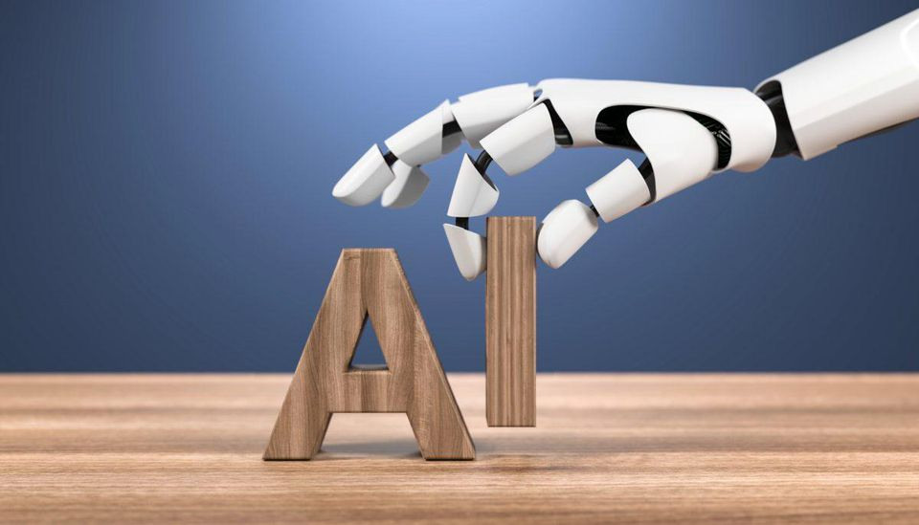
The end

