Slide 1



Antal Jakovác
Representing Reality
AIME 2025
Bu­dapest, Hun­gary, No­vem­ber 27-28, 2025

Slide 2

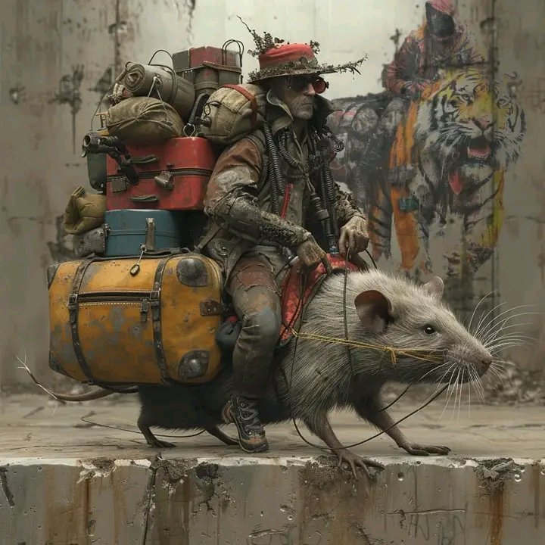

Introduction: successes of AI
Neural networks → magnificent achievements
classification (dog breeds, faces, birdsong, flowers, etc.)
text generation (chatGPT, Bing, DeepSeek, etc.)
image generation (midjourney, Dall-E, Dreamstudio, etc.)
autonomous cars / AI driving assistants
etc.
Billion USD business (2023: ~ 200 bUSD)

Slide 3
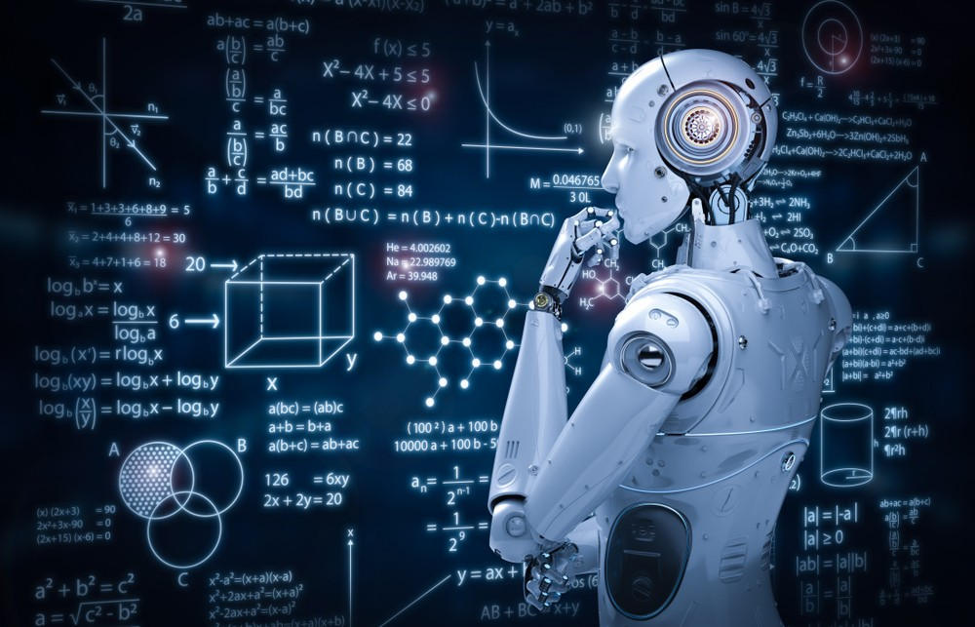

Introduction: AI challenges
Challenges and limitations
“I don’t know” category (balanced datasets are needed for training)
generalization (“catastrophic forgetting”)
prone to adversarial attacks
no goals, planning
hallucinations in generative networks
At the root of many AI-related problems lies an insufficient representation of reality.

Slide 4
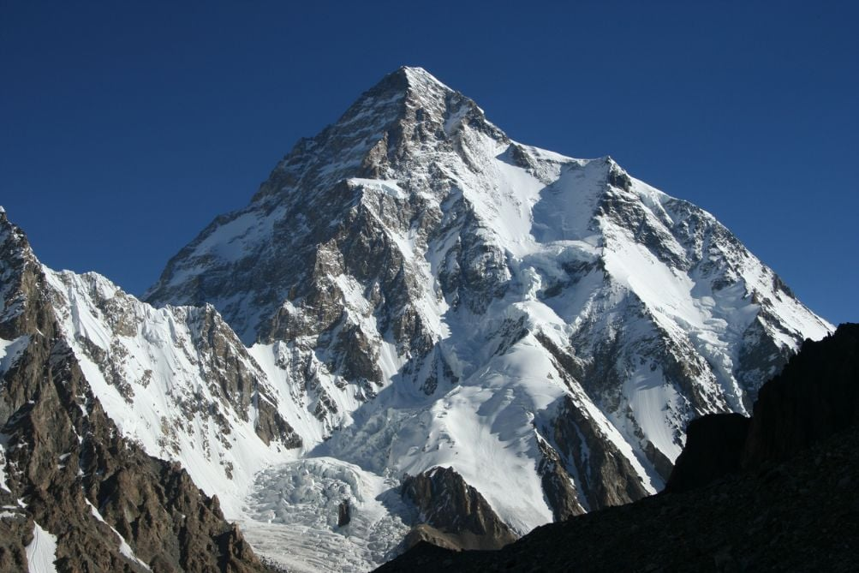

Reality and AI Models
Aspects of reality: general and actual
general reality
  laws and generic algorithms describing how the world works
examples
  a map describing the streets → show the possibilities
  in LLMs: possible tokens that can come from a context
in AI: part of the (trained) hardware → represented by millions to ~100billions of parameters

Slide 5
Reality and AI Models
Aspects of reality: general and actual
actual reality:
  describes the actual environment, the objects, persons and phenomena that are actually active
examples
  in the map the actual traffic, road works, detours, obstacles, etc.
  in LLMs: the actual question we want an answer to, prompt
in AI: part of the input → ~million tokens
In AI applications, general reality is represented much more thoroughly.

Slide 6
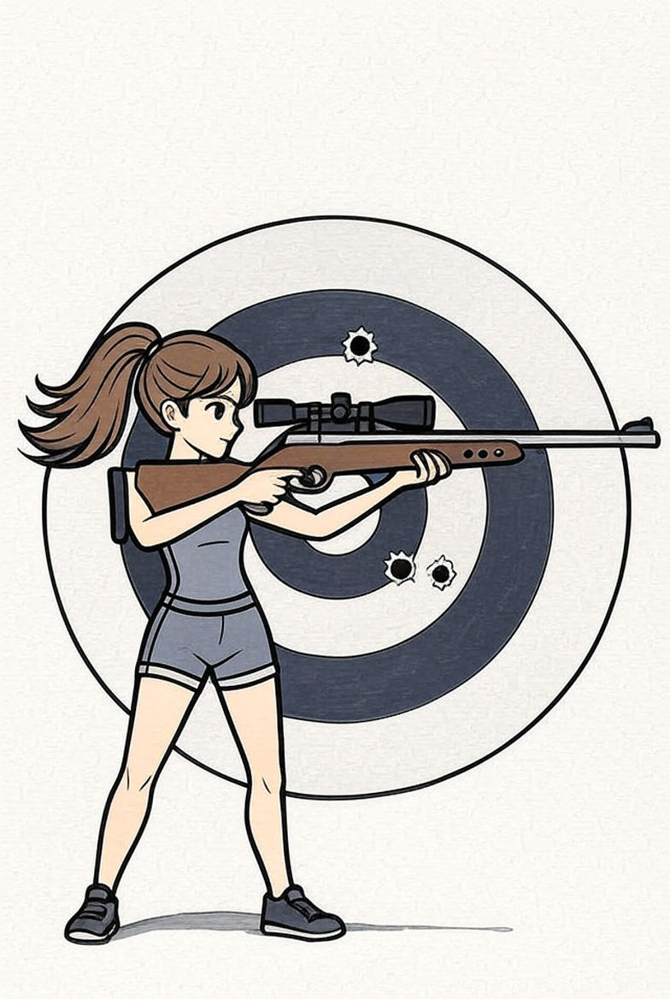
Introduction: target accuracy
How can we shoot better?
take a gun, shooting to a target: it is not accurate
improve accuracy → general level
  improve weapon (e.g. attach a scope)
  change for better weapon (e.g. handgun → rifle)
improve accuracy → actual level
  better aiming
  steadier hold

Slide 7
Introduction: target accuracy
How can we shoot better?
take a gun, shooting to a target: it is not accurate
improved accuracy: better tool, better aiming
→ still there is a distance where precision is lost
initial conditions (aiming) is a pure representation of reality
true for any systems: initial conditions & propagation → drift
  physical systems → like mechanical projectiles
  iterative computations → like generative neural networks

Slide 8
Introduction: target accuracy
Maintain precision
for long-term precision a control mechanism is necessary:
compare modeled and actual reality
weapons → frequent course corrections
in general:
  apply generation in small steps
  compare state to the actual reality
  apply correction before continuing generation
in this way we can follow the plan, without drifting away from reality

Slide 9

Representing Reality
How can we characterize reality? → ask questions (measurements)
what is a good question?
acquire information → data lakes
  big data approach, measure what we can
  → e.g. measure pixel colors, collect logs, store amplitudes
  hope that all important detail can be recovered from the data
  important details are deeply hidden in the data
  often leads to an enormous, unstructured database with a lot of unnecessary/redundant information
(A. Jakovac, A. Telcs, Mathematics, 2025)

Slide 10

Representing Reality
what is a good question?
useful information (feature) → characterize a phenomenon
  phenomena are equivalence classes of elementary data
  equivalence classes are defined by labels (supervised) or by other means (e.g. temporal subsequence – unsupervised)
  to represent equivalence classes we choose functions constant on them (→ measurable functions)
  features depend on the selected phenomena (context)
  (and any context have stable patterns)

Slide 11

Representing Reality
Concepts as class-constant functions
objects: we observe solid states with definite shape → remains constant while changing place, time, rotate, etc. → in a gaseous environment, ”object” concept would be useless
angle: consider two lines, observers see it in different position, rotation; the invariant property is the angle
laws: persistent relation between measurable quantities:
  Newton law: is true for all times
  market model: price distribution

Slide 12
Representing Reality
Elements of a good representation
context: relevant objects – measurable functions – values
another (natural science vibe) wording:
context: objects – coordinates – values
everything is context-dependent (no “general” reality)
coordination can be general or object dependent
world basically consists of discrete objects, but the raw input is often continuous

Slide 13
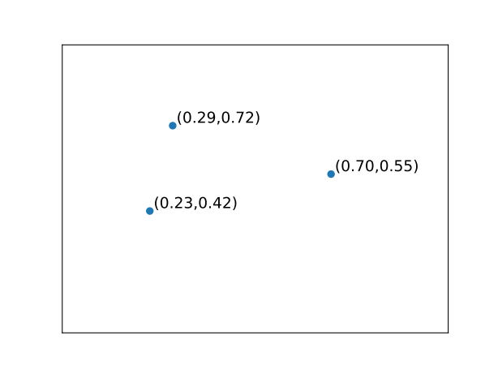
General coordinates
Examples for object independent coordination
mathematics: points in a d-dimensional space
we not have to name the coordinates →
word embedding in LLMs
  one-hot-encoding: all words represent a new dimension
  vector embedding: ~thousand dimensional space
  all coordinates represent a (fixed, abstract) feature, and we store the relation of the word to the given feature

Slide 14
Object dependent coordinates
Optimal coordination
assume we have discrete classes (objects) characterized by class-constant functions
which coordination is the optimal?
  we arrive at the given class with a minimal number of features
  information theoretical question (Shannon entropy, Huffmann coding)
optimal coding is hierarchical: properties of the parents are valid properties of the children → generalization
usually much less property/feature is enough than in the general case
→ c.f. twenty questions (barchoba)

Slide 15
Object dependent coordinates
Shannon entropy and amount of information
example for Huffmann coding
average questions:
0.4+3x0.6=2.2
Shannon entropy:
2.12

Slide 16
Continuous inputs
Sensory inputs are (quasi) continuous → discrete features
we have to define the context (labels, or temporal subsequence)
we have to define a parametrizable functional space (e.g. DNN, LLT, …)
optimize parameters to find class-constant or conserved (time-constant) functions → necessary conditions
collect conditions to fully represent a class
values usually discrete (discrete classes)
→ for regression they can be continuous
dogs
cats

Slide 17
Coordination and objects
Technical solutions for representing reality
time series analysis: LLT/ALT method
reusable computer vision applications (RESNET): last layer provides good features for natural images
databases and Retrieval Augmented Generation (RAG)
  relational databases → fixed coordinates
  nonrelational databases → document databases (JSON)
  graph databases → Resource Description Framework
(Kurbucz et al. arXiv 2025, Scientific Reports 2022)

Slide 18
Coordination and objects
Technical solutions for coordination
time series analysis: LLT/ALT method
  linear laws for time segments
  collection of laws for a given class with ‘OR’ relation
  if rules do not fit to either class → “I don’t know” category (outlier)
  adaptive version to find best scales
(Kurbucz et al. arXiv 2025, Scientific Reports 2022)

Slide 19

LLT/ALT classification results
Dataset | Accuracy | Training time | Benchmark
Ford A | 97.5% | 916 sec | 97-98%
Ford B | 94.3% | 3070 sec | 83-92%
AReM | 100% | 10 sec | 99.6%
Gun_Point | 96.7% | 8 sec | 100%
Mathematical procedure:
new sample arrives
  try the laws of both classes
  keep the bests (top 5%)
  predicted class that performs the best
  use standard classifiers (SVM, KNN)
  if no laws work: none of the classes→ outlier analysis (e.g. ECG signal analysis)
benchmarking: publicly available databases
applications: mechanical motions, ECG signal processing, Bitcoin price prediction, etc.

Slide 20
Resource Description Framework
Triplet representation of reality
knowledge graph representation
each entry is a triplet:
(subject, predicate, object) → (name, property, value)
example: Dorothy : son = Bill
own development: TriosDB → lightweight RDF solution
  values are vectors
  circular representation for efficient queries
  Bill : Dorothy = son, son : Bill = Dorothy
  context as data modules

Slide 21
Conclusion
Representation of reality
correct representation of reality is the main goal of the intelligence
general vs actual reality
  general reality is well represented in AI solutions
  actual reality is poorly and ineffectively represented
key element: find class-constant functions
  continuous input → discrete representation (e.g. with LLT)
  discrete objects → knowledge graphs, hierarchical structure

Slide 22

The end

