Slide 1

Blockchain and Internet of Things
BIoT
Ajal Sunny
2017-21

Slide 2
ABSTRACT
IoTs enables coupling of digital and physical objects using communication technologies and introduces a future vision…
Such a vision requires seamless security, data privacy, authentication and robustness against attacks.
These attributes can be introduced by blockchain, a distributed ledger that maintains an immutable log of network transactions.

Slide 3
TABLE OF CONTENTS
1. Introduction
2. Iot Overview
2.a) IoT Architecture
2.b) The problem with the current centralized model
2.c) Decentralizing IoT networks
3. The Blockchain Approach
3.a) What is Blockchain?
3.b) What are some advantages of blockchain?

Slide 4
TABLE OF CONTENTS (contd)
4. Integration of blockchain and IoT
4.a) questions that may pop up…
5. several applications of BIoT
6. Conclusion
7. References

Slide 5
Introduction
Here we are discussing a comprehensive review on how to remodel blockchain to the specific IoT needs in order to develop Blockchain based IoT (BIoT) applications.
Aims to provide transparency and security which is not offered by the current centralized model of IoT.

Slide 6

IoT overview
Three perspectives can broadly define IoT: Internet-oriented, Semantics-oriented, and Things-oriented.
IoT focuses on optimizing and transforming manual processes to make them part of the digital era, thereby facilitating the development of huge range of smart applications
The Internet of Things (IoT) as a concept is fascinating and exciting, but one of the major challenging aspects of IoT is having a secure ecosystem encompassing all building blocks of IoT-architecture.

Slide 7
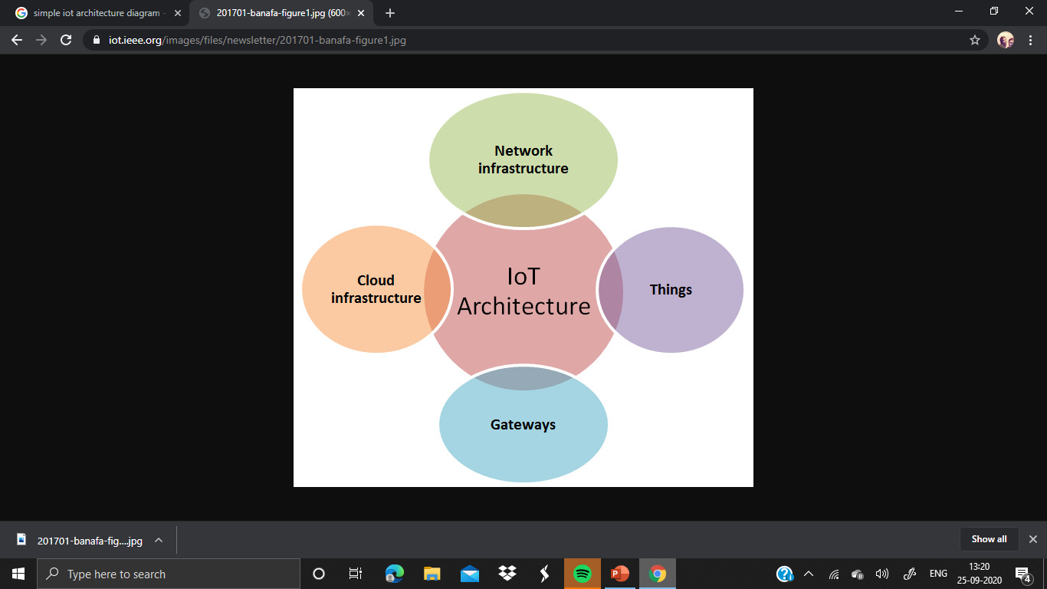

Slide 8
The problem with the current centralized model
Current IoT ecosystems rely on centralized, brokered communication models.
All devices are identified, authenticated and connected through cloud servers that sport huge processing and storage capacities.
Existing IoT solutions are expensive because of the high infrastructure and maintenance cost.

Slide 9
Decentralizing IoT networks
A decentralized approach to IoT networking would solve many of the issues with the current approach.
It significantly reduce the costs associated with installing and maintaining large centralized data centers
However, establishing peer-to-peer communications will present its own set of challenges, chief among them the issue of security.

Slide 10
decentralized approach must support three foundational functions:
• Peer-to-peer messaging;
• Distributed file sharing;
• Autonomous device coordination.

Slide 11
The Blockchain Approach
Blockchain, the "distributed ledger" technology, has emerged as an object of intense interest in the tech industry.
Blockchain technology offers any digital interaction in a way that is designed to be secure, transparent, highly resistant to outages, auditable, and efficient.

Slide 12
What is Blockchain?
Blockchain is a database that maintains a continuously growing set of data records.
A blockchain consists of two types of elements:
• Transactions are the actions created by the participants in the system.
• Blocks record these transactions and make sure they are in the correct sequence and have not been tampered with.

Slide 13

What are some advantages of blockchain?
The big advantage of blockchain is that it's public.
A blockchain is decentralized
That means there's a huge amount of trust involved since all the participants in the network have to reach a consensus to accept transactions.
Most importantly, it's secure.

Slide 14
Integration of blockchain and IoT
The ever-expanding IoT device ecosystem shift towards a decentralized architecture in order to maintain its sustainability.
From the consumer’s perspective, there is lack of trust as well as need for ‘‘security through transparency’’ approach.
Whereas, from the manufacturer’s side, there is huge maintenance cost associated with the current centralized model.
These issues can be effectively countered by blockchain which itself is a trust less, scalable peer-to-peer network model capable of distributing data securely and operating transparently.

Slide 15
questions that may pop up…
What will happen if the trusted party is hacked and all its data is seized by the adversary?
What will happen if the trusted party can no longer remain trusted and become rogue?
Why not communicate using peer-to-peer (P2P) instead of an intermediary that introduces additional communication delays?
Blockchain provides solution to all these problems by putting forth the premiere decentralized cryptocurrency named bitcoin . The transfer and exchange of bitcoin occurs using a shared distributed ledger that keeps track of all the transactions taking place within the network participants without any need of trusted centralized party.

Slide 16
several applications of BIoT
Farming and agricultural sector
Telecommunication systems
Defense and public safety
Energy sector
Smart cities
Personal sensing
Healthcare

Slide 17
Conclusion
Today’s IoT systems are lacking capability to defend themselves and are insecure .
In such an ecosystem, blockchain can offer a platform for sharing information to IoT that defies non-collaborative organizational structures.
Blockchains achieve secure and immutable records using distributed consensus mechanisms thereby providing a trust-less record keeping environment. Further, blockchain is capable of providing a decentralized IoT fabric that needs no authorizing or managing intermediaries.
However, one can easily fall into risks like amending any technology without adequately assuring its behaviour or applying it to the frameworks in which cost does not adequately compensate the improvement. Therefore, the benefits of applying blockchains to IoT systems needs careful analysis and caution.

Slide 18
References
IEEE Access, 6, 67893–67926. https://doi.org/ 10.1109/access.2018.2879189.
Yli-Huumo, J., Ko, D., Choi, S., Park, S., & Smolander, K. (2016). Where is current research on blockchain technology? A systematic review. PLoS ONE. https://doi.org/10.1371/journal. pone.0163477.
Ahram, T., Sargolzaei, A., Sargolzaei, S., Daniels, J., & Amaba, B. (2017). Blockchain technology innovations. In 2017 IEEE technology & engineering management conference (TEMSCON). https://doi.org/10.1109/temscon.2017.7998367.https://doi.org/10.1007/978-3-642-32946-3_29

Slide 19
THANK YOU

