Slide 1
Belly Rubb Analysis Report
January 24, 2025

Slide 2
Based on transaction data from 2023-2024, what is the projected AOV in 2025?

Slide 3
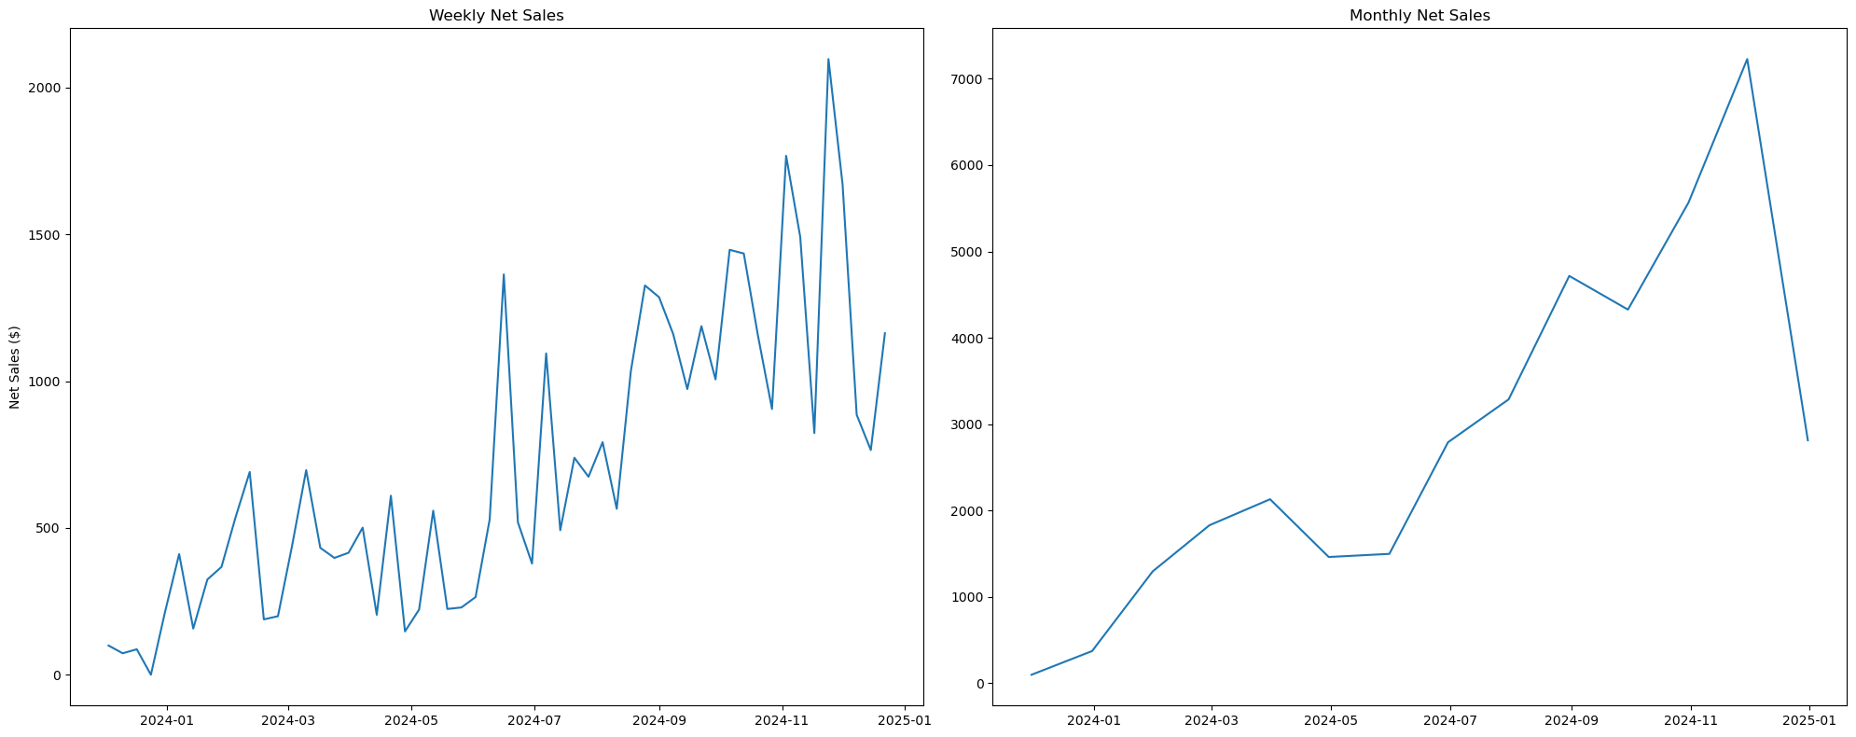
Net Sales

Slide 4
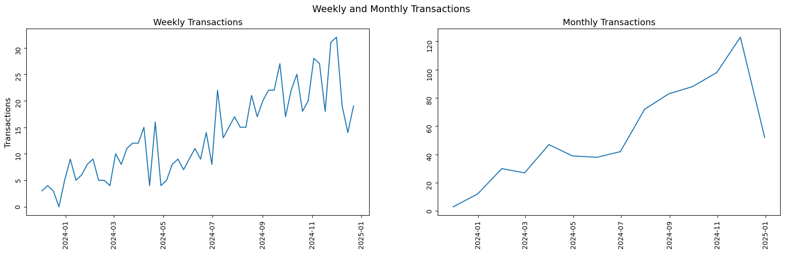
Number of Transactions

Slide 5
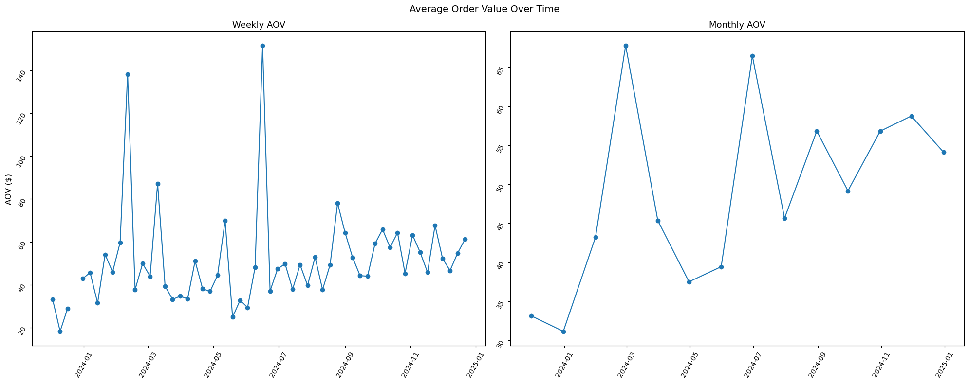
AOV Over Time

Slide 6
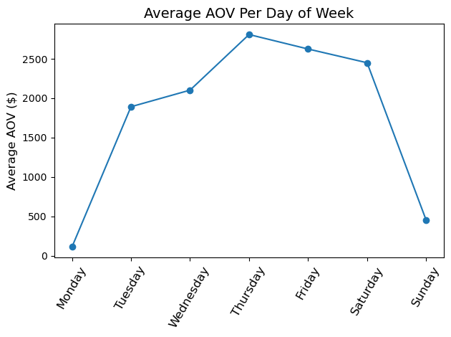
AOV Per Day of Week

Slide 7
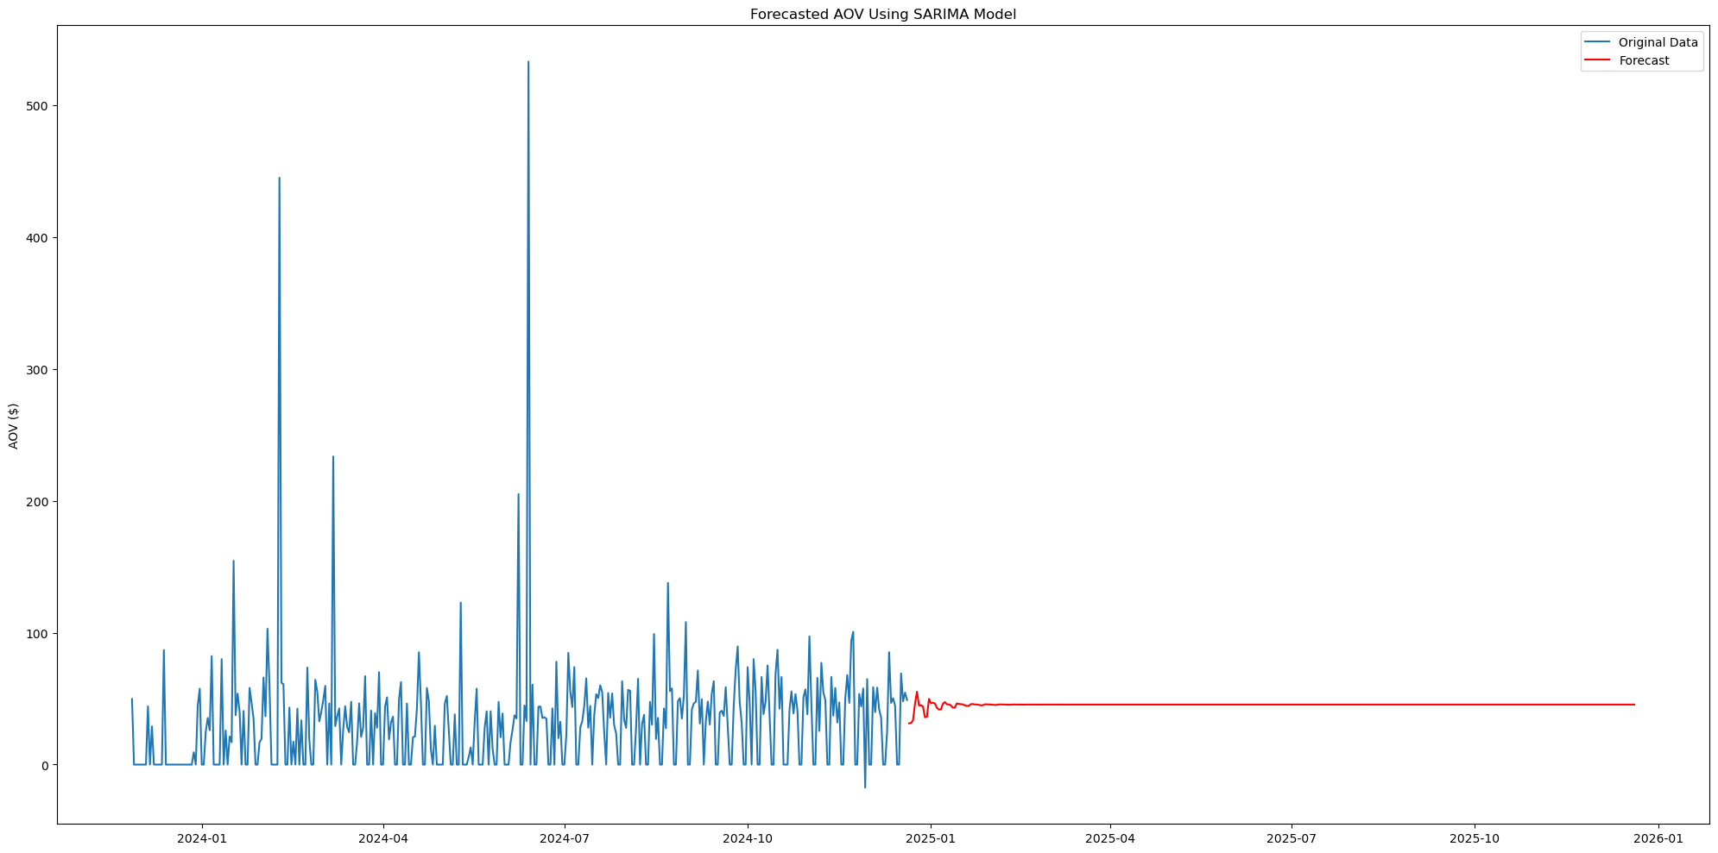
Forecasted AOV in 2025

Slide 8
Conclusions
Collect more data
Few overall transactions
Limited time span
Change metric
Model number of transactions or net sales
AOV stability
AOV varies quite a bit day by day
AOV will remain relatively stable

Slide 9
Data Overview
Cleaning
Collection
Exploratory Data Analysis

Slide 10
Data Cleaning
Missing Values
Validation
Other
Primarily Missing Not At Random
Drop over 72%
No imputations
Card Brand
Fulfillment Type
Channel
Remove duplicate rows
Drop constant columns

Slide 11
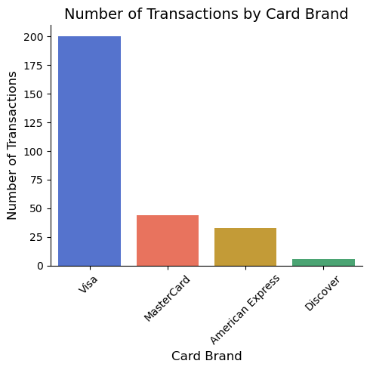
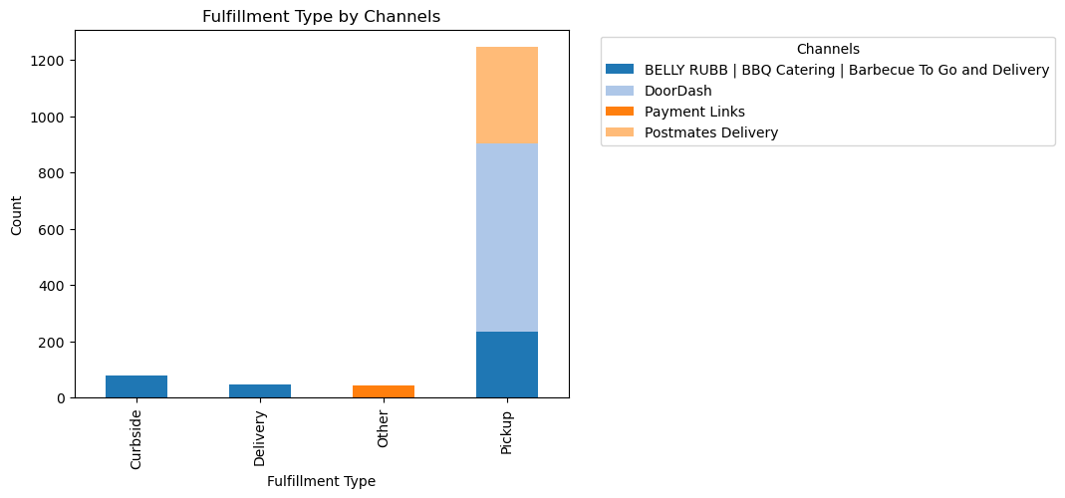
EDA Findings
Most orders placed through DoorDash
Nearly all orders picked up
Visa most frequently used credit card

Slide 12
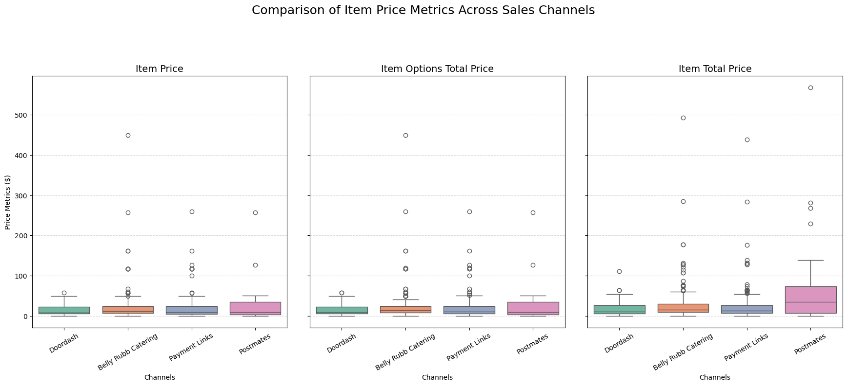
EDA Findings (cont…)

Slide 13
Modeling

Slide 14
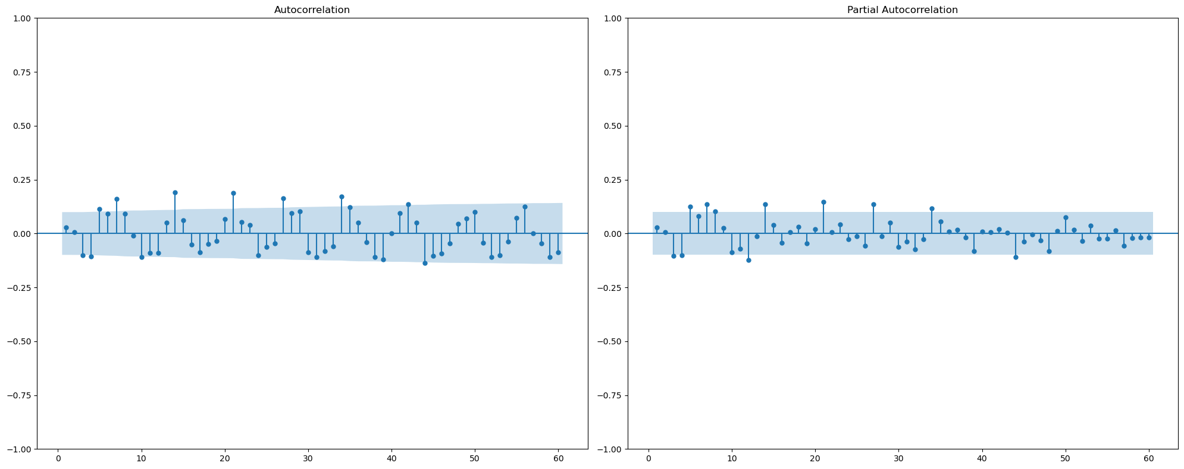
ACF and PACF of Daily AOV

Slide 15
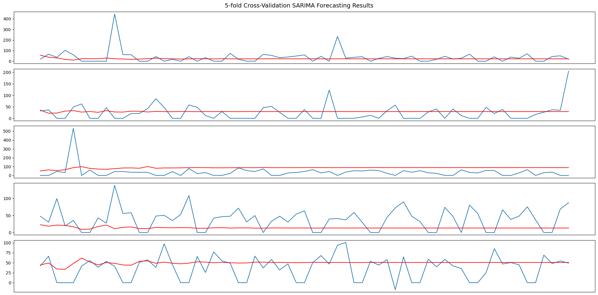
5-Fold Cross-validation

Slide 16
2025 Forecast

Slide 17
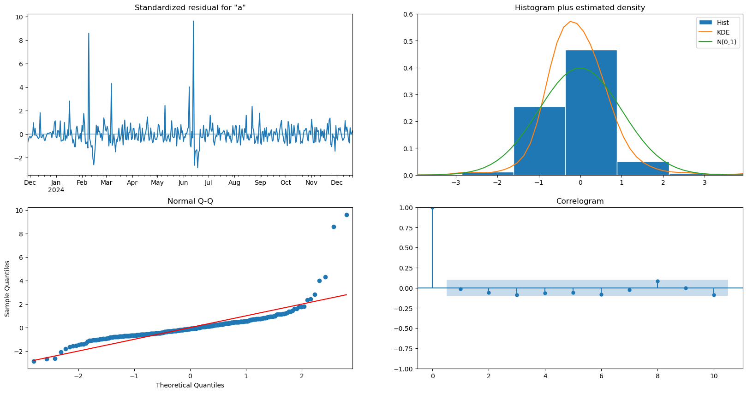
SARIMA Model Diagnostics

