Slide 1



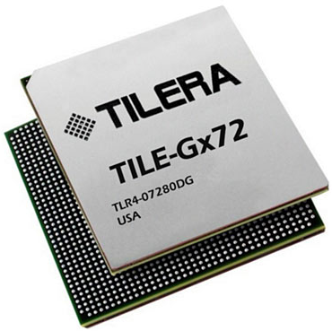
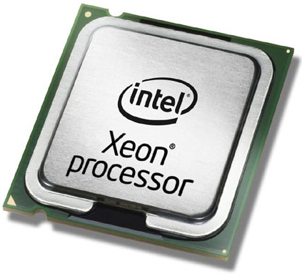

Balancing between Power Efficiency and High Performance on Software-based Intrusion Detection Systems
Muhammad Jamshed, Jaehyun Nam, Byungkwon Choi, Dongsu Han, and KyoungSoo Park Electrical Engineering Dept., KAIST, {ajamshed, namjh, cbkbrad}@kaist.ac.kr, {dongsuh, kyoungsoo}@ee.kaist.ac.kr
Motivation
Fast growth of Internet traffic
» 54.3 EB/Month (2013) → 117.8 EB/Month (2017) [Cisco VNI, 2013]
Existing S/W-based IDS (Kargus, CCS ‘12)
Various security threats
» Targeted attacks, mobile vulnerabilities, spam, etc. [Symantec, 2013]
High performance
» ~ 33 Gbps
Problems in the state-of-the-art IDS appliances
» High power consumption » Inflexibility
Poor power efficiency
» ~ 900 W (2 CPUs + 2 GPUs)
Many-Core Processors (MCPs)
Objectives
Highly-scalable general-purpose processors
Low power consumption (~400 mW per core)
Each core capable of running independent applications
Power-efficient, highly-scalable IDS
» Main IDS engine on MCP
» Use host machine when MCP is under stress
» Opportunistically offload subtasks to host
Goal: High performance per power
Key Insight
“Enforce dynamic IDS subtask offloading techniques while minimizing overall power usage”
Design
Flow-centric offloading
HOST
Offloading Scheme
» Forward packets of new connections to the host
Key Idea
MCP continues managing the existing flows
» offload packets from Packet Rx module, or
» offload packets after flow management
DAQ
Decode
FlowMgt
Stream
Detect
Output
MCP
Case 1: Flow-centric offloading
Packet Rx
Decode
Flow Mgmt
Stream
Detect
Output
Functional offloading
Case 2: Functional offloading
Offloading Scheme
» Traffic that requires detailed analysis is forwarded to the host
Key Idea
» Process incoming packets until the multi-string pattern matching phase (Detect-I)
» Suspected flows that pass the first phase of detection are offloaded to the host for further analysis (Detect-II)
HOST
Detect - II
Output
Preliminary Evaluation
Experimental environment
» 50 Gbps transmission rate (synthetic traffic)
» Snort HTTP rules v2.9.2.1 (2433 rules)
0% attack traffic
Expected
performance
55 Gbps
100% attack traffic
Expected
performance
10 Gbps
MCP: Tilera TILE-Gx72 (72 cores)
 | Clock speed | 1.0 GHz
 | Cache size | L1: 32KB/ L2: 256KB
 | Mem size | 12 GB
 | IDS | Suricata
Case 1: Flow centric offloading
Case 2: Functional offloading
Host: Intel Xeon (8 cores)
 | Clock speed | 3.33 GHz
 | Cache size | L3: 12MB
 | Mem size | 24 GB
 | IDS | Multi-threaded Snort
Current Status
» Offloading statically
» Analyzing stress-specific parameters
TODO
» Develop dynamic offloading schemes
» Optimize offloading techniques (e.g., zerocopy)
Performance per watt
Networked and Distributed Computing Systems Lab & Intelligent Network Architecture and Distributed Systems Research Lab

