Slide 1



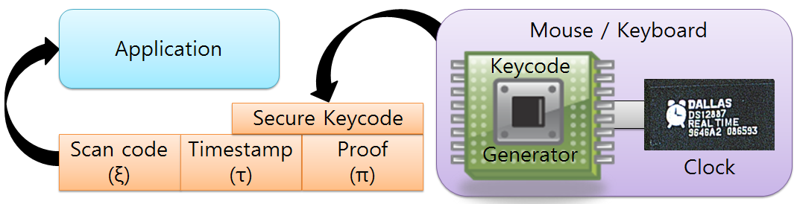
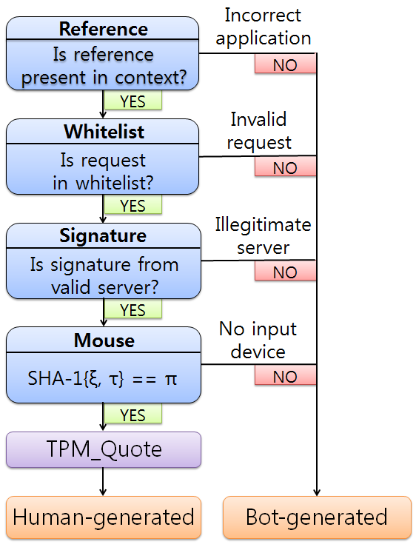
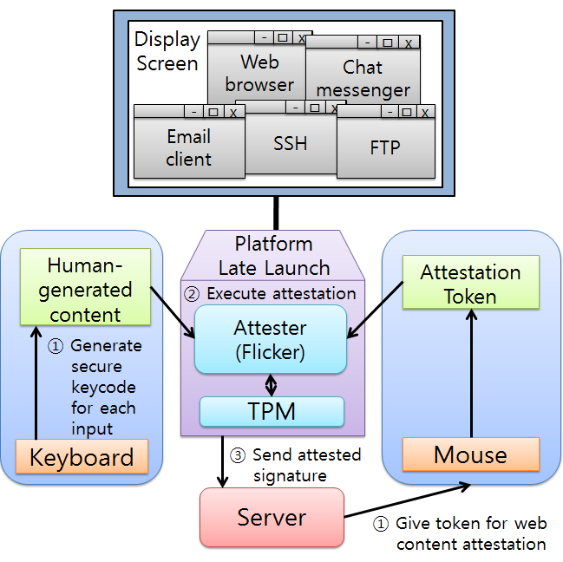
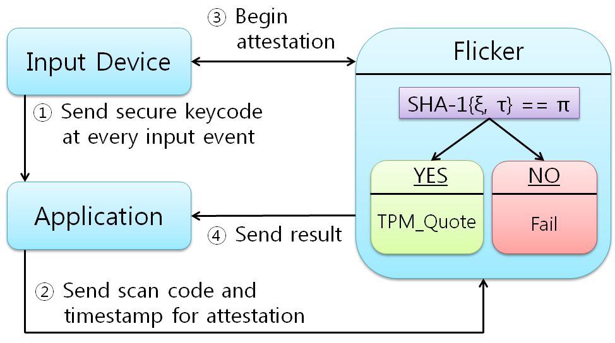
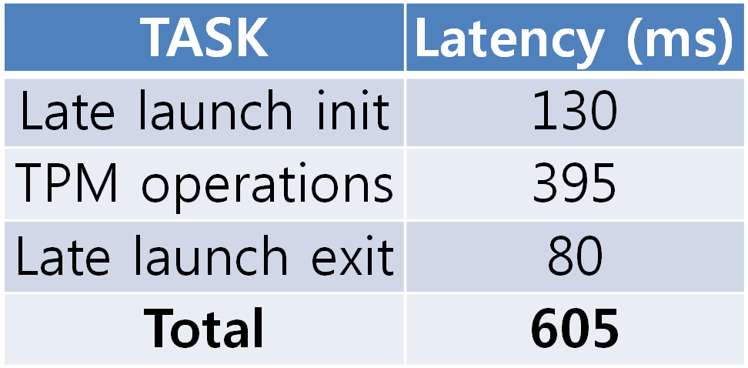
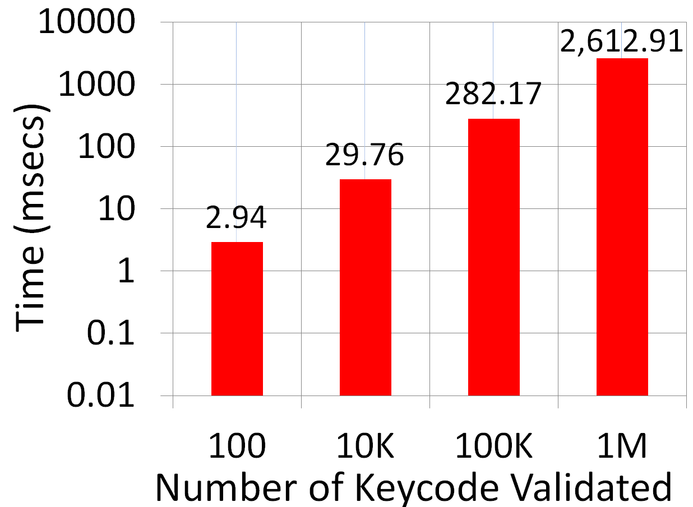
Suppressing Malicious Bot Traffic using an
Accurate Human Attester
Muhammad Jamshed, Younghwan Go, and KyoungSoo Park Department of Electrical Engineering, KAIST, {ajamshed, yhwan}@ndsl.kaist.edu, kyoungsoo@ee.kaist.ac.kr
Motivation
Malicious bots pose a threat to Internet
» Major DDoS attacks on government and
portal sites on March 3rd, 2011
» Constitutes over 90% of all spams
» Money loss from click frauds
» Employed in online games for unfair gain
Existing technique (Not-A-Bot, NSDI ‘09)
No binding of input events to its message
» Bots steal the attestation for random contents
Attestation on dedicated machines without key clicks
» Signature doesn’t carry a proof of the attester code
» Malicious attester signs any content without key clicks
Objective
Human message attestation model
» Human-attested messages accepted as bot-free
Secure binding of key event and its message
» The root of trust on the input devices and TPM
Prevent invalid attester from producing signature
» Authenticate valid attester code binary
» Use a physical input device for message creation
Transparent, accurate and general framework
» Accurate, automatic attestation on all applications
Key Insight
“Bot-free Internet framework with accurate human attestation that binds key event to message”
Design
Architecture
Attestation process
Extended key event for input devices
» Secure keycode with proof (an HMAC-SHA1)
General framework
» Late launch environment to verify keycode
» TPM verifies the proof of attester and keycode
Optimization
» Attestation token test
» Verify through image
» Confirm valid action
Browser process
Technology
» Root of trust = TPM
» Sandboxed = Flicker
Architecture
» Valid attester code
» Message produced
by relevant key click
» Proof signed by TPM
3-stage flow chart
Evaluation
Attestation latency
» Mainly due to hardware
» In range of interactive use
Keycode validation time of
varying sizes within attester
» Practical for applications
Conclusion
1) Bind the message to its relevant key events
2) Only the valid attester generates a signature
3) Manual user action is not required
4) Easily deployable to existing network applications
5) Distinguish human-generated from bot-generated
Accurate Human Attester
8th USENIX NSDI, March 31, 2011
Networked and Distributed Computing Systems Lab, KAIST

