Slide 1
Stuxnet
Fundamentals of Cybersecurity - AUT
Ali Janalizadeh
(based on Symantec’s “Stuxnet Dossier”)
slide <number>

Slide 2
What is Stuxnet?
Stuxnet is a computer worm and Trojan horse. You could also call Stuxnet a virus:
By Worm I mean it spreads on it’s own
By Trojan horse we mean it does something it’s not supposed to do (causes damage)
By virus we mean it actually attaches itself in other data files and software in order to cause itself to be spread by humans
Note: Stuxnet has 50 times the logic of your typical computer virus (=> has to be a government attack)
slide <number>

Slide 3
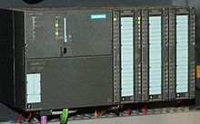
Why was it created?
To disrupt Iran’s nuclear power plan.
slide <number>

Slide 4
How exactly does it work?
There are four distinct phases that Stuxnet has to go through:
  It’s got to spread on its own..
  Until it discovers the proper computers..
  Where it can disrupt the centrifuges..
  All while evading detection.
slide <number>

Slide 5
Stuxnet Architecture
It is worth outlining the architecture of Stuxnet before continuing with our analysis
The heart of Stuxnet consists of:
  A large .dll file that contains many different exports and resources.
  Stuxnet also contains 2 encrypted configuration blocks
The dropper component of Stuxnet stores all the components in itself in a section named “stub”
slide <number>

Slide 6
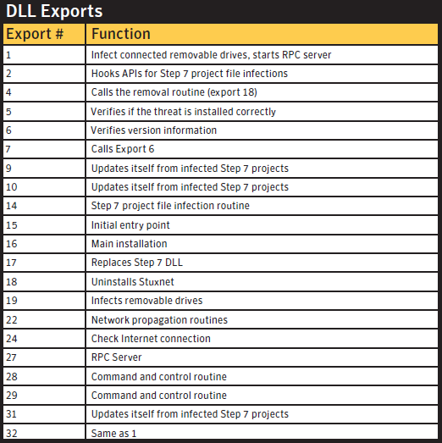
Exports
The main .dll file
contains all of the
code to control the
worm
Each export from
this .dll file has a
different purpose
in controlling the
threat
slide <number>

Slide 7
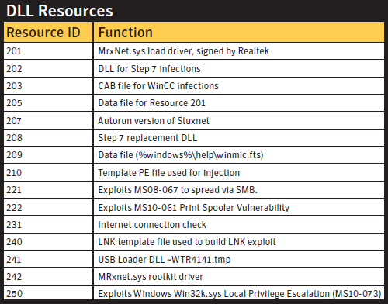
Resources
The main .dll file
also contains many
different resources
that the exports use
in the course of
controlling the worm
The resources vary
from full .dll files to
template executables
to configuration files
and export modules
slide <number>

Slide 8
Stuxnet Architecture
When Stuxnet is executed
  the wrapper extracts the .dll file from the stub section
  Maps it into memory as a module
  Calls one of the exports available in the .dll file
  A pointer to the original stub is passed to this export as a parameter
  This process repeats recursively
    Therefore, each layer of the threat has access to the main .dll and configuration blocks.
slide <number>

Slide 9
Stuxnet Architecture
Another way Stuxnet calls exports from the main .dll file:
  Reads an executable template from its own resources
  Populates the template with appropriate data
    Which .dll file to load
    Which export to call (in what order)
  Injects this newly populated executable into another trusted process and executes it
  The newly populated executable template will load the original .dll file and call whatever export the template was populated with
slide <number>

Slide 10
Installation
Export 15 is the first export called when the .dll is loaded for the first time. What it does is:
  First it checks if the configuration is up to date
  Then checks if it is running on a compatible version of windows and whether it is 32bit or not
  After that it checks whether the computer is already infected or not
  Elevates the privilege of the current process to admin
  Checks what antivirus product(s) is installed
  Checks what the best process to inject into is
  It then injects the .dll file into the chosen process
  Calls export 16
slide <number>

Slide 11
Installation
When the process does not have admin privelages, Stuxnet will try to attain these privaleges by using one of 2 attacks depending on the OS version:
  If system is Windows XP or 2000, Windows Win32k.sys local privilege escalation vulnerability (MS10-073) is exploited
  Otherwise, the currently undisclosed Task scheduler escalation of privilege vulnerability is exploited
slide <number>

Slide 12
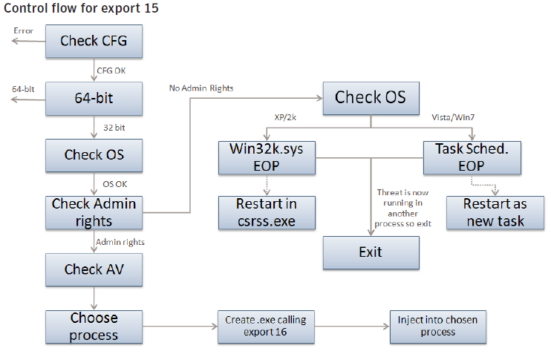
Installation
slide <number>

Slide 13
Installation
Export 16 is the main installer for Stuxnet
  It checks the date and the version number of the computer
  Decrypts, creates and installs the rootkit files and registry keys
  Injects itself into the services.exe process to infect removable drives
  Injects itself into the Step7 process to infect all Step7 projects
  Sets up global mutexes that are used to communicate between different components
  Connects to the RPC server
slide <number>

Slide 14
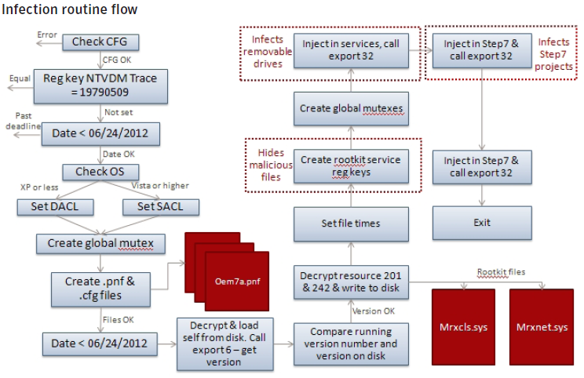
Installation
slide <number>

Slide 15

How does it spread?
Stuxnet uses 7 mechanisms to spread:
6 of these attacks targeted flaws (back doors) that were unknown to the security industry and software vendors!
  It copies itself to open file shares
  It attacks a hole in the windows print spooler
  It attacks a hole in the windows RPC service
  It attacked the database software (step7)
  It affects the PLC data files
  It has a peer to peer updating mechanism
  It will copy and embed itself into local data files
slide <number>

Slide 16
How did it get into an air-gapped System?
There are 3 theories:
  USB drives!
  A shared printer between the network
  It might have been an insider that just walked in and placed Stuxnet onto one of the computers in the network
slide <number>

Slide 17
What does it do after it discovers the target computer?
It gets down to business is what!
The first thing it does, is download a set of malicious logic to the PLC – Groundbreaking!
  Basically, it’s a threat that is working on 2 separate systems with different logic, both windows and the PLC
Next it measures the operating speed of the frequency converters for 13 days
  Stuxnet makes sure that the PLC motors are running between 800Hz and 1200Hz (required to spin centrifuges)
Once Stuxnet is sure that it is in a centrifuge..
slide <number>

Slide 18
What does it do after it discovers the target computer?
It starts its mischief
It raises the spin rate of the centrifuges to 1410Hz for 15 minutes
  Note that the logic used for this is exactly integrated with the previous logic that was running in Iranian PLCs
Then Stuxnet sleeps remains for 27 days!
Then slows the spin rate to 2Hz for 50 minutes
Then sleeps for another 27 days
Stuxnet repeats this process over and over
slide <number>

Slide 19
Injection Technique
Whenever an export is called, Stuxnet injects the entire .dll into another process and then just calls the particular export.
  Note that Stuxnet can inject into an existing or newly created process or a preselected trusted process
The trusted process consists of a set of default Windows processes and a variety of security products
slide <number>

Slide 20
Injection Technique
The currently running processes are enumerated:
  Kaspersky KAV (avp.exe)
  Mcafee (Mcshield.exe)
  AntiVir (avgaurd.exe)
  BitDefender (bdagent.exe)
  Etrust (UmxCfg.exe)
  F-Secure (fsdfwd.exe)
  Symantec (rtvscan.exe)
  Symantec Common Client (ccSvcHst.exe)
  Eset NOD32 (ekrn.exe)
  Trend Pc-Cillin (tmpproxy.exe)
slide <number>

Slide 21
Injection Technique
In addition, the registry is searched for indicators that the following programs are installed:
  KAV v6 to v9
  McAfee
  Trend PcCillin
If one of the security product processes are detected, version information of the main image is extracted.
Based on the version number, the target process of injection will be determined, or the injection process will fail if the security product is unknown.
slide <number>

Slide 22
But what about our failsafe systems?
Obviously, there must be a manual way of overriding the system!
  Surely the nuclear scientists could hear the engines getting louder and quieter sometimes!
Stuxnet puts a perfect picture in front of the camera!
  It sends reports from when the system was running fine to the monitor!
What about the big red button??
  Stuxnet changed the program logic so that nothing would happen
slide <number>

Slide 23
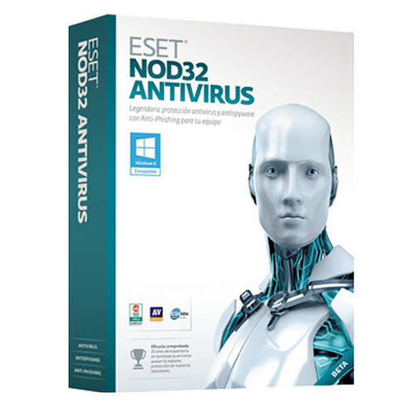
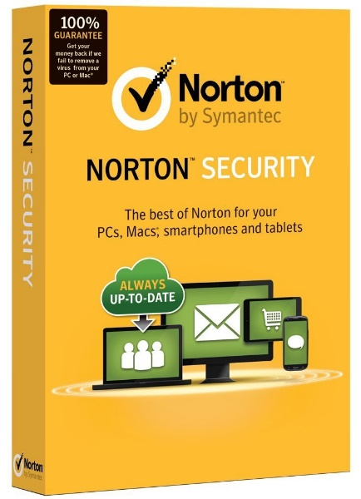
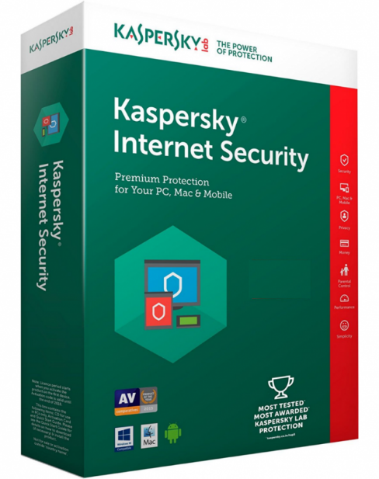
What about other fail safes?
Stuxnet inhibits different behaviors in the presence of different security products to avoid detection!
slide <number>

Slide 24
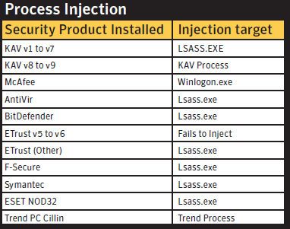
What about other fail safes?
This table describes which process is used for injection depending on which security product is installed
slide <number>

Slide 25
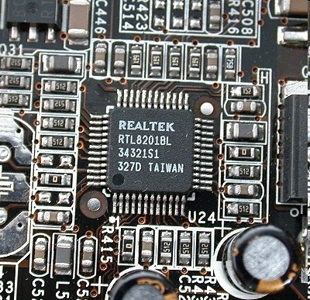
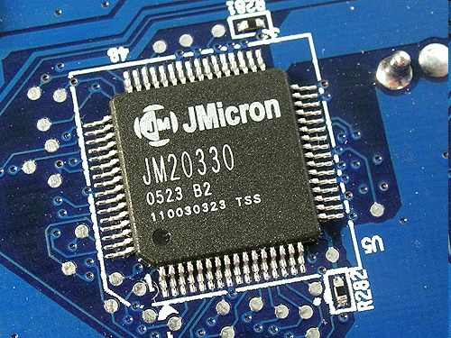
Realtek and JMicron
Stuxnet drivers were signed using stolen certificate keys of two Taiwanese semiconductor companies
  Makes Stuxnet looks authentic
slide <number>

Slide 26
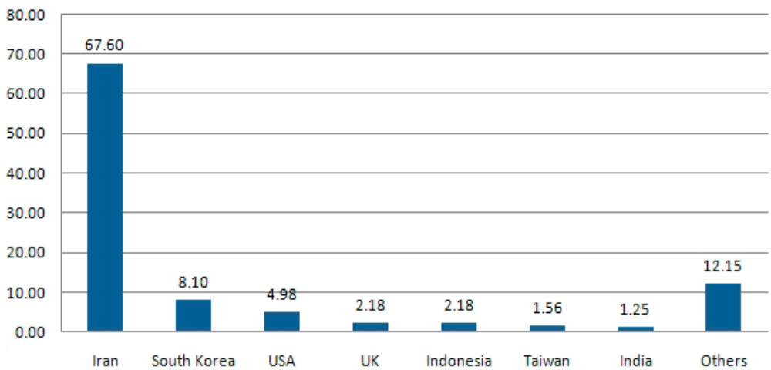
Affected Systems
Percentage of Stuxnet-infected hosts with Siemens software installed
slide <number>

Slide 27
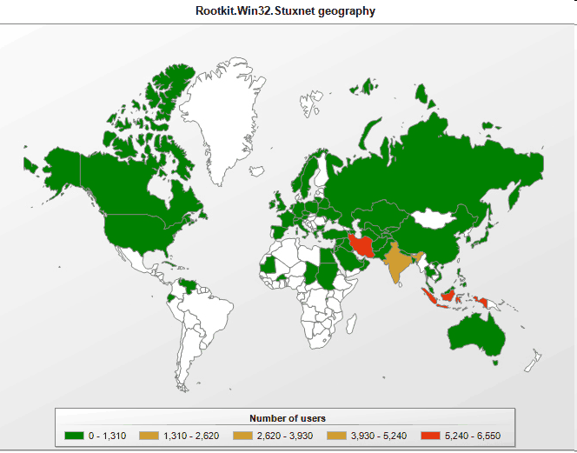
Stuxnet Infections Worldwide
slide <number>

Slide 28
QUESTIONS?

