Slide 1
TECHNICAL SECTION
Equivariant Neural Networks
Experiments on MNIST & the 6/9 Problem
Part 1
4 models on rotated/unrotated MNIST
Part 2
The 6/9 problem & group restriction

Slide 2
PART 1 · SETUP
Experimental Setup: 4 Models
Train 4 models, and evaluate on unrotated MNIST / rotated MNIST.
CNN
C₄ ENN
→ trained on unrotated MNIST
→ trained on rotated MNIST
→ trained on unrotated MNIST
→ trained on rotated MNIST
Each trained model is evaluated on BOTH unrotated MNIST and rotated MNIST.
📝 NOTE TO REPORTER
These parts are necessary background — in the actual report some parts can be omitted accordingly.
Ref: General E(2)-Equivariant Steerable CNNs — arxiv.org/abs/1911.08251

Slide 3
PART 1 · BACKGROUND
Definitions & Evaluation
C₄ ENN
Evaluation
C₄: the C₄ group. ENN: Equivariance Neural Network.
Evaluate the trained model: test the accuracy of correctly distinguishing the digit given a test picture.
MNIST
A dataset of handwritten-digit pictures, each labeled with the digit it shows. Both train and test data included.
Footnote: why C₄?
For the grid ℤ², only subgroups of D₄ are exact symmetries. (ref: chap. 2.8)
rotated
Before train/test, the picture was rotated in advance.
📝 NOTE TO REPORTER
Background slides — can be skipped or compressed when integrating into the final deck.

Slide 4
△ MAIN RESULT
Comparison ① — CNN vs C₄ ENN, both trained on rotated MNIST
Tested on rotated MNIST
CNN (train rot)
C₄ ENN (train rot)
96.65%
97.52%
accuracy on rotated MNIST
accuracy on rotated MNIST
Takeaway C₄ steerable has the better accuracy — meaning the inherited rotational symmetry built into the network does make models perform better at distinguishing rotated data.
Ref: General E(2)-Equivariant Steerable CNNs — arxiv.org/abs/1911.08251

Slide 5
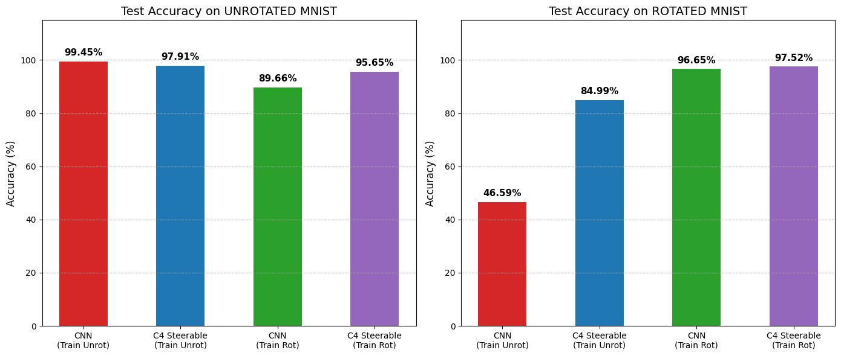
PART 1 · COMPLETENESS
Other Comparisons — ② ③ ④
② Train unrot → Test rotated
CNN 46.59% vs C₄ ENN 84.99%
CNN learns almost nothing about the rotational feature of digits. C₄ ENN still performs well — it doesn't learn rotation from data, but inherits the rotational symmetry by construction.
③ Train unrot → Test unrotated
CNN 99.45% vs C₄ ENN 97.91%
The compulsory group restriction on C₄ ENN reduces learnable parameters — making it slightly less expressive on the standard (unrotated) task.
Capacity Dilution
④ Train rot → Test unrotated
When CNN is forced to learn rotational invariance from data, some of its model capacity is spent on memorizing rotation by rote — leaving less capacity for the actual digit-classification task. ENN avoids this by encoding rotational symmetry directly in its structure.
CNN 89.66% vs C₄ ENN 95.65%
Benefiting from built-in symmetry structure, ENN can spend more resource learning the digit itself rather than rotated features. CNN has to separate some resource to learn rotated features by rote. → Capacity Dilution
📝 NOTE TO REPORTER
Too long for 5-min talk — skip or skim.

Slide 6
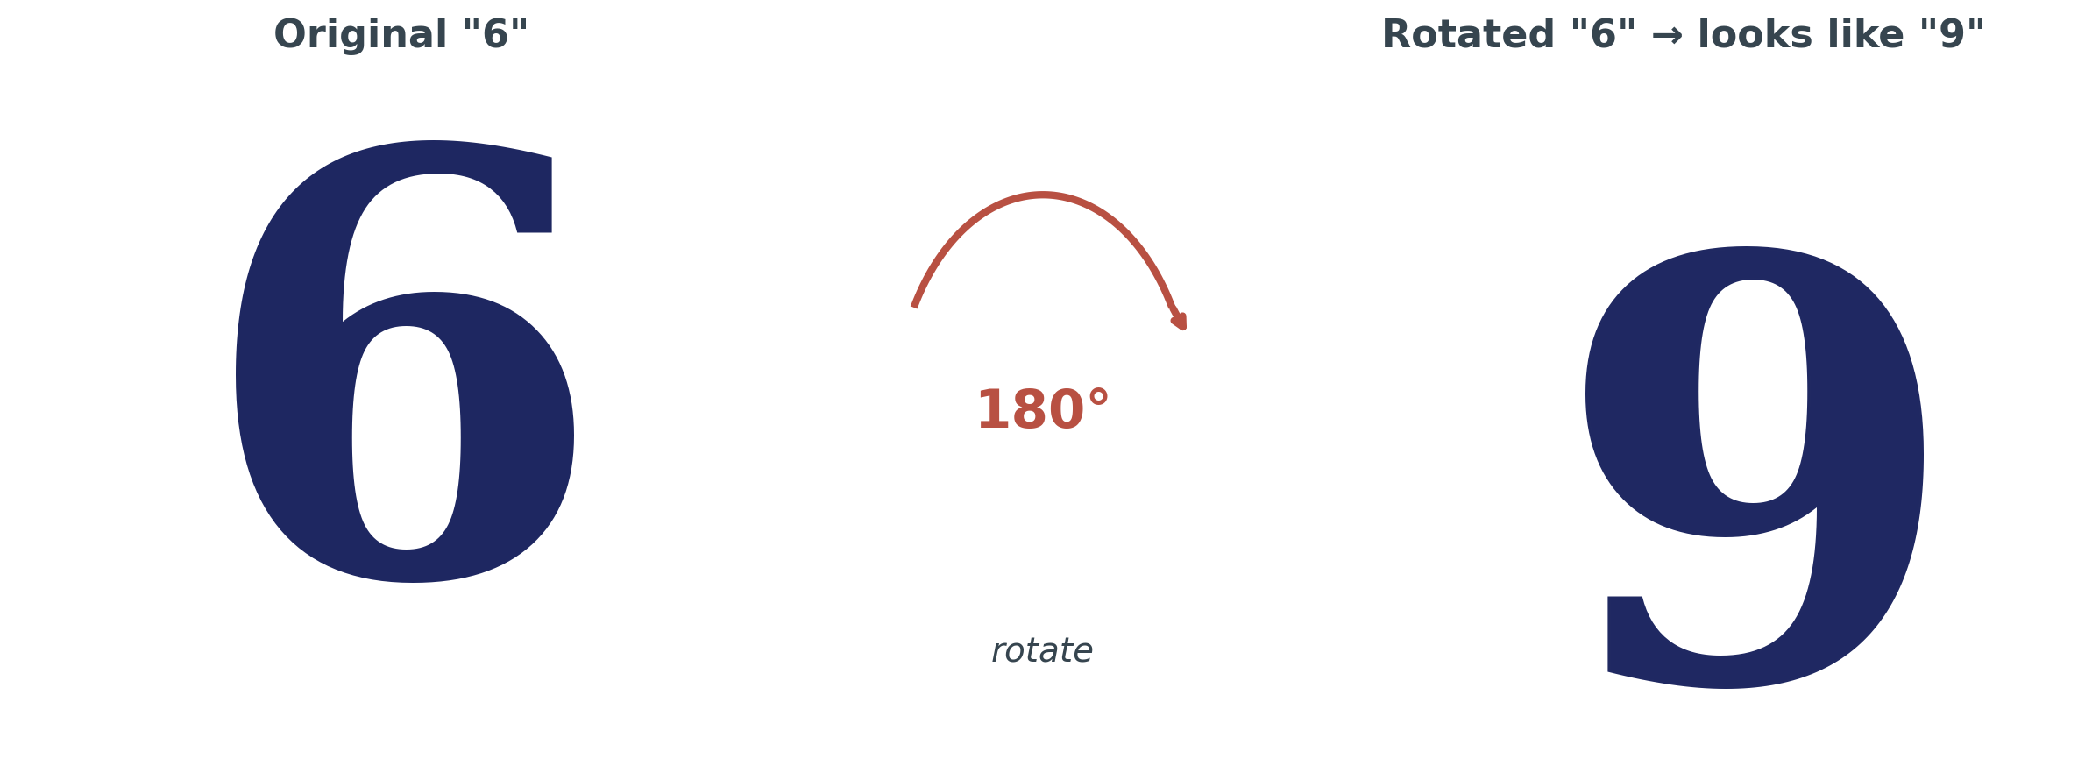
PART 2 · A PITFALL OF ROTATIONAL ENN
The 6/9 Problem
Why ENN fails here
ENN with rotational symmetry can only learn in the sense of rotation.
In the sense of rotation, 6 and 9 look alike.
Therefore, it is easy for an ENN to mistake 6 for 9.
Footnote
The problem generalizes to other digits (e.g. 5 and 7), to tasks beyond digit classification, and to broader symmetry groups beyond rotation.
Ref: General E(2)-Equivariant Steerable CNNs — arxiv.org/abs/1911.08251 (chap. 2)

Slide 7
PART 2 · SOLUTION
Solution: Group Restriction
Idea Keep the C₄ structure in the first 5 layers (same as traditional C₄ ENN — invariant under 90°, 180°, 270°, 360° rotation), then restrict the group to the trivial group {e} in the 6th layer (no symmetry restriction).
① Traditional C₄ ENN
input
→
L₁
→
L₂
→
L₃
→
L₄
→
L₅
→
L₆ (out)
input ⇔ output : C₄ operation invariant
② Refined C₄|{e} ENN
input
→
L₁
→
L₂
→
L₃
→
L₄
→
L₅
→
L₆ (out)
input ⇔ L₅ : C₄ operation invariant │ L₅ ⇔ L₆ : {e} operation invariant (group restriction C₄ → {e})
Footnote ① In practice we also need to claim the representation of the group, and there is a fully-connected classifier at the end — omitted here for simplicity. Footnote ② For details on group restriction, see ref chap. 2.7.

Slide 8
PART 2 · WHY IT WORKS
Intuitive Perspective
Different layers, different scales
1
Deeper layer = broader receptive field
The deeper a layer is, the broader its receptive field.
2
Different depth ↔ different scale
Requiring different symmetries between layers of different depth is essentially requiring different symmetries at different scales.
3
Sacrifice large scale, keep small scale
In C₄|{e}, we sacrifice the large-scale symmetry while maintaining the small-scale C₄ symmetry.
KEY POINT Group restriction is a technique to mitigate the 6/9 problem.
📝 NOTE TO REPORTER
For timing: reporter can skim the technical parts — focus on the intro and the result. (Ref chap. 2.7 for full details.)

Slide 9
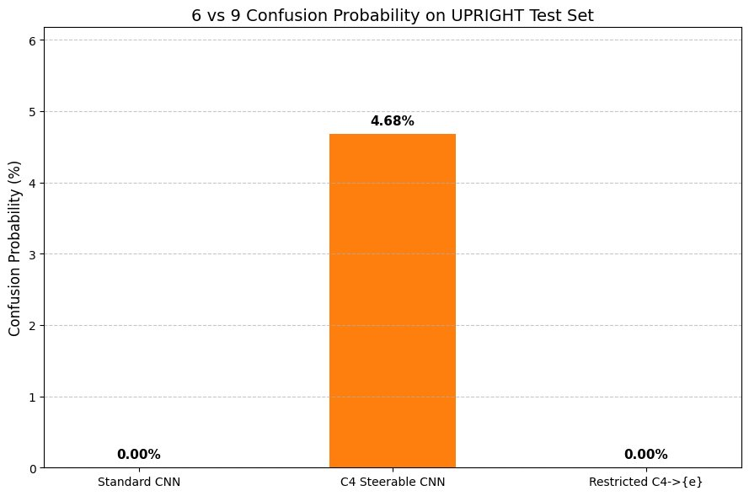
PART 2 · RESULT
Result: 6/9 Confusion Probability
What this shows
Traditional C₄ ENN
4.68%
Suffers from the 6/9 problem.
Refined C₄|{e}
0.00%
Group restriction eliminates it.
Standard CNN
0.00%
Doesn't have rotational symmetry, so no confusion.
Footnote The 6/9 problem in traditional C₄ ENN is not too severe in practice — handwritten 6 and 9 still have differences beyond pure rotation. But C₄|{e} and CNN don't have the problem at all.

Slide 10
END OF TECHNICAL SECTION
References
All chapter references in this section point to:
General E(2)-Equivariant Steerable CNNs
Maurice Weiler, Gabriele Cesa · NeurIPS 2019
https://arxiv.org/abs/1911.08251
Specific chapters cited in this section:
• Chapter 2.8 — rationale for choosing the C₄ group on the ℤ² grid
• Chapter 2 — inherent rotational features of C₄ ENN constructions
• Chapter 2.7 — full details of group restriction

