Slide 1
Green Alps: Persuasive and Sustainable Mobility
Green Alps:

Slide 2
Goal
Persuade commuters and tourists to use public transport/bike when going from A to B

Slide 3

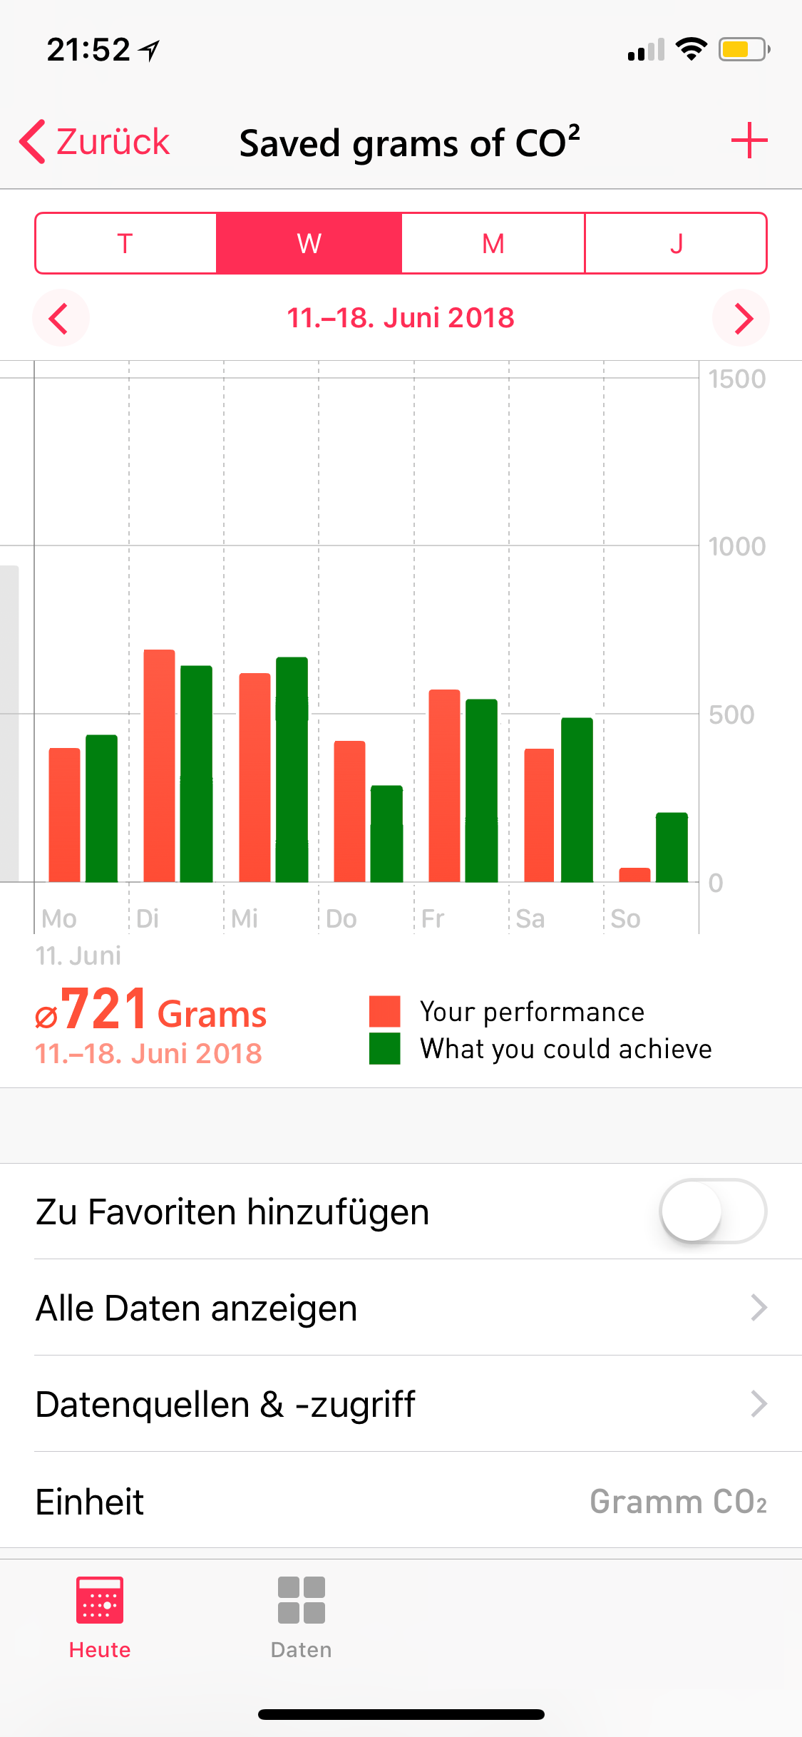
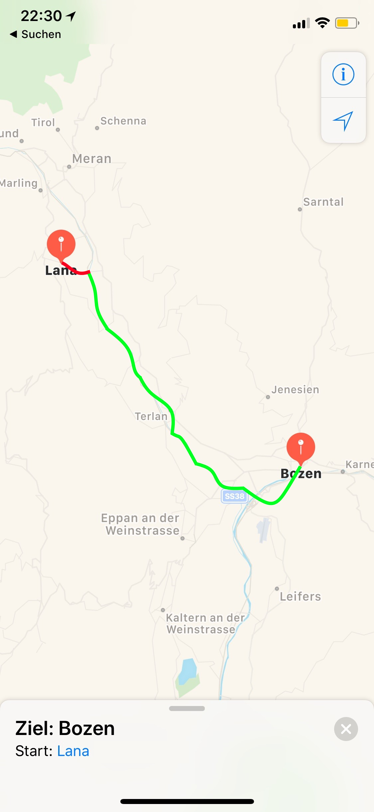
Self monitoring
See how much CO₂ and money you safe
See where you waste it

Slide 4
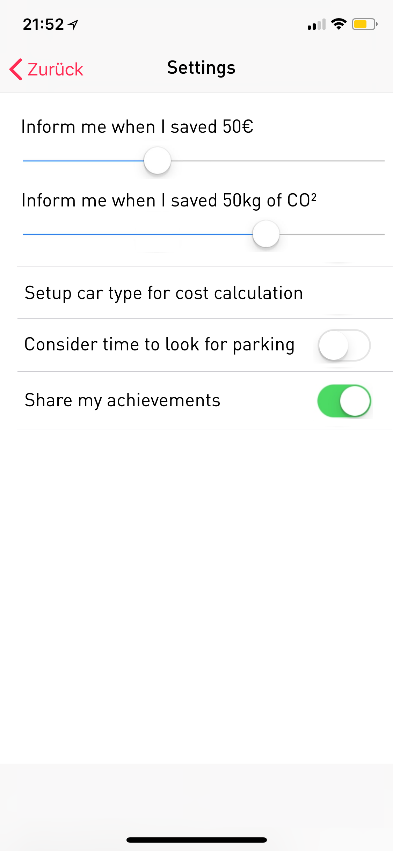
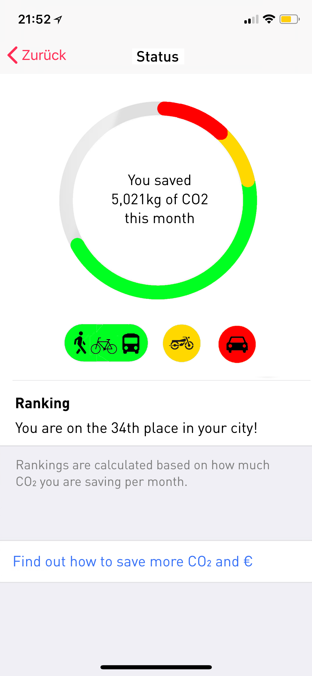
Challenges, goal setting, and social comparison
Achieve CO₂ and € challenges
Compare your achievements to others nearby
Based on the travel classification using Open Street Map data
Aggregated views for other stakeholders

Slide 5
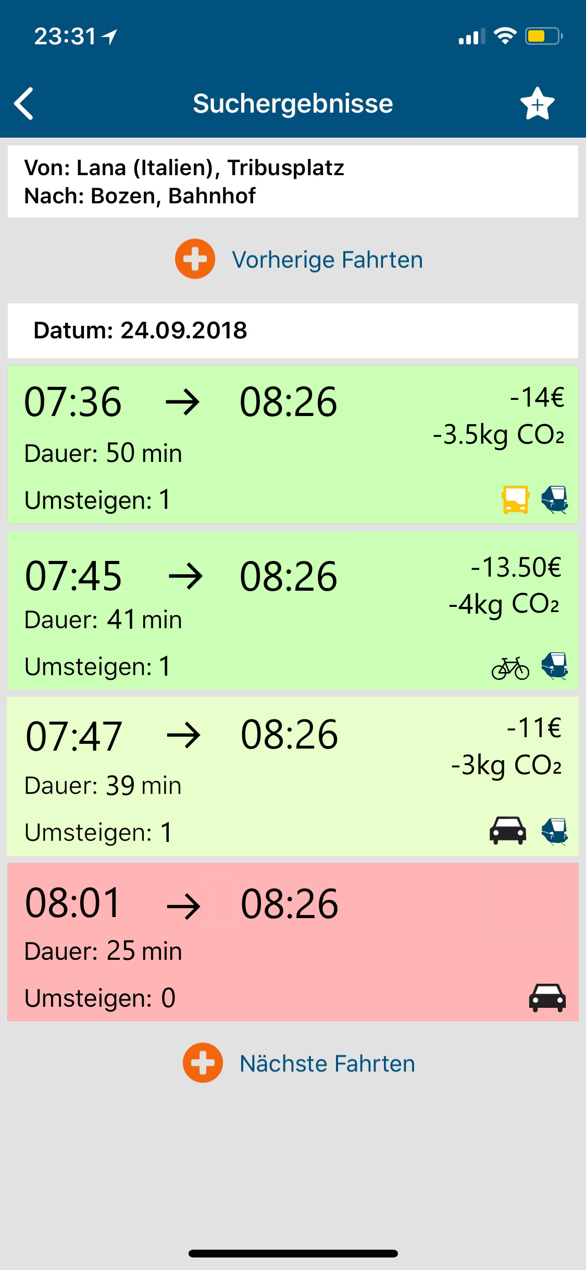
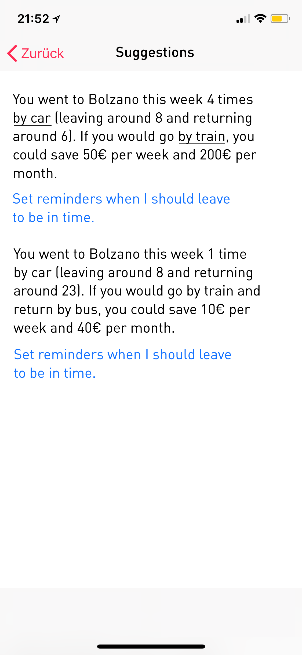

Personalized Suggestions for Commuters
Based on transport schedule
Expected traffic (based on Open Data Hub’s presence of guests)

Slide 6
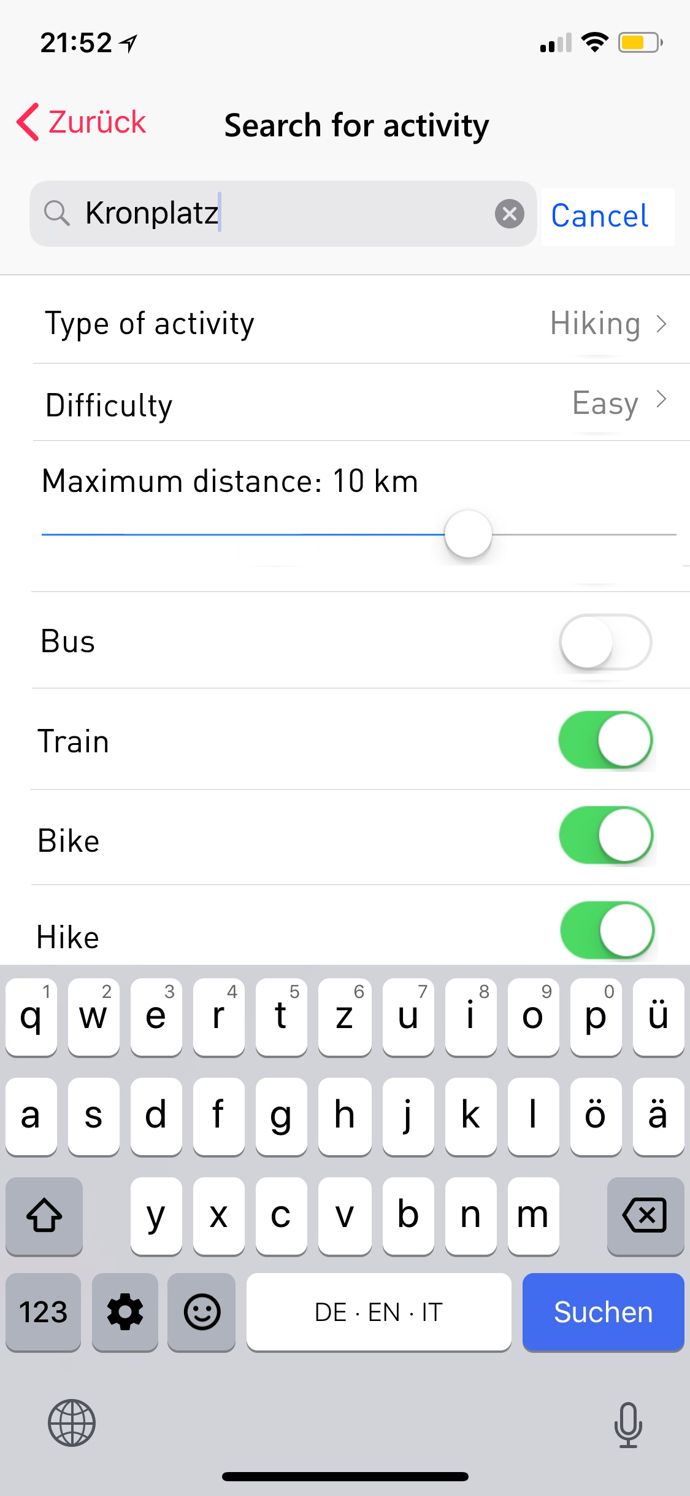
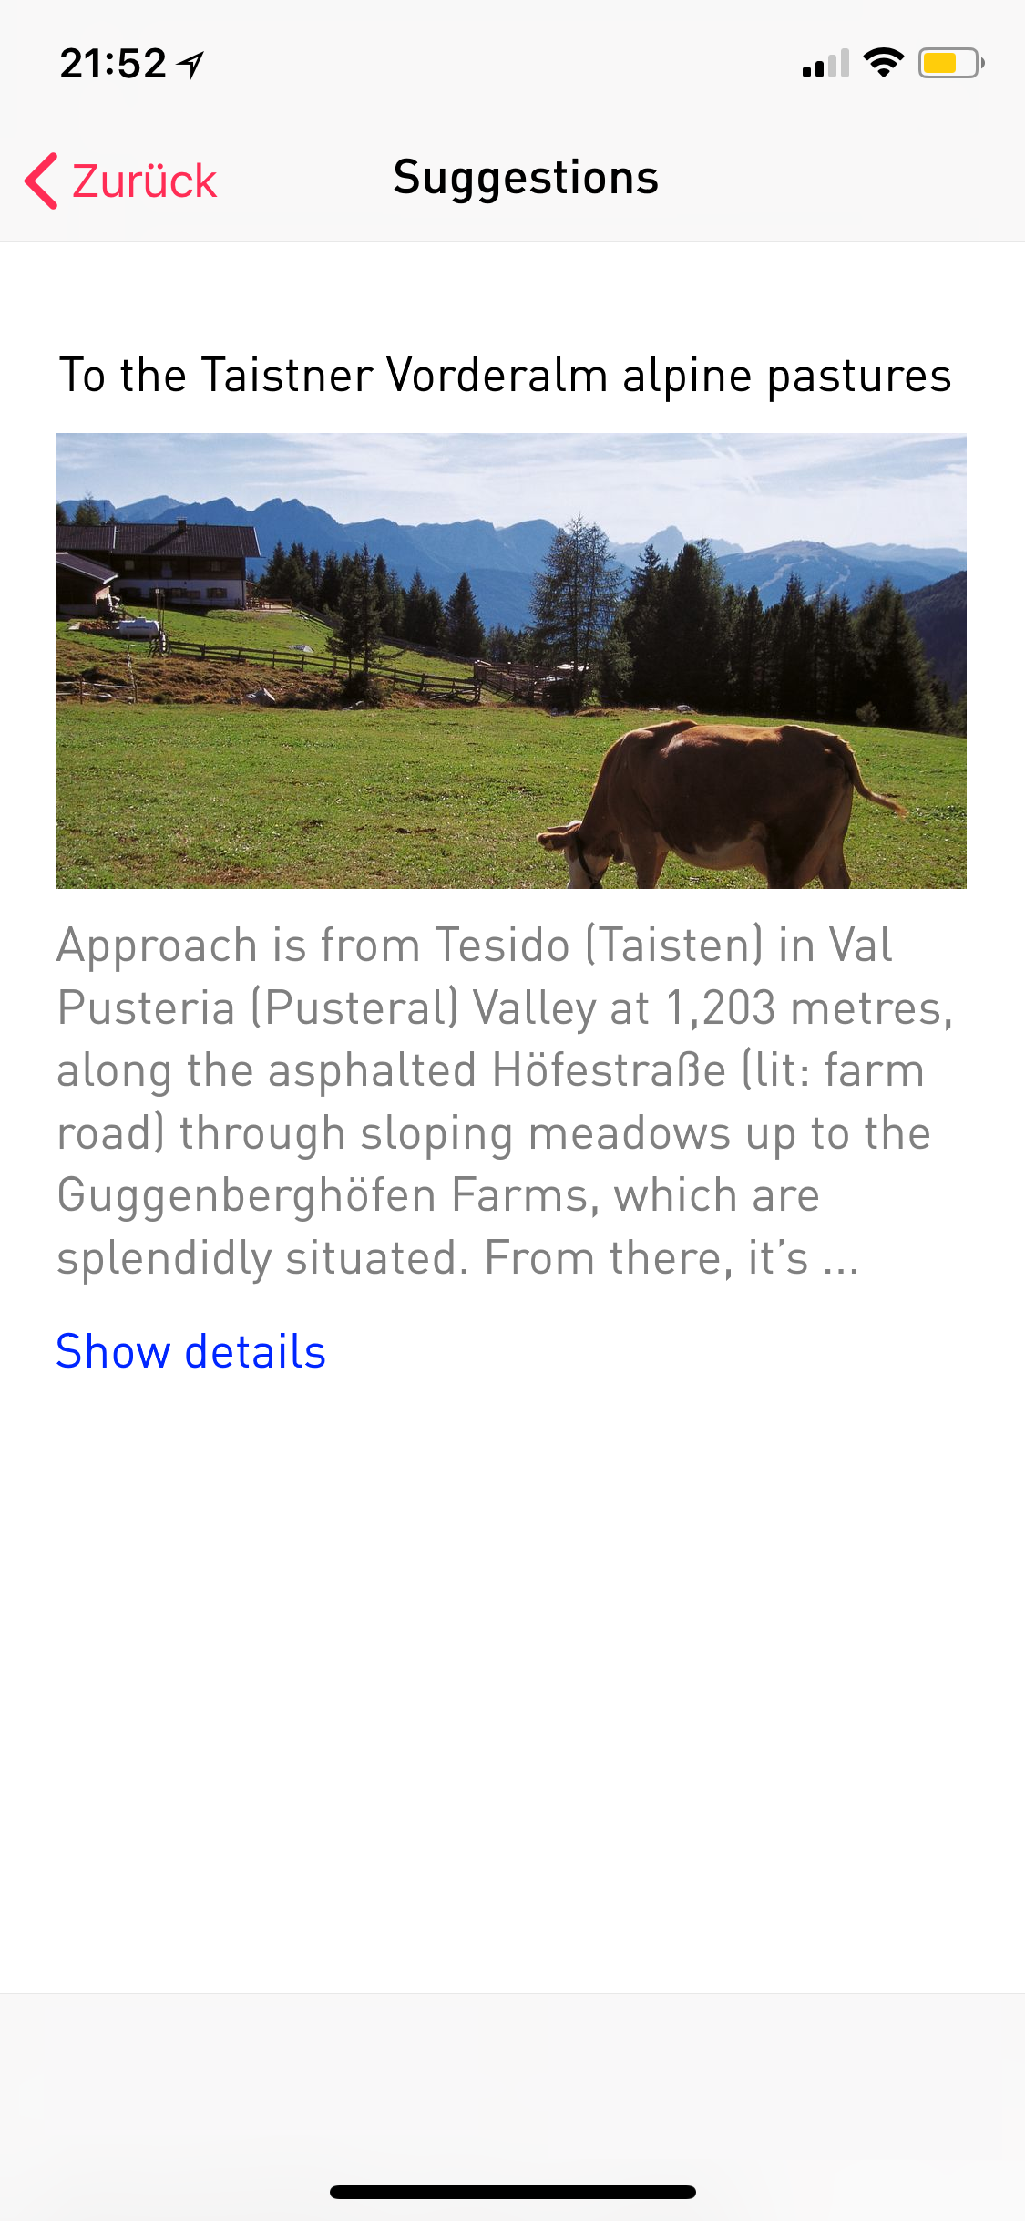
Personalized Suggestions for Tourists
Based on planned activity type
Connect with partners to suggest activities doable on foot, with bike, or public transport

Slide 7
Thank you!

Slide 8
References
Kazhamiakin, Raman & Marconi, Annapaola & Perillo, Mirko & Pistore, Marco & Piras, Luca & Avesani, Francesco & Perri, Nicola & Valetto, Giuseppe. (2015). Using Gamification to Incentivize Sustainable Urban Mobility. Visited 22.09.2018, Link
Anagnostopoulou, Evangelia & Bothos, Efthimios & Magoutas, Babis & Schrammel, Johann & Mentzas, Gregoris. (2016). Persuasive Technologies for Sustainable Urban Mobility. Visited 22.09.2018, Link
De Lijn, CO2-emissions of vehicles. Visited 22.09.2018, Link

Slide 9


Data Architecture
Hard coded/configured CO₂ consumptions
Public transport schedule
Detected steps, activities (biking, driving) through Android/iOS API
Hotel room availability
Parking place availability
Observed behavior
Traffic intensity
Location
Open Data Hub
Ways
Suggestions
Understand if on road or rail
based on distance to node type
Open Street Map
Feedback to Stakeholders
Feature is implemented in the proof of concept

