Slide 1
Sztuczne sieci neuronowe w Keras

Slide 2
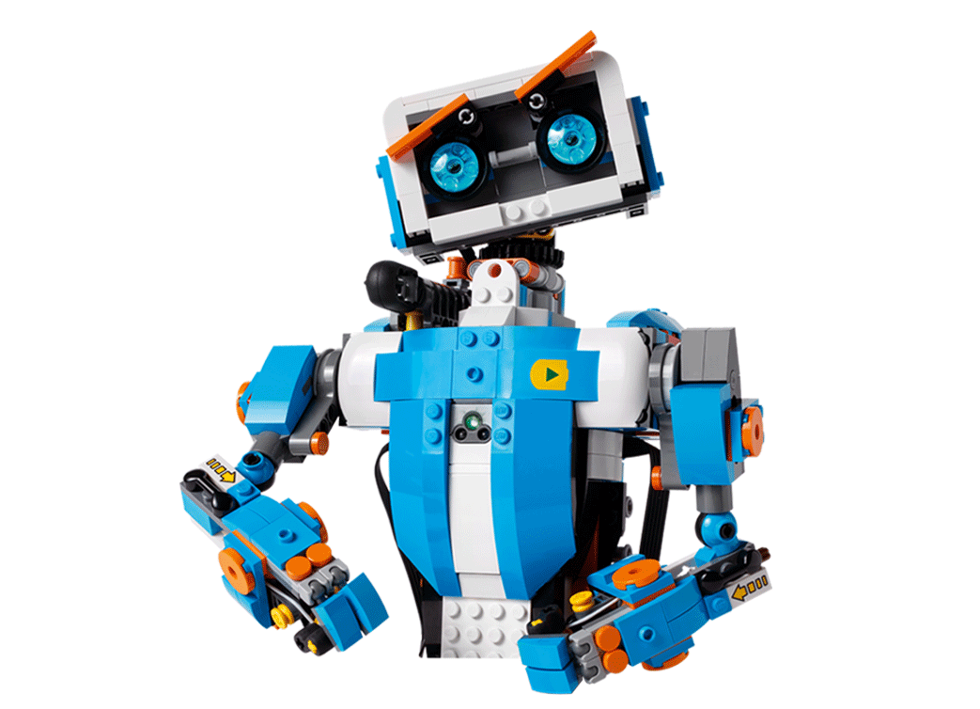
Agenda
Keras i Tensorflow
Keras w 30 sekund
Konwolucyjna sieć neuronowa
Transfer learning
Ważne techniki
Dropout
Optymizers

Slide 3
TensorFlow i Keras
1

Slide 4

Biblioteka TensorFlow
Google’s library for ML
Expresses calculations as a computation graph
GPU/CPU Support
Many language bindings
Supports/provides pre-trained models

Slide 5
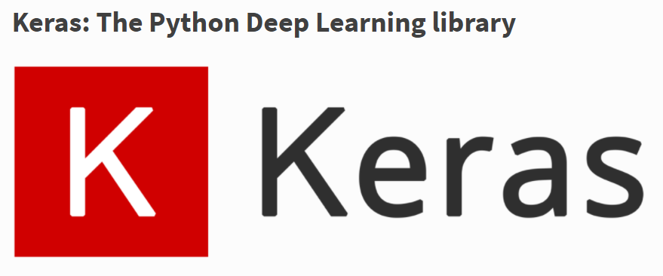
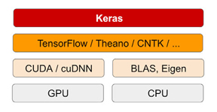
Biblioteka Keras
Neural Network library written in Python
Design to be simple and straightforward
Built on top of different deep learning libraries such as Tensorflow (Google), Theano (UM) and CNTK (MS)

Slide 6
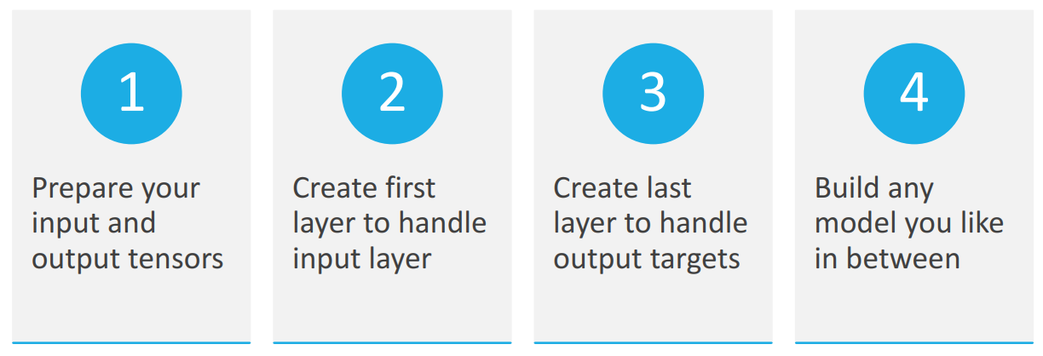
Keras workflow

Slide 7
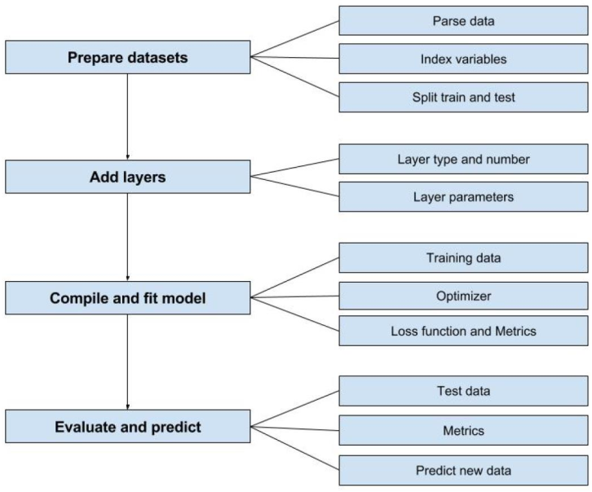
Keras workflow

Slide 8
Keras in 30 seconds
2

Slide 9
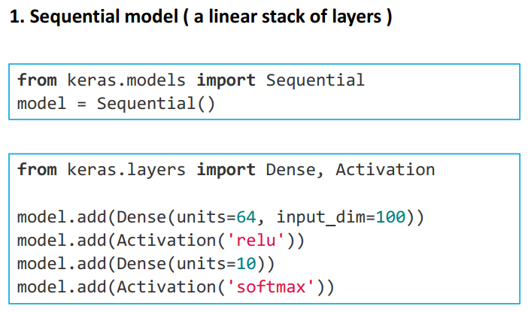
Keras w 30 sekund

Slide 10
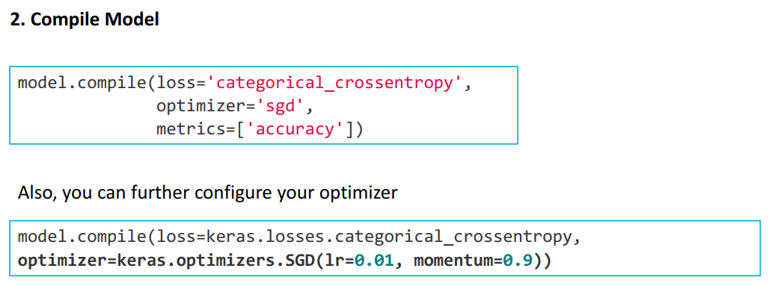
Keras w 30 sekund

Slide 11
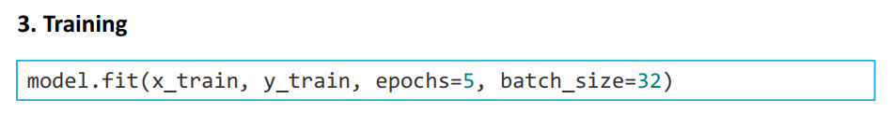
Keras w 30 sekund

Slide 12
Keras: kluczowe definicje
3

Slide 13
Keras Terminology
Dense
Activation
Optimizer
Loss
Epochs
Dropout
Notes:
Look for ‚five pairs’

Slide 14
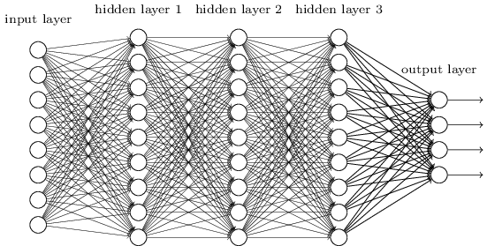
Keras Terminology
Dense
Densely connected layers, where every node is connected to every other node
Each node in each layer is connected to every other node in the next layer.
Notes:
Look for ‚five pairs’

Slide 15
Keras Terminology
Sequential
A set of layers connected in series
Layers connected in a sequence.
Notes:
Look for ‚five pairs’

Slide 16
Keras Terminology
Optimizer
the mechanism through which the network will update itself (based on the data it sees) to minimize its loss function.
Optimization algorithms for network: (SGD (Gradient Descent), Adam, etc.)
Notes:
Look for ‚five pairs’

Slide 17
Keras Terminology
Loss Function
Method of calculating errors
Mean squared error
Binary cross-entropy
etc.
Notes:
Look for ‚five pairs’

Slide 18
Keras Terminology
Epoch
One pass over the full data set
More passes = more refined
Notes:
Look for ‚five pairs’

Slide 19
Keras Terminology
Dropout
The term refers to dropping out units in a neural network (we temporarily remove them from the network, along with all its connections). The choice of which units to drop is random (each unit is removed with a fixed probability)
Notes:
Look for ‚five pairs’

Slide 20
Sieci konwolucyjne
3

Slide 21
Konwo.. co?

Slide 22
Deep learning i sieci konwolucyjne
4

Slide 23
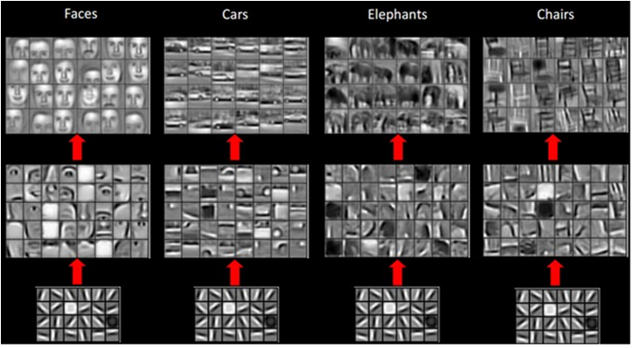
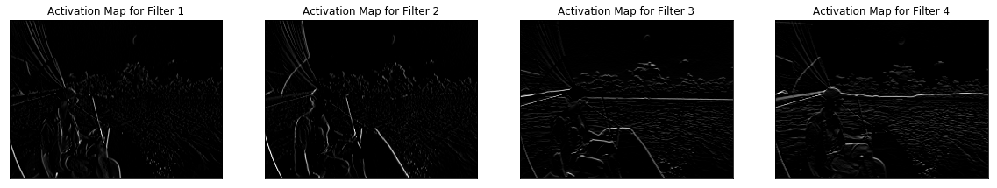
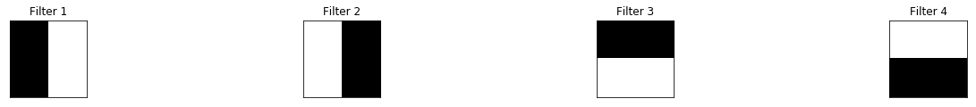
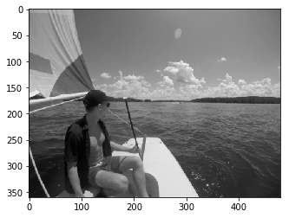
Jak działają konwolucje?
http://scs.ryerson.ca/~aharley/vis/conv/
https://cs.stanford.edu/people/karpathy/convnetjs/demo/mnist.html

Slide 24
AI we wdrożeniach
5

Slide 25
Trening vs. inference
Training
Human
Bicycle
Forward
“Strawberry”
?
“Bicycle”
Lots of labeled data!
Backward
Error
Strawberry
Model weights
Accuracy
Inference
Forward
“Bicycle”?
??????

Slide 26
AI i hardware
6

Slide 27
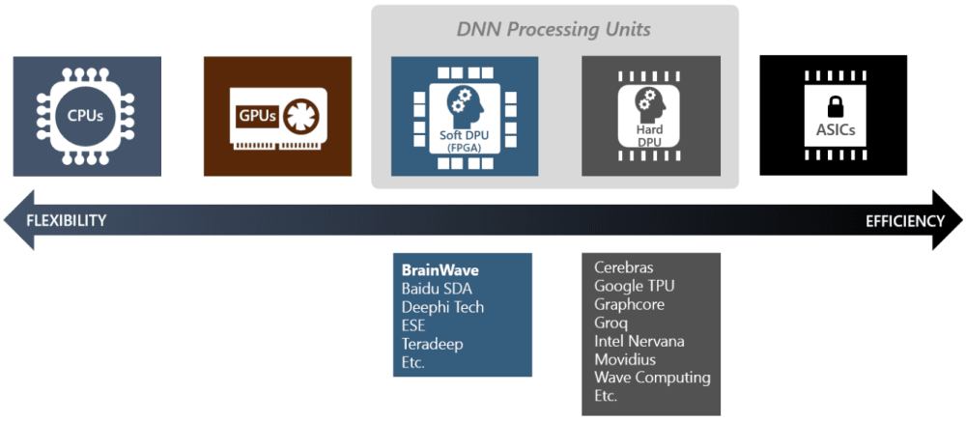
Różne metody wdrożenia ML na poziomie sprzętowym

Slide 28
Pytania?

Slide 29
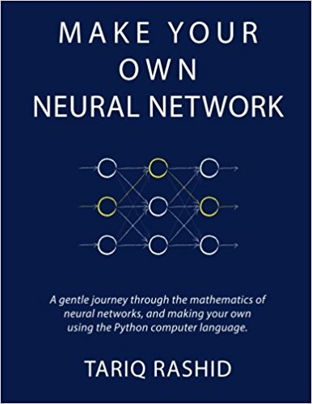


Książki - Subiektywny wybór

Slide 30
Net -

Slide 31

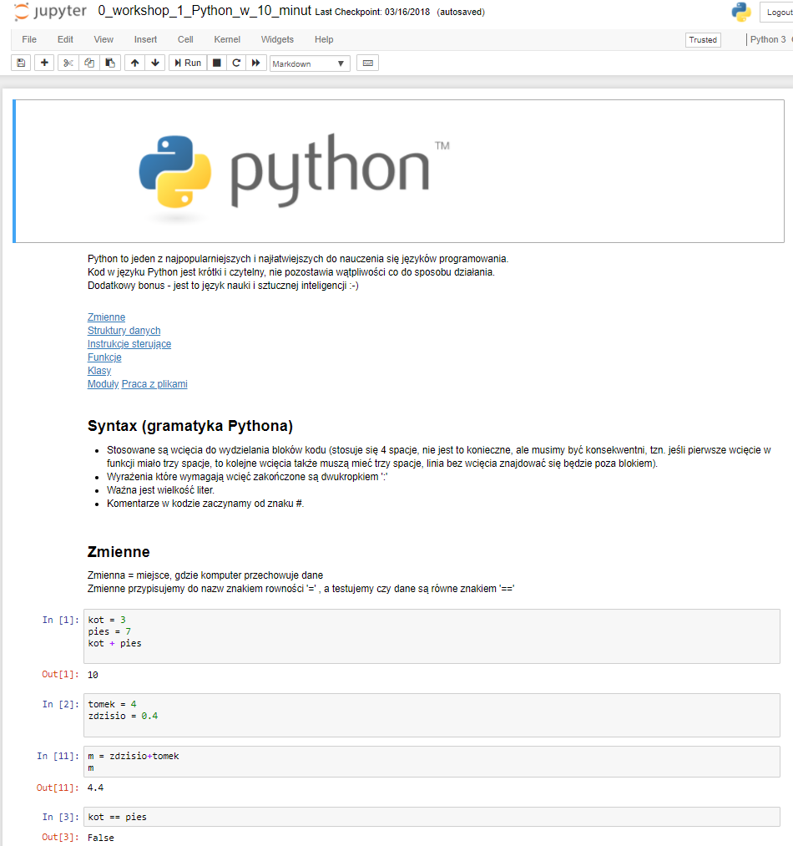
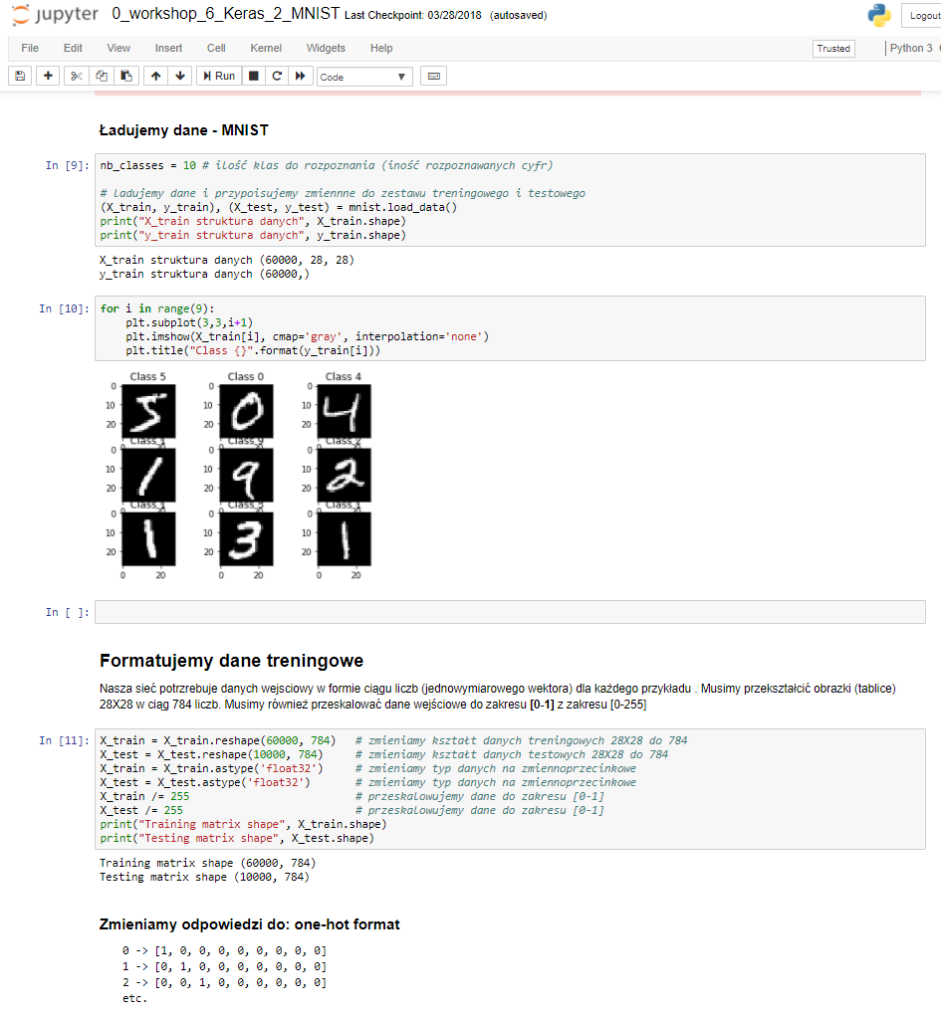
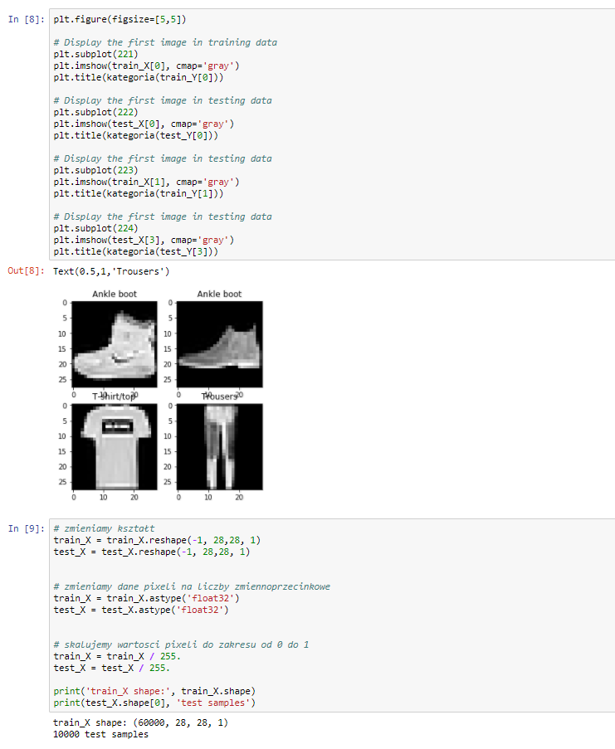
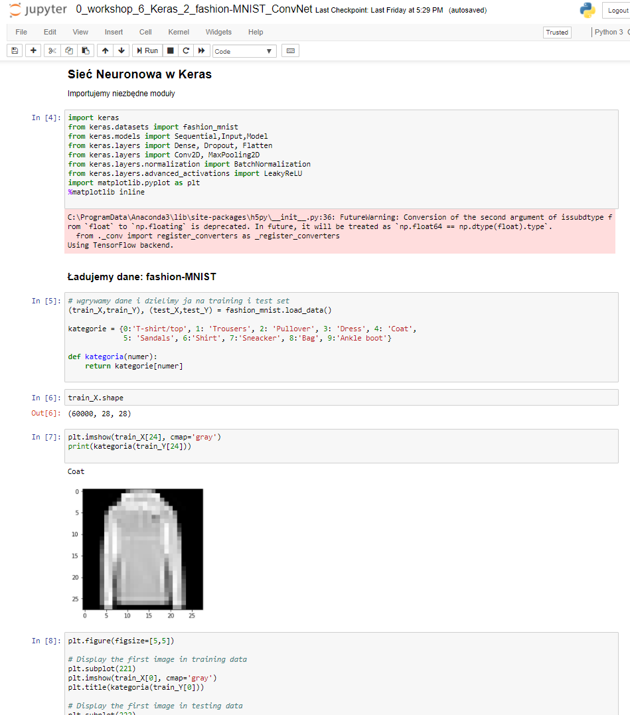
Sztuczna Inteligencja warsztaty
od print(‘hello world’) do modelu w chmurze

