Slide 1

CS 5/6110, Software Correctness Analysis, Spring 2022 Lecture 11
Ganesh Gopalakrishnan
School of Computing
University of Utah
Salt Lake City, UT 84112

Slide 2
Review to put everyone nearly on the same plane
Discrete Math and Logic can be made to “stick” with real-world analogies!

Slide 3
Overview of Formal Verification of Software
Formal Methods achieve their goal as much by elevating one’s intellectual abilities as by creating tools that find bugs
-- GG just made up the quote!

Slide 4
Terminology Deluge, and where we need it
We heard of Boolean Logic and Boolean Algebra
Quite OK to equate it with Propositional Logic or Propositional Calculus
What are some other logics that exist? What must we know about?
First order logic – AKA predicate logic
The true “power” behind SMT solvers is to tame a subset of FOL using SAT inside!
Full first-order logic is undecidable
Relational logic of Alloy
Builds on FOL and emphasizes relations – but the power is in finite-domain analysis!!
Fully side-steps the troubles of undecidability !!
Then we need to reckon with higher order logics, modal logics, temporal logics, program logics (including Hoare logic and Separation Logic) – you must know what they mean (no details)
See Moshe Vardi’s lecture on Formal Methods on Canvas in slide form!
Moshe Vardi helped inaugurate the World Logic Day recently!
https://events.rice.edu/#!view/event/event_id/155303

Slide 5
What is First Order and what are Higher Order?
First Order
You don’t quantify over functions and predicates!
Like in first-order programming where you don’t pass functions as arguments
Higher Order
You can quantify over functions and predicates
Like in higher-order programming where you can pass functions as arguments
Aside: good grounding in logic and functional programming is very handy
If you throw in probability, linear algebra and more math topics, you are super-human!
What is one higher order logic thing you studied in discrete math?

Slide 6
What a Familiar Higher Order Logic Assertion ?

Slide 7
A Familiar Higher Order assertion
What is one higher order logic thing you studied in discrete math?
Answer: Induction!
Arithmetic induction
Look at “Book-1” to see a proof that Arithmetic Induction and Complete Induction are equivalent
Modern adaptation : K-induction – very handy!
Almost like setting up K basis cases – and exploit that in the inductive step
Very nifty and works great! Can prove many real software designs using K-induction!!
Makes the task of finding the inductive assertion much easier
As you can explot ”all those basis cases”

Slide 8
Aside
Even Alloy has a higher-order logic incarnate
Higher Order Logic Analyzier or HOLA
It helps state and check some graph theorems → Turan’s Theorem (look up)
It has been used for program synthesis in a limited way

Slide 9
We must begin studying Alloy by reviewing Relations Binary Relations of interest most often

Slide 10
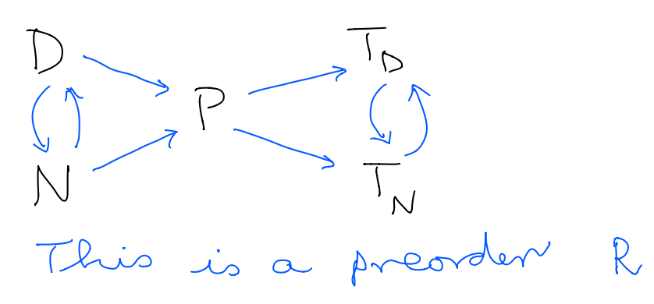
This is a reflexive and transitive relation
NOTE : INSERT SELF-EDGES AT EACH NODE TO MAKE IT REFLEXIVE !!

Slide 11
Models the “pecking order” of power between machines DFA more powerful (or same power) as NFA, i.e. there is a D->N and N->D. Likewise, D->P and N->P for P being a PDA. Td and Tn are DTM and NDTM. What does Td->Tn and Tn->Td say? .
NOTE : INSERT SELF-EDGES AT EACH NODE TO MAKE IT REFLEXIVE !!

Slide 12
Preorders allow two things to stand in ”<=“ without being the same E.g. “steph-curry” <= “lebron-james” and “lebron-james” <= “steph-curry” but “steph-curry” not the SAME as “lebron-james”
NOTE : INSERT SELF-EDGES AT EACH NODE TO MAKE IT REFLEXIVE !!

Slide 13
RELATIONS – a recap
A good way to develop intuitions is to depict the “power relation” among formal machines in Computability Theory
Example: D = DFA, N = NFA, P = PDA, T_D = DTM, and T_N = NDTM
Our universe = U = { D, N, P, T_D, T_N }
Universal relation = { <a,b> : a,b in U }
Iden or Identity Relation = { <D,D>, <N,N>, … }
Let <= means “less powerful or has the same power”
Then we have
<= equaling { <D,D>, <D,N>, <N,D>, <D,P>, <P, T_D>,
<P, T_N>, <T_D, T_N>, <T_N, T_D> }

Slide 14
COMPUTE <= & ~<=
i.e. take the power relation and intersect it with its inverse
What is the type of relation you then get?
Preorder?
Partial order?
Equivalence relation?
Identity equivalence relation?
Universal equivalence relation?
What are the above anyhow (you need to know)
The family of all relations you can construct over any set forms a lattice, with the “top” being the universal equivalence relation (everything is paired up with everything else) and the identity equivalence relation (things paired up only with themselves are at the bottom) and the lattice ordering is set inclusion

Slide 15
Partial Orders
Are Preorders + Anti-Symmetry
What does Anti-Symmetry do?

Slide 16
Partial Orders
Are Preorders + Anti-Symmetry
What does Anti-Symmetry do?
Anti-symmetry says if a R b and b R a then a=b (in the underlying universe)
Antisymmetry makes things the same!
E.g. for sets A and B, if A [= B (contained in B) and B [= A
Then A = B
They are the same set
Question : What is the universe over which [= is defined ?

Slide 17
Partial Orders
Are Preorders + Anti-Symmetry
What does Anti-Symmetry do?
Do you consider 10 ohms = two 20 ohms in parallel ?
Will you use a preorder or a partial order ?
How do resistors in parallel work?
R1 and R2 in parallel give you a resistance of R1R2 / (R1+R2)
Answer if you care only about the resistive value
Answer if you care about other attributes also
Size, looks, topology of the circuit (may matter for a printed circuitboard)

Slide 18
One more exercise
Define intervals over real numbers as pairs (a,b) such that a <= b
a and b come from Reals or R
Define a new relation <I= such that
(a1,b1) <= (a2,b2) IFF a2 <= a1 and b1 <= b2
<I= is read “interval-less-than”
Is <|= a preorder or a partial order? Prove!

Slide 19
Asg4 hints
Hints for Asg-4
sig S { …. }
Sig S { pre : …. }
Sig S { pre : …maps to a subset of S }
fact { state that pre and par are not empty }
Some none lone
S <: iden is a constrained identity
You can say S <: iden in pre as a fact
fact { all a, b, c: S a,b pair in pre and b,c pair in pre then … }
assert preAndPreinvIden {
pre & ~Pre …. } … inverse intersection is in what ?
check preAndPreinvIden for exactly 3 S -- false!
--run {} for exactly 4 S

