Slide 1

CS 5/6110, Software Correctness Analysis, Spring 2022
Ganesh Gopalakrishnan
School of Computing
University of Utah
Salt Lake City, UT 84112

Slide 2
Let’s go through all the details of a simple pgm
We will fully analyze a program that multiplies two numbers through repeated addition
We will illustrate the ideas of
Weakest precondition of a command with respect to a postcondition
Loop invariant
Termination (“measure”) function
We will take examples from Gordon’s book and run it under Dafny – our first candidate is g20a.dfy and the ”real” code is “g20b.dfy” with all details. g20a.dfy will keep us busy!

Slide 3
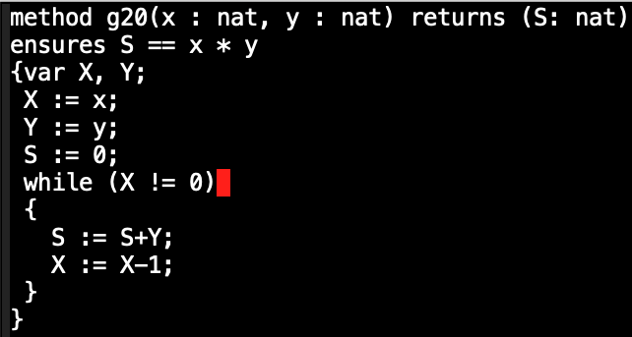
g20a : Gordon’s example 20
The question is
Does the
“ensures”
Clause hold?

Slide 4
General approach
Be prepared to analyze only straight-line programs!
Assignment
Conditional
If-then-else
For loops, try to find an argument to, in effect, analyze the loop body (which, assume for now, is a straightline program)
We will reveal this idea soon

Slide 5
But wait, even this example is too complicated!
We will take a much simpler example….
….. Your friend XOR-swapper !!
Each following slide builds on the previous

Slide 6
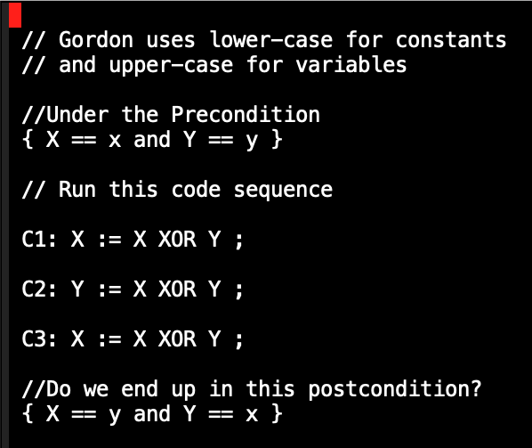

Slide 7
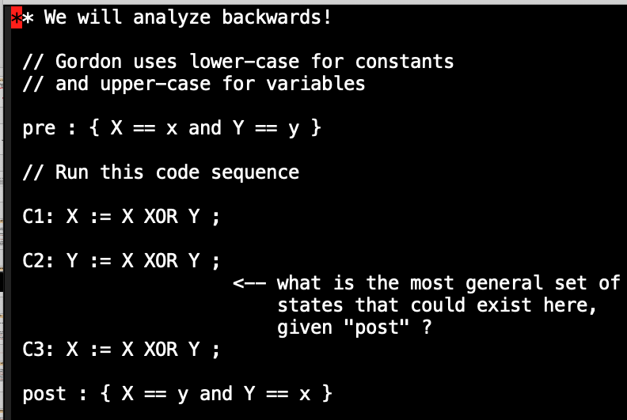

Slide 8
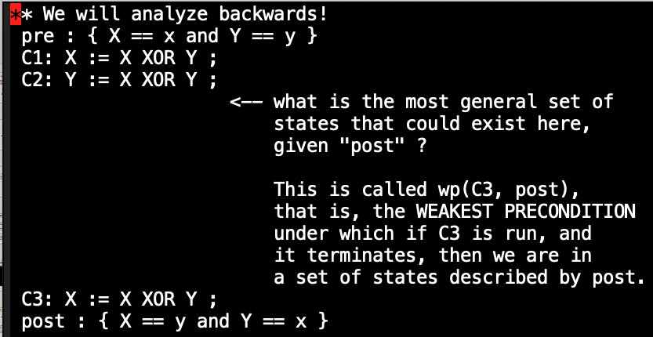

Slide 9
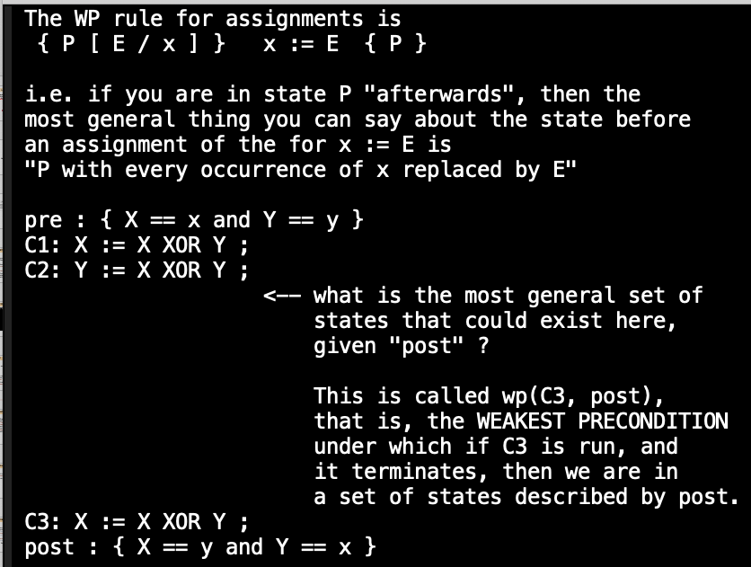

Slide 10
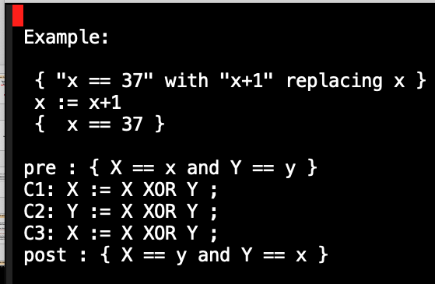

Slide 11
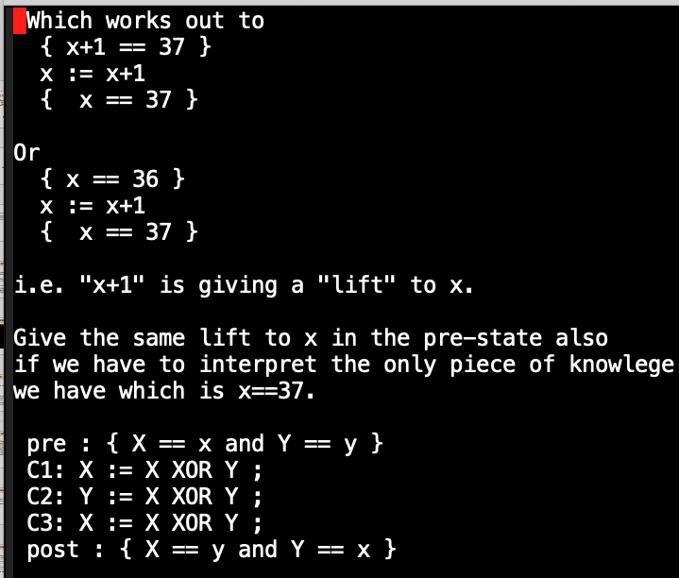

Slide 12
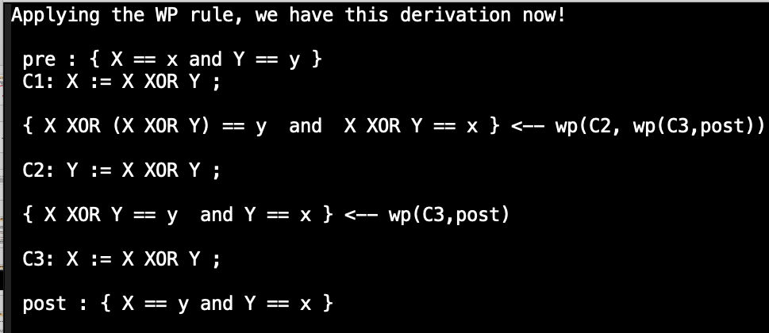

Slide 13
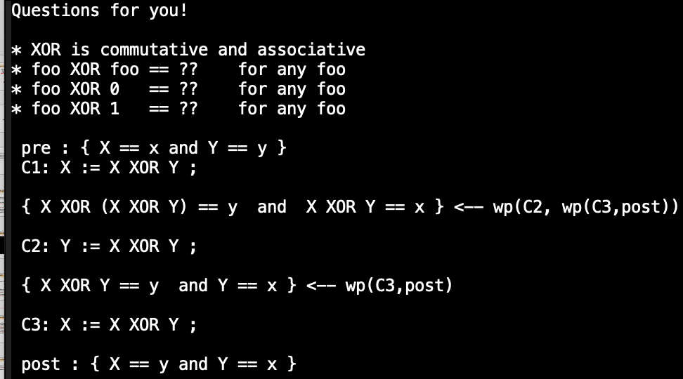

Slide 14
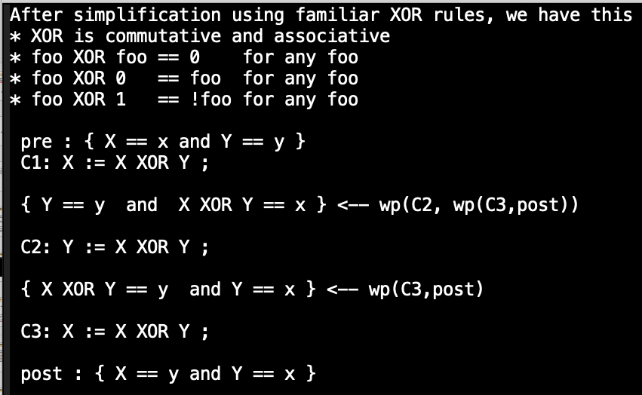

Slide 15
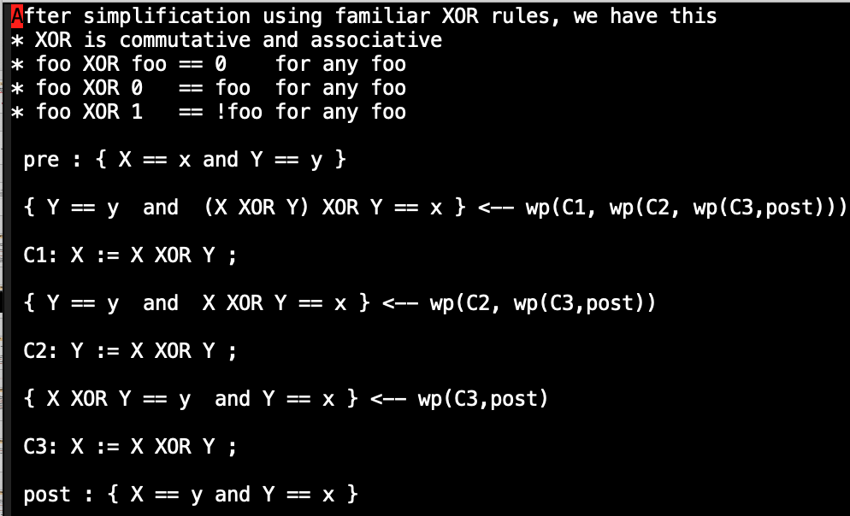

Slide 16
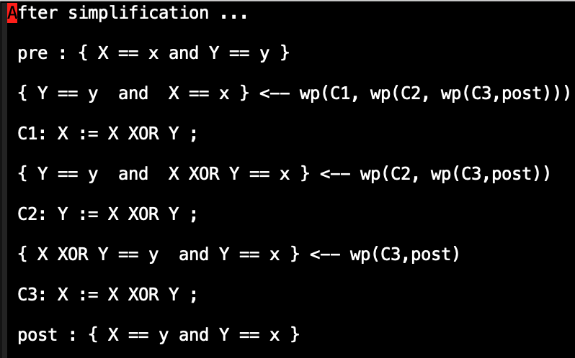

Slide 17
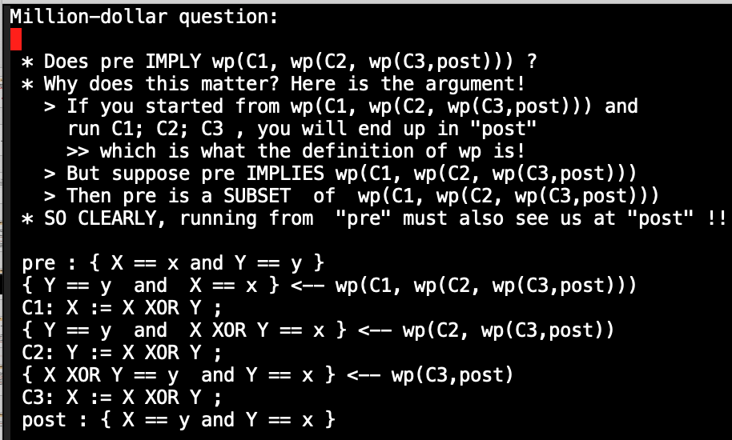

Slide 19
This finishes the proof of the XOR-swapper
We now return to the Gordon example g20
See my hand-derivation of the “LI march backwards!!”
This is how Floyd originated his ideas
Hoare adapted the ideas to the form of “program logic"

Slide 21
To confine to sequential verif, we need “LI”
We (users) have to come up with an assertion to place at the loop head, called Loop Invariant, or “LI”
( memory aid : those who said verification was easy said a LI ☺ )
This is such a general statement that must
Be true when you hit the loop head the first time
Must stay true every time you hit the loop head
Even the last time (when about to exit) the LI must be true!
Come up with such a LI ☺

Slide 22
What is a good Loop Invariant to place immediately after “while” and
Before the “{ “ ?? THINK OF IT THIS WAY! IMAGINE YOU’VE BEEN RUNNING THE CODE FOR A WHILE … take a snapshot using your camera, and characterize the variable values that you see at that point into a mathematical relationship!
Hint! Look at the final answer you have to deliver … this LI when specialized to the exit condition must be close enough (or actually imply) the post-condition!
What is it for this program ?? Spend 5 mins! Let the students independently type their LIs and discuss!

Slide 23
What is a good Loop Invariant to place immediately after “while” and
Before the “{ “ ?? THINK OF IT THIS WAY! IMAGINE YOU’VE BEEN RUNNING THE CODE FOR A WHILE … take a snapshot using your camera, and characterize the variable values that you see at that point into a mathematical relationship!
Hint! Look at the final answer you have to deliver … this LI when specialized to the exit condition must be close enough (or actually imply) the post-condition!
What is it for this program ?? Spend 5 mins! Let the students independently type their LIs and discuss!
Ask yourselves
How much of the S has been computed?
What remains to be computed?
How does the remaining work reflect in the
residual value of X?
* How to now capture “S” as a function of
X and the other variables ??
YOUR ANSWER NOW !!

Slide 24
What is a good Loop Invariant to place immediately after “while” and
Before the “{ “ ?? THINK OF IT THIS WAY! IMAGINE YOU’VE BEEN RUNNING THE CODE FOR A WHILE … take a snapshot using your camera, and characterize the variable values that you see at that point into a mathematical relationship!
Hint! Look at the final answer you have to deliver … this LI when specialized to the exit condition must be close enough (or actually imply) the post-condition!
What is it for this program ?? Spend 5 mins! Let the students independently type their LIs and discuss!
Ask yourselves
How much of the S has been computed?
What remains to be computed?
How does the remaining work reflect in the
residual value of X?
* How to now capture “S” as a function of
X and the other variables ??
YOUR plausible ANSWER NOW !!
(x – X) * Y == S

Slide 25
YOUR plausible ANSWER NOW !!
(x – X) * Y == S
Why only plausible?
Invariant discovery is the
hardest problem
(the most creative aspect) of
verification
Model-checkers find invariants
for you
They find SIN s … Strongest
Invariants ☺
(but only for those finite cases)
We need a closed-form invariant
for the general case!

Slide 26
There are two methods to confirm an LI
Ask Dafny or similar tools
But remember, these tools are worse than your nagging boss !!
You may be close enough but these tools bite you hard at <you-know-where>
2) Have a method to hand-check!!
This is what we will show you how!

Slide 27
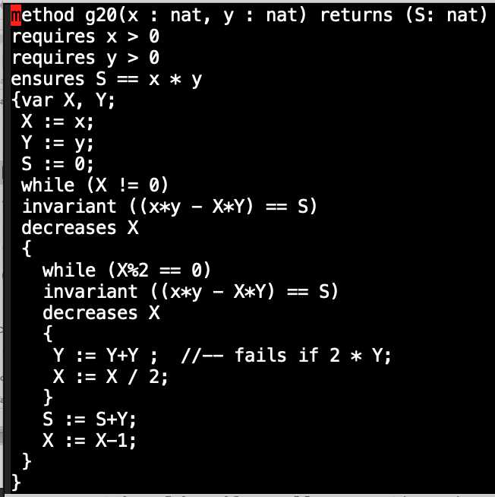
Why you need to know how ”dafny thinks”!
Maybe I’ve not learned how to steer
Dafny well-enough… but this took
an extra late night hour before I could sleep!
⬅

Slide 28
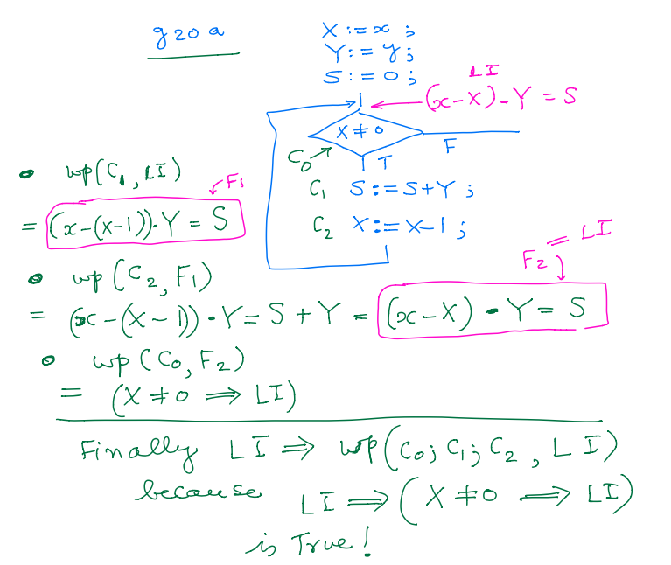
Gordon’s g20 example and its “LI walk-back”

Slide 29
This is all for the next week
I’ve given Asg-5
PROMISE to grade Asg-1 thru 4 before Monday!
As we will stay with Dafny through thick and thin for a week or so
Historically the first verification approach considered
Recently TimSort was found to be buggy and upgraded
See Wikipedia article on the TimSort bug
Proved by people using the theorem prover called Key
A good intuition about how Hoare Logic verifiers work is important
Next lecture (2/24): I’ll try and demo Dafny
Requires some “magic” on Macs to work (mine stopped working; will fix)
Will study a Lisp-based verifier in Gordon’s book meanwhile

