Slide 1

CS 5/6110, Software Correctness Analysis, Spring 2021
Ganesh Gopalakrishnan
School of Computing
University of Utah
Salt Lake City, UT 84112

Slide 2
Overview of lectures before/after break
Today, 3/3
Show how FOL encodings can be made in Alloy
What tools exist and we can learn from
Gordon’s verifier
Hoare-verifier in Python + Z3
Dafny
Verifast (does also separation logic)
Left tutorials online
After the break
Can we see where the state-of-the-art is in concurrent program verification?
Perhaps involves separation logic
Also perhaps involves the Rust language
This means we must study
First-Order Logic
Hoare Logic
Separation Logic
Would be good to read the PhD dissertation
“Understanding and evolving the Rust programming language”

Slide 3
Overview of lectures before/after break
Assignment 6
Question 1:
Use the Alloy simulation of FOL and check validity (see next slide)
Question 2:
Read Mike-Gordon-Slides.pdf
Covers Hoare Logic, First-Order Logic, Separation Logic
Try the Gordon Prover
Question 3:
Project Selection
A 2-page proposal
Details TBD
John has been briefed

Slide 4
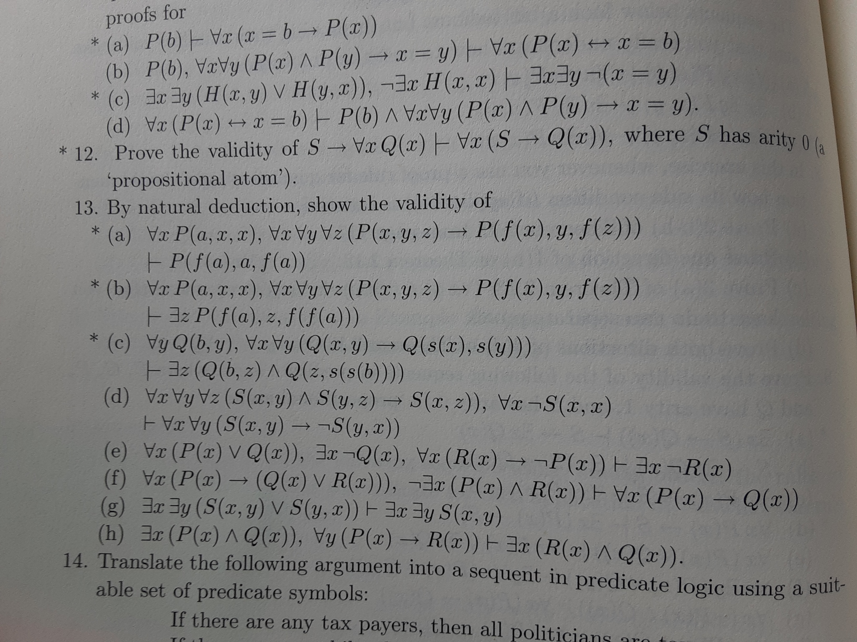
FOL
Work
book

Slide 5
Material on Dafny (after the break)

Slide 6
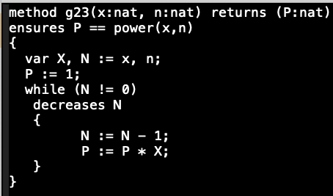
Dafny Exercises: Loop invariant?

Slide 7
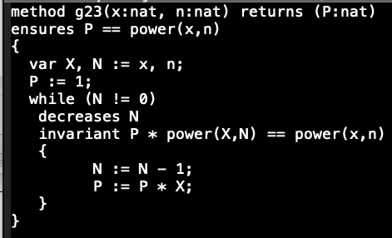
Dafny Exercises: specificiation of power?

Slide 8
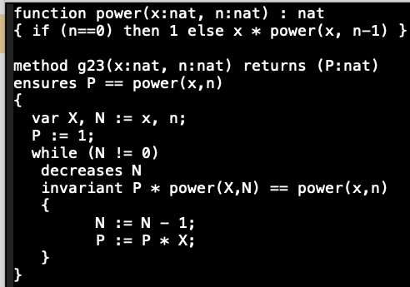
Dafny Exercises

Slide 9
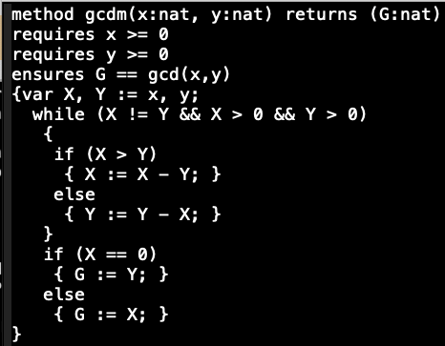
Dafny Exercises: Ranking function (“decreases”)?

Slide 10
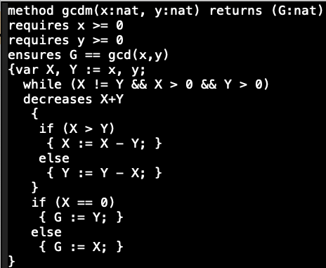
Dafny Exercises: Loop invariant?

Slide 11
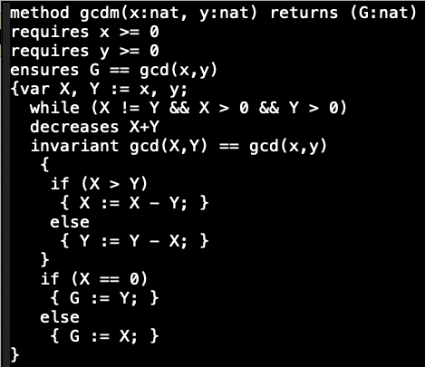
Dafny Exercises: Specification?

Slide 12
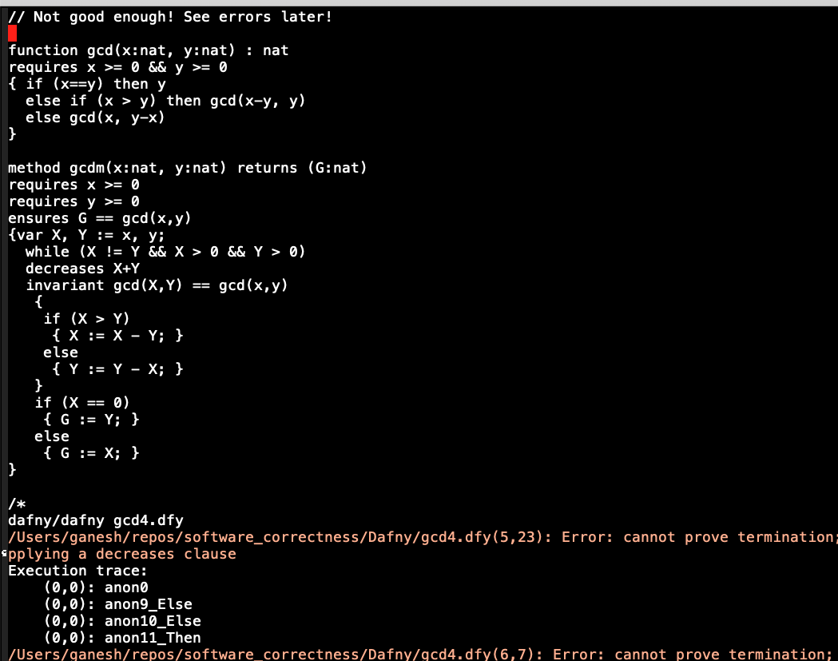
Dafny Exercises: Help prove termination!

Slide 13
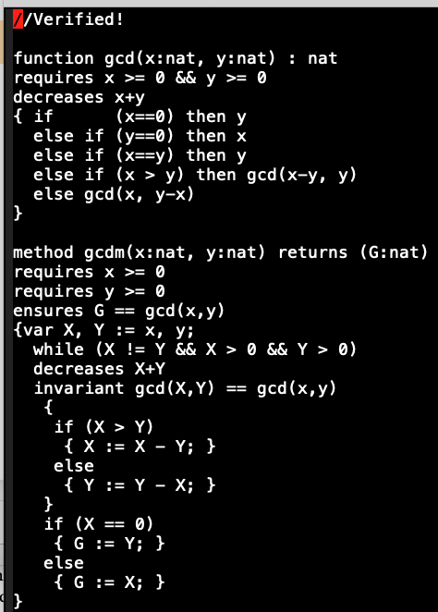
Dafny Exercises: Finally!

Slide 14
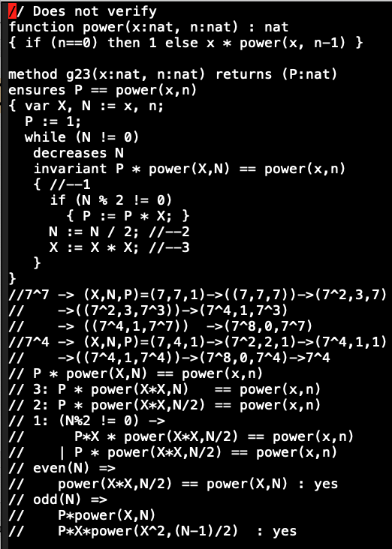
Dafny Exercises: Optimized exp (unfinished..) plz try with me! Two approaches: 1) more simple invariants 2) lemma

Slide 15
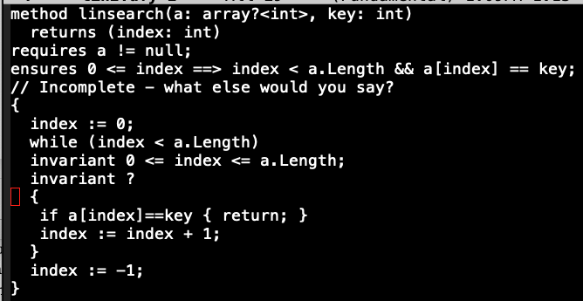
Dafny Exercises: Lin search

Slide 16
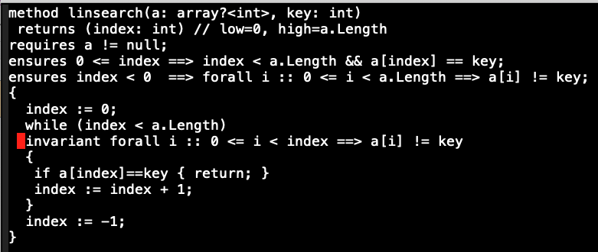
Dafny Exercises:

Slide 17
Dafny Exercises:
See other failures and successes – see files kept online

Slide 18
An intro to Hoare Logic and its rules
Follow Gordon’s prover code kept online

Slide 19
Dafny Exercises
We will continue with more Dafny in Asgs
Wed: Finish up Hoare Logic
Then Static Analysis

