Slide 1
Forecasting on Sales Data
By
Ajantika Paul

Slide 2
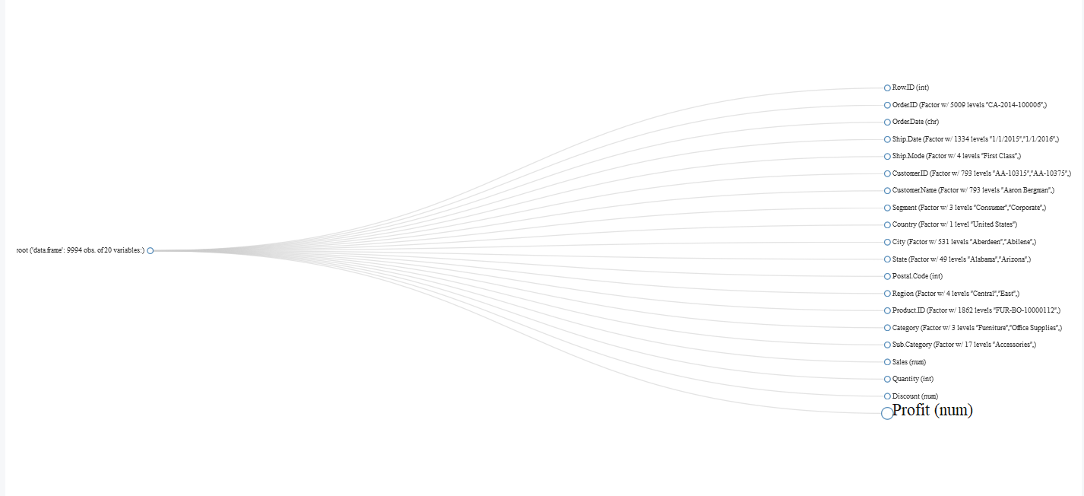
DATA EXPLORATION

Slide 3
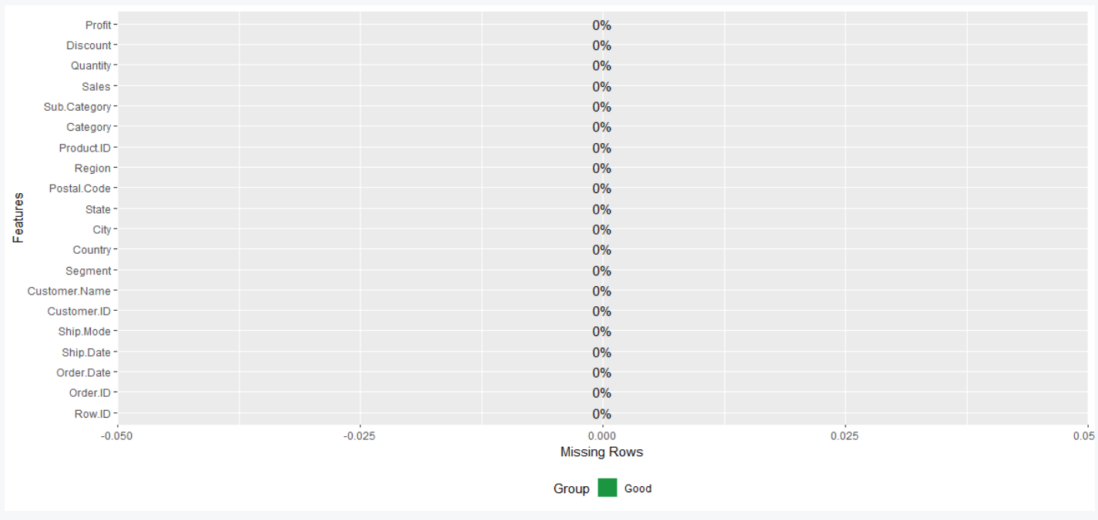
CHECKING MISSING VALUES

Slide 4
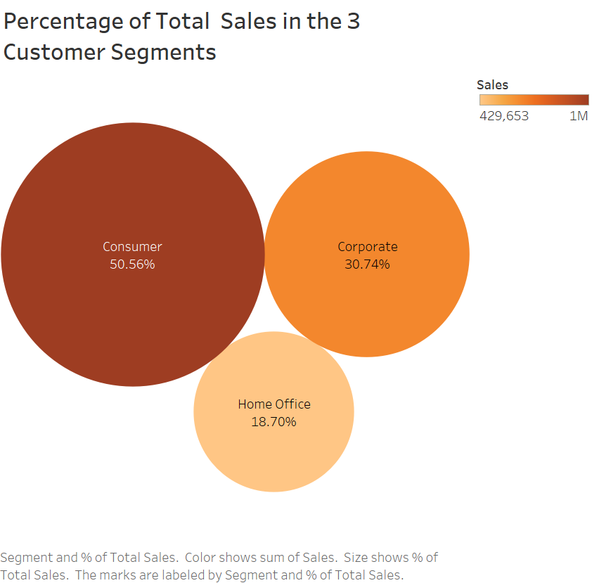
PERCENTAGE OF TOTAL SALES

Slide 5
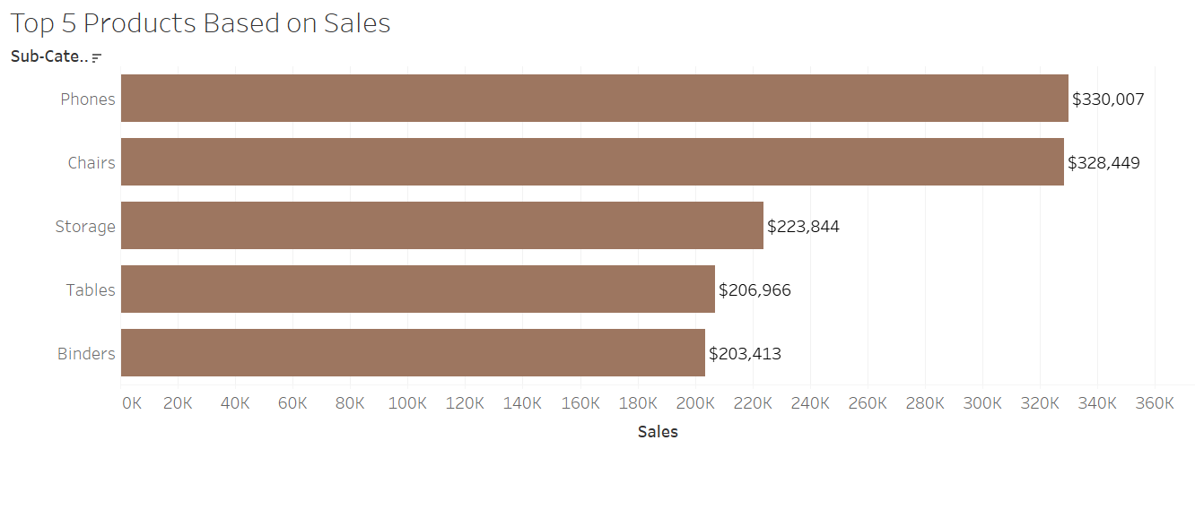
TOP 5 BEST SOLD PRODUCTS

Slide 6
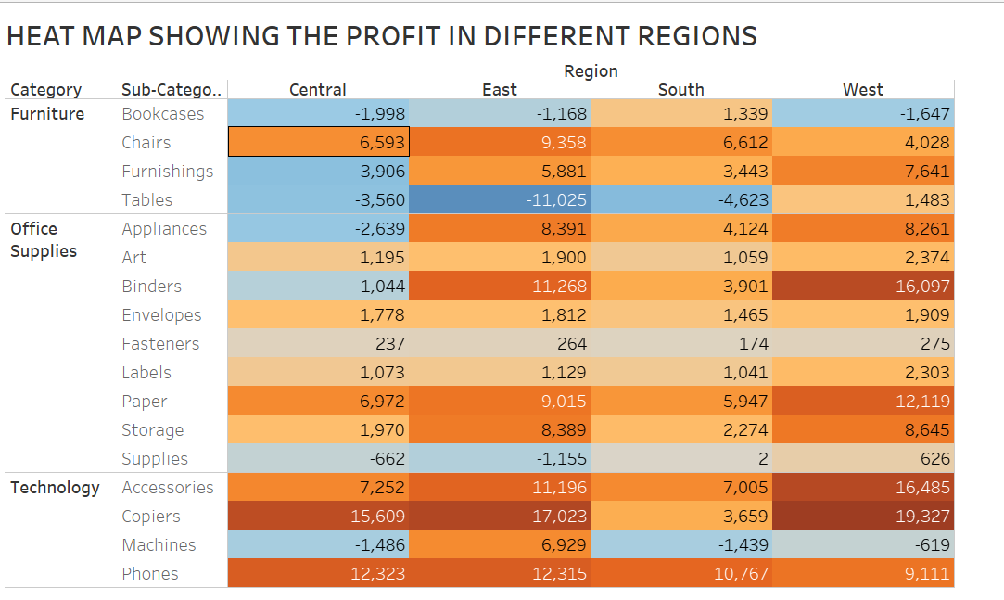

Slide 7
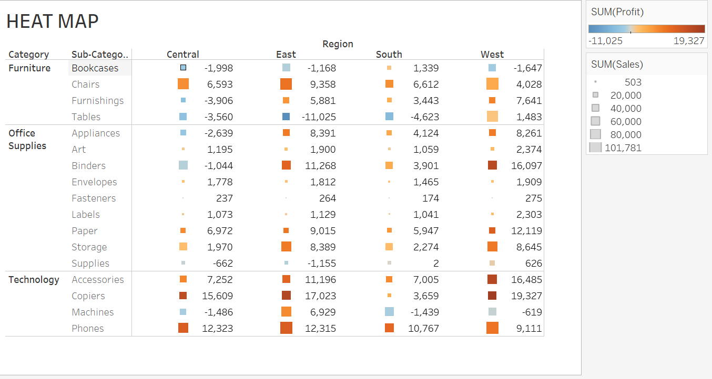
HEAT MAP SHOWING SALES AND PROFIT

Slide 8
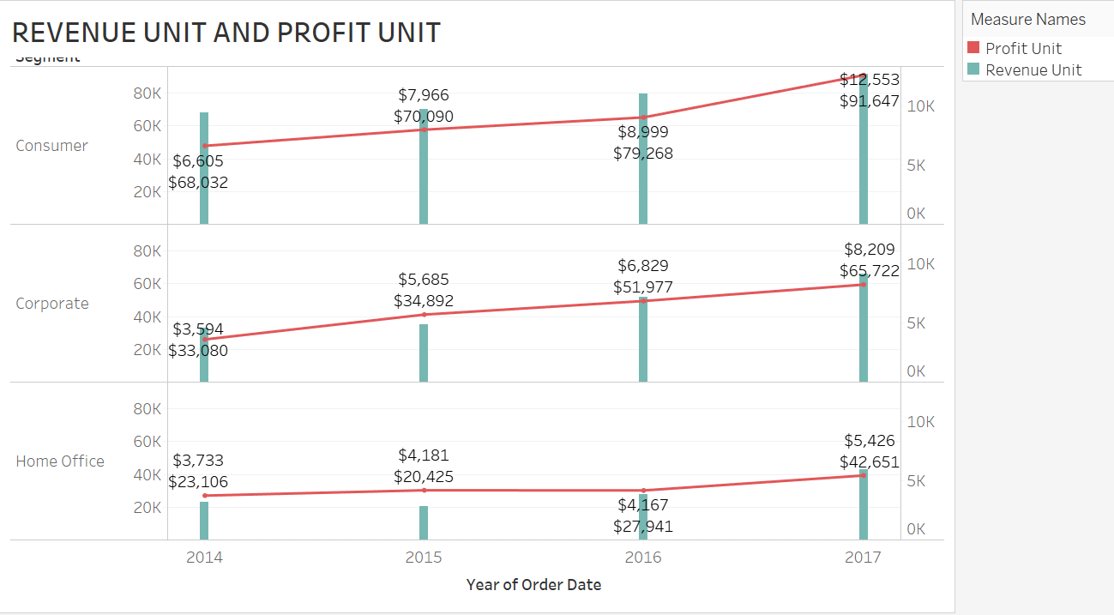
REVENUE UNIT AND PROFIT UNIT BASED UPON CATEGORY

Slide 9
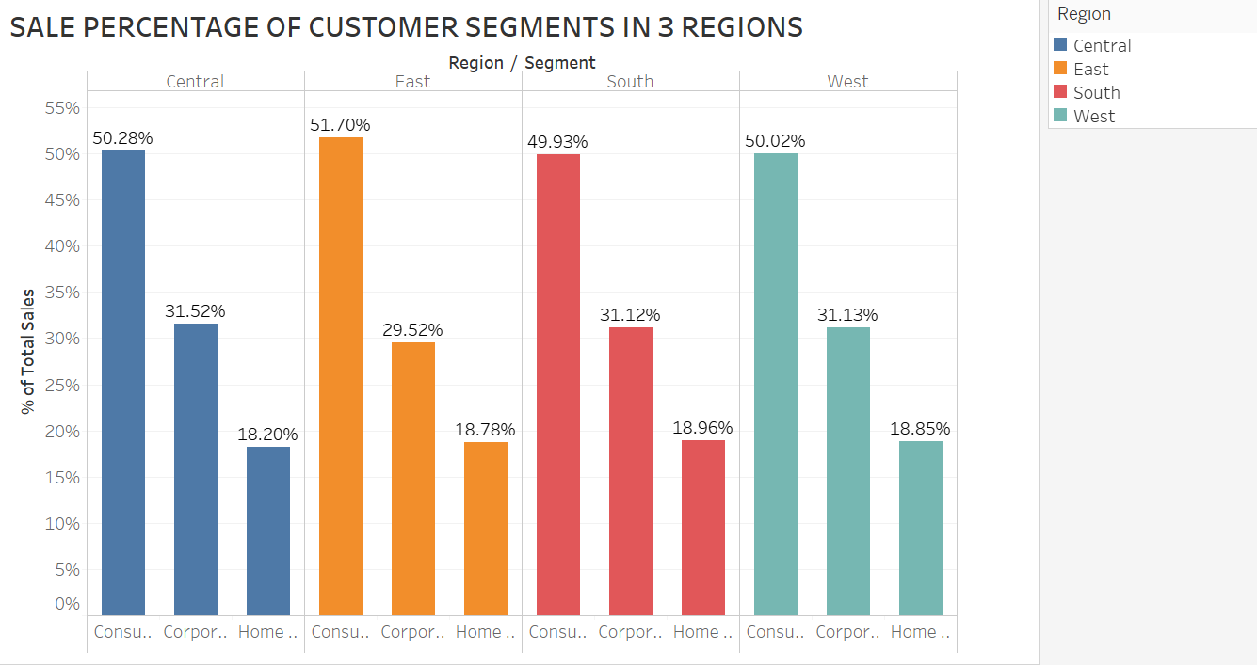
SALE PERCENTAGE OF CUSTOMER SEGMENTS IN 3 REGIONS

Slide 10
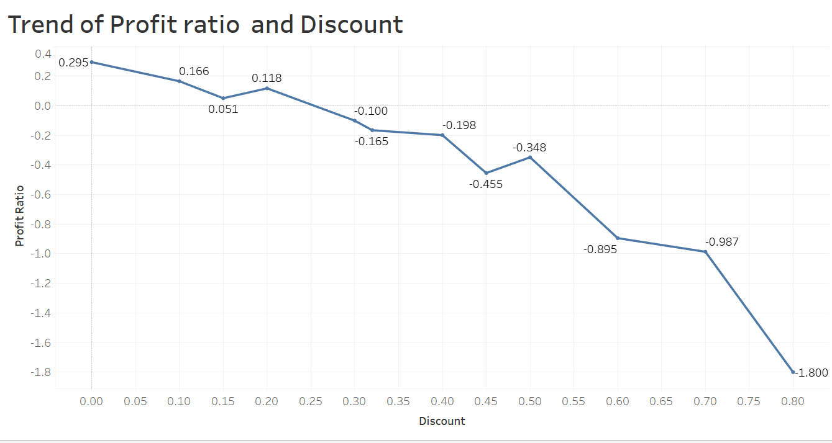
TREND OF PROFIT RATIO AND DISCOUNT

Slide 11
TIME SERIES FORECASTING

Slide 12
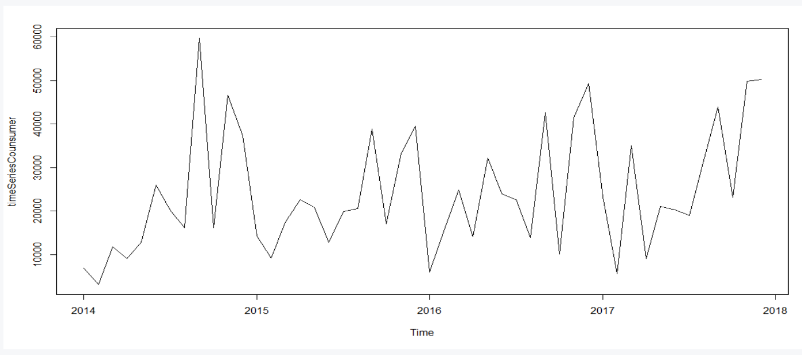
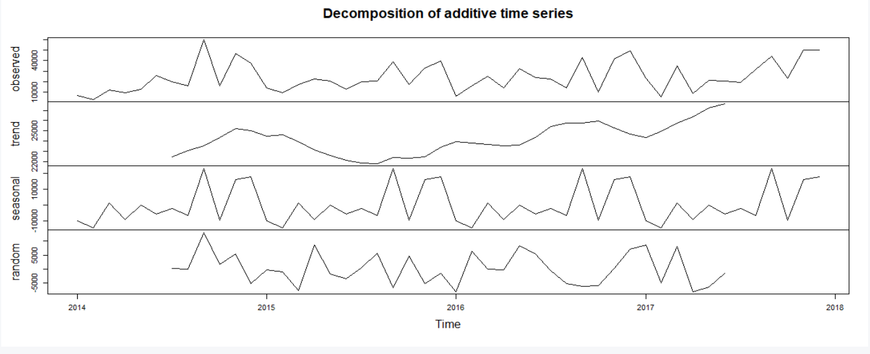
Sale of Segment-Consumer

Slide 13
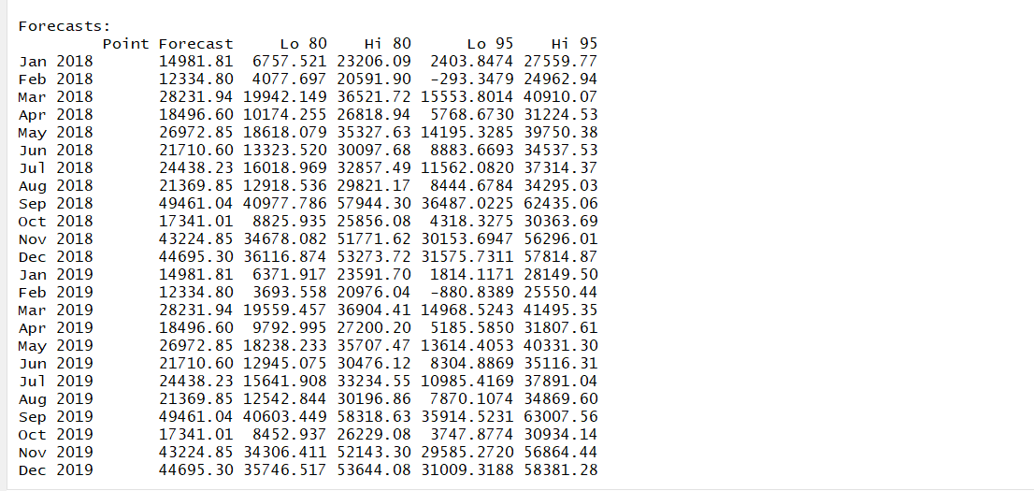
FORECASTING FOR NEXT 2 YEARS
Dec 2017= $50232.46
Dec 2018=$44695.30

Slide 14
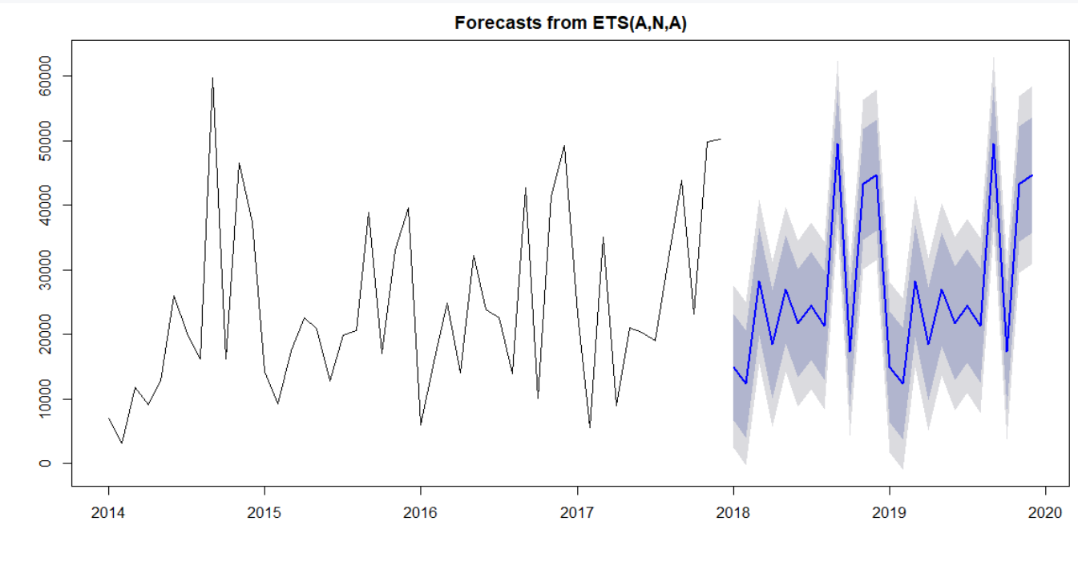
FORECASTING GRAPH

Slide 15
Forecast of Consumer Segment in the three Regions
 | REGION
 | SOUTH | CENTRAL | WEST | EAST
DEC 2017 | $11159.3222 | $13793.727 | $12589.989 | $12689.418
DEC 2018 | $6525.516 | $9472.7526 | $11603.561 | $13327.104

Slide 16
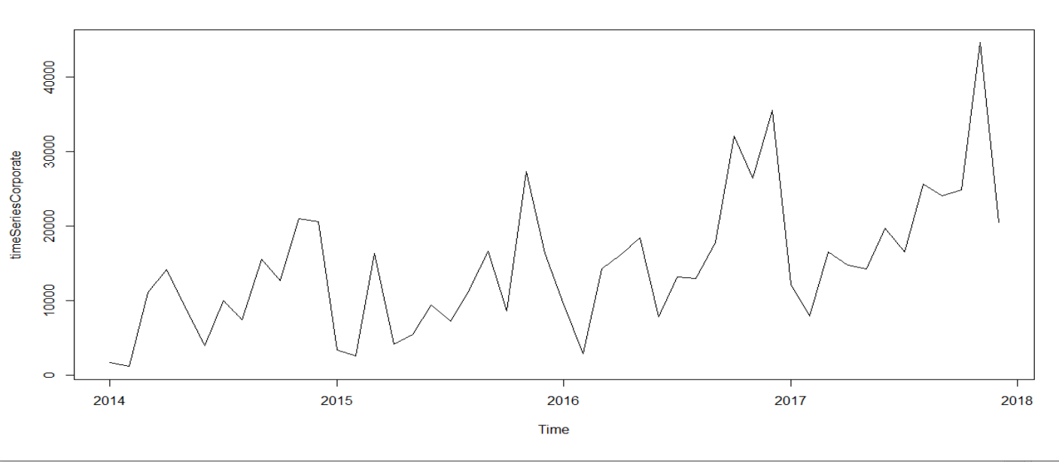
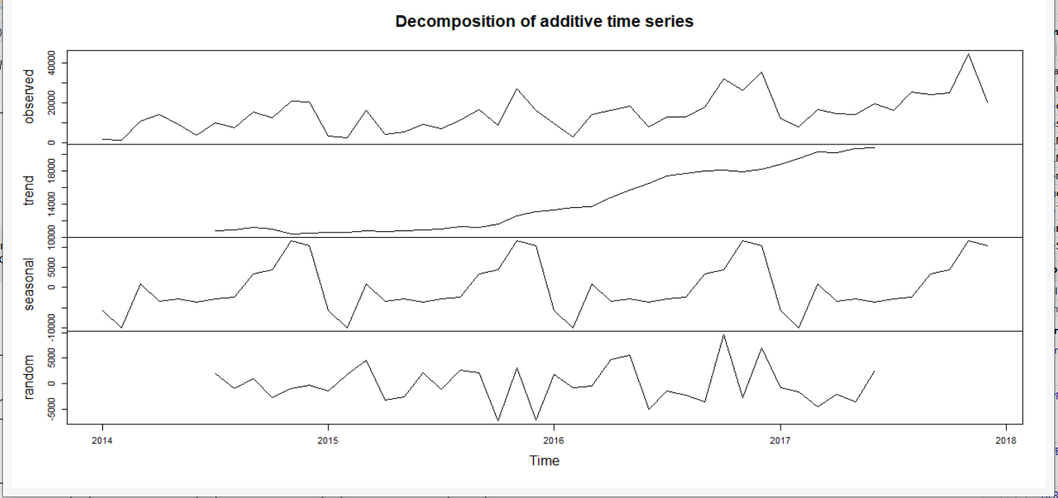
SALE OF CORPORATE SEGMENT

Slide 17
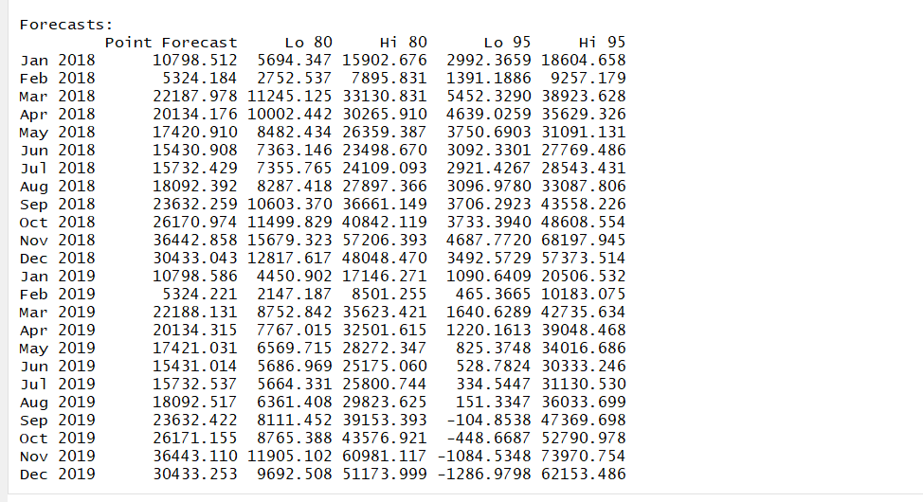
FORECASTING FOR NEXT 2 YEARS
Dec 2017=$20524.43
Dec 2018=$30433.043

Slide 18
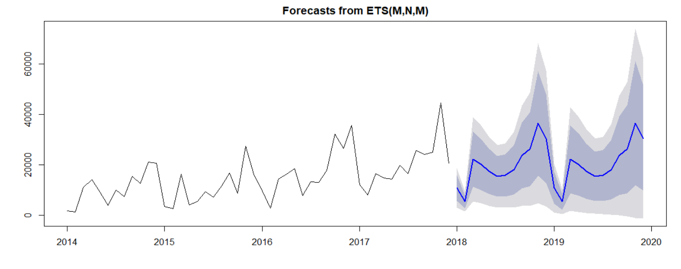
FORECASTING GRAPH

Slide 19
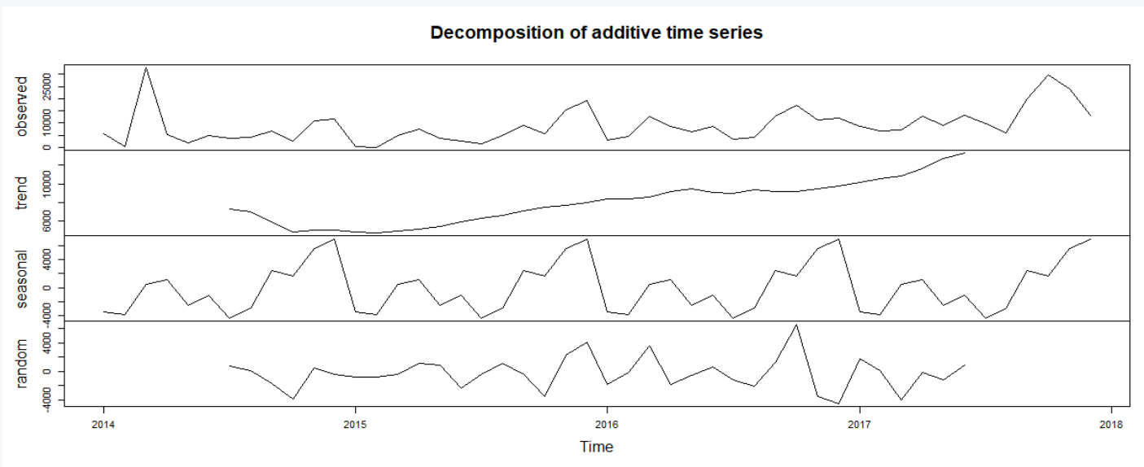
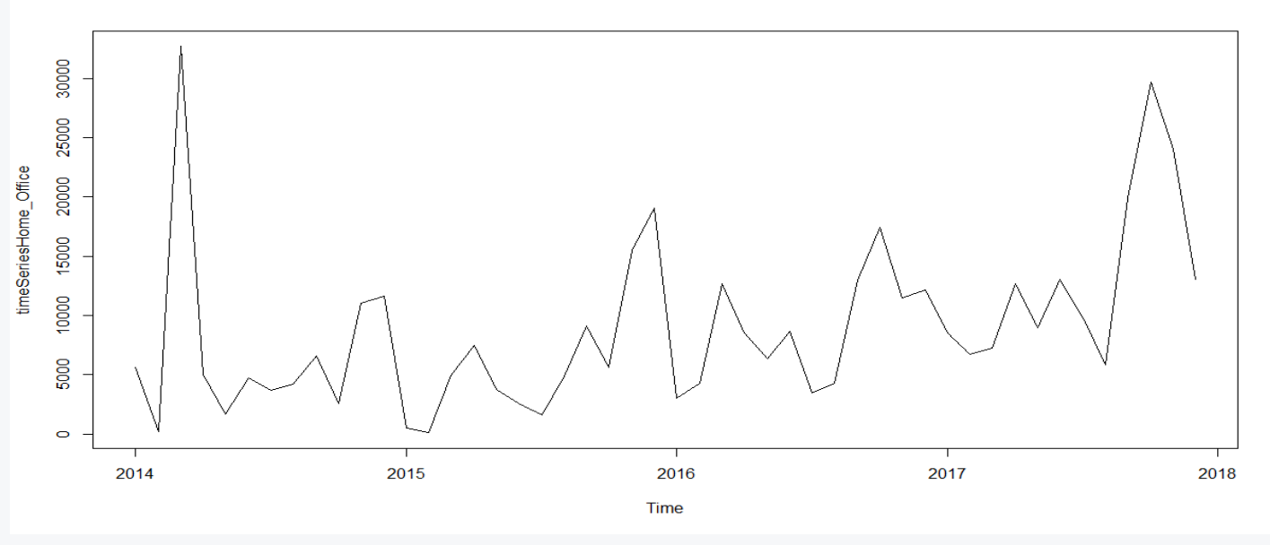
Sale Of Home Office Segment

Slide 20
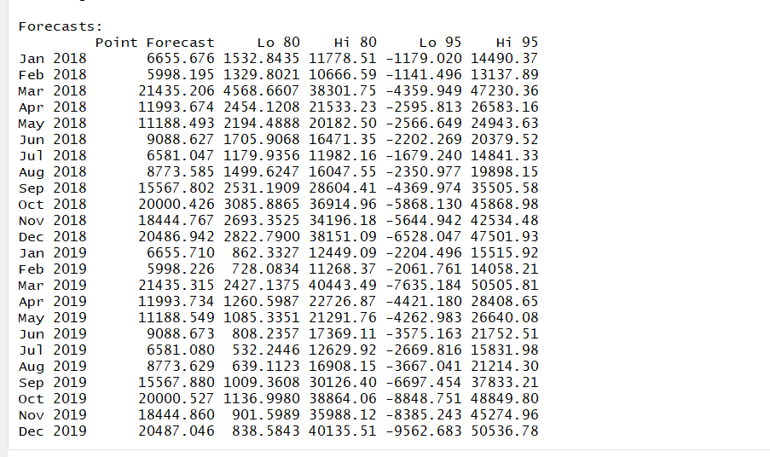
FORECASTING FOR NEXT 2 YEARS
Dec 2017=$13072.431
Dec 2018=$20486.942

Slide 21
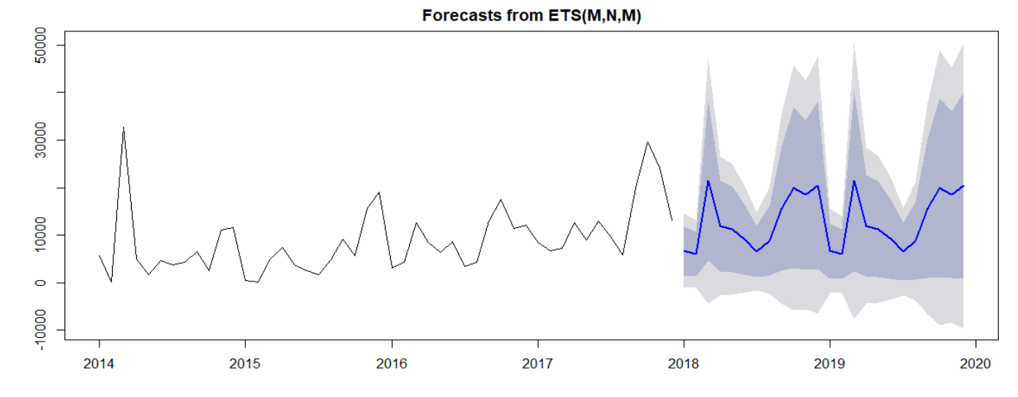
FORECASTING GRAPH

Slide 22
Conclusions:
Sales across all analysed market segments have shown seasonal behaviour
Highest Sale is received from East Region for Consumer Segment
The Discounted order show less profit than undiscounted order
Discounts should be given till 20%
Given more visibility to the Data, we can check:
How many new customers is gained each year?
Are there particular months where they acquire or lose more customers than usual?
Home Office Segments has potential chances of growing its sales next year
Though Consumer sale is highest across all regions, there might be a downfall next year it is recommended to keep track of how many Consumer products are sold per month in the South Region since forecast shows that after 1 year Sale of Consumer in South Region will be less.

