Slide 1
Data City, Open City, Our City
TU Berlin and MOD Institute
July 03-04, 2014
Politics of Data:
Media, Materiality and Movement
Sumandro Chattapadhyay
Research Associate, The Sarai Programme
Centre for the Study of Developing Societies, Delhi, India
<sarai.net>
<ajantriks.net>

Slide 2


Slide 3
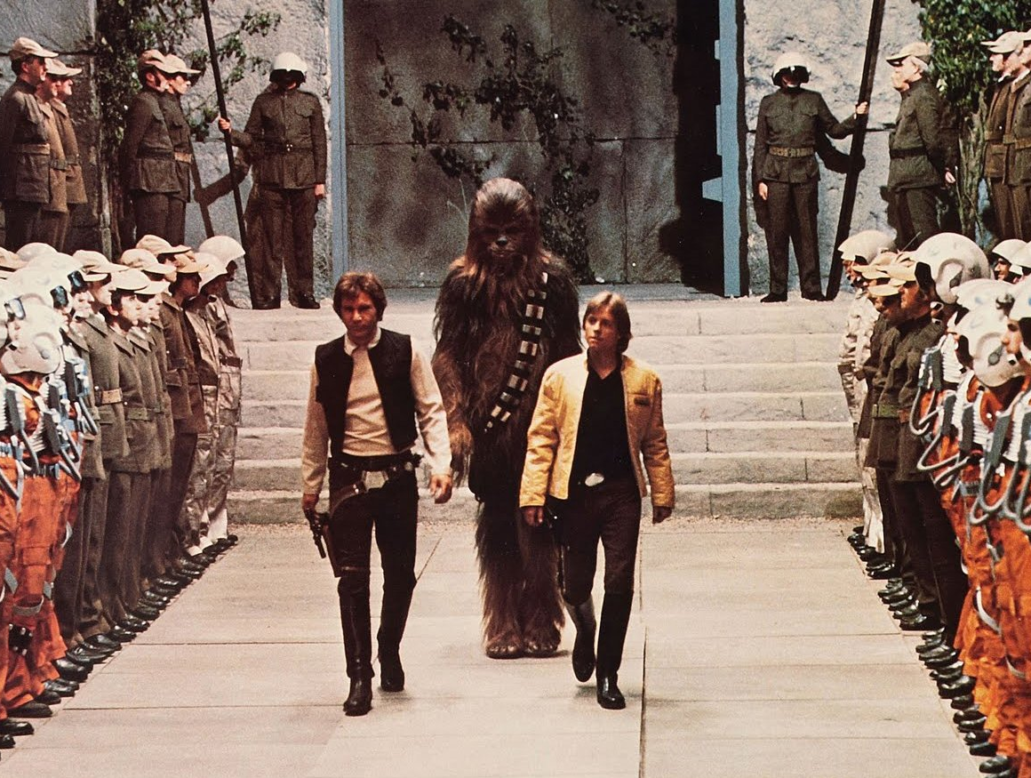

Slide 4
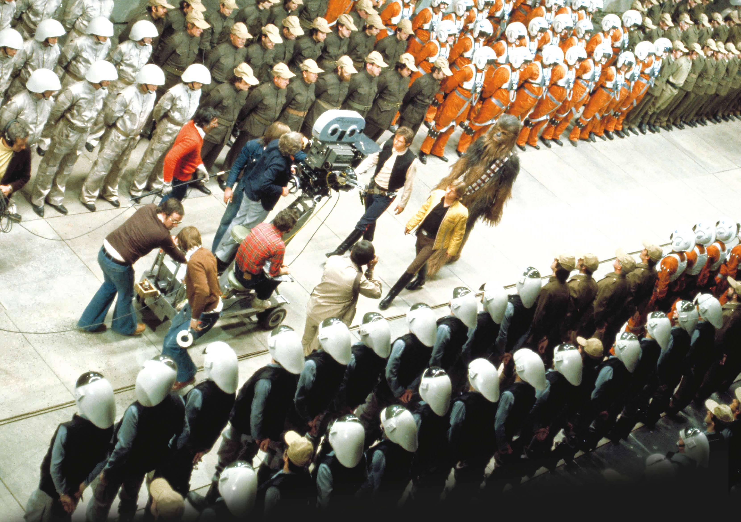

Slide 5
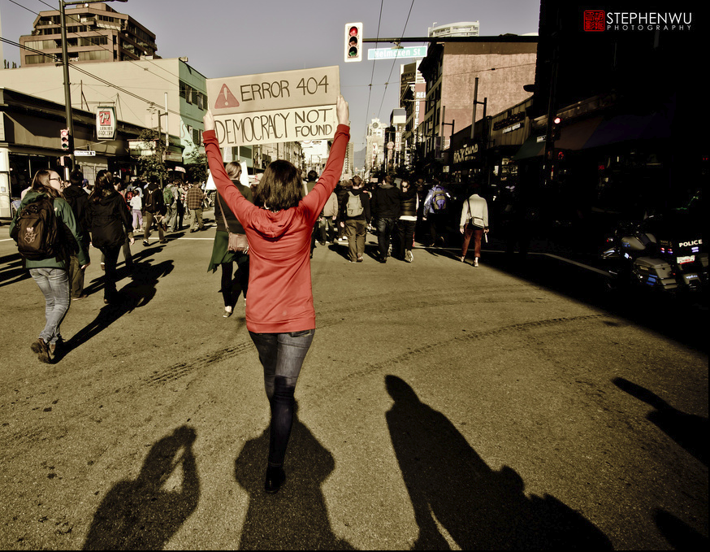

Slide 6
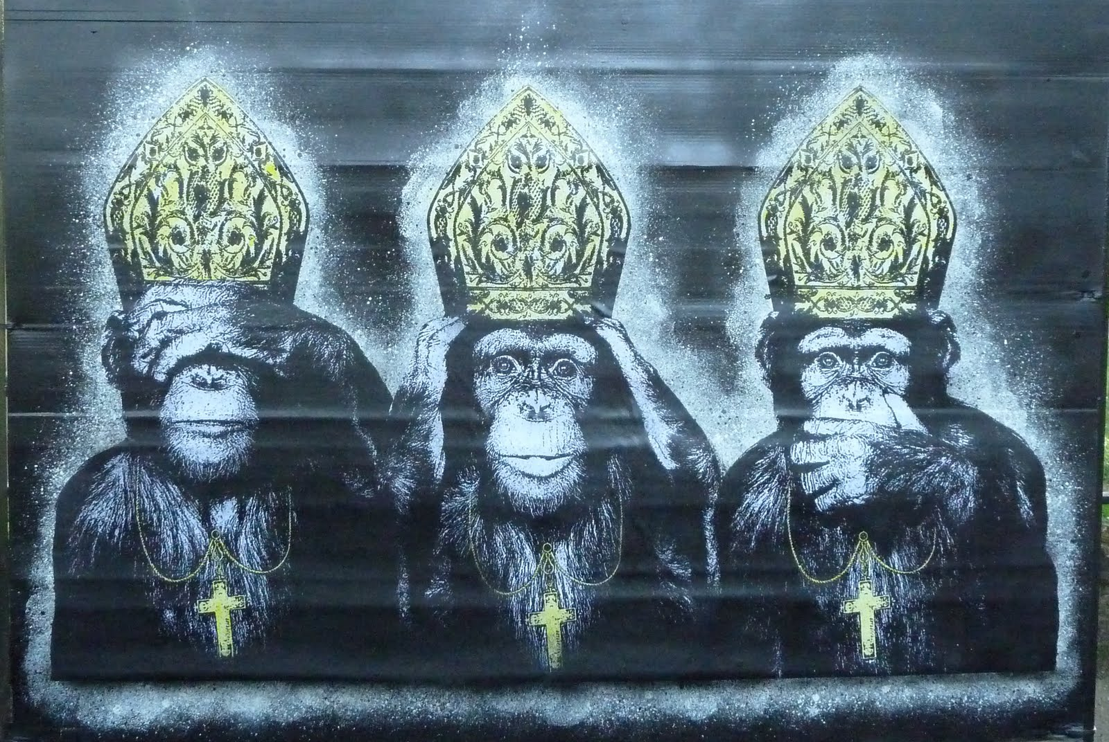

Slide 7
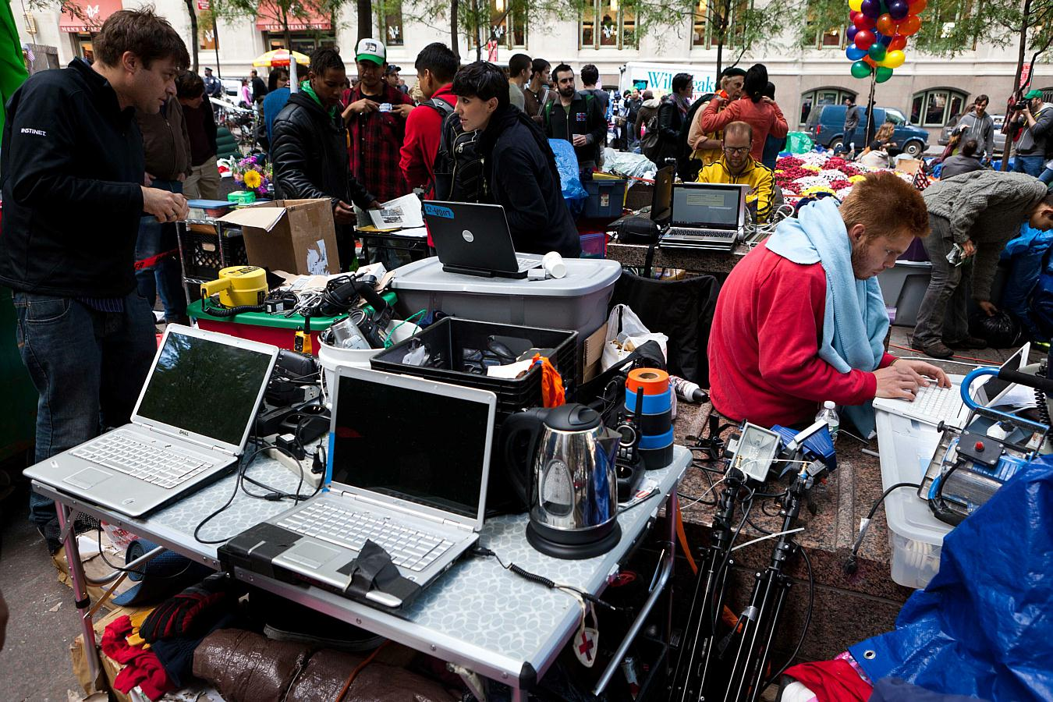

Slide 8
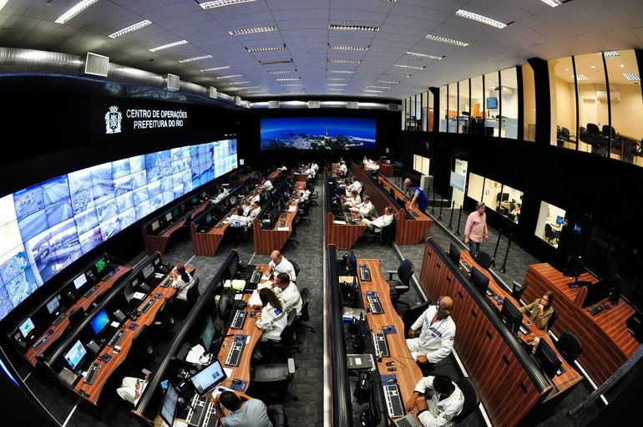

Slide 9
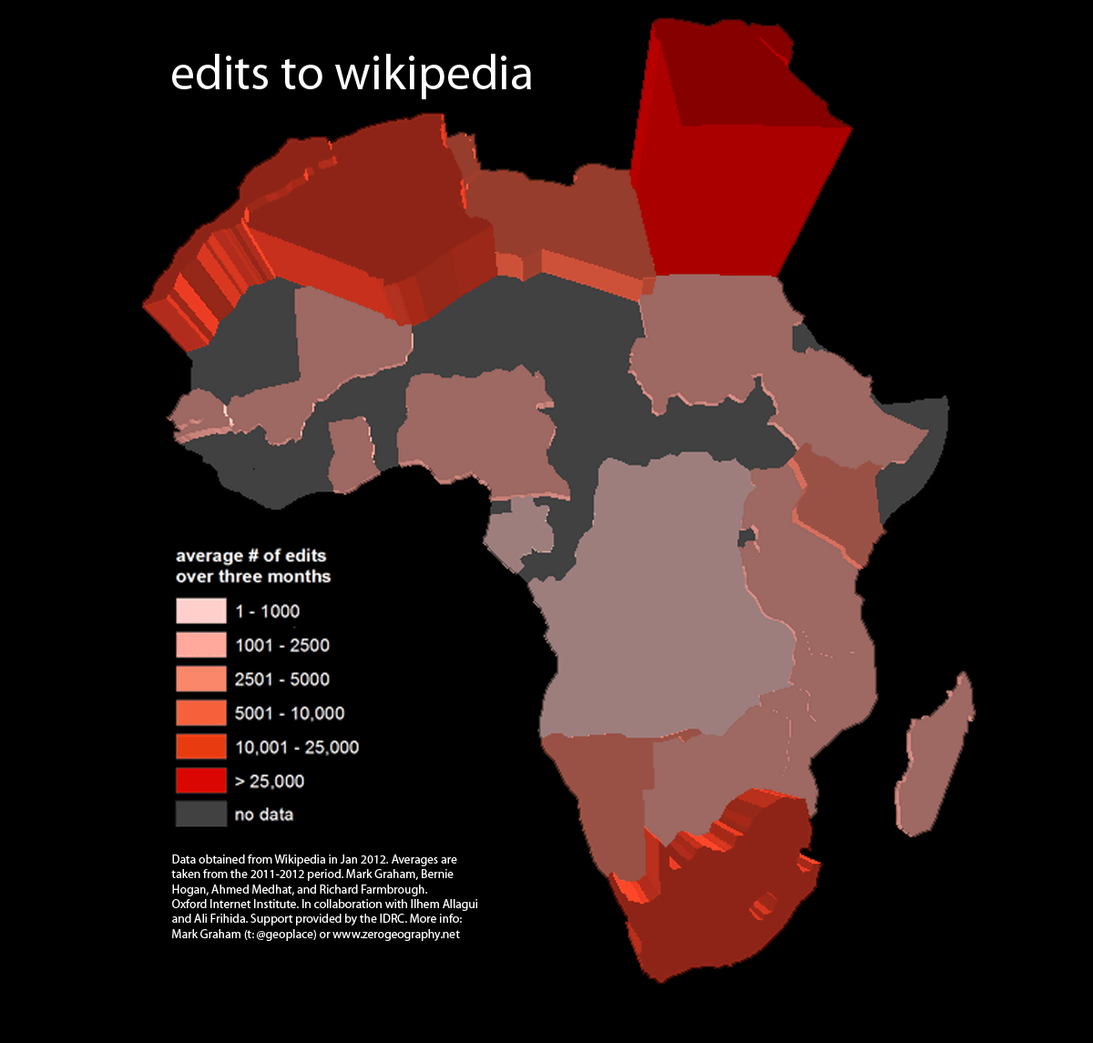

Slide 10
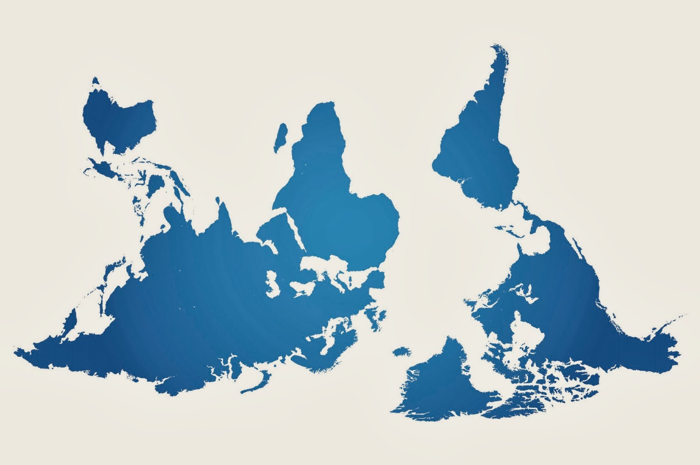

Slide 11
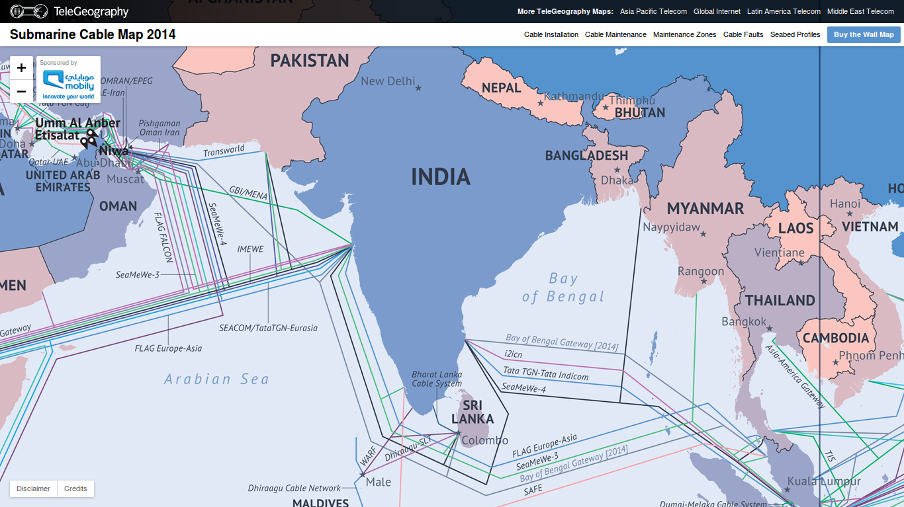

Slide 12
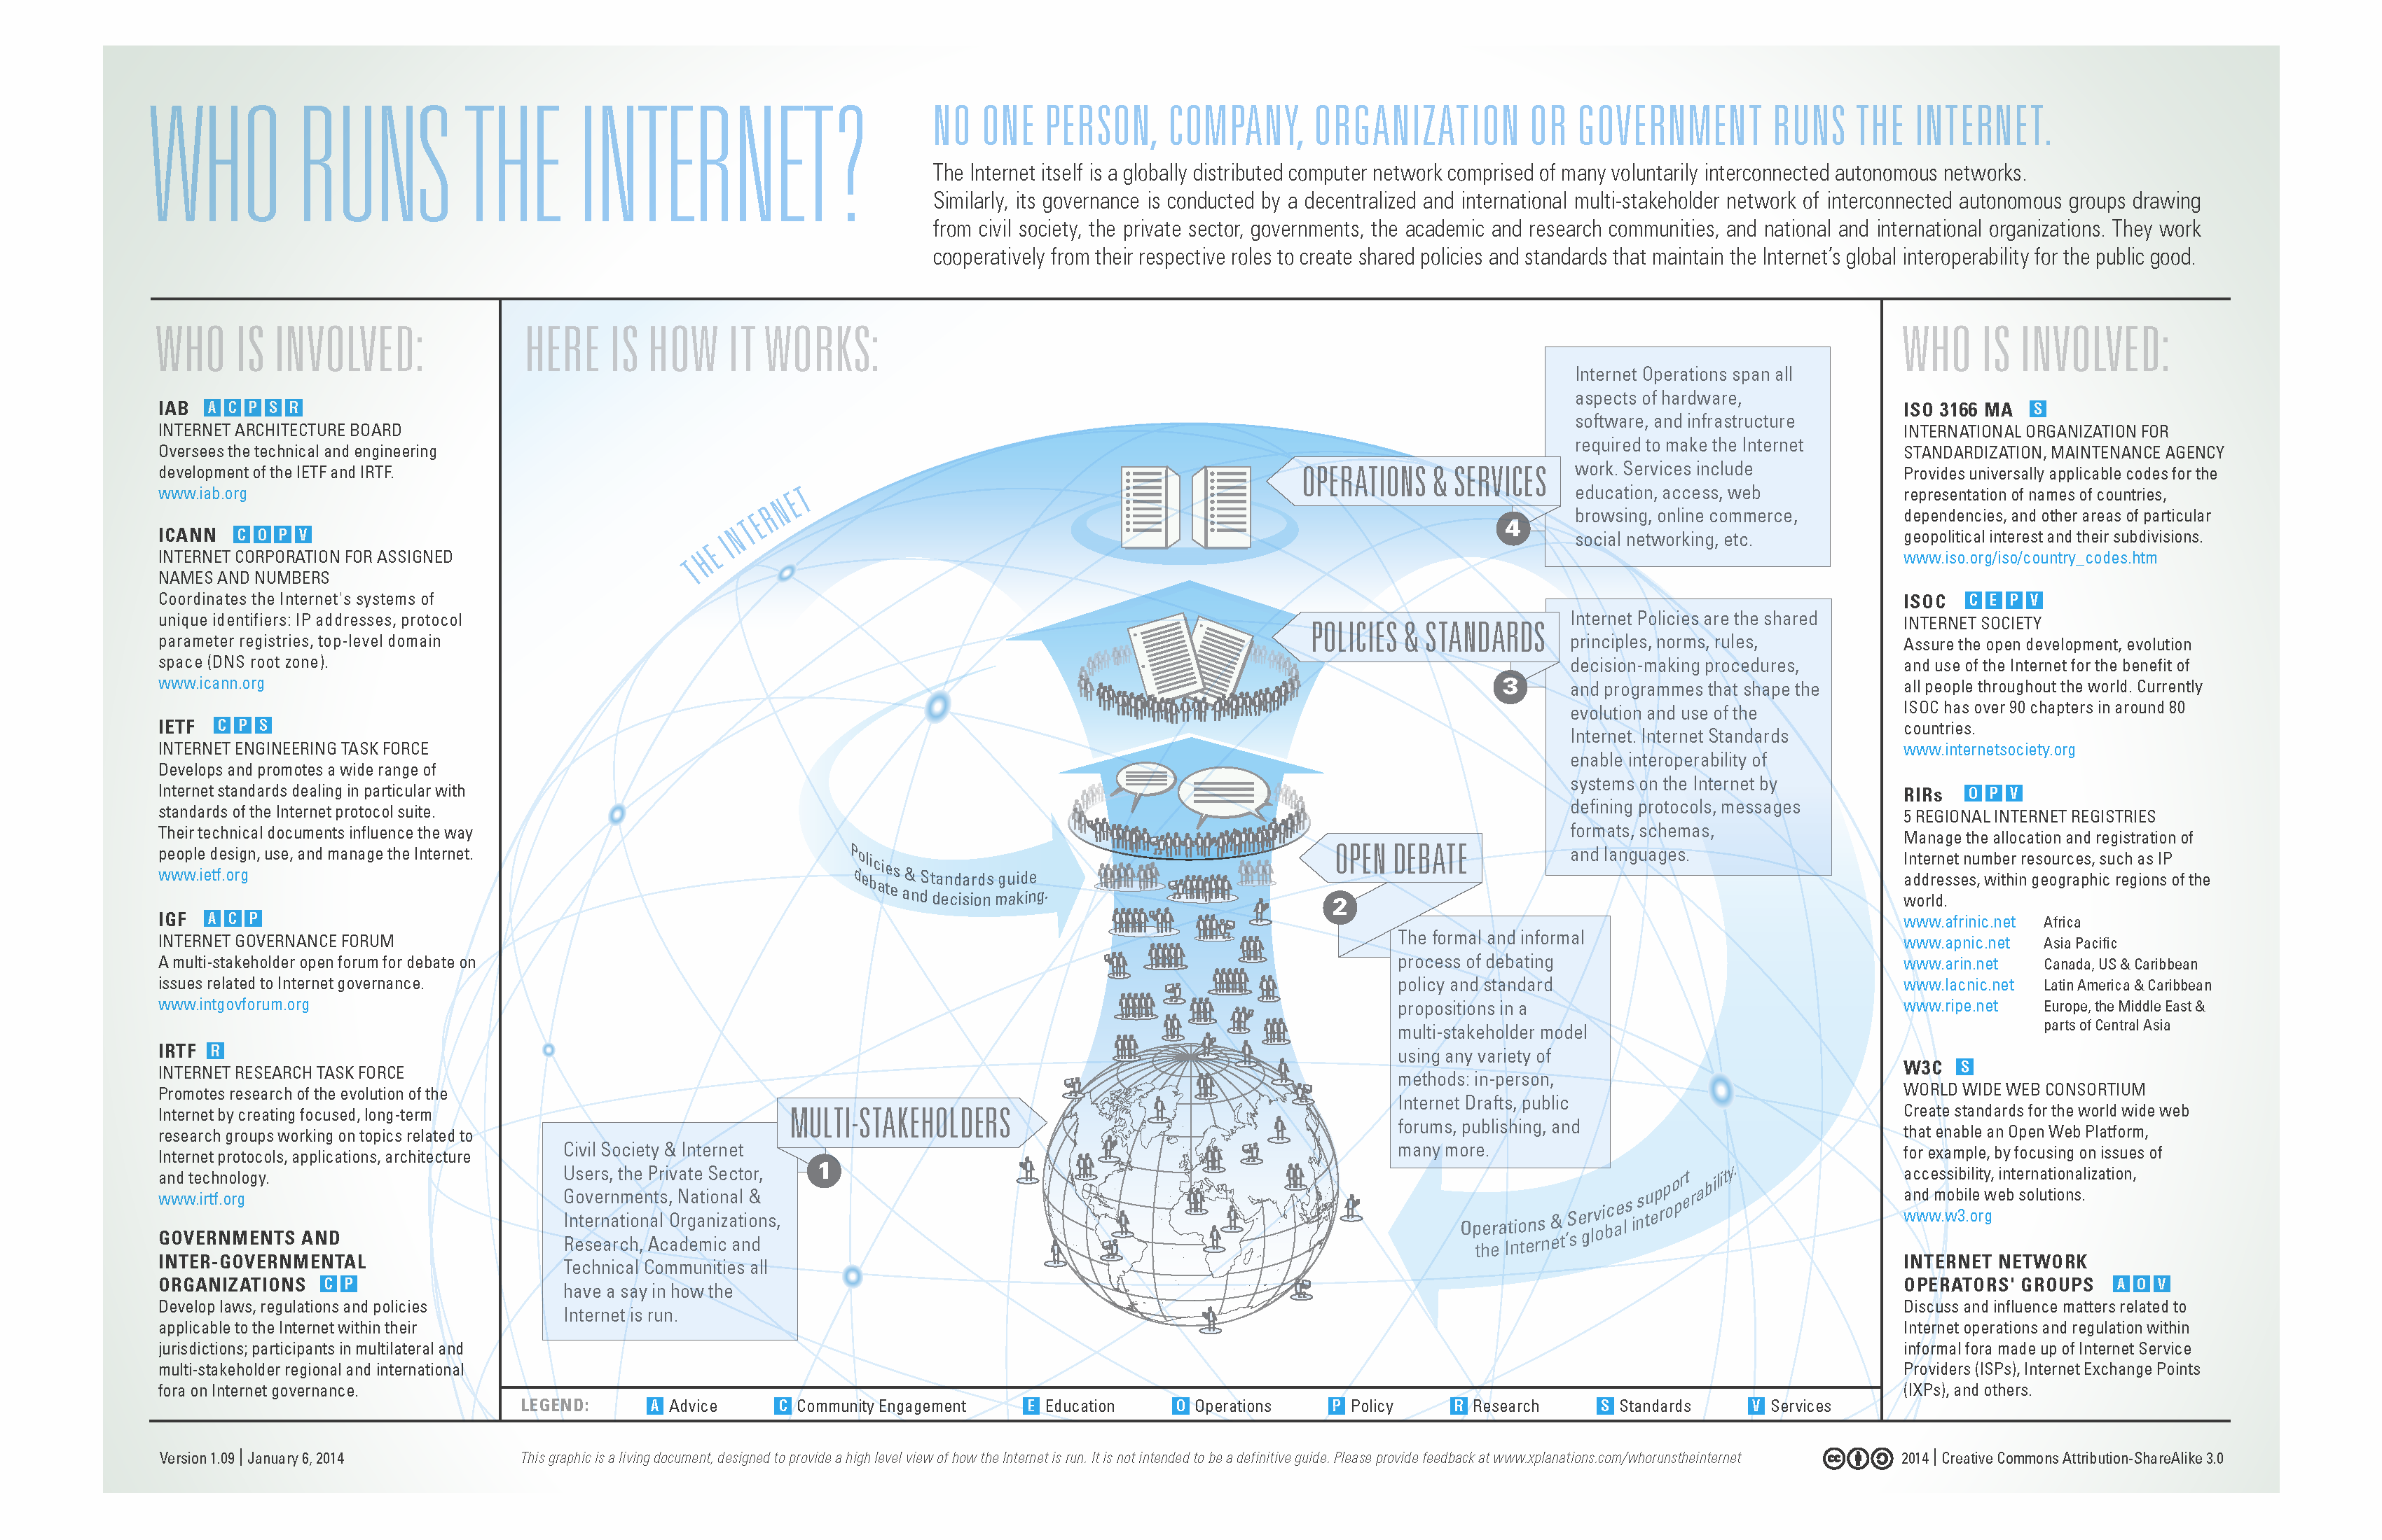

Slide 13


Slide 14
Grammatisation

Slide 15
Exteriorisation
of Memory

Slide 16
Big Data!

Slide 17


Slide 18


Slide 19
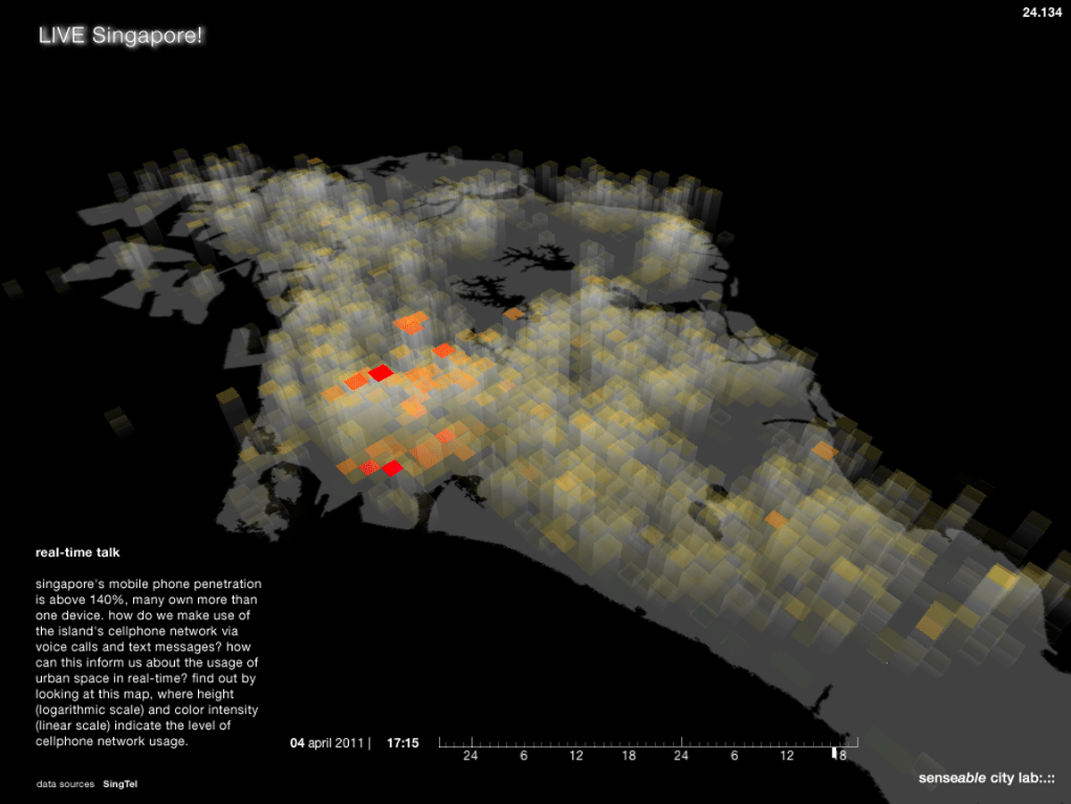

Slide 20
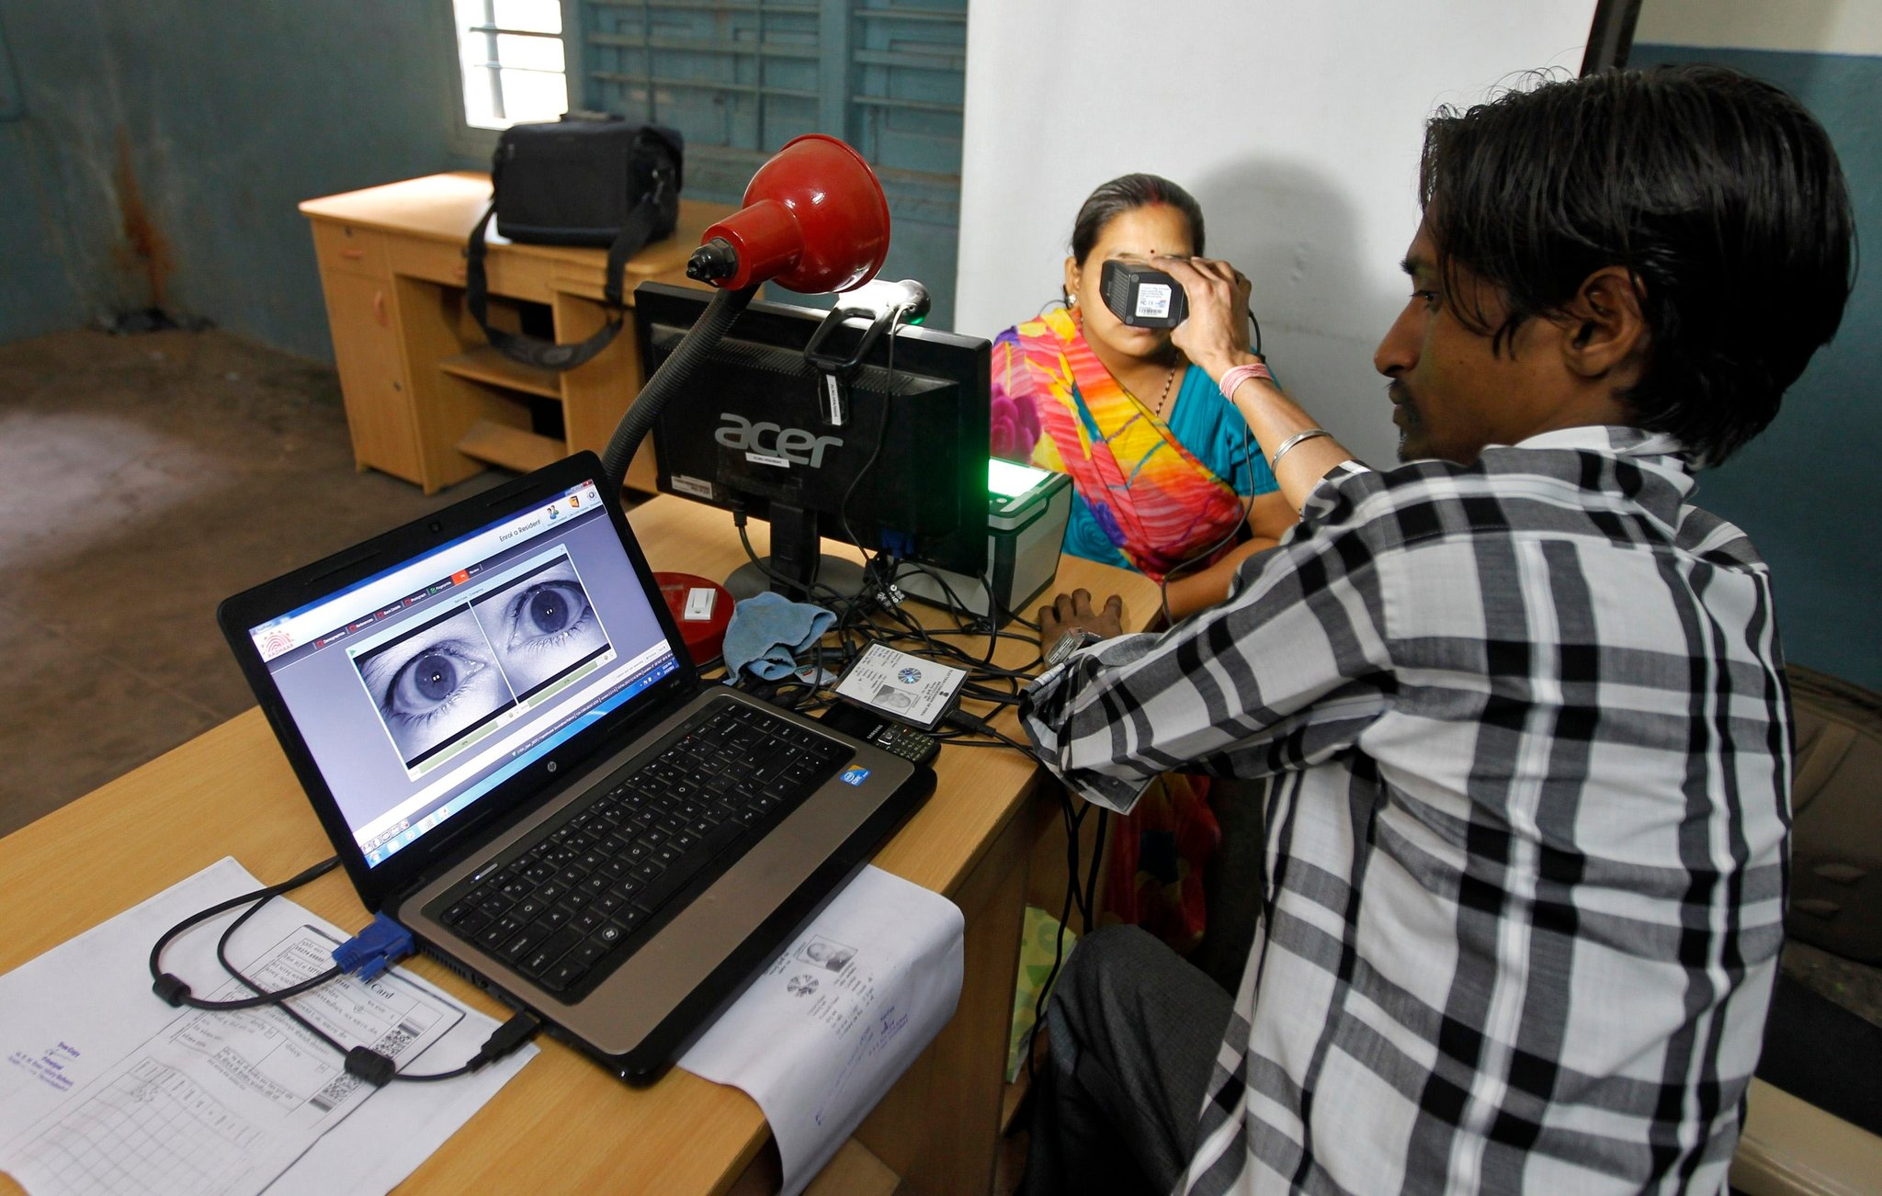

Slide 21
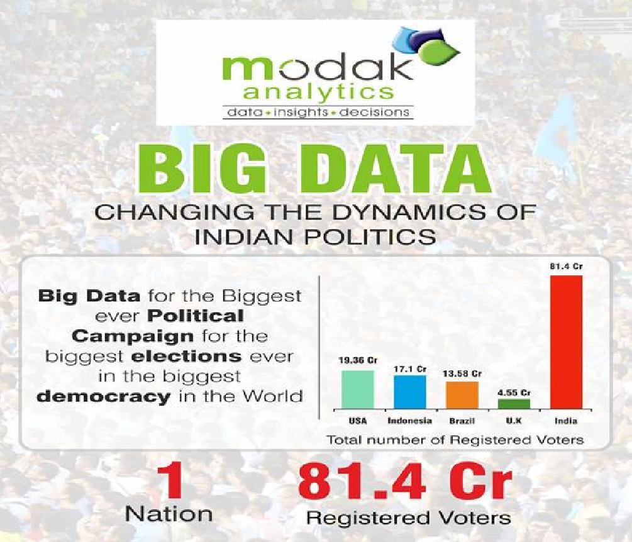

Slide 22
Thank You
Sumandro Chattapadhyay
Research Associate, The Sarai Programme
Centre for the Study of Developing Societies, Delhi, India
<sarai.net>
<ajantriks.net>

Slide 23
Image Credits
01 <http://www.myfreewallpapers.net/starwars/wallpapers/the-empire-needs-you.jpg>
02 <http://michaelmay.us/12blog/05/0525-ceremony.jpg>
03 <http://img2.wikia.nocookie.net/__cb20120726002949/starwars/images/a/ab/
Yavin_celebration_at_Shepperton.jpg>
04 <https://www.flickr.com/photos/stephenccwu/6248668869/>
05 <http://3.bp.blogspot.com/_qaaoo8tBRTI/TJUYb2bs0cI/AAAAAAAAAxo/
cVg0xRkkm34/s1600/P1000842-1.JPG>
06 <https://blogsensebybarb.files.wordpress.com/2011/07/pict15.jpg>
07 <http://www.dinamicarpneus.com.br/wp-content/uploads/2013/09/centro-de-operacoes.jpg>
08 <http://www.oii.ox.ac.uk/vis/images/4f6c647c/wikipedia_edits_africa_m.png>
09 <http://www.piksel.com/wp-content/uploads/2013/10/UpsideDownMap-640x426.jpg>
10 <http://submarine-cable-map-2014.telegeography.com/>
11 <https://www.icann.org/news/multimedia/78>
12 <http://static.rubbingalcoholic.com/images/blog/troll_the_nsa.png>
16 <http://www.bigbrotherwatch.org.uk/wp-content/uploads/2012/02/banksy-1.jpg>
17 <http://www.wired.com/wp-content/uploads/blogs/wiredenterprise/
wp-content/uploads/2012/10/ff_googleinfrastructure2_large.jpg>
18 <http://senseable.mit.edu/livesingapore/images/real_time_talk_lg.png>
19 <http://graphics8.nytimes.com/images/2013/05/24/world/asia/24-Aadhaar-IndiaInk/
24-Aadhaar-IndiaInk-superJumbo.jpg>
20 <http://www.modakanalytics.com/big_data_big_elections.pdf>

