Slide 1
Cravr: Help to resolve your daily dilemma.

Slide 2
Problem: The User Challenge
Solution: Cravr
> Seamlessly understands your unique preferences and past orders
> Effortlessly simplifies your choices through a few smart questions.
> Rapidly satisfies your craving and hunger
> Want to Order something, but totally undecided.
> Struggle with endless dilemma with endless choices.

Slide 3
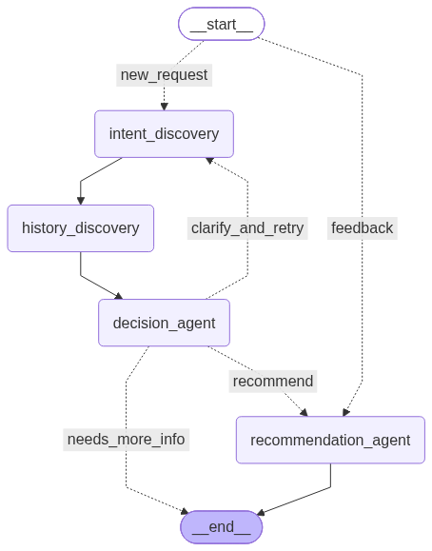
Current Architecture (Demo only):

Slide 4
Proposed Architecture:
Ready for the recommendation.
IntentAgent
Recommendation Agent
Present Suggestions
ContextAgent
Update user feedback
user-query
DecisionAgent
User Response
Need more info ?
negative
positive
Preference Agent
Update info
Clarification Agent
HistoryAgent
Feedback
Execution Route
FoodOrder Agent
Restaurant Agent
End

