Slide 1
DPE Logements Existants
A
Energy Performance in Paris Housing
B
Research Question
C
How are energy labels (A–G) distributed, and how do they relate to construction period and dwelling surface?
D
E
F
G
Group 6 · MSA-DATI07-03 · November 2026

Slide 2
What is DPE?
Diagnostic de Performance Énergétique: French energy label for homes (A = best, G = worst)
Rates energy consumption and greenhouse gas emissions per m²
Required for all residential sales and rentals in France since 2006
F and G labels = "passoires thermiques" (thermal sieves): priority for renovation under French law
10,000
Records collected
216
Raw columns in API
17
Columns kept for analysis
Source: ADEME open-data portal · dataset dpe03existant · Licence Ouverte / Etalab 2.0

Slide 3
Data Collection Pipeline
1
2
3
4
ADEME REST API
Polite Session
10,000 Rows
17 Columns
dataset: dpe03existant
requests-cache: no duplicate calls
1,000 records per page
Selected from 216 raw columns
filter: code_departement_ban:"75"
Retry on 429 / 5xx + backoff
10 pages fetched
Based on business question
862,377 total matching records
0.5s pause between requests
Saved as raw.parquet (216 cols)
Pandera schema: 0 violations

Slide 4
Schema-as-Contract
Pandera DataFrameSchema
strict=True · 17 columns · lazy=True validation
What it guarantees:
• Column names and dtypes are exactly as expected
• No extra columns slip through (strict mode)
• Domain constraints validated before any analysis
• lazy=True collects ALL failures before raising
etiquette_dpe / etiquette_ges — restricted to labels A–G only
✓
✓
surface_habitable_logement — > 0 m² when present (nullable)
✓
conso & emission_ges — ≥ 0 per m² when present (nullable)
✓
nombre_niveau_logement — ≥ 1 floor when present (nullable)
0 Violations on Raw Data

Slide 5
Data Quality: Duplicates
0
1,856
Exact Duplicates
Near-Duplicates
Identical rows — none found
Same 16 descriptive columns · Different numero_dpe
Decision: Near-duplicates retained and flagged. Why? They may represent distinct apartments with identical characteristics, or multiple DPE assessments of the same dwelling. Dropping them would silently remove valid records.

Slide 6
Data Quality: Impossible Values
0
surface_habitable_logement
✓
Rule: > 0 m² · Min observed: 3.4 m²
conso_5_usages_par_m2_ep
✓
Rule: ≥ 0 kWh/m² · Min observed: 51 kWh/m²
emission_ges_5_usages_par_m2
✓
violations
Rule: ≥ 0 kgCO₂/m² · Min observed: 0 kgCO₂/m²
All rows kept
nombre_niveau_logement
✓
Rule: ≥ 1 floor · Min observed: 1 floor

Slide 7
Data Quality: Missingness
Column | % Missing | Mechanism | Decision
nombre_niveau_logement | 3.01% | MAR | Keep NaN — 301/302 missing in immeuble records
surface_habitable_logement | 3.00% | MAR | Keep NaN — concentrated in collective-building records
type_installation_chauffage | 0.46% | MAR | Keep NaN — all 46 missing in maison records
conso & emission_ges (each) | 0.01% | Unknown | Keep NaN — single isolated row
Why no imputation? Missingness is structural and related to building type. For collective buildings and houses, the missing fields may be non-applicable or recorded differently. Replacing them with averages would invent information and bias the analysis. Original NaN values are preserved.

Slide 8
Data Quality: Outliers
Method: log(1 + surface) IQR
Why log transform? Surface is right-skewed — direct IQR would miss extreme large values.
Parameters: k = 1.5
Lower fence: ∼ 8 m²
Upper fence: ∼ 195 m²
Decision: flag and retain all 121
No clear data-entry errors identified. Values are contextually plausible (large apartments, immeubles). surface_outlier_flag column added for downstream triage.
121 Flagged Rows
106
apartments above fence (up to 422 m²)
8
houses above fence (196–324 m²)
2
immeubles above fence (1,151–1,876 m²)
5
apartments below fence (3.4–4.8 m²)

Slide 9
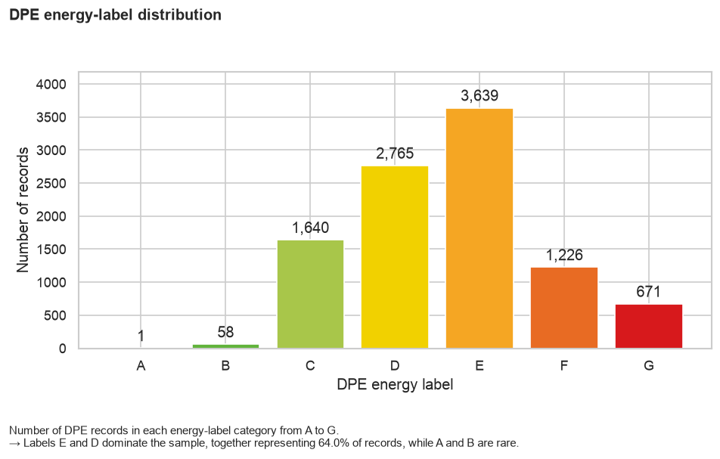
Finding 1 — Energy Label Distribution
D + E labels dominate
∼64% of all 10,000 records fall in D or E
A and B are very rare
Only a small fraction of Parisian homes meet high efficiency standards
Modelling implication
Class imbalance must be addressed — accuracy alone will be misleading

Slide 10
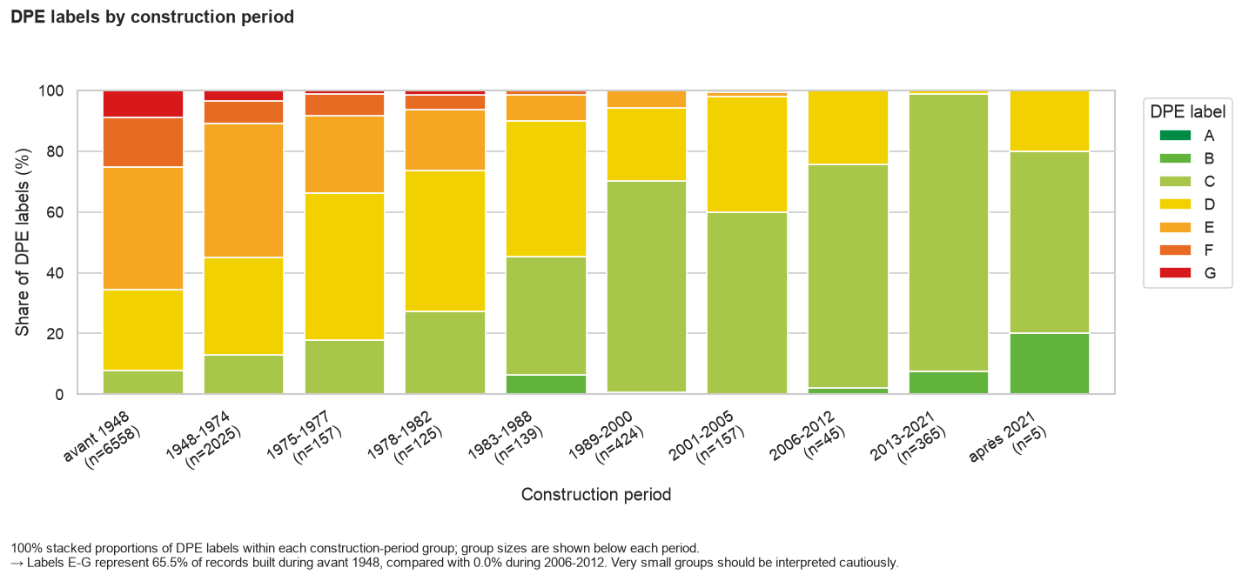
Finding 2 — Older Buildings, Worse Labels
Pre-1948 buildings
65.5% carry E, F, or G labels
2006–2012 buildings
0% carry E, F, or G labels
Construction period is the strongest observable predictor of DPE label quality
Note: observational only — reflects renovation history, heating systems, insulation, and surface simultaneously

Slide 11
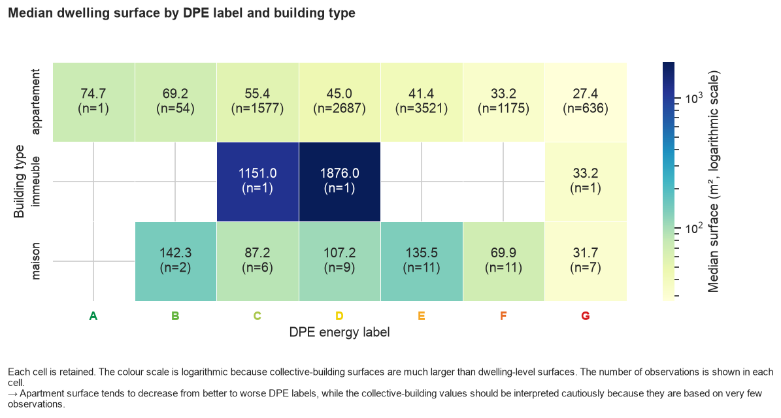
Finding 3 — Surface and Label Quality
Among apartments
Label B: median ∼69 m²
Label G: median ∼27 m²
Caveat
Immeuble cells have very few non-missing values — medians are unreliable
Relationship is observational
Surface and building type may each be useful explanatory variables for modelling

Slide 12
What Cannot Be Trusted
!
surface_habitable_logement medians for immeuble are based on very few non-missing values — unreliable
!
après 2021 construction period: only 5 records — do not generalise these proportions
!
type_installation_chauffage for maisons: 100% missing — cannot be analysed at all
!
1,856 near-duplicates mean results are record-level, not unique-dwelling-level
!
Capped 10,000-row Paris snapshot only — not representative of all French housing

Slide 13
Five Testable Hypotheses
H | Variable | Expected Direction | Test
H1 | periode_construction | Older buildings → more E–G labels | Chi-square
H2 | surface_habitable_logement | Smaller apartments → worse labels | Spearman / Kruskal-Wallis
H3 | type_energie_ principale_chauffage | Fossil fuels (gas/fioul) → more E–G | Chi-square / Logistic
H4 | etiquette_ges | Worse GES label → worse DPE label | Chi-square + Cramér's V
H5 | type_batiment | Label distributions differ by building type | Chi-square / Multinomial

