Slide 1
MALARIA DETECTION USING DEEP LEARNING
AJANYA .R
TVE17MCA004
COLLEGE OF ENGINEERING TRIVANDRUM

Slide 2
INTRODUCTION
Malaria is a serious and sometimes fatal disease caused by a parasite that commonly infects a certain type of mosquito which feeds on humans.
This disease arises due to damaging of red blood cells in blood and identifying of which is a difficult proposition in a clinical set-up.
Many automated methods have been found to predict or diagnosing the malaria disease.
Present some of our recent progresses on highly accurate classification of malaria-infected cells using deep convolutional neural networks.

Slide 3
Manual detection weakness is highly inﬂuenced by human subjectivity that makes it inconsistent in certain conditions.
Therefore, a computer assisted technology is needed to help classifying the results of detection of malaria and to deduce the results more accurately with a relatively faster time.
The aim of this project is to build a system that can detect malaria using Deep Learning training using the CNN classifier.

Slide 4
EXISTING SYSYTEM
Conventional diagnostic tool for malaria is the examination of stained blood cell of patient in Microscope.
The blood to be tested is placed in a slide and is observed under a microscope to count the number of infected RBC.
An expert technician is involved in the examination of the slide with intense visual and mental concentration.
This is tiresome and time consuming process.
Inconsistent

Slide 5
PROPOSED SYSTEM
It focused on automated method used to detecting malaria using deep learning .
This system use CNN classifier for detecting malaria accurately.
It needed to help classifying the results of detection of malaria .
And to deduce the results more accurately with a relatively faster time.
Consistent.

Slide 6
DEEP LEARNING
Deep Learning relates to the field of ML-based algorithms, focusing on how neurons in the brain work and applying a similar analogy to help machines learn by the use of Artificial Neural Networks.
The simplest unit of Neural Network is Perceptron , it takes inputs, runs through the process, and finally provides a response.
A deep neural network (DNN) is an artificial neural network (ANN) with multiple layers between the input and output layers.
Convolutional Neural Network (CNN) is one of deep learning’s methods that has the most signiﬁcant result in image recognition because it tries to imitate the same way of recognizing images in visual cortex as humans so that they are able to process the same information.

Slide 7
CONVOLUTIONAL NEURAL NETWORK
CNN will automatically extract features of images and it will classify images into categories.
As CNNs currently have been shown an impressive performance on recognizing patterns in digital images, it is well-suited to detecting malaria from cell images.
This project aims at optimizing the array of layers in CNN architecture to better learn a classiﬁer to extract high level features of malaria from cell images.
It will determine how high of accuracy and recall that the model can achieve on malaria classiﬁcation with CNNs.

Slide 8
STEPS INVOLVED IN BUILDING CNN:
Convolution
Max pooling
Flattening
Dense
Dropout
Activation

Slide 9
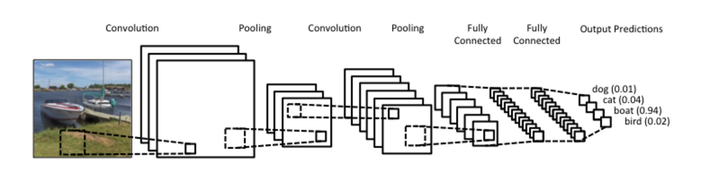
CNN ARCHITECTURE

Slide 10
STEP 1 -CONVOLUTION
A function derived from two given functions by integration which expresses how the shape of one is modified by the other. There are 3 main elements of the convolution operation:
Input image
The actual image in pixels (basically our input data)
(2) Feature detector
These can even be called filters.
They basically detect certain features in the input image.
The feature detector then moves alone the input image to cover all of its areas and the distances it moves can be referred to as “strides”.
(3)Map of features

Slide 11
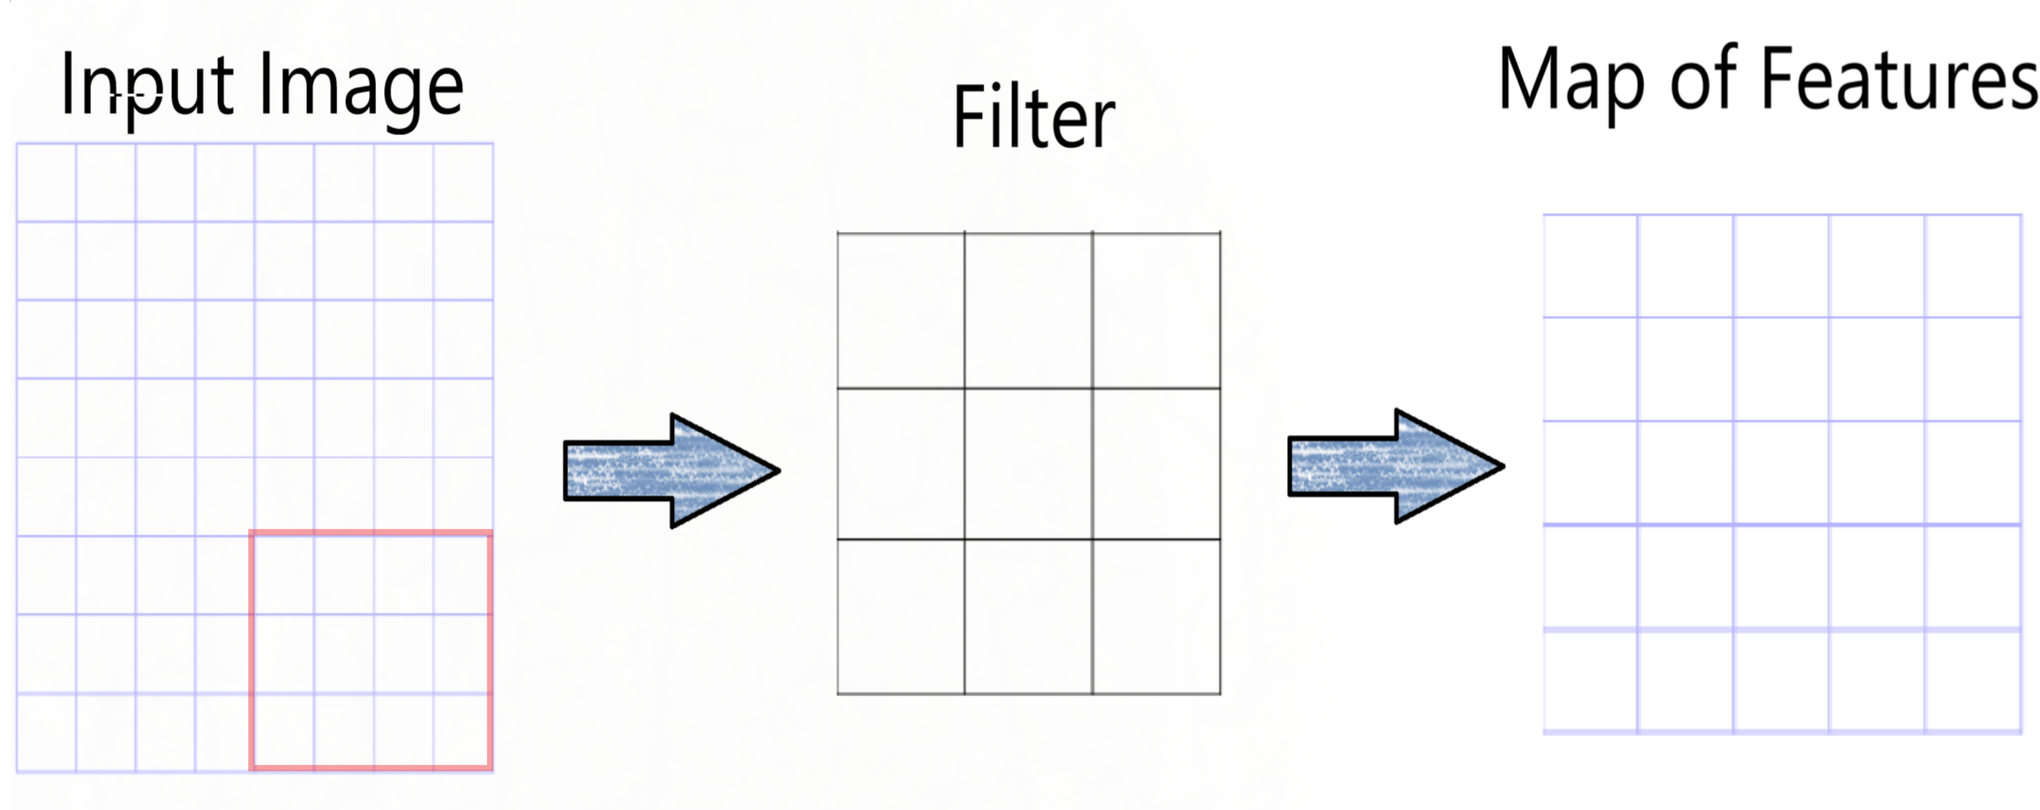

Slide 12
STEP 2 – MAX POOLING
The purpose of max-pooling is to enable the CNN to detect an image when presented with basic modification (flipped, mirrored, upside-down).
In this step, we determine a pooled feature map.
This process involves placing a smaller matrix on top of the feature map and insert the maximum value within the matrix into our pooled feature map.
Then we keep moving towards the right until we fill all the values, as it was done in the convolution step.

Slide 13
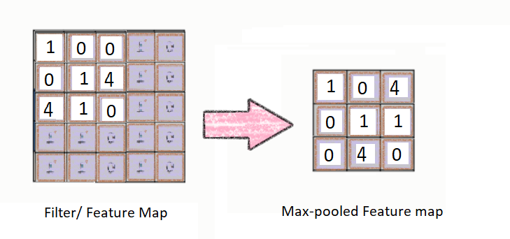

Slide 14
STEP 3 - FLATTENING
Flatten our pooled feature map into the shape of a column.
So instead of looking like a box squared matrix, our pooled feature map now looks like a vertical column.
After flattening is that we end up with a long vector of input data that we then pass through the artificial neural network to have it processed further.

Slide 15
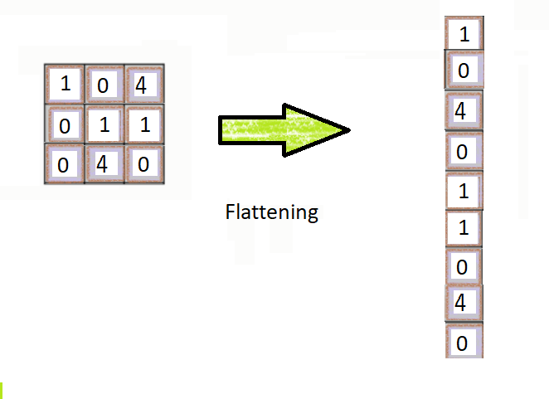

Slide 16
STEP 4 – DENSE LAYER
A dense layer represents a matrix vector multiplication.
The values in the matrix are the trainable parameters which get updated during backpropagation.
A dense layer thus is used to change the dimensions of your vector.
Mathematically speaking, it applies a rotation, scaling, translation transform to your vector.

Slide 17
STEP 5-DROPOUT LAYER
A dropout layer is used for regularization where you randomly set some of the dimensions of your input vector to be zero with probability keep_prob.
A dropout layer does not have any trainable parameters i.e. nothing gets updated during backward pass of backpropagation.

Slide 18
STEP 6-ACTIVATION FUNCTION
Neural network activation functions are a crucial component of deep learning.
Activation functions determine the output of a deep learning model, its accuracy, and also the computational efficiency of training a model—which can make or break a large scale neural network.
Activation functions also have a major effect on the neural network’s ability to converge and the convergence speed, or in some cases, activation functions might prevent neural networks from converging in the first place.

Slide 19
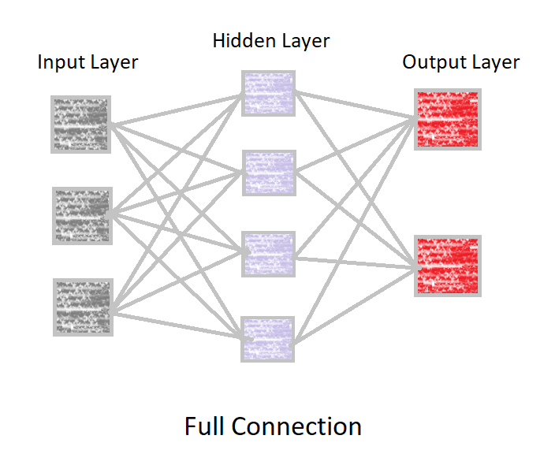

Slide 20
LITERATURE SURVEY
Sl no. | Title of Paper | Author | Method Used
1 | Detection of Malaria Parasites Using Digital Image Processing | Ahmedelmubarak Bashir, Zeinab A.Mustafa, Islah Abdelhameid | ANN
2 | Image Analysis for Malaria Parasite Detection from Microscopic Images of Thick Blood Smear | Ishan R. Dave | SVM
3 | Malaria Detection Using Image Processing and Machine Learning | Suman Kunwar, Manchana Shrestha, Rojesh Man Shikhrakar | Machine learning Algorithm
4 | Computer-Automated Malaria Diagnosis and Quantitation Using Convolutional Neural Networks | Courosh Mehanian, Mayoore Jaiswal, Charles Delahunt, Clay Thompson, Matt Horning | CNN

Slide 21
CONCLUSION
The CNN sequentional Model created above was tested to recognize from an image whether a malaria is infected or uninfected.
The experiment was conducted on 23500 images of test data using a diﬀerent number of training data (images) and epochs in the training process.
The experiment results prove that the amount of training data and epochs used for training aﬀects the level of accuracy in detecting malaria. The more data that is trained, the better the test results will be produced .

Slide 22
CONCLUSION CONTD...
In this project, I proposed a completely automated, custom-built, portable, cost-effective prototype system with necessary instrumentation as well as image analysis/classiﬁcation algorithms that can be used for quantitative malaria detection.
The results produced in this project suggest using CNN over traditional classiﬁers like SVM for considerable improvement in speciﬁcity and sensitivity and also suggest operating on focus stack of images for malaria diagnosis.

Slide 23
THANK YOU

