Slide 1
Highlights of a Security Scorecard Project
Andrew Sudbury
Director, Security Metrics Design & Best Practices
asudbury@clearpointmetrics.com

Slide 2
Lessons learned
This is not academic – practical use of security metrics to drive management decisions
Not measuring the universe – specific measures around decisions and metrics as indicators of process control as much as state – i.e. are you in control of your controls?
Single-source data is available, but “business value” accrues by combining data from multiple sources – keys are required (i.e. Business unit ≡ IP subnet)
The resolution of the available data is tightly coupled with the business process in place – e.g. how long to patch or remediate a vulnerability

Slide 3
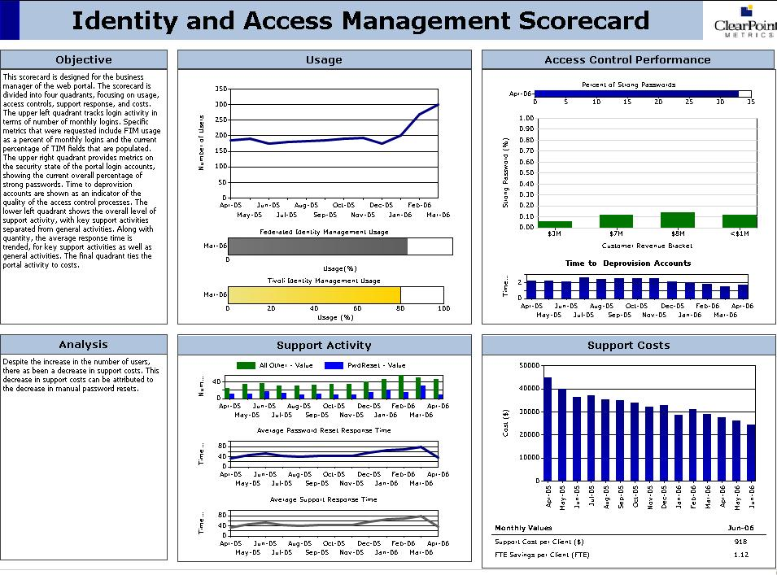
<$1M
$3M
$5M
$10M+

Slide 4
The two sections on the far left that hold textual narrative provide both a generic description of the information in the scorecard as well as a specific analysis of the data included in this edition of the scorecard. Note that scorecards, in our definition, are regularly published reports. So, for example, a monthly scorecard would have regular editions that are disturbed to entitled consumers precisely once per month—regularly. The analysis of this edition’s data appears in the lower left block.
The top middle block is entitled “Usage.” The key performance metrics are provided—one with history and two with just the current value. The top graph reflects the count of user accounts that are going through the single sign-on system to access applications. This is a key performance indicator that reflects the adoption rate of the SSO system. It looks like adoption has been accelerating for the past few months. The second two metrics shown in the green and yellow bars reflect first current adoption as a percentage of user accounts and second completeness of user account data in the directory. As we can see, while the raw counts of users leveraging SSO has dramatically risen, we still have a ways to go—over 20% of the user base is still not using SSO. The yellow bar reflects that user information (e.g. title, telephone number, address, etc) is, on average, 80% complete. This is good news for the Customer Resource Management group who will want to develop analytics around application usage and user demographics.
The top right block is designed to reflect Access Control Performance as measured by password strength and time to deprovision user accounts. The top bar indicates what percentage of user passwords are deemed to be “strong” by a password strength rating tool. The green bars break this number down by customer revenue bracket. The low revenue customers seem to have the least strong passwords but the higher revenue customers’ passwords are not all that much stronger. One question to consider is whether one should initiate a campaign to educate and/or enforce more stringent password policies. As you will see from the data reflected in the lower left block, this might have a negative effect upon support workload associated with customer password resets. This scorecard provides key insight into the tension between the expense of supporting password problems with customers and the enhanced security of strong passwords.
While the lower left block deals specifically with customer support activity (measured in number of incidents) related to deprovisioning, provisioning and resetting user accounts as measured in number of accounts, the lower right block maps this activity to dollars. It appears that the cost of support is decreasing as a result of increased SSO adoption. Additional metrics could easily be generated to see if the cost of the cost savings in support cover or exceed the cost of the SSO system.

Slide 5
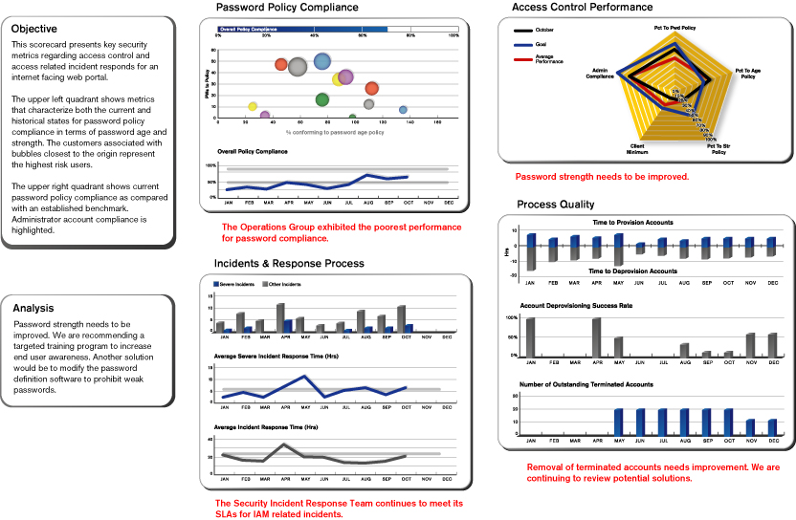
Consumer Web Portal Access Controls

Slide 6
Consumer Web Portal Access Controls: Commentary
This scorecard presents key security metrics around access controls and access related incidents and responses for an internet facing web portal, enabling a security manager to monitor the state and quality of access controls and processes, and their trends over time.
Current State of Passwords
The upper left quadrant shows metrics that characterize both the current and historical states for password policy compliance in terms of password age and strength. The customers associated with bubbles closest to the origin represent the highest risk users.
Objective
The objective of the scorecard describes the purpose and management goals for the organization’s business processes.
Multi-Dimensional Detail
The upper right quadrant shows current password policy compliance as compared with an established benchmark. Administrator account compliance is highlighted.
Quality of Access Control Processes
The lower right quadrant captures quality of service metrics for the current reporting period. These include time to provision and de-provision accounts as well as de-provisioning success rate and a raw count of outstanding terminated accounts.
Commentary and Annotation
Space is provided for annotation and comment by the managers involved in this process. The annotation space can be used to explain significant events, changes, or other items of interest.
Quality and SLA Levels of Support Response
The lower left quadrant characterizes incident frequency and response. Current incident counts as well as historical trends of response times are shown, highlighting these metrics for severe IAM incidents.

Slide 7
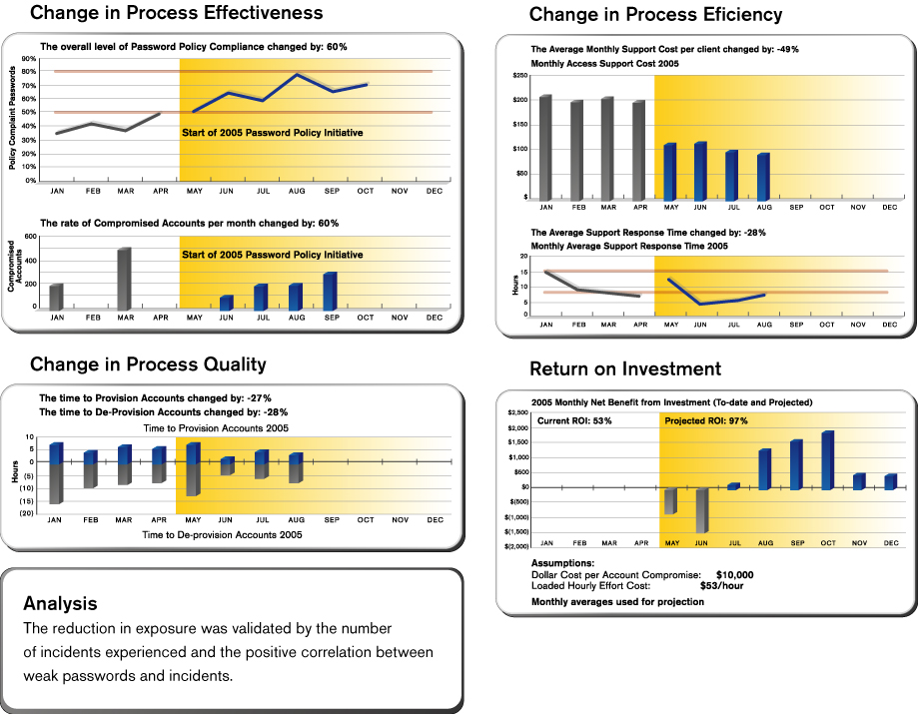
Single Sign-on Initiative Value
Efficiency

Slide 8
Single Sign-on Initiative: Commentary
The objective of this scorecard is to measure the value, in terms of effectiveness and efficiency, of a specific security initiative to implement a Single Sign-On system. Metrics and charts for effectiveness are on the left hand side. Effectiveness is measured in terms of password compliance, access related incidents, and the time required to provision and de-provision accounts. Efficiency metrics and charts are on the right hand side, and is measured in terms of support workload and effort and a simple ROI calculation.
Change in Process Effectiveness
This metric tracks the overall compliance with the password policy.
Correlating Policy adherence with account compromises creates the link between security management activity and security incidents.
Change in Process Efficiency
Much of the benefit of this investment comes from reduced support effort account. In order to complete the picture we need to know if the reduction in cost has come with a reduction in support responsiveness.
ROI
The current return on investment is based on the actual costs and benefits received. Projections are based on the monthly averages and a linear regression model. The simple ROI formula used is:
(Reduction in effort + (reduction in incidents x cost of incidents))
______________________
(system cost)
Change in Process Quality
The quality of the service delivered is characterized in terms of the effort required to provision and de-provision accounts, both before and after the implementation of the Single Sign-on System.
Commentary and Annotation
Space is provided for annotation and comment by the managers involved in this process. The annotation space can be used to explain significant events, changes, or other items of interest.

