Slide 1

Enterprise Security Dashboard
A Real Life review of
Information Security Metrics
Prepared by
Laura L. Glowick, CISSP
Federal Home Loan Bank of Boston

Slide 2
Agenda
The History
  How metrics were developed
    FHLB Security Program Components (see handout)
      Security Organization and Management
      Security Policies and Procedures
      Application and Data Security
      Infrastructure Security
      Physical Security
Current Metrics
  What I do to today
  Lessons learned
Looking Forward
  Fixing 3rd party/non-OS metrics
    What to report on/how to measure
Q&A/Comments/Suggestions

Slide 3
History
2006 Exam Finding
  Information Security required to provide the Board of Directors a Metrics report twice a year
  Where to start?
    Researched the internet for what was available (before Andrew’s book was published)
    Reviewed tools the Bank had that I could get data from
Notes:
About the Bank: 1 of 12 bank for banks 1 of 12 serving New England region: We are SEC registrants – not traded, our “members are our stock holders.
– we provide advances/liquidity to local regiion bannks - no one had heard of us (we weren’t in the news much) until the credit crisis – the FHLB system has been credited wth providing credit to loacal banks when there was no credit to be had. I’ll leave it at the good news – but needless to say some of the banks got caught in the MBS losses.
About Me – I’ve been an IT professional for more years than I can to mention, but have been directly involved in Security for the past 10 years. Direcor of Security at JH and now MGR of IS at FHLB since 2006.
WHAT – We couldn’t do this at JH and you think I can do it here!
What documents where ussed?
Andrew’s book was not published yet!

Slide 4
Security Element
Category
The Layout of the pages cross reference to spreadsheet handout
Metric: X.X
This area is use to provide the PURPOSE of the metric
  This area is used for the Metric Reporting section/Quarterly
Comment/Observation: This is the area used to “explain” risk level or observations of trends
Notes:
This is the template page for the report: All sections correspond to the hand out
Walk through the sections

Slide 5
Table of Contents
Executive Summary Page 3
Information Security Metric Reports
  Security Policy & Procedures
    Security Awareness Page 4
    Policy & Standards Page 5
  Audit Tracking
    FHFB Examination Findings Page 6
  Application & Data Security
    User Privileges Page 7
  Infrastructure Security
    Vulnerability Monitoring and Patching Page 8
    Malicious Code Protection Page 13
    Event and Activity Logging and Monitoring Page 14
    Summary of Assessments Completed Page 16

Slide 6
Executive Summary
Workstation Patch Statistics – Trends in patching statistics for this quarter indicate that the Bank was able to achieve compliance levels of roughly 96% within 10 days of the release of new patches. Compliance levels increase to approximately 99.5% when measured at month end. These numbers represent a dramatic improvement over last quarter’s results and demonstrate the effectiveness of new procedures implemented by IT in Q3.
Remediation of Annual Internal Vulnerability Assessment Issues – All of the vulnerabilities identified by Solutionary in June 2009 and reported in the Q2 Information Security Metrics Report have been closed.
Regulation and Law Compliance Status: i.e. Mass. Privacy Law
Other Trends observed by the Information Security Team:

Slide 7
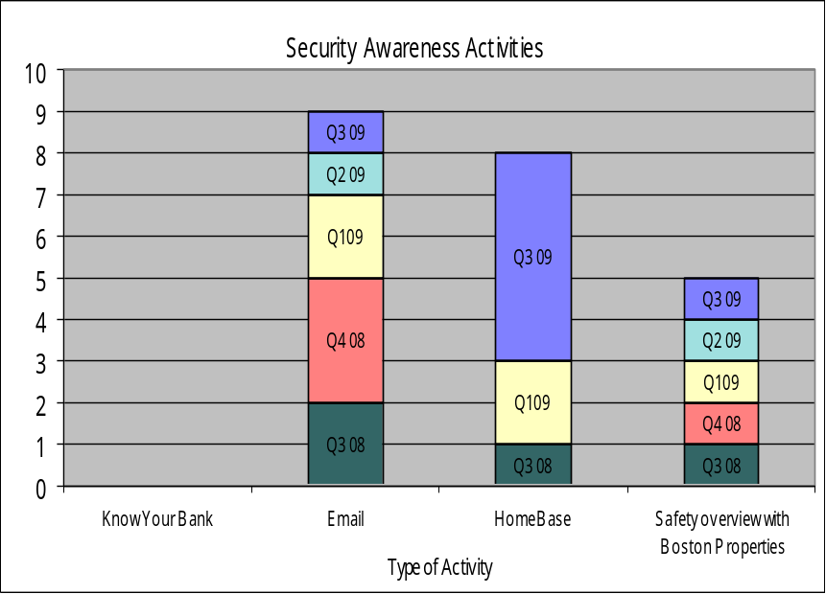
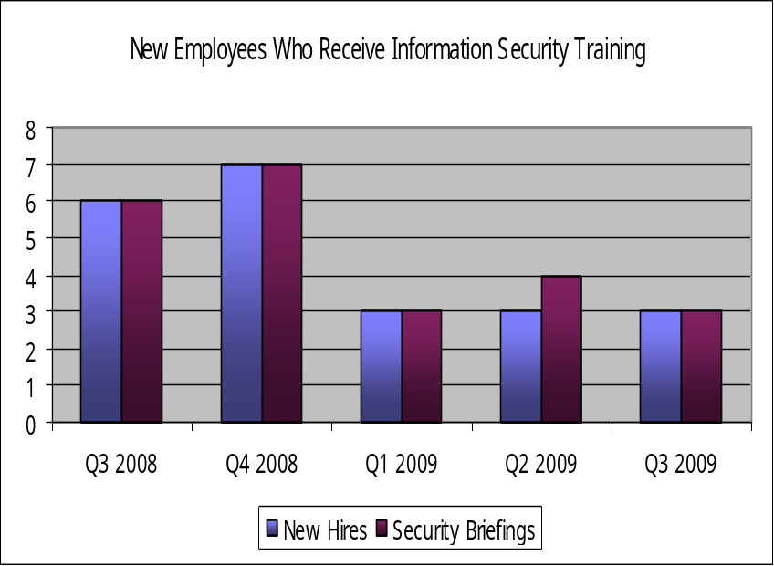
Security Policy & Procedures
Security Awareness
Metric: 2.0, 2.1 and 2.2
An active information security awareness program can greatly reduce many risks that cannot be addressed through security software and hardware devices. This metric focuses on the education of employees on different elements of information security.
Comment: During Q3, the Information Security department launched an “Information Security Articles and Tips” web page that is used to disseminate educational materials to all Bank employees on a broad range of Information Security related topics, ranging from how to develop a strong password to “Ten Types of Malware”.

Slide 8
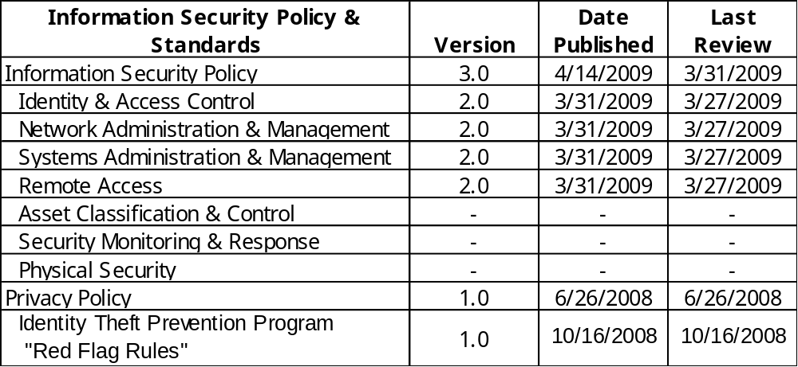
Security Policy & Procedures
Policy & Standards
Metric: 3.1
The purpose of this metric is to track the Information Security department’s management of information security policy and standards. In addition to tracking when the Information Security Control Standards are published, this metric will track periodic reviews and updates.
Comment: The annual review of the Bank’s Privacy Policy is behind schedule but will be completed in Q4.

Slide 9
Metric: 4.1
Audit Tracking
FHFB Examination Findings
This metric tracks the status of the Bank’s efforts to address Information Security related findings identified during Federal Housing Finance Agency (FHFA) examinations.
The following is information based on the 2009 examination results:
  No Information Security related findings were identified in 2009. There are no outstanding Information Security findings from previous examinations.

Slide 10
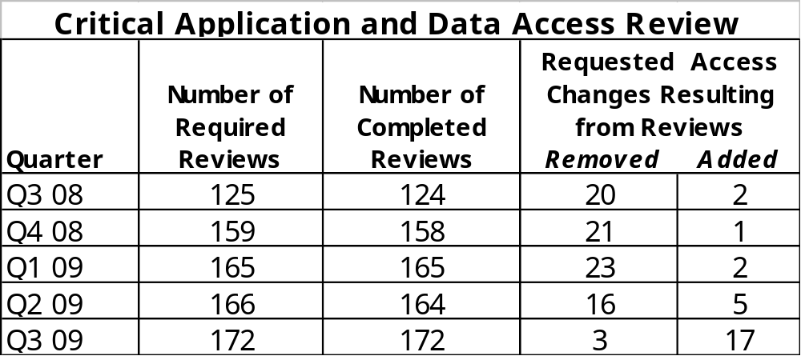
Application & Data Security
User Privileges
Metric: 5.1
This metric is used to monitor account access to critical applications and data thus focusing on the Bank’s efforts to mitigate the potential risk associated with inappropriate access.
Comment: All Q3 reviews were completed on time. Three new applications, one additional database, and two additional Prodiance groups were added to the monthly review in Q3.

Slide 11
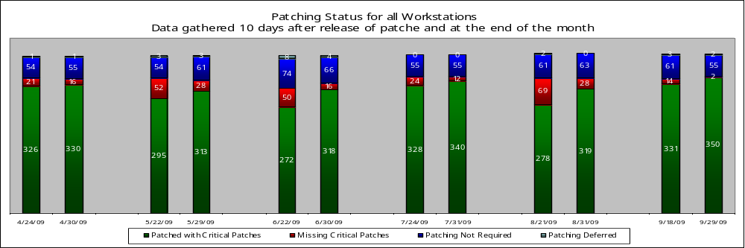
Infrastructure Security
Vulnerability Monitoring and Patching
Metric: 6.2
This metric tracks the Bank’s progress in improving monitoring and patching to ensure that systems are protected against known security vulnerabilities. This page provides information related to workstation compliance.
Bank PC and Laptop Inventory
Total Desktops: 303
Total Laptops: 106
Total Workstations: 409
Workstations were considered patched if they had received all of Microsoft’s applicable critical Security patches released on or before September 8, 2009.
Additional information regarding workstations classified as “Missing Critical Patches” in Q3 is provided on the next page, Vulnerability Aging for Workstations.
Comment: IT implemented procedural changes in Q3 that resulted in almost 100% compliance for workstation patching in September. The changes included requiring users with laptops at home to bring their laptops into the Bank for servicing on a monthly basis. This has addressed a historical problem area in the patching process by improving the desktop support team’s ability to ensure that all required laptop patches have been applied on these remote machines.

Slide 12
Infrastructure Security
Vulnerability Monitoring and Patching
Metric: 6.2
This metric tracks the Bank’s progress in improving monitoring and patching to ensure that systems are protected against known security vulnerabilities. This page provides additional analysis about the cause of unpatched workstations and the risk posed to the Bank.
Vulnerability Aging for Workstations
As of 9/30/09 | Older than 3 Months | Three Months Old | Two Months Old | One Month Old
Number of affected workstations | 1 | 0 | 0 | 1
As of September 30, 2009, there were 2 workstations missing one or more patches without an approved variance.
Older than 3 Months
  1 laptop was missing patches related to the SQL development tool that was originally released in January and February. This laptop was still in the pc inventory at the end of the month but was not on the network. The laptop was replaced with a newly built machine (this was the only effective method to apply these patches); however, the user kept the original machine for a short time to ensure all applications on the new laptop were working.
One Month Old
  1 workstation was missing a patch that was one month old. This patch needed to be installed manually and IT needed to coordinate with the business to schedule a time to perform this work because the workstation was a shared machine. This was not considered a high priority since the patch addressed a low risk vulnerability.
MITIGATED
LOW

Slide 13
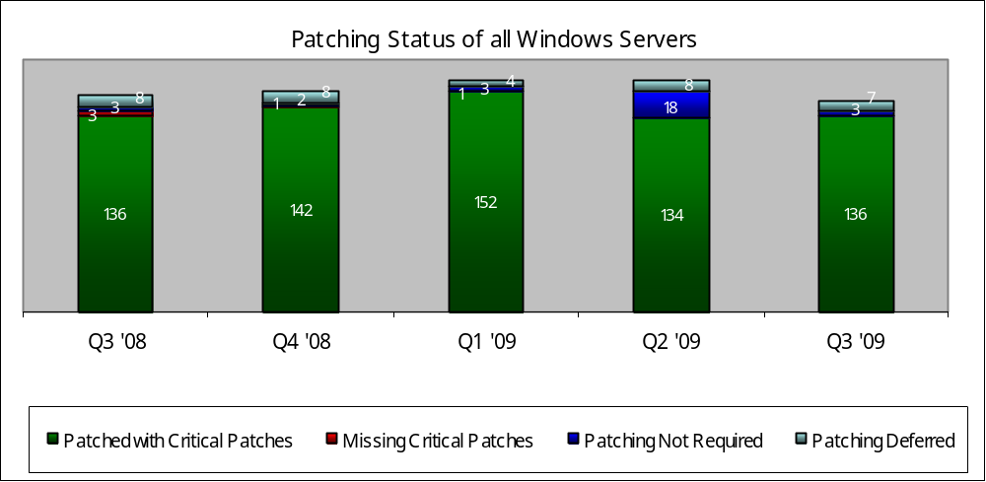
Infrastructure Security
Vulnerability Monitoring and Patching (continued)
Metric: 6.2
This metric tracks the Bank’s progress in improving monitoring and patching to ensure that systems are protected against known security vulnerabilities. This page provides information related to Windows server compliance.
In accordance with the patching policy, Windows servers are considered patched if they have received the applicable Microsoft critical operating system patches released in the months up to and including August 2009 with the exception of two patches released, as they were not available from the patching vendor on patching weekend.
Comment: The 3 servers identified as “Patching Not Required” are systems that are not on the Bank’s production network. The 7 servers identified as “Patching Deferred” are systems that have been granted authorized variances to avoid the potential risk of negatively impacting server performance during a critical production time.

Slide 14
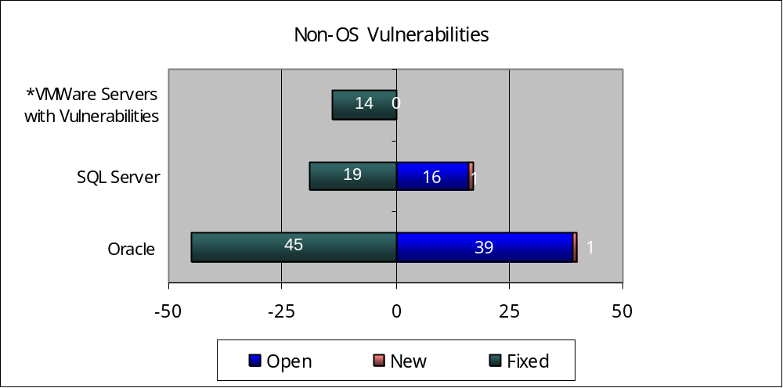
Infrastructure Security
Vulnerability Monitoring and Patching (concluded)
Metric: 6.2
This metric tracks the Bank’s progress in improving monitoring and patching to ensure that systems are protected against known security vulnerabilities. This page provides compliance information related to security patches for non-operating system (non-OS) software.
*This statistic represents the NUMBER of VMWare servers that have vulnerabilities.
The Oracle and SQL Server statistics represent the number of vulnerabilities on all production databases.
This Slide/Metric needs help/suggestions
Comment: The VMware are all compliant with critical security patches up to August 30, 2009.
The outstanding vulnerabilities in the SQL and Oracle database environments have been assessed and are considered low risk. IS and IT continue to work together to refine our monitoring systems to enable us to ignore vulnerabilities for which we have determined remediation is not warranted.

Slide 15
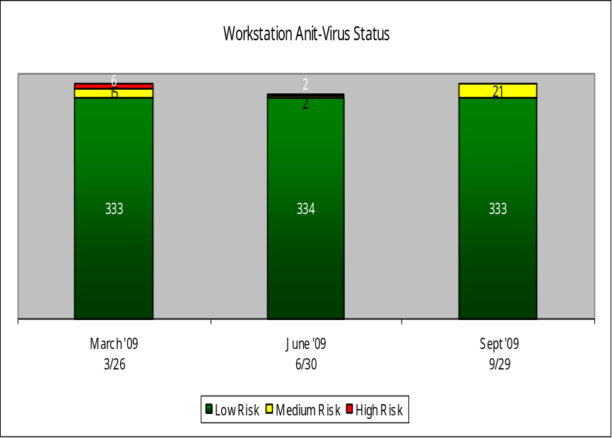
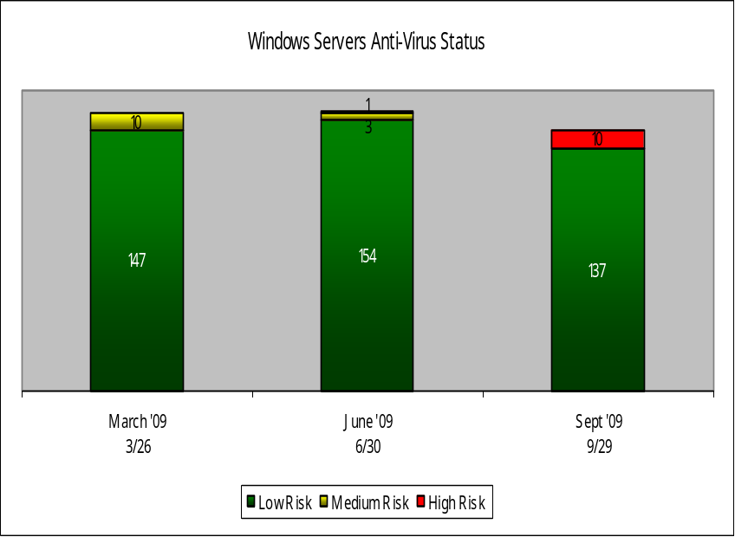
Infrastructure Security
Malicious Code Protection
Metric: 6.6
This metric measures the currency of malicious code protection (a.k.a., anti-virus) on workstations and servers. Malicious code protection requires the installation of “virus definitions” that enable the anti-virus software to recognize and protect the target machine against specific emerging threats. When virus definitions are not kept current, the risk of a breach involving malicious code execution increases.
Observation: To assess the risk associated with individual machines, the age of the virus definitions was assessed against the criticality and network connectivity of workstation or server. Machines with definitions that are older and directly connected to the Bank’s internal network are considered to be at the highest risk, while machines that are more current or with extremely limited access to critical resources on the internal network are considered to pose the least risk.
Comment: The 10 servers rated as high risk were servers that experienced stability problems when the anti-virus client software was upgraded to the latest version. The stability problems were caused by a conflict between the anti-virus software and security monitoring software. Due to the conflict, the anti-virus software was reverted to the previous version which does not provide the same level of reporting as the newer version, making these machines more difficult to maintain. The conflicting security software has been upgraded on these machines and IT is working to re-apply the upgraded anti-virus software.
Notes:
This slide (again remember this is old) has “Pushe” our IT team to ensure we have antivirus softare on all device AND that it is up-to-date.

Slide 16
Metric: 6.10
Infrastructure Security
Event and Activity Logging and Monitoring – Vulnerability Monitoring
This metric tracks the number of security events which are logged and the resulting number of alerts sent to IS and IT. Alerts require action to be taken to ensure a security breach has not occurred.
July 1, 2009 – September 30, 2009
66,743
Scans of FHFB devices
(Visibility, Verification, Vulnerability)
1,123
Events of Interest
741
Events
(all events are investigated)
254
Alerts
(validation step)
65
Client Notified Tickets
FHLB = 0 Open Tickets
FHLB investigated and closed all tickets.
ev3 Service
Comments: Solutionary’s eV3 service provides continuous scans of the Bank’s Internet accessible devices. The service also monitors the Bank’s internet domain registrations (e.g., fhlbboston.com) to detect registration lapses, web page defacement, etc. Finally, the eV3 service provides quarterly external vulnerability scans as well as on-demand vulnerability scans of new devices deployed to the network. Refer to page 14 for the latest quarterly results.
Notes:
The next two slide show the VALUE of our outsourced arrangement with Solutionary, Ind vor our IDS/IPS/fireall/DMX monitory. These slide continue to provice value for cost of outsourcing rather than having to add staff to our team or IT for log monitoring/confiuring/managing devices to monitor for attacks againt the bank. outward facing devices and

Slide 17
Metric: 6.10
Infrastructure Security
Event and Activity Logging and Monitoring – Security Activity Monitoring
This metric tracks the number of security events which are logged and the resulting number of alerts sent to IS and IT. Alerts require action to be taken to ensure a security breach has not occurred.
July 1, 2009 – September 30, 2009
492,499,411
Log Items Received at Solutionary SOC
7,167,767
Log Items of Interest
122,427
Events
(all events are investigated)
1,918
Alerts
(validation step)
116
Client Notified Tickets
FHLB = 0 Open Tickets
FHLB investigated and closed all tickets.
ActiveGuard
Comments: Solutionary, Inc provides the Bank with managed security services called ActiveGuard. This services provides management and monitoring of 4 external and 3 internal Intrusion Detection System (IDS) devices. The IDS devices inspect all inbound and outbound network activity and identify suspicious patterns that may indicate malicious activity. In addition to network traffic monitoring, 9 of the Bank’s firewalls are monitored for changes and abnormal traffic. Based on the investigation and analysis performed by the Solutionary Security Operations Center, Information Security receives alerts which are further investigated to ensure that no malicious activity has occurred.

Slide 18
Infrastructure Security
Summary of Assessments Completed
Metric: 6.10
A third party vendor will perform a vulnerability assessment, which will assess the Bank’s level of protection against external and internal attacks. This page provides information related to the Bank’s efforts to address and mitigate the risks associated with identified vulnerabilities.
External Vulnerability Assessment Summary (reflecting assessment conducted in August 2009)
  Total vulnerabilities reported this quarter: High – 0, Medium – 0, Low - 41
    Low –The risks posed by these vulnerabilities have been assessed and are considered minimal. The assigned IT teams will address these vulnerabilities as time permits.
Enterprise (Internal) Vulnerability Assessment Summary Update (reflecting assessment conducted in June 2009)
  Total 14 vulnerabilities identified in June 2009: Critical - 0, High - 7, Medium -7, Low - 0 risk
    All vulnerabilities have been assessed and are considered closed.

Slide 19
Lessons Learned
Don’t become a victim of your own success
  Find ways to automate
  Don’t be afraid to report on what your audience understands
  Don’t be afraid to stop reporting on items that are meaningless and provide no value!
Became the asset management POC - note
  no matter how many times I kept reminding mgmt it was IS!
Notes:
Must have a good relationship with IT – even though we are compliance and have to “tell” on our friends, I always share first.
Found out we WERE NOT patching prior to the implementation of the metrics – I’ll leave it to your imagination, but we have had 3 ft mgrs of infrastructure while I have been at the bank (mgr in place today is AWESOME)
Keeps everyone focused on SECURITY of our devices and makes tham understand WHY we are doing/asking questions. Relationship building has been most important in the success of the Security Program.
Measuring really helps to “provide value” – We have always gotten funding for our needs early on but because we are doing such a “good” job mgmt seems to have forgotten why we need to improve – I would love ideas on “freshing” up my approach.
I need to get out of the weeds – easier to stay there for me so I need to focus on trends and how they can impact us ie cloud computing.

Slide 20
Going Forward

