Slide 1
An Attack Surface Metric
Pratyusa K. Manadhata Jeannette M. Wing
Carnegie Mellon University
{pratyus, wing}@cs.cmu.edu

Slide 2
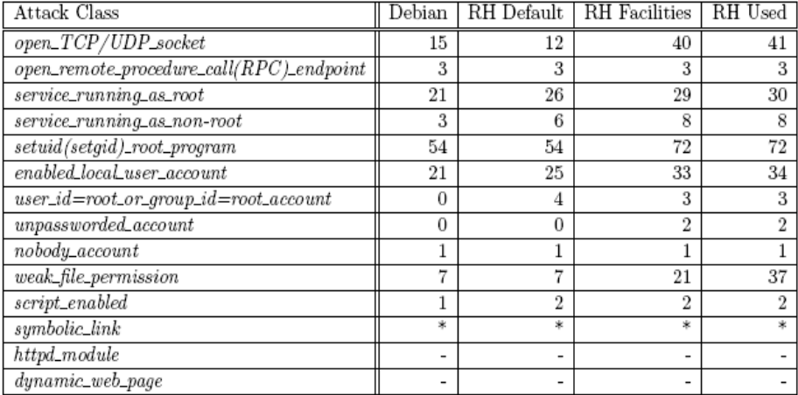
Motivation and Goals
Is system A more secure than system B?
Compare the attack surface measurements of A and B.
Prior work [HPW03, MW04] shows that attack surface measurement is a good indicator of security.
700
600
500
400
300
200
100
0
Windows NT 4
Windows 2000
Windows Server 2003
RASQ
RASQ with IIS enabled
RASQ with IIS Lockdown
Goal: Define a metric to systematically measure a software system’s attack surface.

Slide 3
Intuition Behind Attack Surfaces
Attacks
system surface
Entry/Exit Points
2. Channels
1. Methods
3. Data
The attack surface of a system is the ways in which an adversary can enter the system and potentially cause damage.
Attack Surface Measurement: Identify relevant resources (methods, channels, and data), and estimate the contribution of each such resource.

Slide 4



Attack Surface Measurement
Formal framework to identify a set, M, of entry points and exit points, a set, C, of channels, and a set, I, of untrusted data items.
Estimate a resource’s contribution to the attack surface as a damage potential-effort ratio, der.
Resource | Damage Potential | Effort
Method | Privilege | Access Rights
Channel | Protocol | Access Rights
Data Items | Type | Access Rights
The measure of the system’s attack surface is the triple,
< , , > .

Slide 5
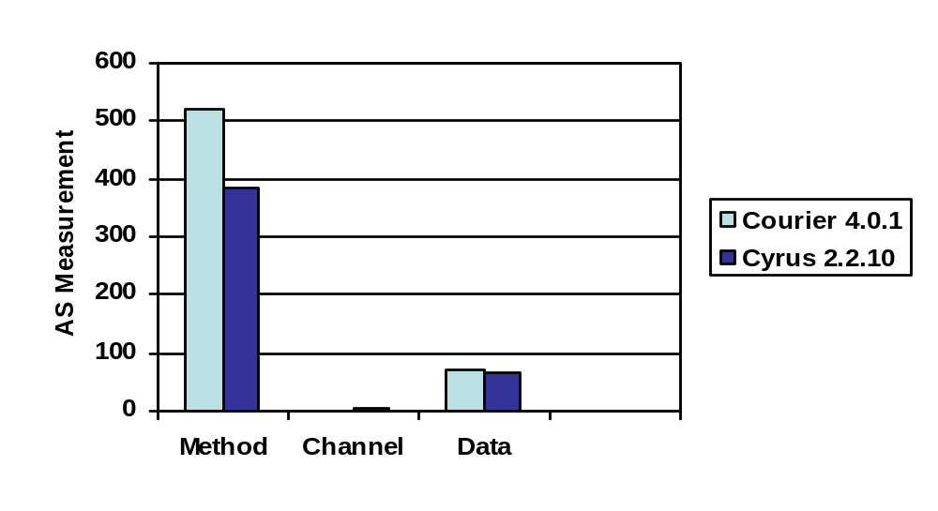
IMAPD Example
Courier 4.0.1 (41KLOC), and Cyrus 2.2.10 (50KLOC)
Annotated the source code and analyzed the call graph to identify entry and exit points.
Used run time monitoring to identify channels and untrusted data items
To compute der, assumed a total ordering among the values of the attributes and assigned numeric values according to the total order

Slide 6
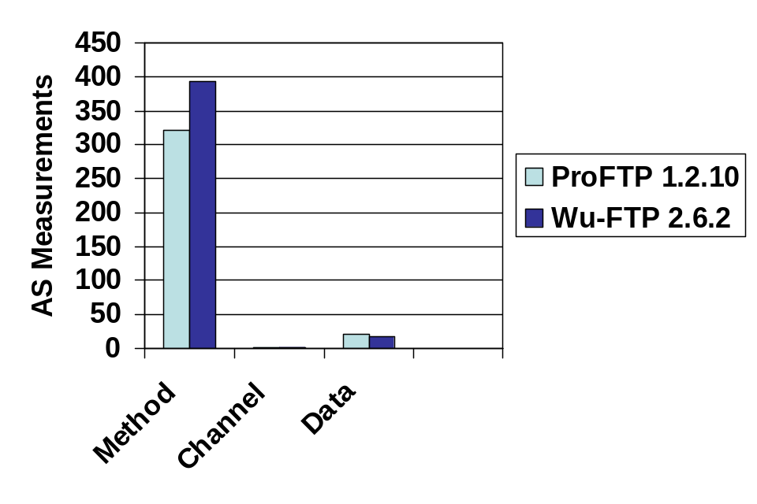
Validation (work-in-progress)
Formal Validation: I/O Automata [LW89]
Empirical Validation
  Vulnerability report count*
  Machine Learning (MS Security Bulletins)
  Honeynet Data
Database | ProFTP | Wu-FTP
CERT | 0 | 1
CVE | 2 | 4
SecurityFocus | 3 | 7
*Joint work with Mark Flynn and Miles McQueen, INL.

Slide 7
Backup Slides

Slide 8
IMAPD Example
Courier 4.0.1 (41KLOC), and Cyrus 2.2.10 (50KLOC)

Slide 9
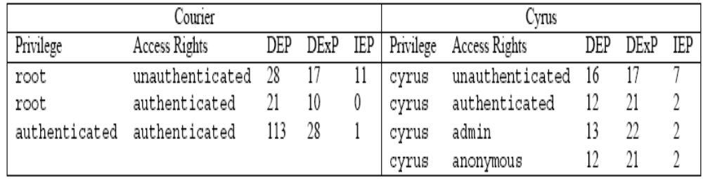
Entry Points and Exit Points

Slide 10
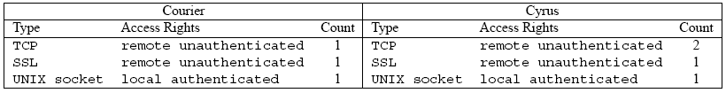
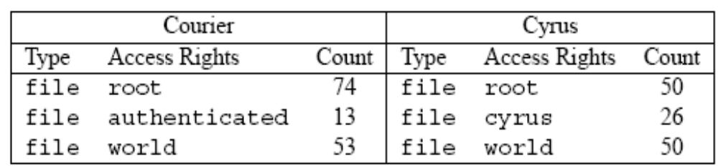
Channels and Data Items

Slide 11
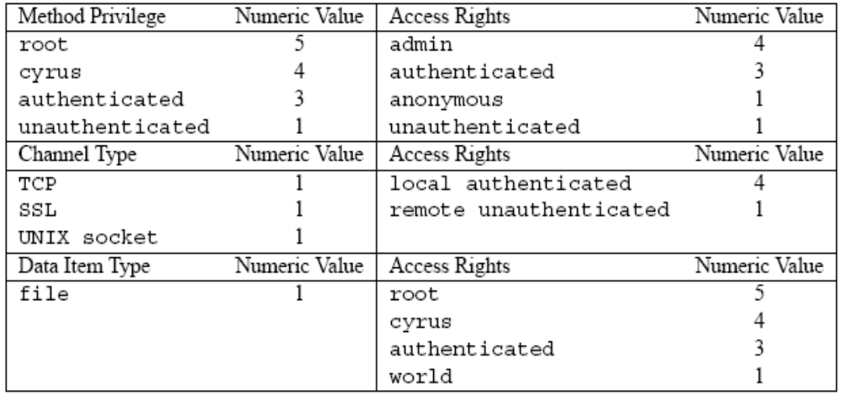
Numeric Values

Slide 12
FTPD Example
ProFTPD 1.2.10 and Wu-FTPD 2.6.2

Slide 13
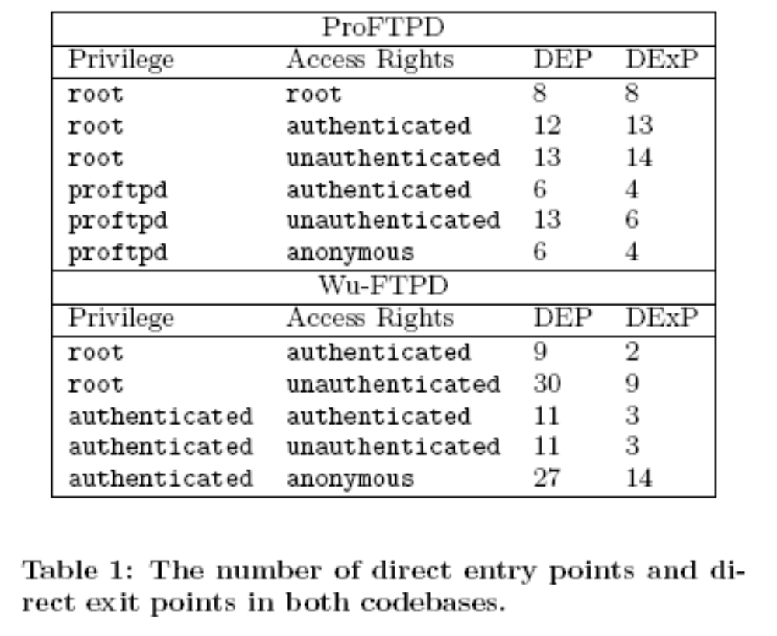
Entry Points and Exit Points

Slide 14
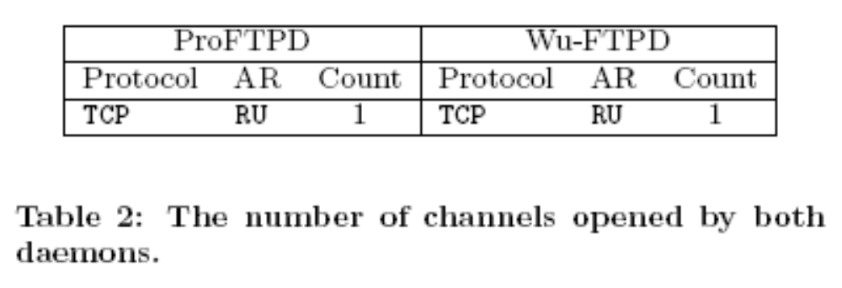
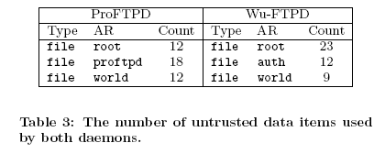
Channels and Data Items

Slide 15
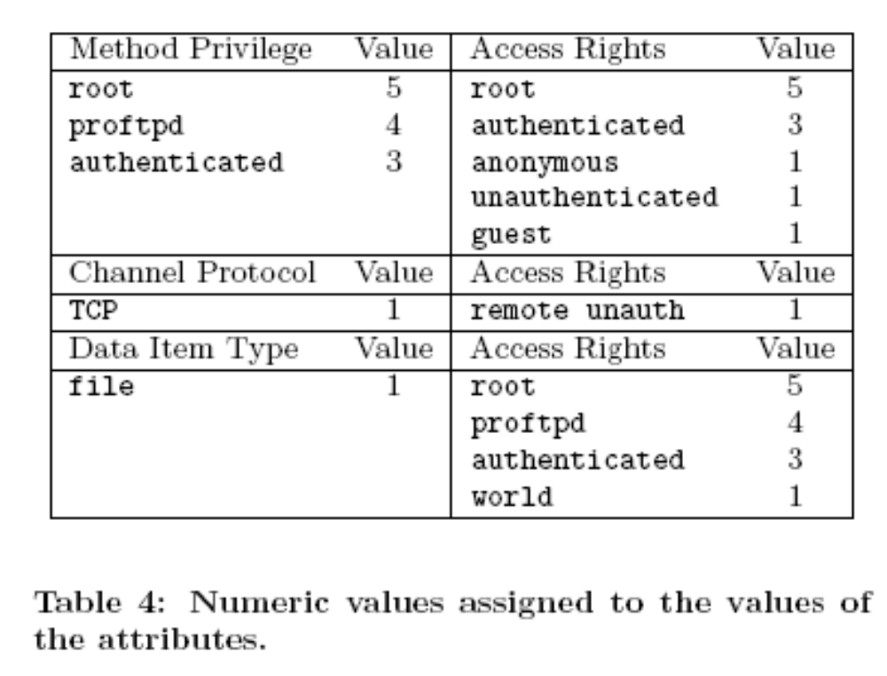
Numeric Values

