Slide 1
John S. Quarterman
Gretchen K. Phillips
InternetPerils
1 August 2006
Metricon
Vancouver, BC
No Substitute
for Ongoing Data,
Quantification,
Visualization,
and Story-Telling

Slide 2
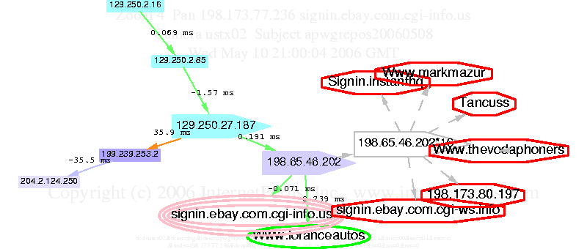
A Month's Phishing Infestation

Slide 3
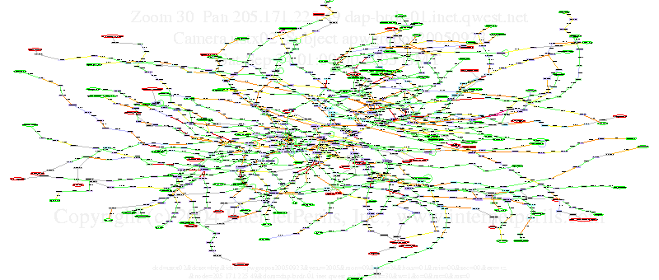
Multiple Servers and Targets
Both red and green nodes are phishing servers
Some churn in ongoing infestation
Multiple targets, e.g., paypal and ebay
No single target would know this
Phishers use leverage of Internet: can't counter that alone
Lists of phishing servers from APWG repository
Topology & performance data & visualization by InternetPerils
Give to collaborate: report phishing to APWG; focus nodes to monitoring companies; etc.; iterate for collective action

Slide 4
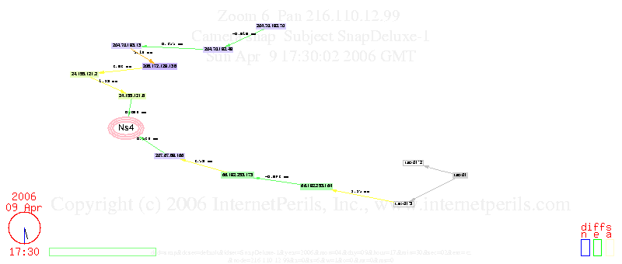
Know Your Network Neighborhood

Slide 5
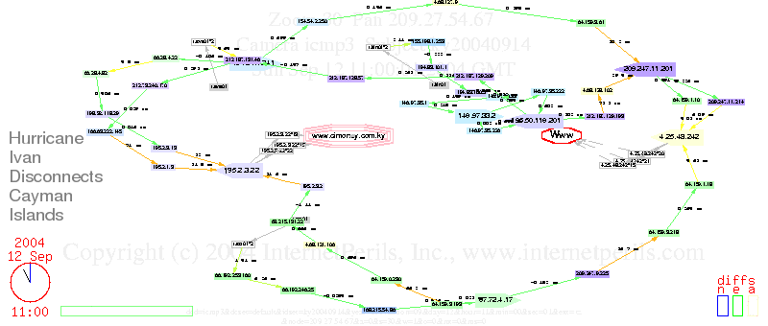
Hurricane Ivan Meets Cayman Islands

Slide 6
No Substitute
ISPs won't tell you (competitive info.; embarrassment)
ISPs can't tell you: don't know outside their network
Running forensic tools yourself is not enough
Need early warning: need independent 3rd party data
Need real data for baselines + longitudinal + ongoing
Already watching when events occur + frequent scans to catch event + specific focus + wide view to see related
Quantify + visualize for pattern recognition and presentation
Tell a story!

Slide 7

Contact Information
  John S. Quarterman
  jsq@internetperils.com
  Gretchen K. Phillips
  www.internetperils.com
  book: Risk Management Solutions

