Slide 1
Security Metrics in Practice Development of a Security Metric System to Rate Enterprise Software
Brian Chess brian@fortify.com
Fredrick DeQuan Lee flee@fortify.com

Slide 2

Overview
Background: Java Open Review
Why Measure?
What Can We Measure?
What Should We Measure?
The Whole Picture

Slide 3

Java Open Review
http://opensource.fortifysoftware.com/
Over 130+ Open Source Projects
74+ millions of lines scanned weekly
995 open source defects
365 open source bugs *fixed*
Responsible for fixes in:
  Azureus
  Blojsom (OS X Server’s blogging software)
  Jforum
  Groovy on Rails

Slide 4
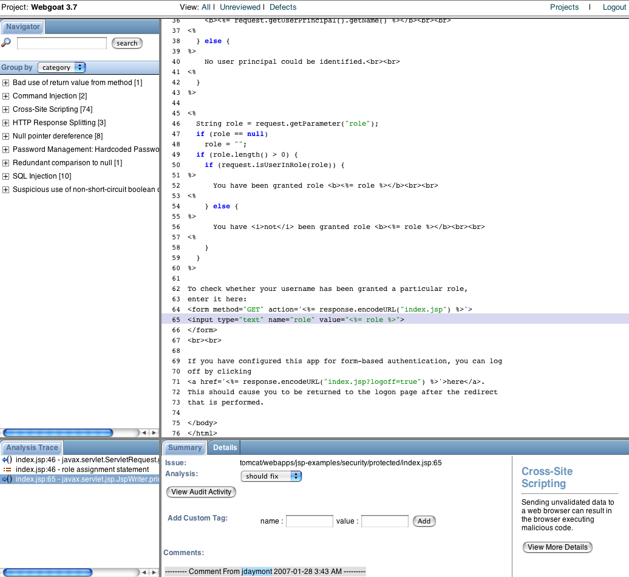
Java Open Review (cont.)
Reviews Open Source Java projects for
  Security defects
  Qualitfy defects
Utilizes Fortify SCA and Findbugs static analysis tools
Allows remote developers to collaborate on security audit process

Slide 5
Next Logical Step
Users immediately asked “which is better?”
  Which project is more secure?
Gathered lots of data over several classes of applications
Customers wanted to know how to choose between projects that fulfilled the same function

Slide 6

No two projects are alike…
Notes:
Every snowflake is “unique”
However, they have enough similar characteristics that we can classify them in an objective manner
The same holds for software security

Slide 7
Why Measure?
Determine which development group produces more secure software
Which software provider should I use?
In what way is my security changing?
What happens when I introduce this component into my environment?

Slide 8

No risk metric for you!
Risk assessments need:
  Threats, Vulnerabilities, and Controls or
  Event Probability and Asset Value
Analyzing the source code only uncovers vulnerabilities
Risk information should be derived by the consumer of the software
Lacking complete information, we steer clear of risk determinations
We can’t answer
  “How secure am I?”
  “Where should I place my security resources?”

Slide 9
What We Can Measure?
Objective, automated, repeatable, and plentiful:
  Security defects found in source code
  Quality defects found in source code
  Input opportunities of software

Slide 10

Software Security Metrics
Create a descriptive model
  Present the customer with everything we know about the software
  Utilize project artifacts to gauge the security of software
    Utilize existing tool results to present useful, high-level information
      Any tool that produces objective, repeatable, and easily digested security information.
Metrics used by customer to:
  Benchmark software counterparts
  Develop clear path towards improving software security in a measurable fashion
  Feed into existing risk management system

Slide 11

Software Security Metrics
Metrics Fortify SCA can facilitate for projects:
  Common Vulnerability Scoring System (CVSS)
    Fortify SCA can automatically provide most of the Base information for a CVSS score
      Audited issue provides information for Temporal category of CVSS
      Report consumers can provide the Environmental information for a context sensitive CVSS measurement
Useful metrics SCA can deduce about projects:
  Lines of Code
  Cylcomatic Complexity per Function
  Defects/KLOC
  Defects/External data entry-points
  Defects/Internal data consumption points

Slide 12
Categorizing Applications
Applications are categorized to aid in “apples to apples” comparisons of projects
    “Show me the best mid-sized CRM system”
Genres are a combination of:
  Application Size
    Small < 150KLOC
    Medium > 150KLOC; < 500KLOC
    Large > 500KLOC
  Application Type
    Web Application
    Application Server
    Component/API
    Stand-alone utility
    Console application
  Application Industry
    Financial
    Engineering
    Consumer
    eCommerce

Slide 13
“Scoring” Software
Customers requested the information in a condensed manner
A quick “thumbs-up/thumbs-down” view on projects
Modeled a “star” system similar to mutual fund ratings
Mark Curphey’s OWASP Evaluation and Certification Criteria is a similar effort.

Slide 14
Rating System
Morningstar for Software Security
Developing a 5-star/tier rating system
  Some subtlety of assessment is lost in exchange for ease of use
Each tier has criteria before a project may be promoted to the next tier
NOT limited to static analysis tools

Slide 15
Stars Explained
Absence of Remote and/or Setuid Vulnerabilities
Absence of Obvious Reliability Issues
Follow Best Practices
Documented Secure Development Process
Passed Independent Security Review

Slide 16
Critique of Rating System
Ouch!
  Ratings are very harsh
    Impact is high for even one exploit
    If automated tools can find issues, other security defects likely to exist
Ordering in unordered set
  The tiered nature implies more importance for some criteria
  Project information is loss
    A project may have a defined security process, yet have vulnerabilities present
Subjectivity of higher tiers
  Things become more ambiguous as you move up the tiers
    What qualifies as an independent review?

Slide 17
Using the system
Search for software that meets a particular security requirement
  “Show me 2-star, mid-size, shopping cart software”
Use stars to filter out components
Drill down to underlying metrics to make a more informed decision on component usage
  “How does this set of 1-star components compare?”
    Examine detailed defect information
    Does one project have fewer remote exploits?
Feed metrics into existing risk assessment process to make final determination
  Model how the selected software will impact existing risk model

Slide 18
Next Steps?
Validate against Closed Source software
Test against auditor “smell test”
  How do the hard numbers compare against security auditors reports?
Explore additional software metrics that may relate to security

Slide 19
Questions?
Questions? Comments?
Brian Chess brian@fortify.com
Fredrick DeQuan Lee flee@fortify.com

