Slide 1
Operational Security Risk Metrics:
Definitions, Calculations, Visualizations
Metricon 2.0
Alain Mayer
CTO RedSeal Systems
alain@redseal.net

Slide 2
Overview
Operational Security Metrics
  Objectives
  Definitions
  Calculations
Visualizing Metrics
  Objectives
  Paradigm
  Examples

Slide 3
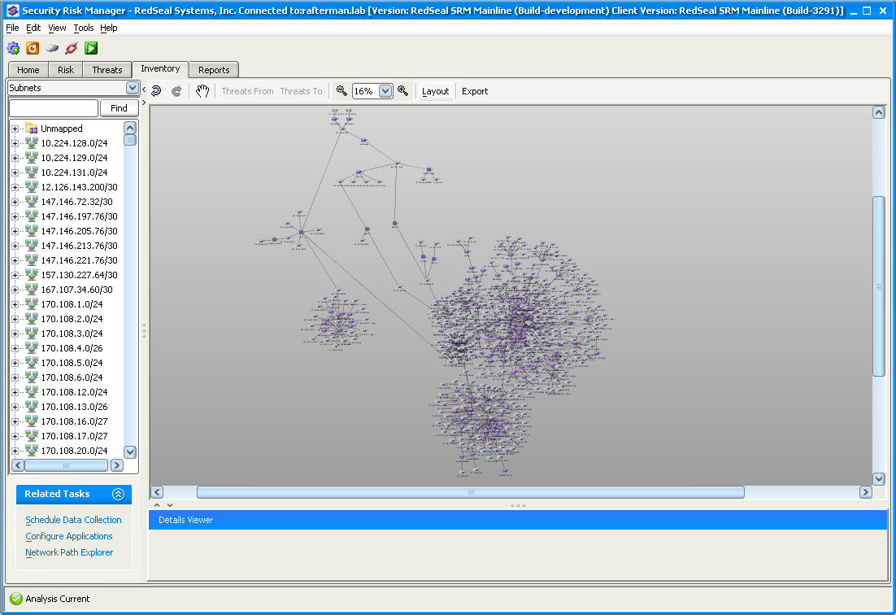

Slide 4
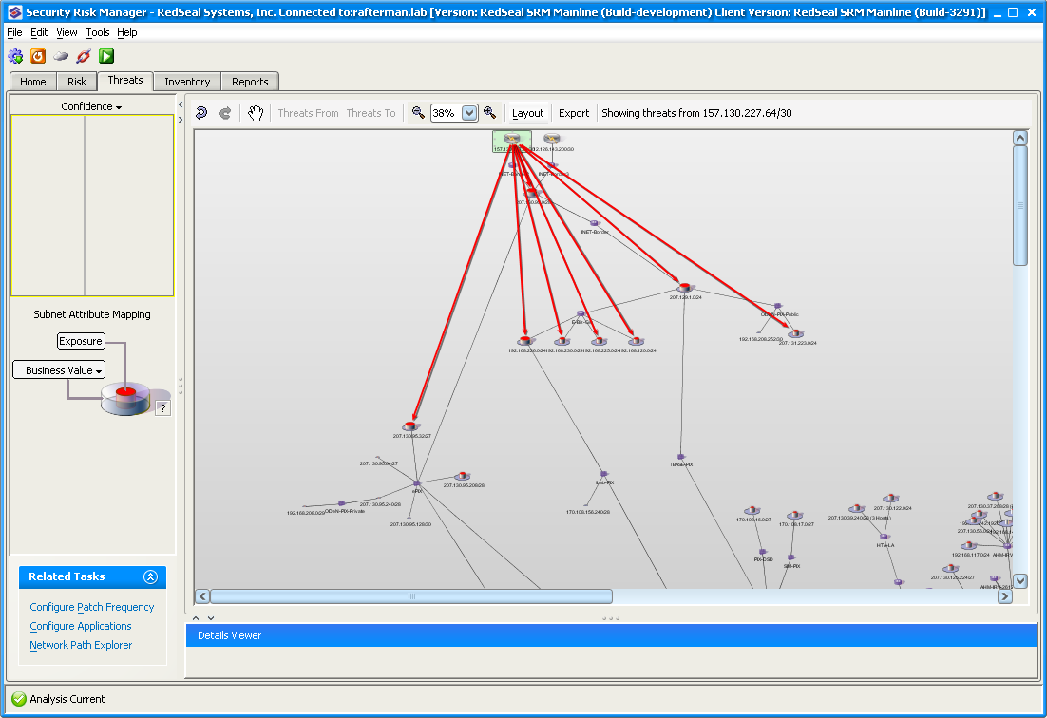
External threat
Limited to DMZ

Slide 5
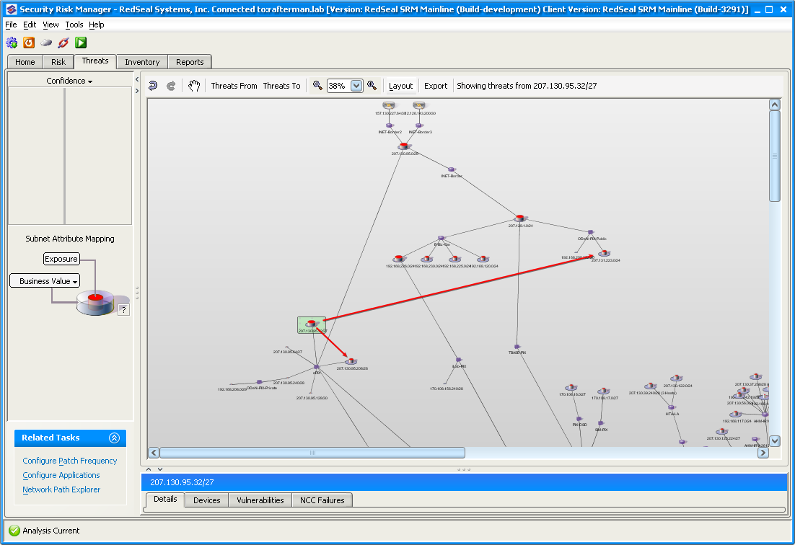
This second hop looks mild enough, but ….

Slide 6
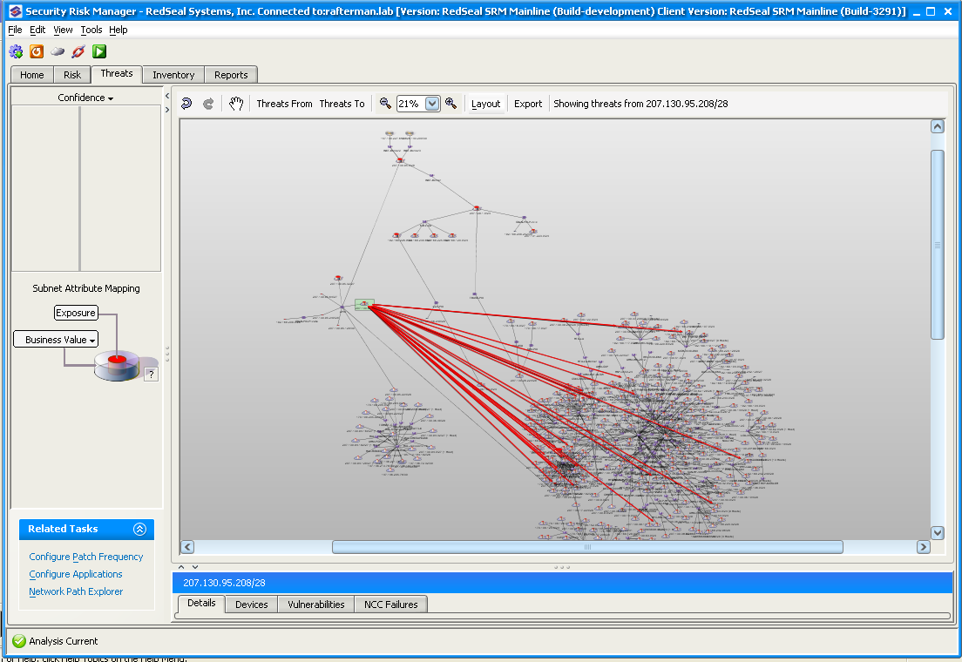
This (and only this) third hop breaks in!

Slide 7
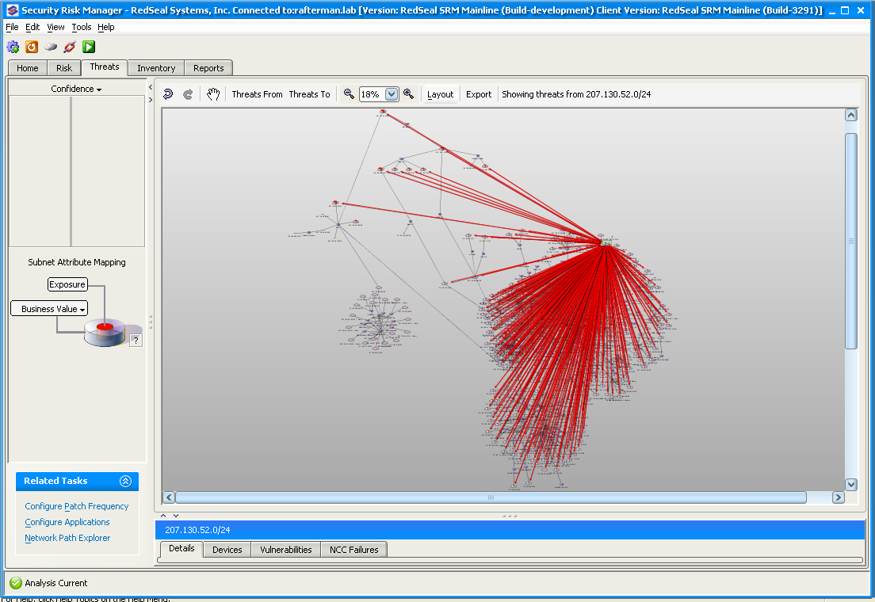
4th hop is anywhere you want to go

Slide 8
Metrics: Goals and Non-Goals
We believe that useful metrics need to include the following:
  Relative scoring of hosts: allow the user to assess which networked machines are the most exposed; which are the most at risk, etc.
  Trending: allow the user to track the all metrics of a network host over time.
  Prioritization of workload: allow the user to decide what mitigation actions are the most overall effective in reducing risk in the environment
  Scalability: allow the user to quickly find the needle in a large haystack
We decided not to focus on the following
    None of our metrics convey any absolute semantic
    None of our metrics involve actual probabilistic calculations
    None of our metrics represent monetary loss

Slide 9
Metrics Choice
4 key metrics for each host in the infrastructure:
  Exposure Score
  Business Value
  Risk Score
  Downstream Risk Score

Slide 10
Summary of the 4 Key Metrics
Threat
Source
Hosts deeper inside
Host
“Exposure”
  Reachability
  Ease of exploit of vulns
Vulns
Services
“Business Value”
  Default is highest value service
“Downstream Risk”
  Cumulative Risk over hosts attackable from here
“Risk”
  Exposure X Business Value

Slide 11
Exposure
CVSS Temporal Scores
for each
Vulnerability on Host H
Exposure
Algorithm
Exposure
Score of
Host H
Context of Host H in the RedSeal Threat Map

Slide 12
Exposure Score
Exposure is a number between 0 and 1
Exposure measures the likelihood of a host being attacked from an un-trusted source by taking into account:
  The distance of a host is to an un-trusted source in the Threat-Map
  The number of vulnerabilities on the host
  The difficulty of exploiting the vulnerabilities on the host (CVSS)
  The difficulty of exploiting the vulnerabilities on other hosts that precede this host in the Threat Map

Slide 13
Risk
Exposure Score of Host H
Risk
Algorithm
Risk
Score of
Host H
Business Value of Host H

Slide 14
Downstream Risk
Risk Score of Host H
RedSeal
Downstream Risk
Algorithm
Downstream Risk
of Host H
Risk Score for each host reachable from H in the RedSeal Threat-Map

Slide 15
Downstream Risk Score
Downstream Risk is an unbounded number
Downstream Risk measures accumulative risk to the host itself and all the other hosts that follow this host in the Threat Map
  In principle, downstream risk calculations traverse the threat map bottom up, in reverse order to the exposure calculation.
  It aggregates risk scores from hosts representing leaves in the threat map towards the predecessor nodes.
  Again, we aggregate the risk along strongest paths only.
    A user typically takes care of the few clearly high-scoring hosts, then re-analyzes and re-assesses the situation.

Slide 16
Visualization
Scale to tens of thousands of hosts
Work with highly complex relationships
Highlight patterns and exceptions
Enable quick root cause analysis
  Interactive drill down
Reflect natural hierarchies
  Subnets
  Locations
  Functionality – Service
  Platform –OS

Slide 17
Tree Maps
“Tree Map” is a space-constrained visualization of large hierarchical structures.
It is very effective in showing attributes of leaf nodes using size and color coding. Enable users to compare nodes and sub-trees even at varying depth in the tree, and help them spot patterns and exceptions in large data sets.
First designed by Shneiderman at Univ of Maryland in the 90’s.
By now, this paradigm is being used for visualizing financial markets (see, e.g., http://www.smartmoney.com/marketmap/), gene expression results in bio-technology, daily news, and many more.

Slide 18
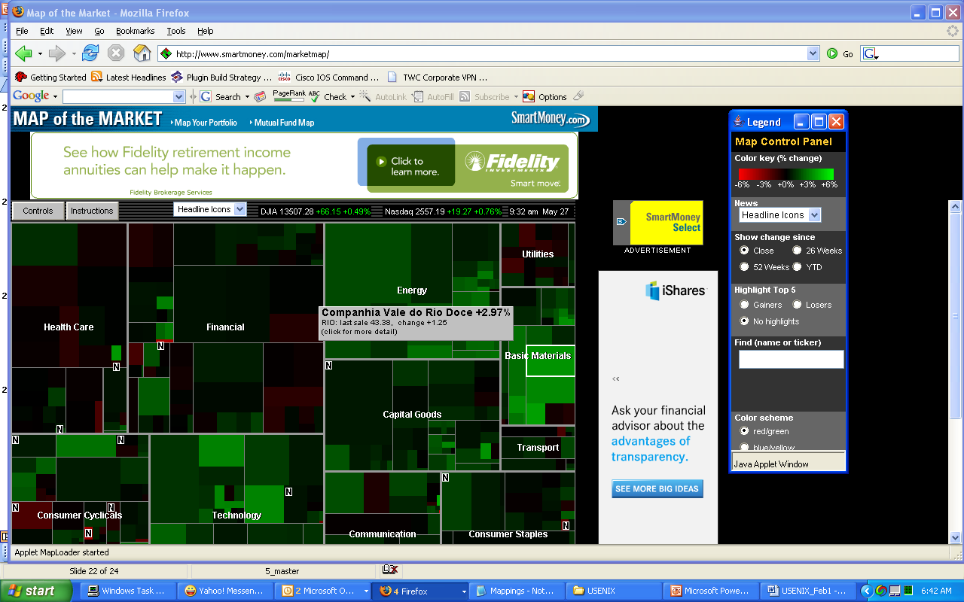

Slide 19
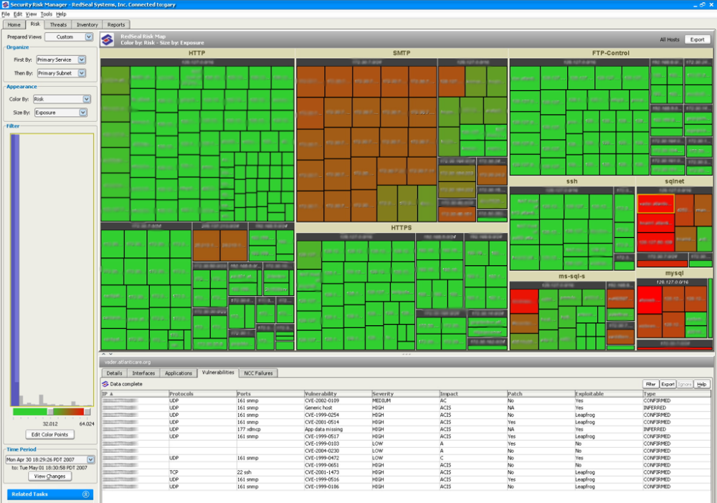

Slide 20
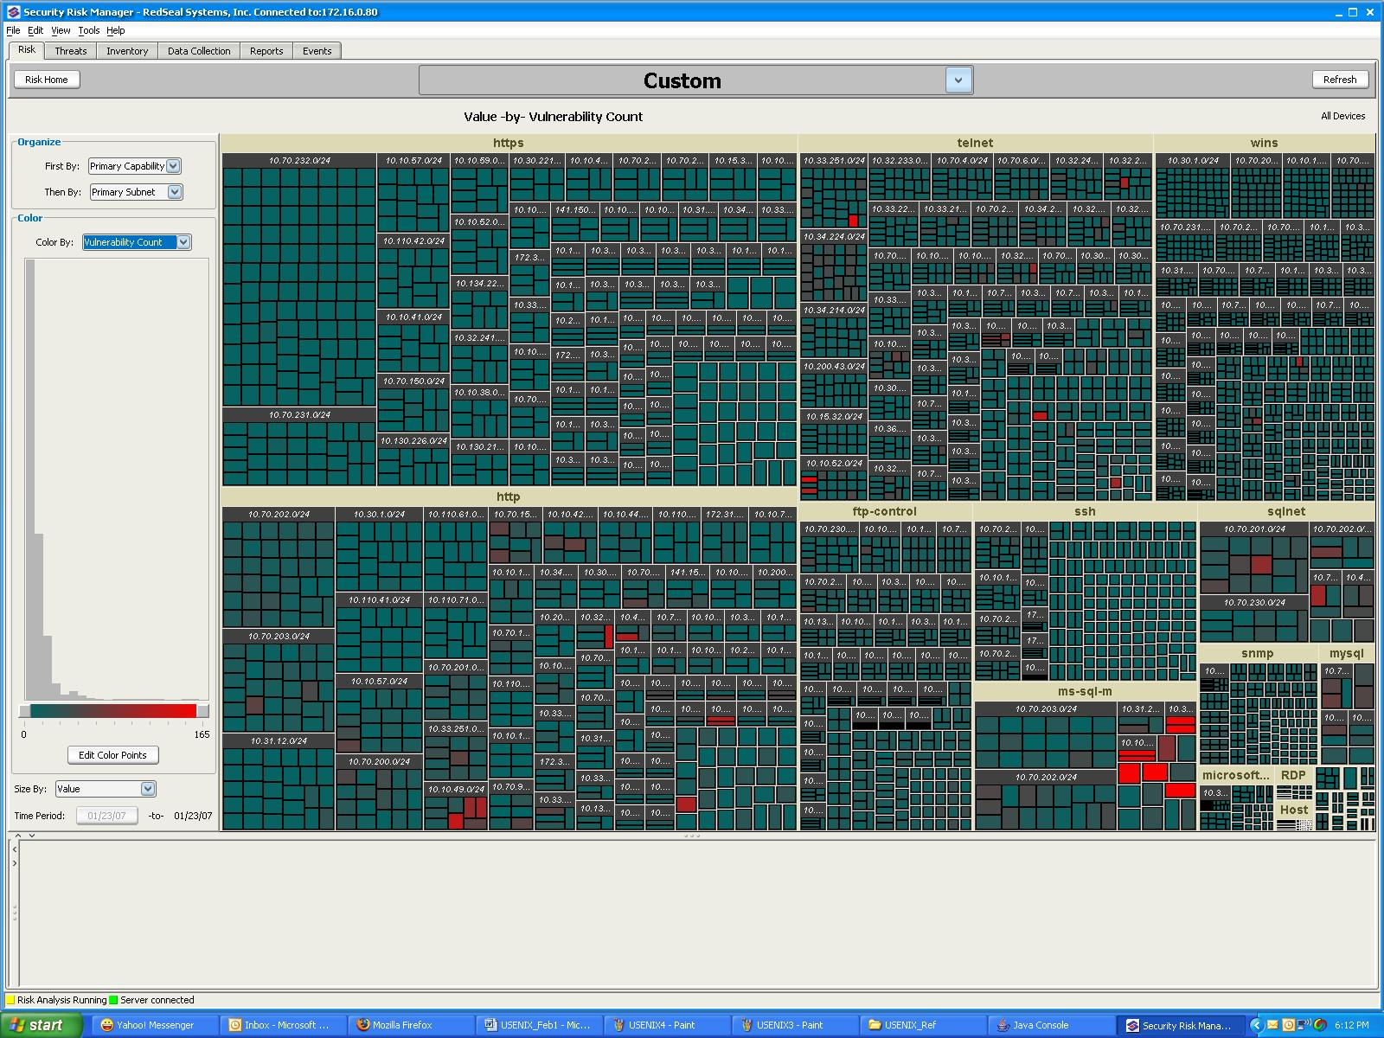

Slide 21
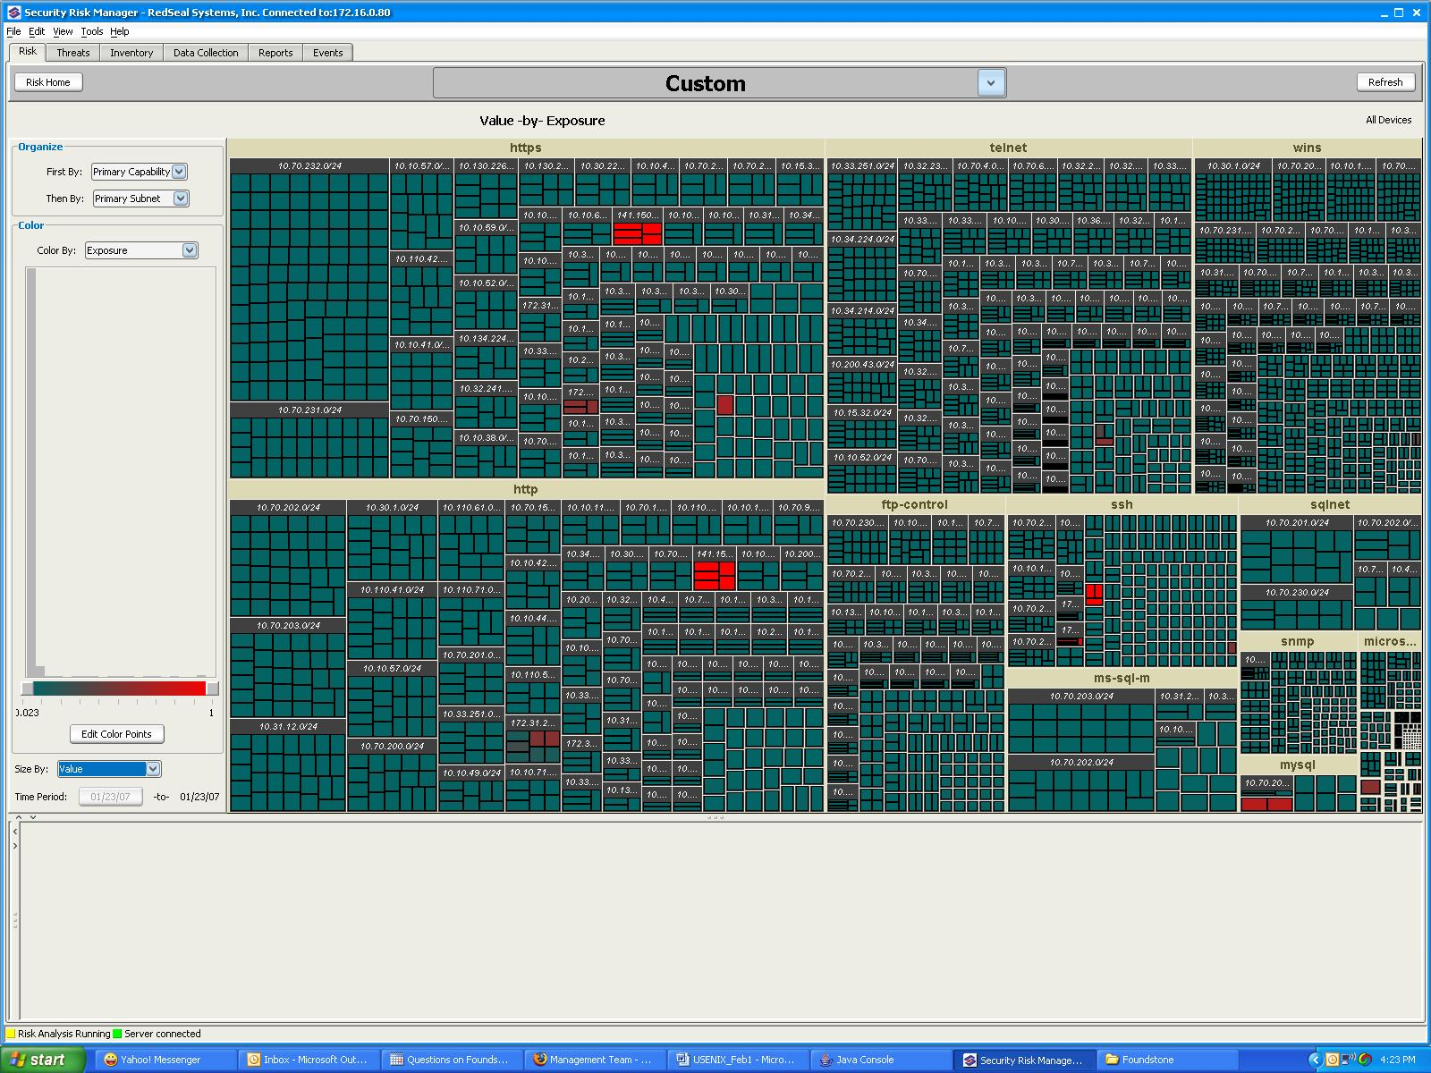

Slide 22
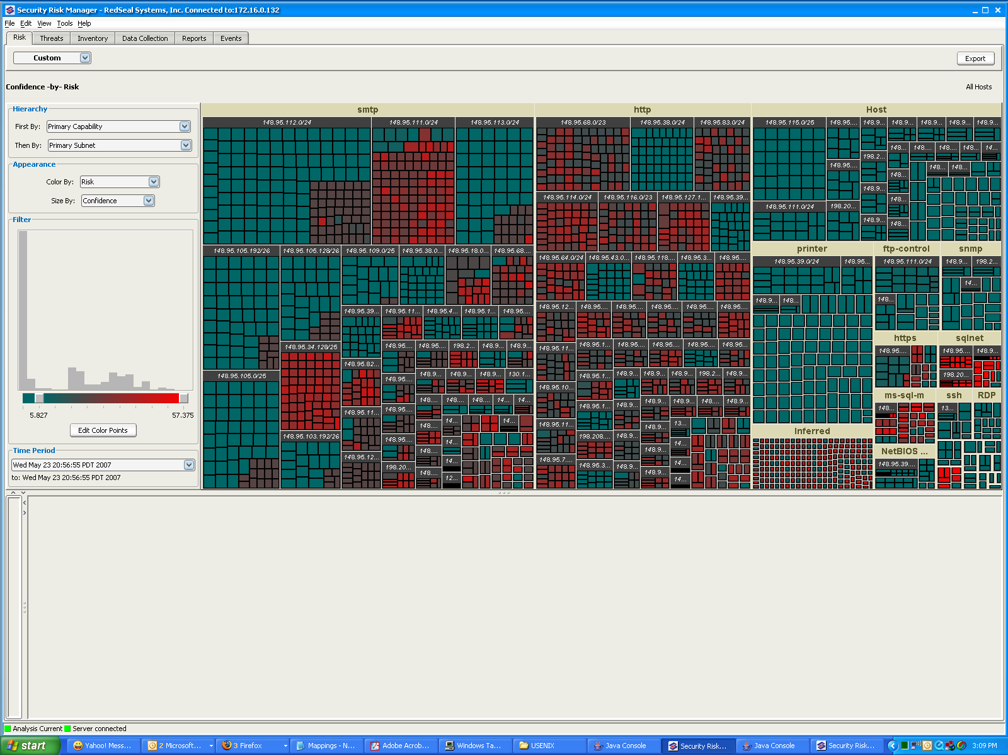

Slide 23
Summary
Presented a new application for Tree Maps
Some users have immediate affinity – some users need more getting used to
Effective way in conjunction with more traditional network topology based visualization
  Allows to quickly spot patterns and drill down
No immediate punch list (a reporting function).

Slide 24
Summary / Open Issues
Presented 3 security metrics – Exposure, Risk, DownStream Risk
  “opinion-based math”
  Never questioned by users → good or bad??
    Still too complex? Making it even simpler → Hop Count
  Closed system – not comparable with any other calculation

Slide 25
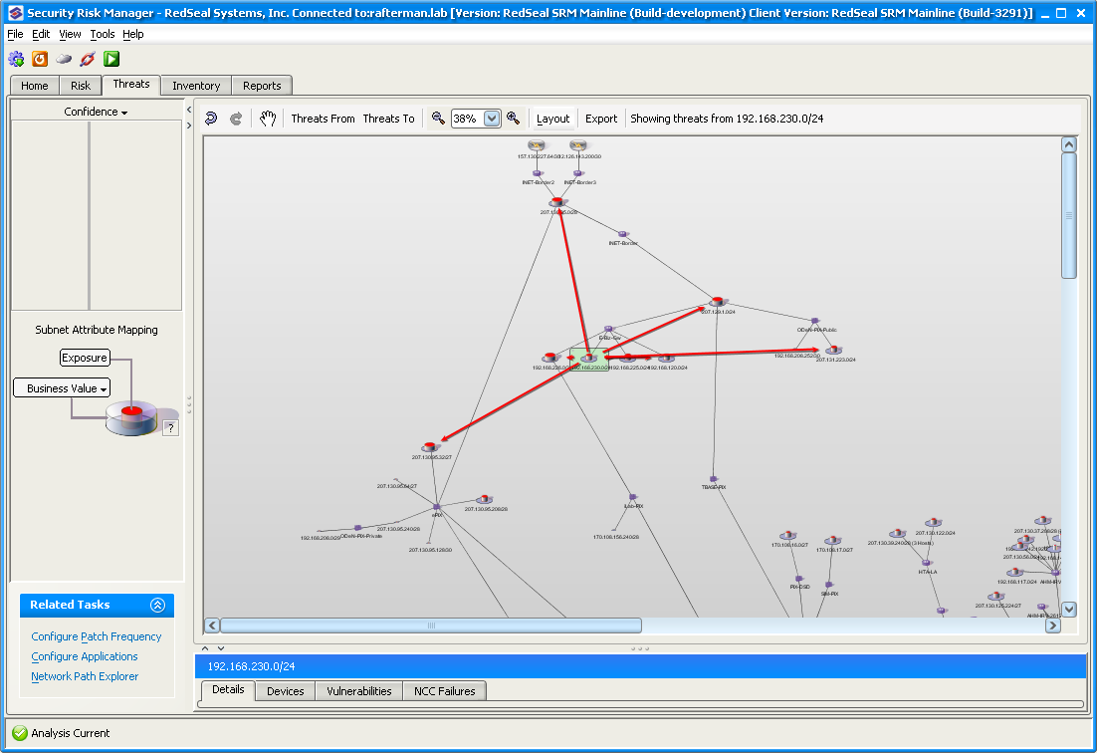
Most DMZ servers can ONLY attack inside DMZ

Slide 26
CVSS
CVSS (Common Vulnerability Security Scoring)
  Base Metrics:
    access location, access complexity, authentication, CIA impact
  Temporal Metrics
    Exploitability, Remediation Level (Patch, etc), Confidence in Available Data
  Environmental Metrics:
  Collateral Damage, Target Distribution
See http://www.first.org/cvss/

Slide 27
Exposure Calculation
Aggregate CVSS (temporal) score for each vulnerability
Use threat map context for Host X
  FOR each predecessor Host A_i in the threat map DO
    Determine Host X’s accessible vulnerabilities from Host A_i
    Group the vulnerabilities by service (e.g., all smtp vulnerabilities, all http vulnerabilities, etc)
    Determine the top vulnerability for each service according to the CVSS temporal scores.
    Determine which services contain the highest CVSS temporal scores, and keep the top three values (one per service). If there are fewer than three values, then just use as many as there are
    Perform inclusion-exclusion calculation on the previous scores to arrive at a exposure score from Host A_i to Host X
  Compute: Exposure(Host X) ← MAX_i (Exposure(Host A_i) * Exposure(Host A_i, Host X));

Slide 28
Exposure
Note that the above calculation replaces inclusion-exclusion for predecessor nodes with a simple MAX (Last Step).
Paths which cause the larger exposure score on their own are favored in the calculation. We found that secondary weaker paths only contributed slightly to the overall score, but were very costly to compute.
For similar reasons, the inclusion-exclusion among all vulnerabilities on hosts has been reduced 3 inputs for inclusion-exclusion, using the highest scoring vulnerabilities among each service. became prohibitively expensive in an environments with close to 10K hosts.

Slide 29
Risk Score
Risk is a number between 0 and 100
Risk measures at the same time the:
  The likelihood a successful attack
  The impact of a successful attack

