Slide 1
Security Meta-metrics
Measuring Learning, Agility, and Unintended Consequences
Russell Cameron Thomas
Principal, Meritology
russell.thomas@meritology.com
Metricon 2.0, August 7, 2007
Boston, MA
Note: speaker notes included
Notes:
Security Meta Metrics – Measuring Agility, Learning, and Unintended Consequences
This presentation will highlight several meta-metrics that are essential for information security success in modern organizations, yet are often completely missing. Even a few “candles” in this darkness will dramatically improve management of information security and its overall contribution to organization success.

Slide 2
Purpose and Definitions
Meta-metrics for Information Security regarding learning, agility, and unintended consequences
“Meta-metric” – measuring the effectiveness of your metrics system.
  Are you measuring the right things?
  Are you measuring them adequately?
  How much should you invest in learning, exploration, experimentation?
  Corrective Action = change or adjust your metrics system & budget allocation
“Learning” – capability for an organization to acquire and utilize knowledge to improve performance.
“Agility” – capability to adapt in pace with changing demands and environment.
“Unintended consequences” – situations where an action results in an outcome that is not what is intended.
  May be foreseen or unforeseen, positive or negative.
  We focus on unforeseen negative consequences.
Notes:
This presentation will highlight several meta-metrics that are essential for information security success in modern organizations, yet are often completely missing. Drawing on ideas from the Balanced Scorecard, Learning Organization, and even Computational Organization Theory, the 15 minute presentation will focus on several quick examples of metrics for InfoSec agility, learning, and unintended consequences.

Slide 3
The Challenge
Information Security performance is an unruly moving target
  Fast-changing, rapidly evolving.
  Evolutionary strategic game between attackers and defenders
Potential Impact
  False sense of security, complacency
  Fighting the last war
  Falling behind in the “arms race”
  Failures of imagination
  Chasing ghosts (F.U.D)
  Unintended consequences (self-defeating behaviors, mal-adaptations)
Why it’s hard
  Shrouded in uncertainty, ignorance, ambiguity, and indeterminism
  Not just “puzzle solving”, but also “mystery solving” (“Unknown unknowns”)
  Must integrate with enterprise performance and incentive systems
Notes:
Question: why is measuring information security performance is different from, say, measuring a manufacturing process?
Answer: the environment for information security is much more unruly. It’s fast-changing and rapidly evolving. In contrast, manufacturing operates in a much more stable, benign environment, which makes it possible to focus mostly on operational metrics. For InfoSec, not only do the underlying technologies, applications, and architectures change rapidly, but risks are determined by the evolutionary strategic games between attackers and defenders. By analogy, the situation is similar to hypercompetitive predator-prey relationships in ecology and pathogen-host relationships in biology. Success depends on being able to rapidly sense and adapt to the changing threat environment.
For information security, this means it’s essential to have at least some meta-metrics regarding the agility and learning performance of the security function itself, broadly defined. Otherwise, an organization will always be vulnerable to “fighting the last war”, falling behind in an “arms race”, and “failures of imagination”. These, in turn, could make an organization much more vulnerable to catastrophic loss events.
Furthermore, information security performance must be evaluated in a forward-looking basis, yet any such evaluation is shrouded in layers of unruly uncertainty and ignorance. If InfoSec investment and implementation decisions are ever going to be made on a rational economic basis, then the information security function needs to be constantly gathering data and drawing inferences regarding cause-effect relationships, likelihood of events, and so on. This, too, means that the information security function has to be a “learning organization” and needs to be effective in mobilizing that knowledge for the benefit of decision-makers and the organization as a whole.
Another important aspect of information security performance is how well it integrates with and supports overall organization performance. If information security is about preventing bad things from happening (i.e. a prophylactic), then it’s important to understand how information security impinges upon value creating activities and processes. At best, the impact will be minimal. At worst, it will be “business prevention” or maladaptive “unintended consequences”. This is especially important for organizations that depend entrepreneurship, individual autonomy and professional judgment, or they must contend with extreme uncertainty or extreme crisis events. Generally speaking, information security teams will tend to have “blind spots” for these impacts, especially when they are focused exclusively on compliance. (This is not unique to InfoSec. Legislators and regulators tend to be insensitive to the burdensome impacts of their laws and regulations.) But unless unintended consequences are made visible and then managed, it’s likely that information security will be undermined by compensating behaviors that can quickly lead to a downward spiral of mistrust, animosity, and even intra-organization fratricide. However, once it’s on the radar screen, this sort of metric can encourage InfoSec teams to be more creative, more collaborative, and have more positive relationships with the organizations they intend to influence.

Slide 4
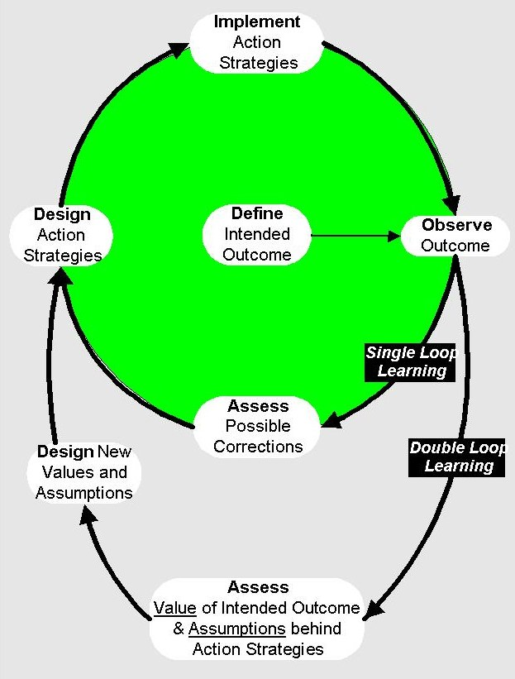
Meta-metrics for “Double Loop Learning”
Single loop learning:
Control loop with pre-defined outcome
Double loop learning:
Control loop that adjusts the defined outcome.
Source:
http://www.learning-org.com/
Notes:
Reference:
Knowledge for Action, by Chris Argyris
http://www.amazon.com/gp/reader/1555425194/ref=sib_dp_pt/105-6174943-1742028#reader-link

Slide 5
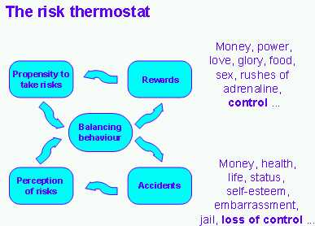
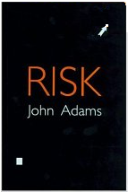
A Model of Risk Management
Source:
The point: Risk mitigation must be seen in the context of risk taking
Notes:
Reference:
Risk, by John Adams
http://www.amazon.com/Risk-John-Adams/dp/1857280687/ref=sr_1_1/105-6174943-1742028?ie=UTF8&s=books&qid=1186353219&sr=8-1

Slide 6
Learning –
Do We Know What We Need to Know?
Balanced Scorecard: "Learning & Growth” perspective
  Typically includes skills, employee retention/satisfaction, research, etc.
  Not independent of other metrics. Should link to other metrics in causal and feedback loops.
  Single loop vs. double loop learning
Learning in order to solve “puzzles”
  Security Awareness Training
  Security Management Training (incl. use of metrics)
  Incident Management (preparation, planning)
Learning in order to solve “mysteries”
  Threat awareness
  Emerging (and emergent) vulnerabilities
  Systemic risk
  Interdependencies with other enterprise risk “silos”
Covered in typical
security metrics
scorecards
Requires meta-metrics
Notes:
References for Balanced Scorecard:
http://www.quickmba.com/accounting/mgmt/balanced-scorecard/
The Balanced Scorecard: Translating Strategy into Action, by Robert S. Kaplan, David P. Norton,
http://www.amazon.com/Balanced-Scorecard-Translating-Strategy-Action/dp/0875846513/ref=pd_bbs_sr_1/105-6174943-1742028?ie=UTF8&s=books&qid=1186255906&sr=8-1
Reference for “Puzzles vs. Mysteries”:
http://www.smithsonianmagazine.com/issues/2007/june/presence-puzzle.htm

Slide 7
Learning in Order to Solve “Mysteries”
Mysteries
(open ended)
Puzzles
(closed ended)
Notes:
Reference:
Gregory F. Treverton, “Risks and Riddles”, Smithsonian Magazine, http://www.smithsonianmagazine.com/issues/2007/june/presence-puzzle.php

Slide 8
Learning Meta-metric Examples
(Focused on “Mysteries”)
Coverage approach
  % of security performance categories with a sufficient* set of metrics
  % of metrics coverage by threat type, or by enterprise architecture element
Decision effectiveness approach
  % of important management decisions that can be or have been influenced by double loop learning (i.e. revision and refinement of targets, measures, criteria, etc.)
Investment approach
  % of security metrics costs for “exploratory” vs. total metrics cost
    Analogy with oil exploration: exploratory wells vs. production wells.

Slide 9
Agility – Are We Adapting Fast Enough?
Tracking a moving target (analogy to control theory)
  Constant or linear drift, oscillations = typical linear control
  Stochastic process (Gaussian, Poisson, etc.) = simple adaptive control
  “Black Swan” process (“fat tail” distributions) = advanced adaptive control
    Regime-switching
  Evolutionary competitive game = strategic control
Information Security includes all types!
The heart of agility: Sense–Decide–Respond–Revise loop
Agility performance dimensions
  Speed of adaptation, response time (goal = adapt quickly)
  Cost of adaptation (goal = minimize # and size of course corrections)
  Average error (goal = stay “on target”, minimize under-shoot & over-shoot)
  Maximum response capability (goal = adapt to extreme changes)
easiest
hardest
Notes:
References on Agility:
Kathleen M. Eisenhardt, 1990, “Speed and strategic choice: How managers accelerate decision making,” Sloan Management Review, 32,3 (Spring): 39-54.
The Black Swan: The Impact of the Highly Improbable by Nassim Nicholas Taleb
http://www.amazon.com/Black-Swan-Impact-Highly-Improbable/dp/1400063515/ref=pd_bbs_sr_1/105-6174943-1742028?ie=UTF8&s=books&qid=1186265230&sr=8-1
Game Theory and Strategy, by Philip D. Straffin
http://www.amazon.com/Game-Theory-Strategy-Mathematical-Library/dp/0883856379/ref=si3_rdr_bb_product/105-6174943-1742028
The Evolution of Cooperation, by Robert Axelrod
http://www.amazon.com/Evolution-Cooperation-Robert-Axelrod/dp/0465005640/ref=pd_bbs_sr_1/105-6174943-1742028?ie=UTF8&s=books&qid=1186265380&sr=1-1
Business Agility and Information Technology Diffusion: IFIP TC8 WG 8.6 International Working Conference, May 8-11, 2005, Atlanta, Georgia, USA (IFIP International ... Federation for Information Processing)
http://www.amazon.com/Business-Agility-Information-Technology-Diffusion/dp/0387255893/ref=si3_rdr_bb_product/105-6174943-1742028
The Greatest Innovation Since the Assembly Line: Powerful Strategies for Business Agility, by Michael Hugos
http://www.amazon.com/Greatest-Innovation-Since-Assembly-Line/dp/0929652398/ref=sr_1_17/105-6174943-1742028?ie=UTF8&s=books&qid=1186259973&sr=8-17

Slide 10
Agility Meta-metric Examples
Speed*
  Cycle time from “Sense” to “Respond” for changing security metrics and management procedures.
Cost*
  Cost of changing security metrics and management procedures as % of total security management costs.
Error*
  % of security metrics that do not tie to any decisions or decision processes (over-shoot)
  % of decisions that have inadequate metrics support (under-shoot)
  % of metrics which have significant number of false signals
Maximum response capability
  Cycle time for rebuilding the security metrics system from scratch (100% transformation)
  * Could be calculated using historical data or forward-looking projections

Slide 11
Unintended Consequences –
Discovering and Mitigating
“You can see a lot just by looking” – Yogi Berra
  Conjecture #1: Most enterprise security programs have at least one major type of negative, unforeseen, unintended consequence.
  Conjecture #1: 99% of firms never look for unintended consequences.
Steps
  Identify – find out where they are, what type, relative significance, etc.
  Quantify – measure cost, frequency, maximum severity, etc.
Methods
  “Walk a mile in their shoes” – spend a few days per year doing what employees are required to do, constrained by their other job duties and performance goals.
  “Ride along” – observe actual behavior (field research)
  Surveys – opinions, attitudes, practices
  Root Cause analysis – TQM-style, post-mortem analysis of incidents, etc.
  Cost data mining – activity-based costing, correlation analysis, etc.
Notes:
Possible causes of unintended consequences include the world's inherent complexity (parts of a system responding to changes in the environment), perverse incentives, human stupidity, self-deception or other cognitive or emotional biases.
(Ref.: Wikipedia article: http://en.wikipedia.org/wiki/Law_of_unintended_consequences)
Robert K. Merton listed five causes of unanticipated consequences:
Ignorance (It is impossible to anticipate everything, thereby leading to incomplete analysis)
Error (Incorrect analysis of the problem, or following habits that worked in the past but may not apply to the current situation)
Immediate interest, which may override long-term interests
Basic values may require or prohibit certain actions, even if the long-term result might be unfavorable (these long-term consequences may eventually cause changes in basic values)
Self-defeating prophecy (Fear of some consequence drives people to find solutions before the problem occurs, thus the non-occurrence of the problem is unanticipated)
Merton is also said to have stated that "no blanket statement categorically affirming or denying the practical feasibility of all social planning is warranted.“
(Reference: Merton, Robert K. On Social Structure and Science. The University of Chicago Press, 1996. http://www.press.uchicago.edu/cgi-bin/hfs.cgi/00/13087.ctl)
Other references:
The Self-Defeating Organization: How Smart Companies Can Stop Outsmarting Themselves. By Robert Earl Hardy, Randy Schwartz
http://www.amazon.com/exec/obidos/ASIN/0201483130
http://books.google.com/books?id=Ri4HAAAACAAJ&dq=The+Self-Defeating+Organization
Edward Tenner, Why Things Bite Back: Technology and the Revenge of Unintended Consequences, Vantage Books, 1997.
http://www.amazon.com/Why-Things-Bite-Back-Consequences/dp/0679747567/ref=sr_1_1/105-6174943-1742028?ie=UTF8&s=books&qid=1186264761&sr=8-1
Yogi Berra quote: http://www.udmercy.edu/crna/agm/quotes.htm

Slide 12
Examples of Unintended Consequences in Information Security
Unnatural acts
Blame shifting
Excessive risk aversion
Inhibiting innovation, creativity, employee initiative
Higher costs
  Procurement
  Hiring
  Supply Chain
  Partnerships, relationships
Malicious compliance
Notes:
References:
The Self-Defeating Organization: How Smart Companies Can Stop Outsmarting Themselves. By Robert Earl Hardy, Randy Schwartz
http://www.amazon.com/exec/obidos/ASIN/0201483130
http://books.google.com/books?id=Ri4HAAAACAAJ&dq=The+Self-Defeating+Organization

Slide 13
Unintended Consequence
Meta-metric Examples
Existence
  Are there any unintended consequences above a given significance* threshold?
Degree of Significance
  Number or frequency of unintended consequences within each band of significance (ordinal or interval scale).
Cost
  Direct and indirect costs of unintended consequences (enumerated), as % of total information security costs (budgeted, both direct and indirect).
Perversity
  Number of unintended consequences that have unacceptable worst-case effects.
  Number of unintended consequences that prevent acceptable crisis response.
* “Significance” could be defined by cost, by opinion/concern, by behavior implications, or worst-case effect.

Slide 14
Conclusions
If your organization is in a simple, static environment, then no meta-metrics are required.
For everyone else, you should have at least one meta-metric each for:
  Learning
  Agility
  Unintended Consequences
There is no canonical or ideal set of meta-metrics for all organizations.
Need not be complicated or expensive to measure
Make a decent attempt
  A few “candles in the darkness” will dramatically improve performance
Notes:
These metrics need not be complicated or expensive to measure. The details of the metrics matter much less than the fact that you make a decent attempt to measure them at all. Even a few “candles” in this darkness will dramatically improve management of information security and its overall contribution to organization success.

Slide 15
Appendix

Slide 16
References
Organization Learning
  Knowledge for Action, by Chris Argyris
  Fifth Discipline, by Peter Senge
  John Boyd’s OODA framework:
    http://www.d-n-i.net/second_level/boyd_military.htm
Risk Management
  Risk, by John Adams
Balanced Scorecard
  http://www.quickmba.com/accounting/mgmt/balanced-scorecard/
Puzzles vs. Riddles
  Gregory F. Treverton, “Risks and Riddles”, Smithsonian Magazine,
    http://www.smithsonianmagazine.com/issues/2007/june/presence-puzzle.php
Unintended Consequences
  http://en.wikipedia.org/wiki/Law_of_unintended_consequences
  The Self-Defeating Organization, by Robert Earl Hardy, Randy Schwartz
  On Social Structure and Science, by Robert Merton
Agility
  Kathleen M. Eisenhardt, 1990, “Speed and strategic choice: How managers accelerate decision making,” Sloan Management Review, 32,3 (Spring): 39-54.
  The Black Swan: The Impact of the Highly Improbable by Nassim Nicholas Taleb
  Game Theory and Strategy, by Philip D. Straffin
  The Evolution of Cooperation, by Robert Axelrod
  Business Agility and Information Technology Diffusion: IFIP TC8 WG 8.6 International Working Conference, May 8-11, 2005, Atlanta, Georgia, USA (IFIP International ... Federation for Information Processing)
  The Greatest Innovation Since the Assembly Line: Powerful Strategies for Business Agility, by Michael Hugos

Slide 17
Meritology Resources
“Incentive-Based Cyber Trust – A Call to Action”
  Full paper PDF, 27 pages:
    http://meritology.com/resources/Incentive-based%20Cyber%20Trust%20Initiative%20v3.5.pdf
  Summary PDF: 6 pages:
    http://meritology.com/resources/Incentive-based%20Cyber%20Trust%20-%20Summary.pdf
“Total Cost of Cyber (In)security”
  PPT, Presented at Mini-Metricon in Feb. `07
    http://meritology.com/resources/Total%20Cost%20of%20Cyber%20(In)security.ppt

