Slide 1

Security Metrics in the
4th Dimension
Notes:
My name is Richard Seiersen, I am here today to present to you on “Security Metrics in the 4th Dimension”. Unfortunately, I have decided I don’t like that title – its misleading to the sci-fi minded of you…and I believe many of you to be of that ilk and I hate to disappoint. To be clear, my discussion will not have the slightest correlation to outer space or little green men….although the 4th dimension will play a huge part…..just not in the way you might think.

Slide 2

Operational Metrics
Data Modeling
& The Art of the Good Question
By Richard Seiersen
Notes:
My focus will be on the meat and potatoes of metrics….i.e. operational metrics. Technically speaking, I will look to emphasize data modeling and the collection of data (etl) for effective metrics. i.e. the basic operational mechanisms for developing a rich data palette for reporting. This will be done by example, showing “how we are doing it”.
The reason I am going “meat and potatoes” in this talk as opposed to something more esoteric, is due to my assessment that we probably don’t do as good of job on the basics of security measurement as we ought. I believe there are some causes for the lack of maturity….but the one I feel is at the root, at least for this discussion, is the fact that we jump to making our graphs and charts……without having ever heard what the original “questions” from our stakeholders were.
Metrics is about answering explicit and implicit questions that various stakeholders may have. Therefore, Questions, good questions from the right stakeholders ……is where I will begin….

Slide 3

Who would cross the Bridge of Death must answer me these questions three, ere the other side he see
So What?!
Notes:
In my company, we meet twice a month to cover metrics. We started out roughly two years ago with a 10 page PowerPoint. Over the past two years, this ppt as gone over 100 pages….many of the pages will have one or more graphs on them.
I have noticed that there are two consistent questions asked of anyone in the metrics hot seat – i.e. defending their metrics against scrutiny. The first, most asked question is “So What?”. This could be translated as, “why is this important to me?” Or “Yeah, I see a pie with lots of red….we have lots of red…..and so what are you trying to tell me?”

Slide 4

The Three Standard Dimensions
Risk
Time
Value
Conforming Dimensions……..
Notes:
“So What!” is a value dimension question. It’s a questions that looks to determine what the denominator is.
Value can be practically understood as an asset, or perhaps and entity. Asset could be a server, it could be data, it could be identity etc. But that “entity” is further understood by its value. i.e. not just a server, but a server relegated to some business purpose of concern.
The other two dimensions are time and “risk”. I say “risk” in quotes as short hand for vulnerabilities and threats…at any layer of any type you happen to be measuring. So, vulnerability is not just CVE, but it could be all the classes of vulns up and in the stack.
Lastly, Time and Value are what we call conforming dimensions. These are dimensions that will show up in most all dimensional data models…….they represent the data glue that allows for asking questions across “domains”….or in BI terms asking “Drill Across and Drill Down questions”.
For clarities sake, lets look at some examples of metrics graphs that represent our 3 dimensions…..and how we approach answering “so what?”

Slide 5
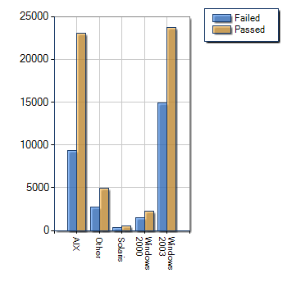
One Dimensional Metrics
Risk(ish)
Asset(ish)
Notes:
This metric is barely one dimensional based on my description. We have a semblance of asset in the form of OS – but no value statement for the assets. We also have some sort of risk in the form of pass/fail and a count – but no depth in terms of risk. Short of more context this qualifies as one, or perhaps no dimensions…..not a lot of value. I would argue that many novice metrics folks will present something like the above. Most security solutions, vertical solutions, present the above only….

Slide 6
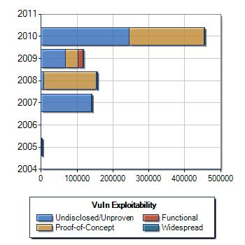
Two Dimensional Metrics
Exploitable Vulnerabilities By Age
Time
Risk
Notes:
This is a two dimensional metric of sorts. Its actually show time as it applies to the aging of vulnerabilities aggregated to a year. It furthermore explodes out the risk rating a bit by adding exploitability aggregates from a risk dimension. This metric still begs the question “so what?”. i.e is this “good or bad?” or “Are we at risk?”

Slide 7
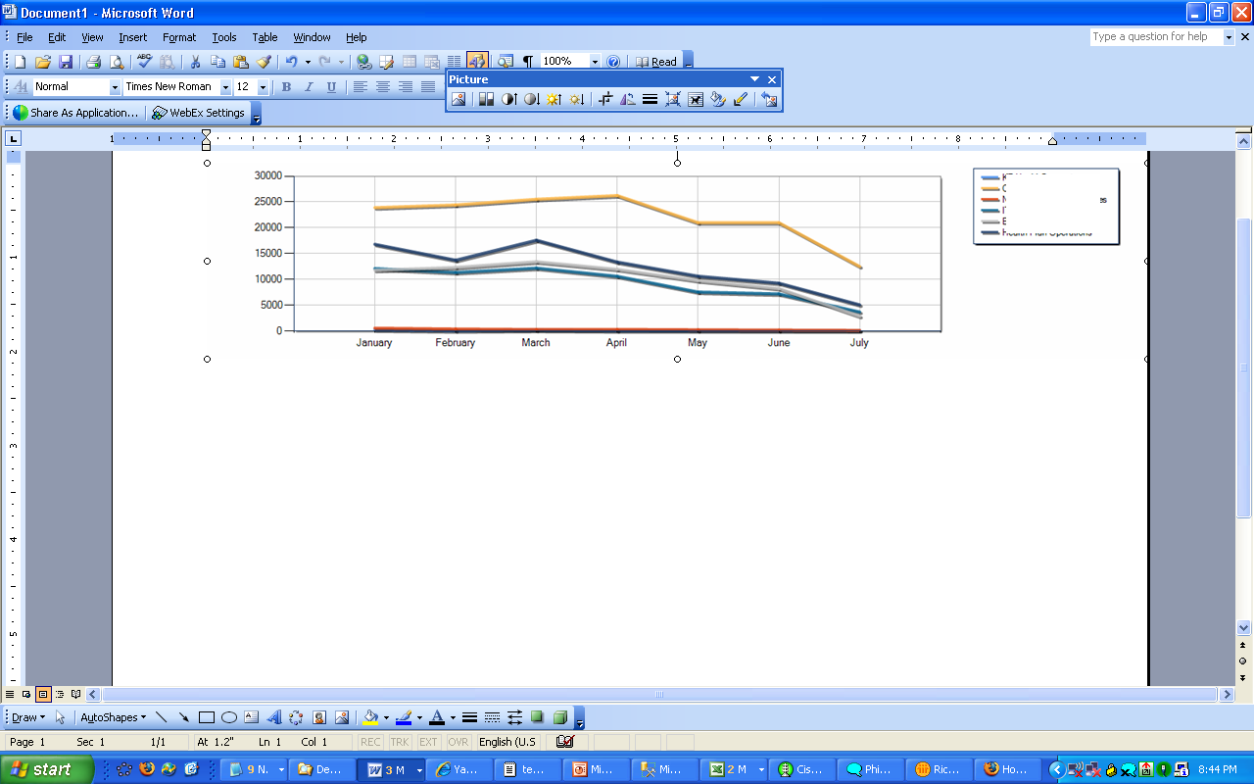
Three Dimensional Metrics
Risk
Critical Exploitable Vulnerability Trend for High Value Portfolio Assets
Asset
Time
Notes:
This graph approaches a three dimensional metric in that it has all 3 elements of time,value,risk. (Risk = ‘Critical Exploitable Vulnerabilities’ and Asset/Value = ‘High Value Portfolio Assets’)
This is a standard graph. But, I would argue that while it measures what looks to be a downward trend……even a drill down to specific assets and their vulnerabilities will not answer the next question that our executive or (Bridge Keeper) would have……
Before we get into that “next question”…we need to take a brief technical excursion into dimensional and data modeling…..

Slide 8
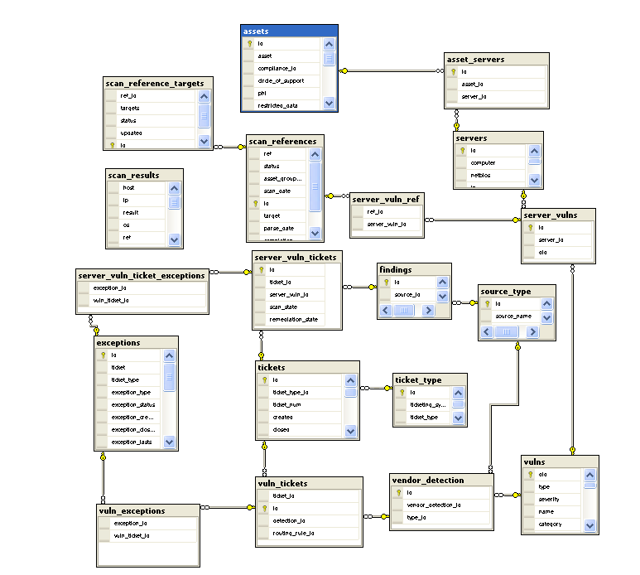
Data Model Excursion: Vulnerabilities
Dashboard Queries are
complex & slow
Notes:
Here is a picture of a standard data model…..a transactional model. Often called a third normal form model. In short, standard data models look to break down subjects into their most atomic parts. That typically means, you have lots of tables to hold that broken down data.
Typically, while “3rd normal form” data models are considered normalized….. Each table has its own subject matter. By breaking things down as such, it makes the model more flexible to meet various business changes. But, with that flexibility comes a prices.

Slide 9
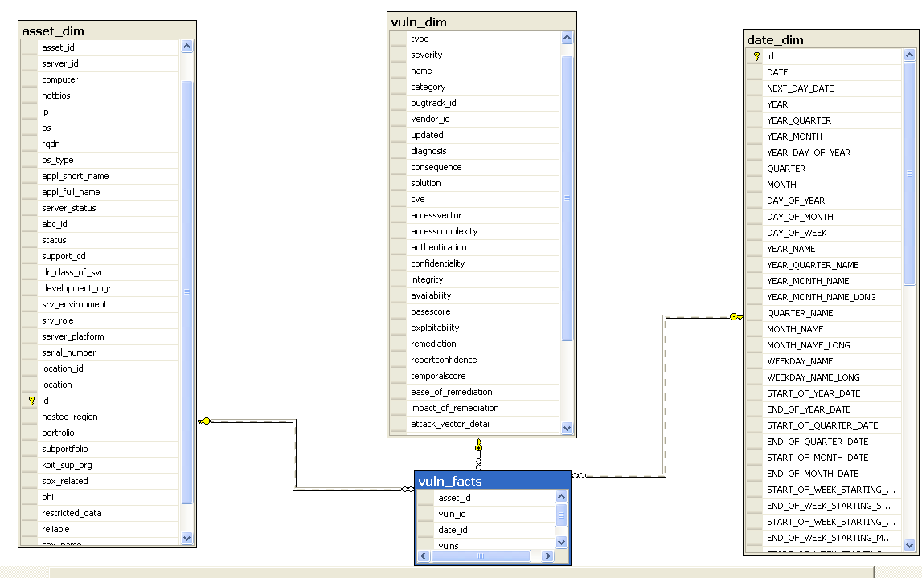
Data Model Excursion: Dimensional Modeling
Speed For Large Dataset
Stakeholder Accessible
Notes:
Practically speaking, we need to model out our security domains to the third dimension. Many stakeholder questions can be answered with this sort of model. Note the richness, or width, of these dimensions.
We will talk more on dimensional modeling as this presentation progresses. The main rationale for moving into dimensional modeling are:
Speed: You wants speed for your big questions. Stakeholders will not sit around for a dashboard with 10 graphs that take 20-60 seconds per to realize…that is 10 graphs in one page….that can be a drag. You need to aim for sub second response. If response is quick, drill down will occur, and questions get answered….and metrics get wider play and become of key strategic value.
Stakeholders: Dimensional models are easy to query, and easy to put into user interfaces. With a good dimensional model you are one or two steps away from self service web interfaces. Also, if you staff is not full of SQL wizardry, you can turn this over with minimal training to the complete neophyte…as I have done.
Dimensional data modeling embodies the principles of “domain driven design”. A data mart, like the one above, models the specifics of our security domain– its quick, easy and iterative. A domain driven datamart can be put together in a few hours with the right toolsets and skills.

Slide 10
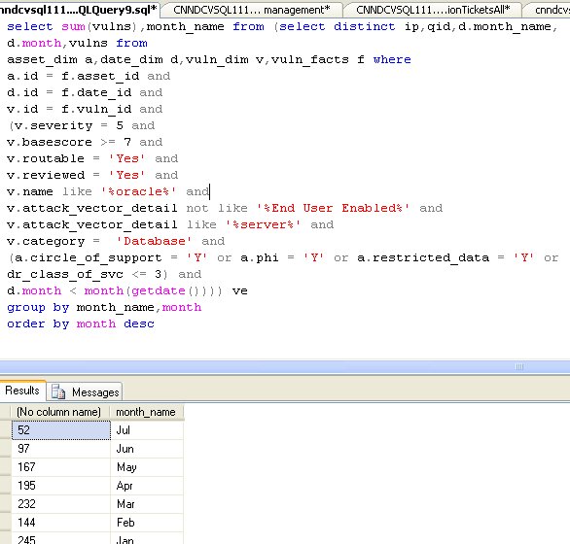
Query Example #1 VulnMart
Simple Joins
Risk Dimension
Asset Dimensions
70 Million Records < 1 Second
Not Real Data – Demo Only
Notes:
This is a quick and dirty query of the previous mart. In reality, we would likely build a vendor specific cube in Microsoft SSIS, Cognos, Pentaho etc….

Slide 11
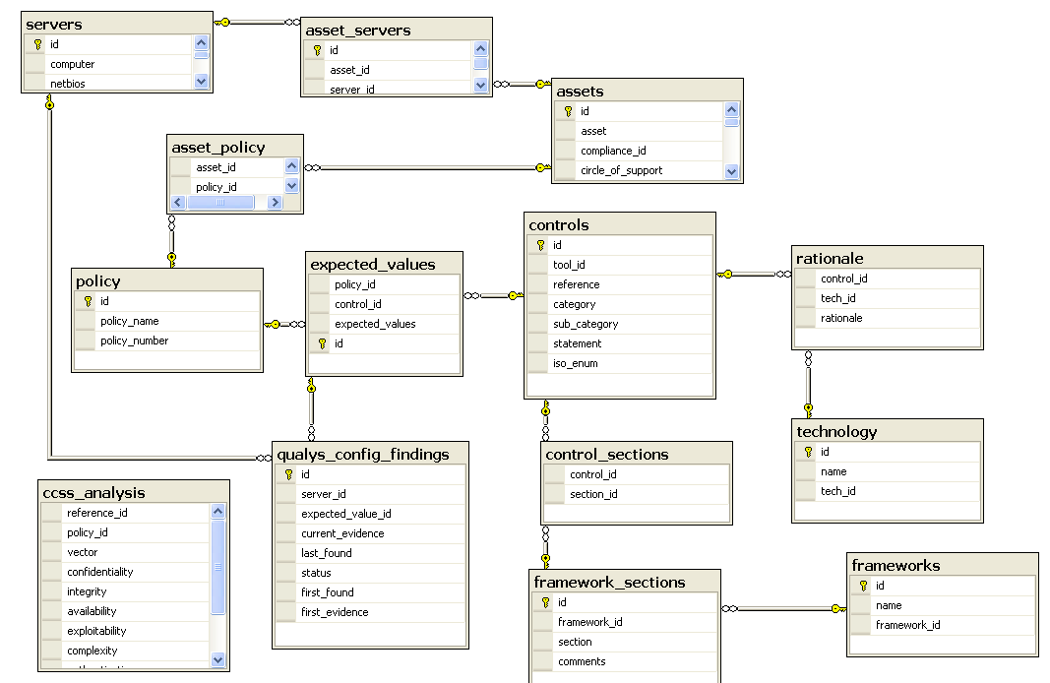
Configuration Management
Numerous Controls…beta application of CCSS
Notes:
Here is a small snapshot of our OLTP for configuration management. We use CCSS to provide a richer set of parameters for determining impact. Nonetheless, most aggregate queries have 10+ tables…..due to normalization…..this will not be acceptable for dashboarding…too slow.

Slide 12
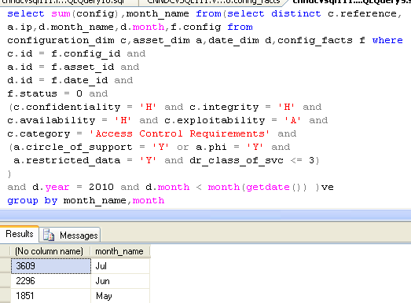
Query Example #2 ConfigMart
Simple Joins
Risk Dimension
Asset Dimensions
Not Real Data – Demo Only
Notes:
Here is an example from our configuration management datamart. This mart reuses both asset and date dimensional tables.

Slide 13
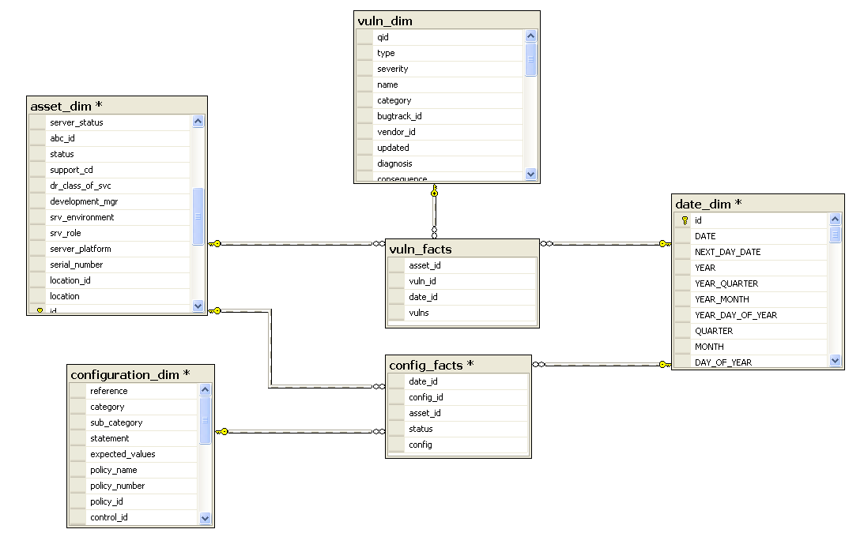
Conforming Dimensions
Conforming Dimensions
Support Drill Across
Notes:
Here are two transactional marts, one for vulnerabilities, one for configuration items. We are now ready to ask “drill across questions”…..

Slide 14
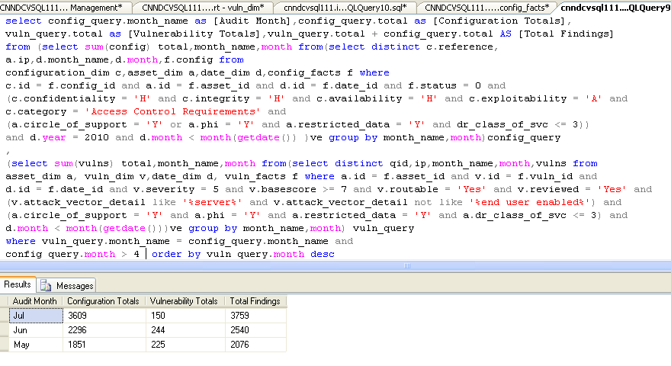
Drill Across And Down Query Example: Vuln & Config Marts
Risk & Asset
Risk & Asset
Drill Across 2 Domains <= 3 Seconds
Notes:
This represents drill across aggregates for two marts…very fast. You can use the data contained to create any sort of graphical representation. For example, we could do a layer of drill down that break things out by business portfolio, region and impact to SOX etc. We can then use ratios of controls to servers to represent data in more of a heat map etc…. In short, we have a very flexible, high speed data palette for answering a myriad of risk related questions.

Slide 15
Who would cross the Bridge of Death must answer me these questions three, ere the other side he see
What are you doing about it?!
Effectiveness
Notes:
If we do a VERY good job in terms of developing rich “WIDE” 3 dimensional models, the savvy bridge keeper will then ask …….”What are you doing about it!?”
That question should be taken to mean “What are you doing to manage the risk I see in this graph?” Or, “What part are you (your program and investments) playing in managing this risk, and although its declining, is it enough?”
“What are you doing about it?” Is trying to measure the effectiveness of your security controls. I don’t think many people, certainly not tool vendors, approach this as a standard question.
Before I go to deep into the 4th dimension of effectiveness….we need another brief excursion…this time into soft skills

Slide 16
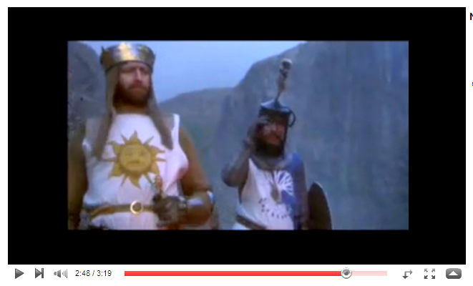
Soft Skills Excursion: Decision Making and Clarifying Questions
Zero day threats, where there is no mitigating control, with active exploitability and applicable to internet and or critical apps must be deployed in one business day by end of Q4. All the rest on regular patch schedules.
How would you know, specifically, that our program is effectively managing this risk?
Notes:
This is the soft skills portion of our show…… “The Art of asking Questions”. I have covered dimensional modeling and the rationale. One could argue that is putting the cart before the horse. In reality, our designs need to be goal/business driven. In many cases, we need to become “metrics counselors” to help our execs create well-formed business goals.
The above goal is not bad. You should shoot for 10 or so such statements…those become your metrics….and one or more marts can be modeled off of these “Goal Statements”. Your dimensions and facts should be contained with well-formed goal statements.
In short, goal statement needs to be Dimensional…which requires coaching. For security, they MUST contain:
Asset/Value – again not just “servers” but servers for xyz purpose
Risk: This is a vuln/threat risk that has some weights and typically some exploitability context.
Date: The Goal needs to be bound to time
Effectiveness: There needs to be a target number….bound to time.
Now that we have a good goal in mind…..we need to step into the fourth dimension.

Slide 17
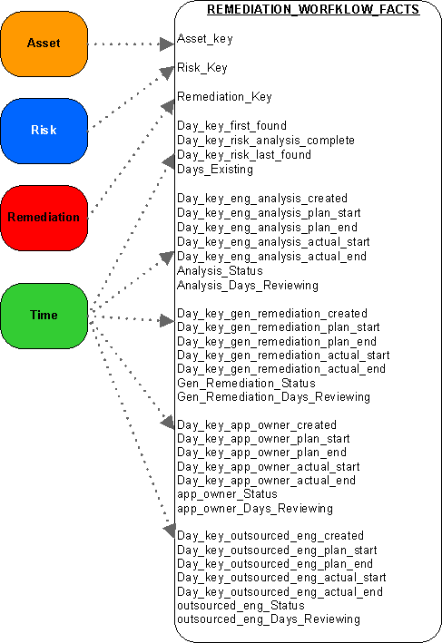
4th Dimension
The Accumulating Snapshot
High Speed Aggregates
For Complex Processes
Tool for applying
effectiveness rules and
measuring success
Notes:
This is THE data structure for modeling effectiveness – for answering the question “what are you doing about it”.
Most security “events” have a life…and death. Some, have a very short life. Some events live months on end. For the majority of your incidents and remediation stuffs this model should suffice.
In short, you end up having one line per item. IN this case, we have:
Asset Dimension – in Orange
We have a Risk Dimension – In Blue. Risk could be a list of vulns, threat, compliance items etc.
Remediation: This could also have been titled “workflow” but this is a dimensional key that holds content relative to a ticket, project, incident etc.
Time: This is the most active of dimensional tables in this case. Most processes have 2 time keys. Start, and end. For my main business, we have close to 20 different “stages” that we measure for SLA.

Slide 18
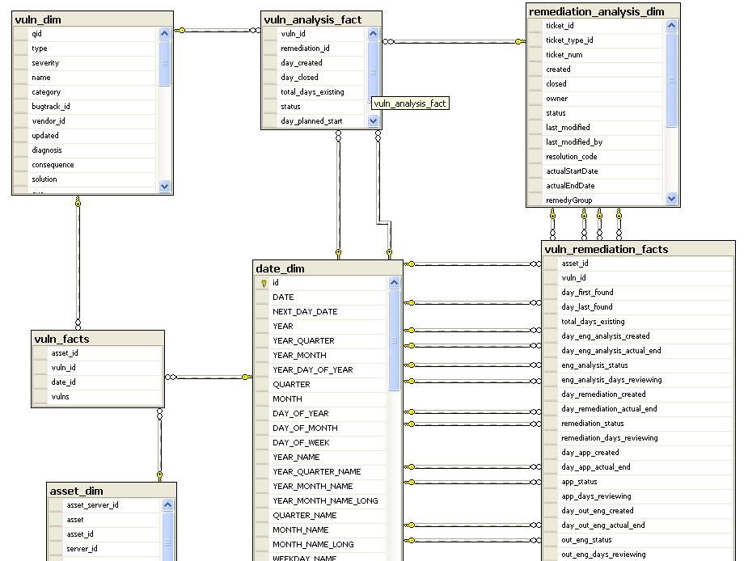
Accumulating Snapshot: AKA Effectiveness Mart
Notes:
Here is the aforementioned schema in all its glory – in BI terms this represents an accumulating snapshot. In short, its designed to lets us now specifically, or in the aggregate, how long it is taking to manage out risk. This particular model is oriented towards vulnerabilities.
To help simplify. Note the 4 connections from the remediation_analysis_dim. In this case, we are modeling 4 macro processes, and each processes has 4 stages. Each stage has a rolling number that represents the number of days that something is at a certain stage. SLA’s and OLA’s are applied to these stages in terms of metrics.
With this model, we can find out which risk, related to which type of asset, for which region, portfolio, exploitability etc is being managed to SLA. We could also see how long our third parties take to do risk analysis and or to push patches or do manual remediation assigned to them (at least I can, since that is our business model).
This is a very, very, very fast way of getting at performance metrics. Processes are Hierarchical…very tree like and bi-directional. That means data gathering is recursive….and recursion over millions and millions of rows is exponentially slow. All the more reason for flattened dimensional models to represent risk management processes.

Slide 19
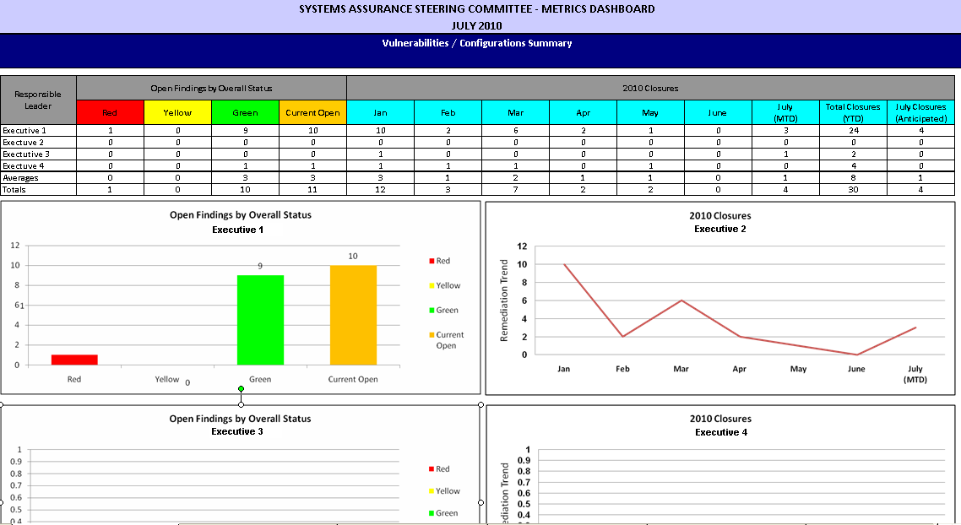
Accumulating Snapshot Based Stakeholder Dashboards : In SharePoint
Notes:
The previous data model makes creating effectiveness dashboards quite simple. The chart above is one used at my company for corrective action plans. Its just a format…and its terribly un-exciting….but it just so happens that the accumulating snapshot easily accommodates this model.
What is important, is that the UI may change…radically, but the data model underneath will accommodate N permutations will drill down and drill across…rapidly.
Names are abstracted on the left, but we put the accountable executive there to show “owned” accountability. The executive can then drill down to find out who in their org owns what for the risk being dashboarded.
So, on the top matrix, any item becomes drill down capable. Drill down by Name, to group, or back up to and across to portfolio.
Typically, the child charts below would hold drill downs as well. (if you recall my demo I drilled down and across 8 times….without nearly exhausting options)
In my opinion, graphs that show movement towards specific goals, and shows the accountability are the bees knees from an operational security perspective……

Slide 20
Conclusions
Good data begs good leading question. Your questions should imply a goal based dimensional answer…in the 4th Dimension. Having a formal decision making model can help as well, there are many out there. Having linguistic tools to clarify goals is also a plus. (For example, transformational grammar as understood in ‘The Structure of Magic,Vol 1’)
Dimensional models: …are great for modeling operational goals and I think we as an industry should adopt as standard practice. The ultimate standard 4th dimensional model is the accumulating snapshot. There are any number of books on Dimensional Modeling. (I favor anything by Ralph Kimball and his followers.)
Future: Data containers may change, SQL may become a thing of the past as massive unstructured sources become our reality. Nonetheless, asking good dimensional, set based, questions of any data is here to stay. A very interesting area of exploration in terms of unstructured data as discussed during Metricon is the place that Hadoop and related technology plays in Big BI. A great subject for a future Metricon…and where I think (hope) the “risk intelligence industry” will be focusing near term.
Call for participation: I am looking to put together an online cookbook of “Risk Intelligence Patterns, Visualizations and Tools” This endeavor is bigger than one pilgrim. So, if you would like to explore participation contact me : richard.b.seiersen@gmail.com

