Slide 1
Gamifying vulnerability report data to encourage coordinated disclosure: The making and remaking of the MSRC Top 100
Christa Anderson
Senior Security Program Manager, Microsoft Security Response Center

Slide 2
A little background
What is the Microsoft Security Response Center?
What happens when you report a vulnerability?
What is Coordinated Vulnerability Disclosure?

Slide 3
The MSRC encourages CVD in several ways
Awareness of CVD
Bounties
Public acknowledgement
The Top 100 announced at Black Hat USA is a key part of our public credit strategy

Slide 4
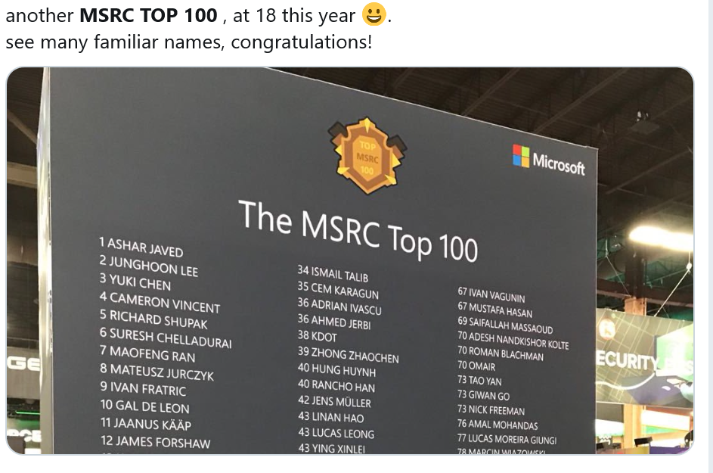


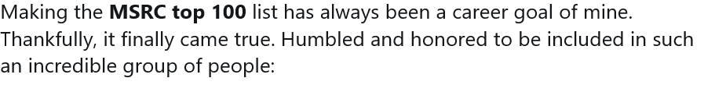
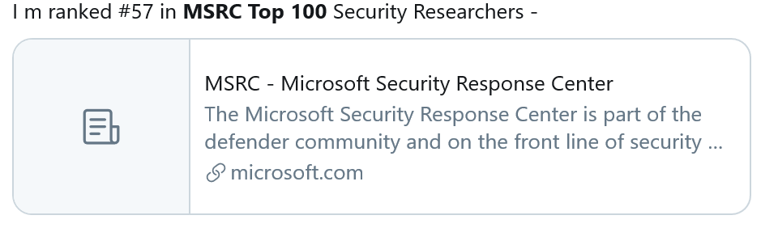
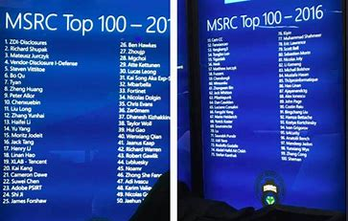
Researchers really, really respond to the Top 100
Researchers watch this measure closely
They notice not only whether they’re on the list but what their rank is, how it compares to last year, and where everyone else is

Slide 5
The Top 100 isn’t just how many issues someone reported
Is it actionable?
What’s the security impact?
How do we credit reports that improve security but aren’t reports of vulnerabilities?
Who gets the credit?
How severe is it?
Notes:
We follow the STRIDE+ RCE model for impact

Slide 6
You can slice even these few data points in several ways

Slide 7
Example #1: Most impactful submitters since MSRC established
Time period
Since 2004 (decay applied every 6 months after 18 months)
Cases included
All reported under CVD and either fixed or in development
Credited to
Report submitter if report acknowledged
Severity limits
Final points
(Severity Points * Impact Multiplier) + Mitigation Bypass Points
Result
Rewards long-time finders with reporting vulnerabilities affecting multiple products. Weights in favor of long-running products/services
Critical, Important, Moderate (5 -3 -1)

Slide 8
Example #2: Most impactful direct submitters of previous 12 months
Time period
12-month period June-June
Cases included
Master and duplicate cases fixed in current period
Credited to
Report submitter if report acknowledged but not aggregated reports from a third party
Final points
(Severity Points * Impact Multiplier + Mitigation Bypass Points
Result
Rewards those who report high-impact and actionable vulnerability directly to Microsoft
Severity limits
Critical, Important, Moderate 5-3-1 scale

Slide 9
Example #3: Most impactful submitters of previous 12 months
Time period
12-month period June-June
Cases included
Master and duplicate cases fixed in current period
Credited to
Acknowledged finder, regardless of whether they reported directly or through a third party
Final points
(Severity Points * Impact Multiplier + Mitigation Bypass Points
Result
Rewards all effort and seeks to give more credit for high-severity issues
Severity limits
Critical, Important, Moderate 9-5-1 scale

Slide 10
Tweaking formulae isn’t the solution
Sure, repurposing data has problems…
Values assigned to severity and impact are arbitrary
Attribution can be tricky because of the way data is stored
Everyday data management/cleanliness issues that pop more given the way it’s published
But the real issue is that we need to update the model to drive the behaviors we want.
And the measures aren’t complete…
How do we take into account customer impact?
Should we consider report quality?

Slide 11
How do we use the Top 100 to get higher-impact reports?
Smooth path to attribution
Give people time and information to adjust their behavior
Promote products/services where we’d like to encourage interest
Account for helpful behaviors (e.g., great quality reports) and non-helpful behaviors
Account for non-actionable reports

Slide 12
How are you using risk data to nudge human behavior?

Slide 13
Thank you!
Christa.Anderson@microsoft.com
@virtualchrista
secure@microsoft.com
@msftsecresponse

