Slide 1
Tactical Metrics don't lead to Strategic Investments
March 22, 2019
Notes:
tart with quick intro
Conclusion
“Abstract Don’t Abdicate” Abstract your metrics so you aren’t abdicating making strategic decisions
What Does that Mean:
Leadership can get too focused on details, up/down, trends, technologies in the numbers. Making everything tactical
Using tactical approaches you can't properly change your program
Leadership may want instant changes, but that might not make sense
Use your metrics to give senior managers a health check.
We all know whats “good” blood pressure and an average resting heart beat.
If you are outside of that value, doctors will look to find the “why”. They will figure out the right next steps and the strategy to bring that into normal levels OR accept that level.
Now imagine giving test results to a patient. THey need to research, determine the right value, and they will plan their next steps. However, they only respond to the data they were given and without the experience and education that comes with being a doctor
Same thing happens in security. With all the fun data, we give the test results to senior managers and they will then give you a tactical solution to make that data you presented “better”.
That solution may be strategic, but since many senior IT people are not security people, they are often point fixes with gains that fall away after a few months.
So if you abstract the metrics so that they become simple aggregates, senior managers don’t have an opportunity to discuss tactical fixes. Instead, they have to ask “how much does it cost me to move this number up?”. Security leaders can translate that want into $. Senior leaders can then decide is that $ increase is worth it.
But how are you addressing the risk side of that equation? Well..no matter what, you have to have some trust with your leadership that you are doing your job. No metric program will generate that.
Because higher will always be better, use a control framework that helps ground the categories to work on. Set an anchor with competitors or industry.
THis was the end of the presentation, if you want to know a little more, stick around and we will tell you how we got to this conclusion
Current offerings
Before making up our own, we looked at the market to see what looked good. We looked at Archer, rapid7, and a few others.
Some were too complex or pricey with very debatable ROI propositions
Some had secret sauce so you didn’t know how to invest and improve your score
Almost all pre-canned approaches didn’t use an open control framework (back to secret sauce) that we felt was necessary to be transparent about our program and how we measured
So back to the drawing board.
We wanted it to be simple
Anyone reading it could answer “so why measure this?” . They knew what sounded “good”. THey had an internal anchor to tell them how far from “good” its acceptable to be. Part of that risk tolerance question
So we picked a framework. CSF was simple, open, and universal
We generate a long list of KPI’s that we assigned to each category from books like Andrew’s, blogs, magazines, anything that said “you should measure this”.
Then we built the principles that each KPI would be evaluated against.
The principles evolved as we went along, but there were some core things like
Simple to understand at a Board level
Can be measured with levels
Not binary
Not compliance driven (supports binary)
So fundamental that anyone looking would say “yup..thats one of the most important things to a security program”
We selected 20kpis
Here are a sample of what we selected
This is the maturity. How did we get maturity? We went back to the internet and loked for articles on what it should be. We looked at contracts (great for things like incident response and patching). We asked people outside security like IT, legal
THen we put them on the ranking system with ranges
Result
See the graph..simple..want to move up. A simple numeric that says “you increased 2 pints, thats a 1% increase and a 1% decrease in risk
Risk tolerance is put against cost.
Metrics exist that say % of spend against revenue and IT budget. We track those seperately. This helps “bound” the risk tolerance conversation.
But the tool looked at the cost and the reduction of risk. So management could see where we are investing.
1

Slide 2
Conclusion
Abstraction, not abdication
Abstract your metrics so you are not abdicating making strategic decisions.
Communicate using simple aggregate scoring built on an abstraction of security health
Use a control framework to organize your metrics
Do not provide tactical metrics because senior management will decide your tactical solutions
2
Notes:
Conclusion
“Abstract Don’t Abdicate” Abstract your metrics so you aren’t abdicating making strategic decisions
What Does that Mean:
Leadership can get too focused on details, up/down, trends, technologies in the numbers. Making everything tactical
Using tactical approaches you can't properly change your program
Leadership may want instant changes, but that might not make sense
Use your metrics to give senior managers a health check.
We all know whats “good” blood pressure and an average resting heart beat.
If you are outside of that value, doctors will look to find the “why”. They will figure out the right next steps and the strategy to bring that into normal levels OR accept that level.
Now imagine giving test results to a patient. THey need to research, determine the right value, and they will plan their next steps. However, they only respond to the data they were given and without the experience and education that comes with being a doctor
Same thing happens in security. With all the fun data, we give the test results to senior managers and they will then give you a tactical solution to make that data you presented “better”.
That solution may be strategic, but since many senior IT people are not security people, they are often point fixes with gains that fall away after a few months.
So if you abstract the metrics so that they become simple aggregates, senior managers don’t have an opportunity to discuss tactical fixes. Instead, they have to ask “how much does it cost me to move this number up?”. Security leaders can translate that want into $. Senior leaders can then decide is that $ increase is worth it.
But how are you addressing the risk side of that equation? Well..no matter what, you have to have some trust with your leadership that you are doing your job. No metric program will generate that.
Because higher will always be better, use a control framework that helps ground the categories to work on. Set an anchor with competitors or industry.
THis was the end of the presentation, if you want to know a little more, stick around and we will tell you how we got to this conclusion
2

Slide 3
Disclaimer
Create a highly untechnical, completely simple, un-sophisticated way to present a rather technical and complex data.
WARNING: This presentation and the concepts we discuss will not blow you away with life changing ideas. It’s pretty much the anti-big data/real-time/threat intelligence metrics program.
3
Notes:
Our Mission - simple, untechnical and board
3

Slide 4



The Challenge
Traditional cybersecurity metrics programs are overloaded with streams of data that focus volume over value.
Industry has developed tools to reflect this same desire and cater to a highly technical audience primarily focused on self-measurement.
Challenge
We are proposing a different approach which has been successful at Abt Associates that focuses on a metrics program for non-technical decision makers and risk owners.
We use uncomplicated metrics that are focused on communicating risk and guiding investments.
How We Addressed the Challenge
Benchmarked against industry
KPIs are Simple
Maturity Grades are Assigned
Change Over Time
Actionable
Benefits of Approach
4
Notes:
The Challenge
Before making up our own, we looked at the market to see what looked good. We looked at Archer, rapid7, and a few others.
Some were too complex or pricey with very debatable ROI propositions
Some had secret sauce so you didn’t know how to invest and improve your score
Almost all pre-canned approaches didn’t use an open control framework (back to secret sauce) that we felt was necessary to be transparent about our program and how we measured
4

Slide 5
The Approach
1
Pilot
Bring in outside risk and cyber experts to pilot a manual metrics program that crossed entire risk footprint (Cyber, IT, HR, Vendor Management). Mapped metrics to NIST CSF. Benchmarked and built target metrics.
Phase 1
Phase 3
Validate
2
Brought independent Big 4 firm to validate approach and methodology behind the program
Phase 2
Automate
3
Developed a web-based application to automate data ingest via API, data entry and reporting.
5
5
Notes:
The Approach (3 Phases)
We wanted it to be simple
Anyone reading it could answer “so why measure this?” . They knew what sounded “good”. THey had an internal anchor to tell them how far from “good” its acceptable to be. Part of that risk tolerance question
So we picked a framework. CSF was simple, open, and universal
We generate a long list of KPI’s that we assigned to each category from books like Andrew’s, blogs, magazines, anything that said “you should measure this”.
Then we built the principles that each KPI would be evaluated against.
The principles evolved as we went along, but there were some core things like
Simple to understand at a Board level
Can be measured with levels
Not binary
Not compliance driven (supports binary)
So fundamental that anyone looking would say “yup..thats one of the most important things to a security program”
5

Slide 6
Sample KPI
CSF Function | Question | Topic | People/Process/Technology | KPI
Protect | How effective is our ability to develop and implement the appropriate safeguards to ensure delivery of critical infrastructure services? | Training and Awareness | People | Average phishing pass rate on phishing exercises
KPI | Maturity Levels | Rational for Maturity Levels
Average phishing pass rate on phishing exercises | 4 - > 92% | < 8% Phishing Fail Rate Department of Health and Human Services goal PhishMe reports that 58% of users will click on a phishing link prior to training. http://phishme.com/story-phish-infographic/
 | 3 - > 80% - 92%
 | 2 - > 58% - 80%
 | 1 - > 0% - 58%
 | 0 - Unknown
6
Notes:
(Sample KPI) We selected 20kpis
Here are a sample of what we selected
This is the maturity. How did we get maturity? We went back to the internet and loked for articles on what it should be. We looked at contracts (great for things like incident response and patching). We asked people outside security like IT, legal
THen we put them on the ranking system with ranges
6

Slide 7
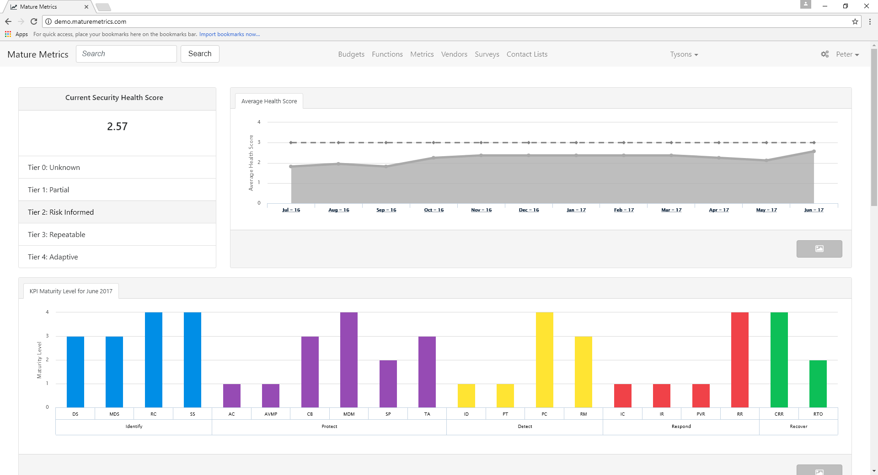
Our Results
Notes:
See the graph..simple..want to move up. A simple numeric that says “you increased 2 pints, thats a 1% increase and a 1% decrease in risk
7

Slide 8
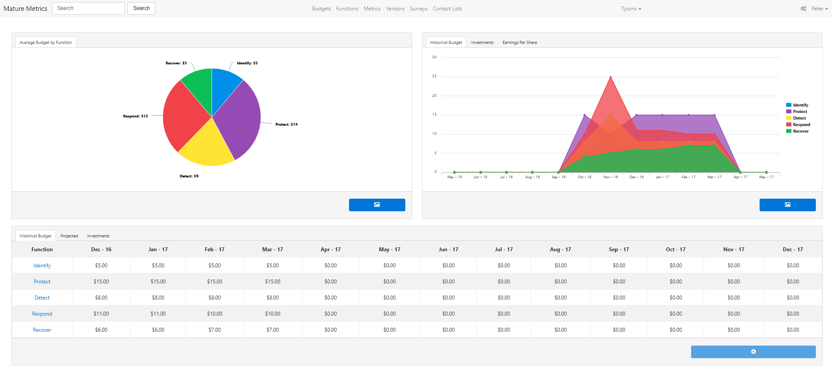
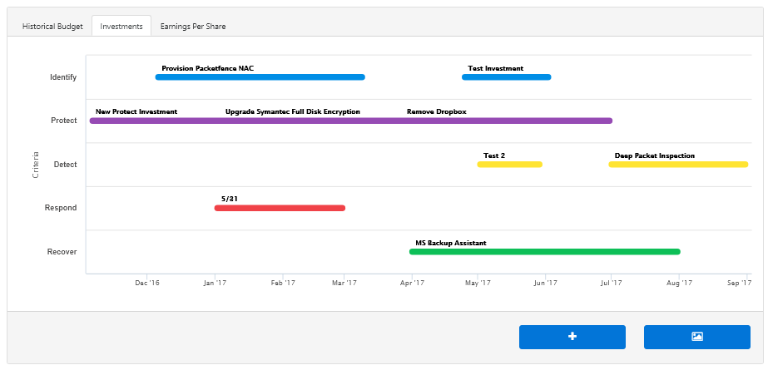
Risk Tolerance & Cost
8
Notes:
Metrics exist that say % of spend against revenue and IT budget. We track those seperately. This helps “bound” the risk tolerance conversation.
But the tool looked at the cost and the reduction of risk. So management could see where we are investing.
8

Slide 9

Brian Gay
Managing Director
Brian.gay@northramp.com
(703) 989-3251
Sean Owen
Senior Director
Sean_owen@abtassoc.com
(301) 347-5734

