Slide 1
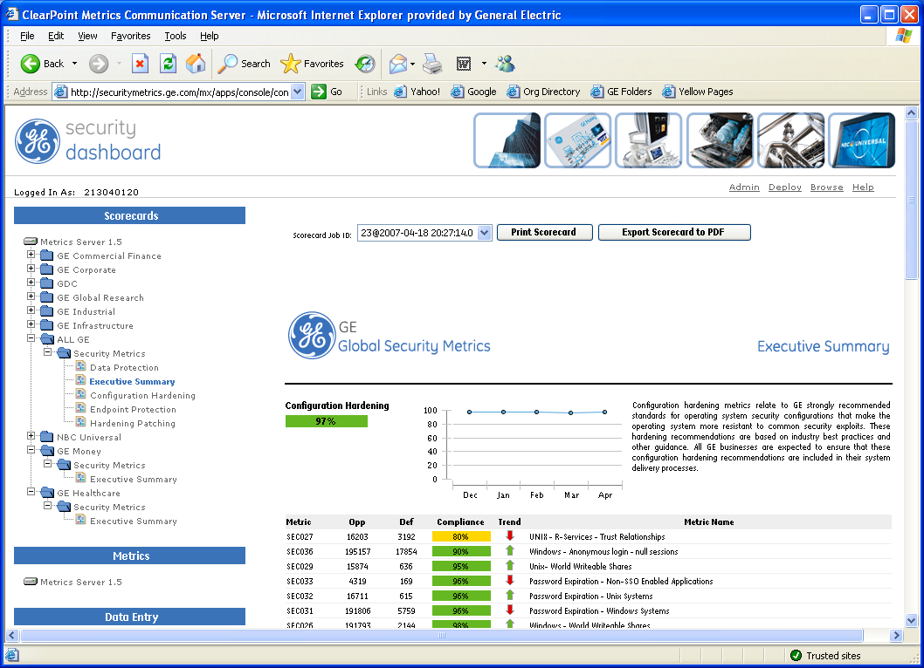
GE Global Infrastructure Services
Security Metrics Automation
Brad Freeman
GIS Security Services
August 7, 2007

Slide 2
Some guiding principles…
Simple
  Simple, intuitive user interface – standard APIs for data collection
  Clear, actionable reports – scorecards, charts, trend reporting
Flexible
  Able to handle diverse sources of input
  Adapts easily to organizational and policy changes
Hierarchical
  Data roll-up to corporate level, sub-business “drill down”
  Role-based delegation of administration – scalable architecture

Slide 3
GE Security Metrics Process
Cisco Netflow
XML Metrics Submission
AV, HIDS, NIDS
DEFECTS
Suspect Management
Suspects
Summary Reports
Manual Inputs
Defect Summary
WSUS/EBR
Vulnerabilities
Opportunity Summary
DB/SIM
Detail Reports
Vuln Scan
Defect Detail
Manual Inputs
Assets
Executive Dashboard
Asset Mgmt
Opportunity Detail
E-mail Reports
Discovery Scan
OPPORTUNITIES
Subnet Discovery
Subnet Inventory
Manual Inputs

Slide 4

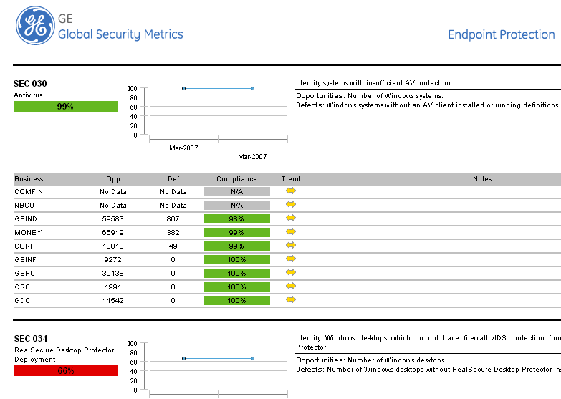
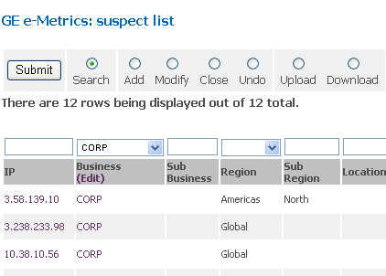








GE Security Metrics Reporting
SIM
Future
Security Information and Event Management
Security Dashboard
Security Metric Summary Reporting
Suspect List
Threat/Vulnerability Detail Reporting
Manual Data Entry
Subnet Inventory
Datasets
GE Policy Metrics
Controllership Metrics
- Business-specific Metrics
JDBCs
Process automation opportunity!
- Cisco Net Flow Alerts
AV/HIDS/NIDS Alerts
Scan Vulnerabilities
Manual Data Entry

Slide 5
GE Security Dashboard
Business Drill Down
Comparative Views
Export to PDF
Trend Charts
Executive Summaries
Compliance Metrics

Slide 6

Clearpoint Metrics Overview
Metrics Accelerator has three installable software components:
  Metrics Studio – to create, customize, test, deploy, and manage metrics
  Metrics Publishing Server – for communication of metric results via existing enterprise facilities such as portals, email and intranets.
  Metrics Production Server – for automating the collection, calculation, and communication of metrics on an enterprise scale
Create
Calculate
Communicate
Courtesy of Clearpoint Metrics, Inc.

Slide 7
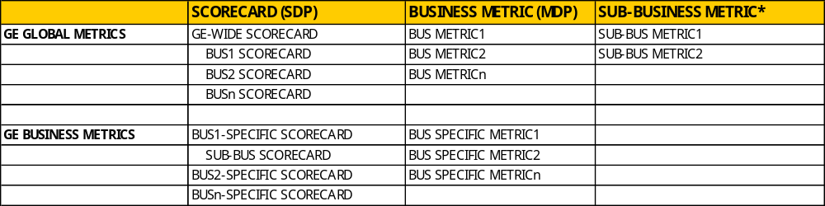
Metrics Data Structures
* Nested MDP or other data source
MDP = Metrics Description Package. An XML document that is the “building block” of our scorecards. Describes data source, data manipulation and update frequency.
SDP = Scorecard Description Package. An XML document that describes the presentation layer of the metrics views. Access policy is mapped to business-level scorecards.

Slide 8
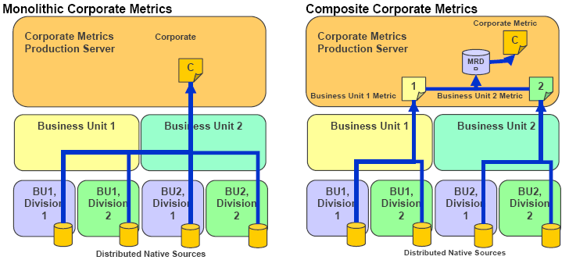
Metrics Data Collection Model
MDP
MDP
MDP
Centralized Data Collection (e.g. ITAM, centralized scans)
Distributed Data Collection (e.g. Manual Data Entry)
Courtesy of Clearpoint Metrics, Inc.
MDP = Metrics Description Package

Slide 9
Things to consider…
What are we measuring?
Beware of poorly defined metrics and poor measurement systems
Garbage in, gospel out!
Why are we measuring it?
Address the “so what” factor – tie metrics to business benefits
Know your audience – what behavior are we trying to change?
How are we measuring and reporting it?
Manual data collection vs. automation
Clear, actionable reports – comparative views, communication plan

Slide 10
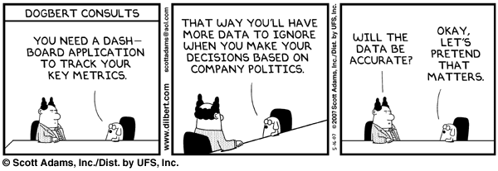
Questions?
Brad Freeman, GE Security Services Leader
brad.freeman@ge.com

