Slide 1
Measuring Network Security Using Attack Graphs
Anoop Singhal
National Institute of Standards and Technology
Coauthors: Lingyu Wang and Sushil Jajodia
Concordia University
George Mason University
Metricon’07

Slide 2
Outline
Background and Related Work
Application Examples
Attack Resistance Metric
Conclusion and Future Work

Slide 3
Motivation
Typical issues addressed in the literature
  Is that database server secure from intruders?
  Can the database server be secured from intruders?
  How do I stop an ongoing intrusion?
Notice that they all have a qualitative nature
Better questions to ask:
  How secure is the database server?
  How much security does a new configuration provide?
  What is the least-cost option to stop the attack?
For this we need a network security metric

Slide 4
Challenges
Measuring each vulnerability
  Impact, exploitability, etc.
  Temporal, environmental factors
  E.g., the Common Vulnerability Scoring System (CVSS) v2 released on June 20, 2007¹
Composing such measures for the overall security of a network
  Our work focuses on this problem

Slide 5
Related Work
NIST’s efforts on standardizing security metric
  Special publication 500-133 1985, 800-55 2003
  NVD and CVSSv2
Markov model and MTTF for security
  Dacier et. al TSE 1999
Minimum-effort approaches
  Balzarotti et. al QoP’05
  Pamula et. al QoP’06
Attack surface (Howard et. al QoP’06)
PageRank (Mehta et. Al RAID’06)

Slide 6
Related Work (Cont’d)
Attack graph
  Model checker-based (Ritchey et. al S&P’00, Sheyner et. al S&P’02)
  Graph-based (Ammann et. al CCS’02, Ritchey et. al ACSAC’02, Noel et. al ACSAC’03, Wang et. al ESORICS’05, Wang et. al DBSEC’06)

Slide 7
Attack Graph
To measure combined effect of vulnerabilities
  We need to understand the interplay between them
  How can an attacker combine them for an intrusion
Attack graph is a model of potential sequences of attacks compromising given resources

Slide 8
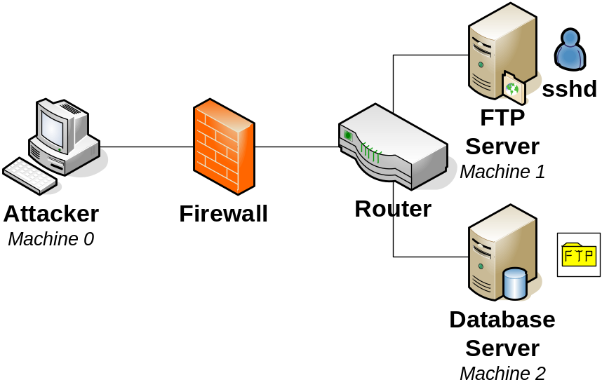
Attack Graph Example

Slide 9
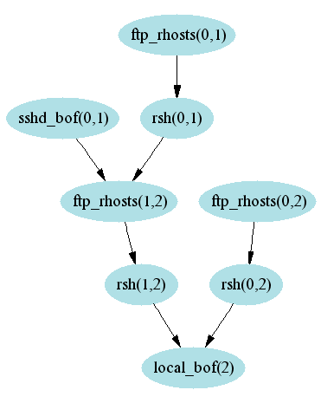
Attack Graph from machine 0 to DB Server

Slide 10






Attack Graph with Probabilities
Numbers are estimated probabilities of occurrence for individual exploits, based on their relative difficulty.
The ftp_rhosts and rsh exploits take advantage of normal services in a clever way and do not require much attacker skill
A bit more skill is required for ftp_rhosts in crafting a .rhost file.
sshd_bof and local_bof are buffer-overflow attacks, which require more expertise.

Slide 11





Probabilities Propagated Through Attack Graph
When one exploit must follow another in a path, this means both are needed to eventually reach the goal, so their probabilities are multiplied: p(A and B) = p(A)p(B)
When a choice of paths is possible, either is sufficient for reaching the goal: p(A or B) = p(A) + p(B) – p(A)p(B).

Slide 12
Network Hardening
When we harden the network, this changes the attack graph, along with the way its probabilities are propagated.
Our options are to block traffic from the Attacker:
  Make no change to the network (baseline)
  Block ftp traffic to prevent ftp_rhosts(0,1) and ftp_rhosts(0,2)
  Block rsh traffic to prevent rsh(0,1) and rsh(0,2)
  Block ssh traffic to prevent sshd_bof(0,1)

Slide 13
Comparison of Options
We can make comparisons of relative security among the options
Blocking ftp traffic from Attacker leaves a remaining 4-step attack path with total probability p = 0.1∙0.8∙0.9∙0.1 = 0.0072
Blocking rsh traffic leaves the same 4-step attack path
But blocking ssh traffic leaves 2 attack paths, with total probability p ≈ 0.0865, i.e., compromise is 10 times more likely with this option.

Slide 14
A Generic Attack Resistance Metric
Given an attack graph G(E∪C,Req∪Imp), define
  r(): E → D,
  R(): E → D
  ⊕ and ⊗: D × D → D
D is the domain of attack resistance
For any exploit e
  r(e) is its individual resistance, and
  R(e) is the cumulative resistance

Slide 15
A Generic Attack Resistance Metric
⊕ and ⊗ are two operators used to calculate cumulative resistances from individual resistances
  Corresponding to the disjunctive and conjunctive dependency relationships between exploits, respectively

Slide 16
Conclusion
Based on attack graphs, we have proposed a metric for measuring the overall security of networks
The metric meets intuitive requirements derived from common senses
The metric can be instantiated for different applications, and it generalizes previous proposals

Slide 17
Future Work
Study of metric for other aspects of network security, e.g., risk and cost
Applying the metric to vulnerability analysis, network hardening, etc.

