Slide 1
Queue
First-in-First-out data structure
Nattee Niparnan

Slide 2
Intro
push(“A”)
push(“B”)
push(“C”)
Just like a normal queue in real life.
First-in-First-out data structure
One way in (back of queue), one way out (front of queue)
push = add data to the back of the queue
pop = remove data from the head of the queue
pop()
push(“X”)
pop()
pop()
A
B
X
C
Front
Back

Slide 3
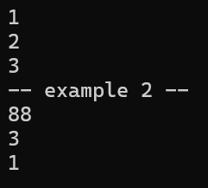
Basic
size_t q.size()
bool q.empty()
void q.push(T data)
void q.pop()
T q.front()
T q.back()
#include <iostream>
#include <queue>
#include <vector>
using namespace std;
int main() {
queue<int> q;
q.push(1);
q.push(2);
q.push(3);
while (q.empty() == false) {
cout << q.front() << endl;
q.pop();
}
cout << "-- example 2 --" << endl;
queue<vector<int>> q2;
vector<int> v1 = {1,2,3};
vector<int> v2 = {99,88,-1};
q2.push( v1 );
q2.push( v2 );
cout << q2.back()[1] << endl;
cout << q2.front().size() << endl;
auto x = q2.front();
q2.pop();
cout << x[0] << endl;
}

Slide 4
Limitation
Same limitation as stack
No iterator
No begin(), end()
Can only access front and back of the queue
If we wish to access all members, we must pop it all
Do not call front(), back(), pop() when the queue is empty

Slide 5
Why queue? Why not vector?
While we can use a vector to achieve the same functionality of a queue, queue is much faster
Queue’s push, back and front are as fast as vector’s push_back, back and front
But queue::pop, is much much faster than vector::pop_front
Like stack, using queue guarantees that no one can modify the inside of the queue
Many basic applications use queue
Queue function | Vector equivalence
push | push_back
pop | pop_front
back | back
front | front
Unlike stack, queue::pop works like pop_front

Slide 6
Radix Sort
Queue Application: Fast sorting with no comparison

Slide 7
Overview
Put all data in an array
For each digit X, from LSD to MSD
PUT TO QUEUE step: Sort by digit X by putting all of data from the array into B queues
B is the base of the number
For example, for a base 10 number, we will have Queue[0] to Queue[9]
Put into the queue labelled with that digit
GET FROM QUEUE step: Start from queue 0 to queue B-1, remove data from the queue and put back to the array

Slide 8
Example:
115
15
42
305
21
8
463
0 1 2 3 4 5 6 7 8 9

Slide 9
Example: Round 1 (digit 0), to queue
115
15
42
305
21
8
463
0 1 2 3 4 5 6 7 8 9
305
15
21
42
463
115
8

Slide 10
Example: Round 1 (digit 0), from queue
21
42
463
115
15
305
8
0 1 2 3 4 5 6 7 8 9
305
15
21
42
463
115
8
Data is now sorted by the last digits, because we pop from queue 0 to 9

Slide 11
Example: Round 2 (digit 1), to queue
21
42
463
115
15
305
8
0 1 2 3 4 5 6 7 8 9
8
15
305
115
21
42
463
In each queue, the data is sorted by the last digit, because we goes from left to right in the array which is already sorted by the last digit

Slide 12
Example: Round 2 (digit 1), from queue
305
8
115
15
21
42
463
0 1 2 3 4 5 6 7 8 9
8
15
305
115
21
42
463
Data is now sorted by last two digits, because we goes from queue 0 to 9, which is grouped by digit 1 and the data in each queue is sorted by the last digit.

Slide 13
Example: Round 3 (digit 2), to queue
305
8
115
15
21
42
463
0 1 2 3 4 5 6 7 8 9
42
21
15
8
115
305
463
In each queue, the data is sorted by the last two digits, because we goes from left to right in the array which is already sorted by the last two digits

Slide 14
Example: Round 3 (digit 2), from queue
8
15
21
42
115
305
463
0 1 2 3 4 5 6 7 8 9
42
21
15
8
115
305
463
Data is now sorted by all digits, because we goes from queue 0 to 9, which is grouped by digit 2 and the data in each queue is sorted by the last two digits.

Slide 15
Code
#define base 10
int getDigit(int v, int k) {
// return the kth digit of v (Least Significant digit is digit 0)
int i;
for (i=0; i<k; i++) v /= base;
return v % base;
}
// d = number of digits
void radixSort(vector<int> &data,int d) {
queue<int> q[base];
for (int k=0; k<d; k++) {
for (auto &x : data)
q[getDigit(x,k)].push(x);
for (int i=0,j=0; i<base; i++)
while(!q[i].empty()) {
data[j++] = q[i].front(); q[i].pop();
}
}
}

Slide 16
Breadth First Search
Queue Application: Gotta generate ’em all!

Slide 17
The Problem
Given a positive integer X
Start with a number 1, find a sequence of arithmetics operations, either “* 3”, or “/ 2” that makes 1 into X
the / 2 is integer division, e.g., 5 / 3 = 1 (not 1.6666)
The sequence must be as short as possible
Example
10 = 1 * 3 * 3 * 3 * 3 / 2 / 2 / 2
31 = 1 * 3 * 3 * 3 * 3 * 3 / 2 / 2 / 2 / 2 / 2 * 3 * 3 / 2

Slide 18
The Idea
Generate all possible sequences
Start with length 1, 2, 3, … until we find one that gives X
This is called an exhaustive search algorithm
Systematically enumerate all possible somethings

Slide 19
Tree Structure
A structure to illustrates search algorithm
Divide into steps
Start with initial solution
For each possible outcome (called a state) of each step, genenate all proper possible next step
Also, check if the current step is what we need
Written as a diagram of node and edge

Slide 20
Enumerate
Edge (step to new state)
Node (state)
Write a diagram, each state is a node (drawn as a circle)
Enumerate all possible next steps of each state as edges (drawn as a line)
Doing each step will result in a new state
Node (new state)

Slide 21

Example
Enumerate all possible meals from this promotion
There are 3 steps: Meat, Soup, Veggie
Each step we have to pick one
Initial solution = starting order
Each step, pick one of the choice and put into order

Slide 22
Example
initial
Step 1 : meat
Step 2 : soup

Slide 23
Back to our problem
1
/ 2
* 3
Start with 1
Each step is either * 3 or / 2
Issue: might get repeated number
Solution: if we have found it, do not generate new step
0
3
/ 2
* 3
/ 2
* 3
ซ้ำ
ซ้ำ
ซ้ำ
9
4
27
2
12
13
81
ซ้ำ
ซ้ำ
ซ้ำ
6
36
39
40
243

Slide 24
Code
void m3d2(int target) {
map<int, int> prev;
queue<int> q;
int v = 1;
q.push(1); prev[1] = -1;
while( !q.empty() ) {
v = q.front(); q.pop();
if (v == target) break;
int v2 = v/2;
int v3 = v*3;
if (prev[v2] == 0) {q.push(v2); prev[v2] = v;}
if (prev[v3] == 0) {q.push(v3); prev[v3] = v;}
}
if (v == target) showSolution(v, prev);
}
Queue makes ordering of how we pick a state to enumerate
From top to bottom and left to right

Slide 25
Display Solution
1
/ 2
* 3
X | prev[x]
0 | 1
1 | -1
2 | 4
3 | 1
4 | 9
6 | 2
9 | 3
12 | 4
13 | 27
27 | 9
36 | 12
39 | 13
40 | 81
Trace back “prev”
0
3
/ 2
* 3
/ 2
* 3
ซ้ำ
ซ้ำ
ซ้ำ
9
4
27
2
12
13
81
ซ้ำ
ซ้ำ
ซ้ำ
6
36
39
40
243

Slide 26
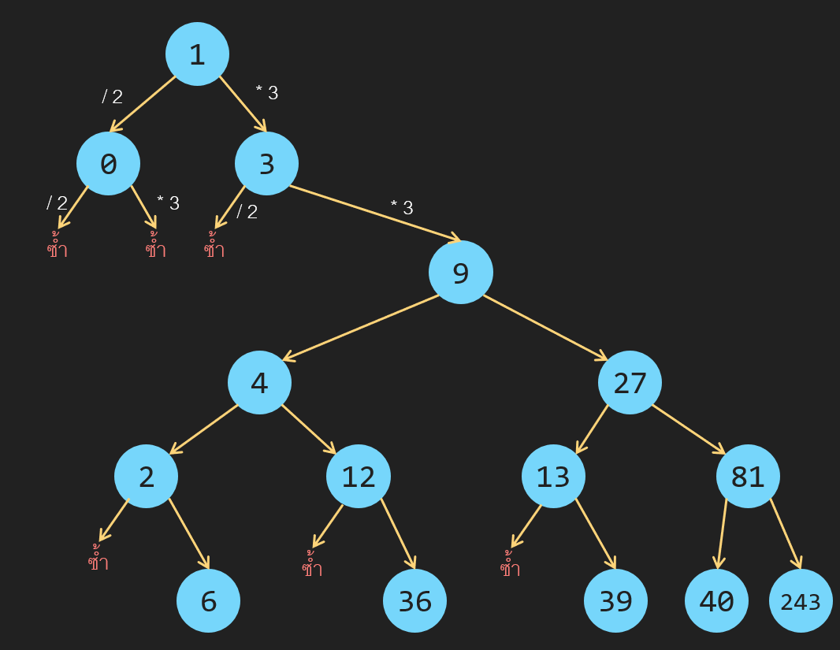
showSolution
X | prev[x]
0 | 1
1 | -1
2 | 4
3 | 1
4 | 9
6 | 2
9 | 3
12 | 4
13 | 27
27 | 9
36 | 12
39 | 13
40 | 81
void showSolution(int v, map<int,int>& prev) {
string out = "";
while(prev[v] != -1) {
if (prev[v] * 3 == v) {
out = "x3" + out;
} else {
out = "/2" + out;
}
v = prev[v];
}
out = "1" + out;
cout << out << endl;
}

