Slide 1
AVL Tree
Binary Tree with value condition
Nattee Niparnan

Slide 2
Overview
Performance of a Binary Search Tree depends on its height (h)
  A BST of n nodes has a wide range of possible height, lg(n) <= h <= n-1
  The best case is very good (logarithmic) while the worst case is bad (linear)
AVL Tree introduces additional constraint on the structure of the tree, called balance constraint
  For any node, the difference between the height of the the node’s subtree and right subtree cannot be larger than 1
  To enforce this constraint, we use several kind of rotation operations on nodes.
  These operations are applied when the tree is modified and applied on every nodes on the path from the modifying node to the root. Hence, this operation is additional O(h) to insert / erase
We can show that this makes the height of the tree as O(log n)
AVL Tree is named after Adelson-Velsky and Landis

Slide 3
How likely a bad tree may happen?
6
A bad tree is, on uniform data assumption, is unlikely to happen
  Even though there are several possible bad trees, but the number is very small
  Consider a tree of n node (1 to n). The worst possible height is n-1. There is (n-1)! possible trees but only 2^{(n-1)} trees are of height (n-1)
With the assumption of uniform insertion, it is proven that the expected height of a binary search tree is approximately 4.31107 log n
  This means that, on average, the height of a BST is O(lg n)
However, in practice, the bad sequence is more likely to happen because a bad sequence is when the data is sort (or partially sorted). This kind of data happens more frequently in practice
5
4
1
2
3
A Note on the Height of Binary Search Trees, Luc Devroye, 1986

Slide 4






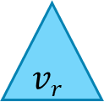
The Balance Constraint
class node {
public:
int data;
node *left, *right;
};
int get_height(node *n) {
if (n == NULL) return -1;
return 1 + std::max(get_height(n->left),
get_height(n->right));
}
int balance_value(node *n) {
if (n == NULL) return 0;
return get_height(n->right) - get_height(n->left);
}
For each node $v$
  We define $vl$ and $vr$ as the left and right subtree of $v$
  We define $h(x)$ as the height of the tree $x$
    Recall from that an empty tree has height as -1
  We define a balance value of the node $v$ as $bal(v)$
    $bal(v) = h(vr) − h(vl)$
the balance constraint is that $\left|bal\left(v\right)\right|≤1$
Every node in the AVL tree must satisfy the balance constraint
$$bal\left(v\right)=h(vr)\text{ − }h(vl)$$
$v$
$$vl$$
$$vr$$
$h(vr)$
$h(vl)$

Slide 5


Example
-1
-1
55
55
0
-1
-1
0
1
0
5
5
49
70
49
70
0
0
0
4
6
4
1
0
0
0
0
47
53
56
88
53
0
48
Every node must be balanced
1
55
1
-2
-2
-2
1
-2
4
55
55
55
49
70
0
0
1
-1
0
5
6
0
1
49
49
49
53
60
0
0
0
0
0
Not BST
53
0
0
50
50

Slide 6

What is the maximum height of an AVL Tree
Why maintaining the balance constraint makes the height of the tree as O(lg n)?
For a non-zero integer h, define A_{h} as an AVL tree of height h that has minimum number of nodes
  A₁, A₂, …, A_{h} are called Fibonacci tree
Let |A_{h}| be the number of nodes in the three A_{h}
  To get to height h, we need at least |A_{h}| nodes,
  We will show the relation between h and |A_{h}|
    It is that |A_{h}| is $Ω$(2^{h})

Slide 7
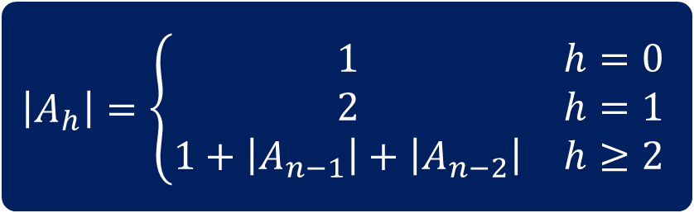
Fibonacci Tree
A₀
A₁
A₂
A₃
A₄
A_{h}
We will solve for |A_{h}|
A_{h-1}
A_{h-2}
$$\left|A_{h}\right|=\left\{\begin{matrix}1 & h=0 \\ 2 & h=1 \\ 1+\left|A_{n−1}\right|+\left|A_{n−2}\right| & h≥2\end{matrix}\right.$$

Slide 8
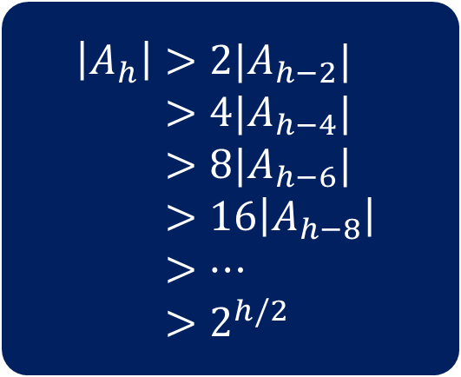
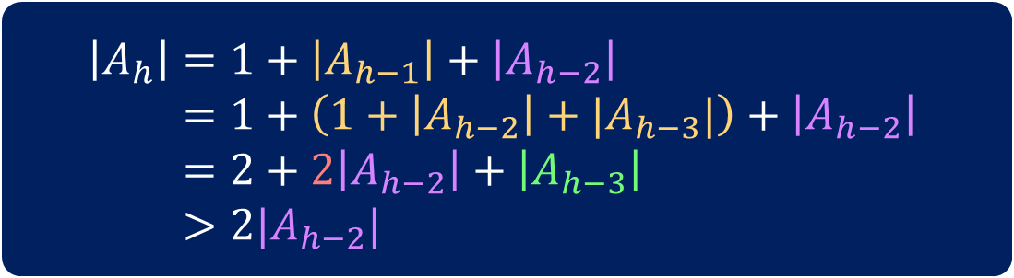
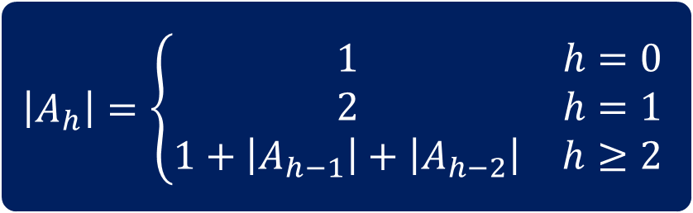
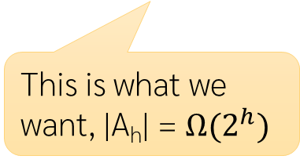
Solving for |A_{h}|
$$\left|A_{h}\right|=\left\{\begin{matrix}1 & h=0 \\ 2 & h=1 \\ 1+\left|A_{h−1}\right|+\left|A_{h−2}\right| & h≥2\end{matrix}\right.$$
$$\left|A_{h}\right|>2|A_{h−2}| \\ >4|A_{h−4}| \\ >8|A_{h−6}| \\ >16\left|A_{h−8}\right| \\ >… \\ >2^{h/2}$$
$$\left|A_{h}\right|=1+\left|A_{h−1}\right|+\left|A_{h−2}\right| \\ =1+\left(1+\left|A_{h−2}\right|+|A_{h−3}|\right)+\left|A_{h−2}\right| \\ =2+2\left|A_{h−2}\right|+\left|A_{h−3}\right| \\ >2|A_{h−2}|$$
This is what we want, |A_{h}| = $Ω(2^{h})$
We get that |A_{h}| > 2|A_{h-2}|

Slide 9
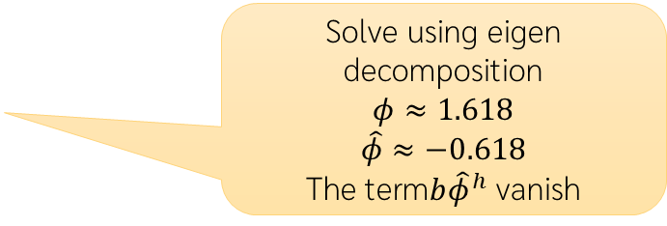
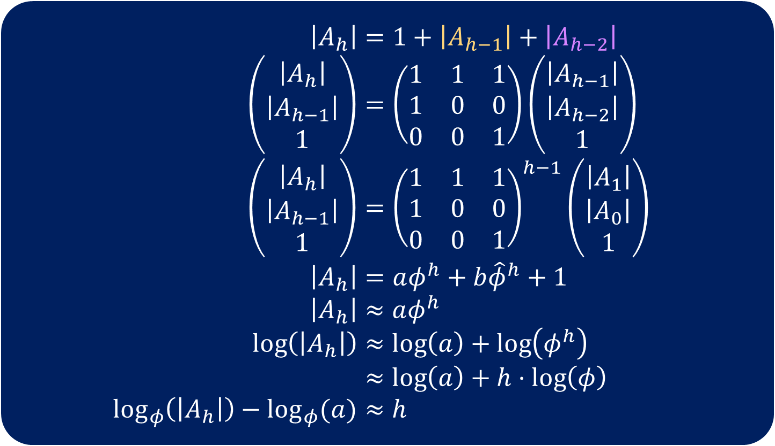
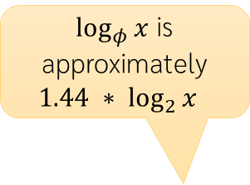
Another Method with better bound
$$\left|A_{h}\right|=1+\left|A_{h−1}\right|+\left|A_{h−2}\right| \\ \left(\begin{matrix}\left|A_{h}\right| \\ \left|A_{h−1}\right| \\ 1\end{matrix}\right)=\left(\begin{matrix}1 & 1 & 1 \\ 1 & 0 & 0 \\ 0 & 0 & 1\end{matrix}\right)\left(\begin{matrix}\left|A_{h−1}\right| \\ \left|A_{h−2}\right| \\ 1\end{matrix}\right) \\ \left(\begin{matrix}\left|A_{h}\right| \\ \left|A_{h−1}\right| \\ 1\end{matrix}\right)={\left(\begin{matrix}1 & 1 & 1 \\ 1 & 0 & 0 \\ 0 & 0 & 1\end{matrix}\right)}^{h−1}\left(\begin{matrix}\left|A_{1}\right| \\ \left|A_{0}\right| \\ 1\end{matrix}\right) \\ \left|A_{h}\right|=aφ^{h}+b{\hat{φ}}^{h}+1 \\ \left|A_{h}\right|≈aφ^{h} \\ \log\left(\left|A_{h}\right|\right)≈\log\left(a\right)+\log\left(φ^{h}\right) \\ ≈\log\left(a\right)+h⋅\log\left(φ\right) \\ \log_{φ}\left(\left|A_{h}\right|\right)−\log_{φ}{(a)}≈h$$
Re-write |A_{h}| as a matrix equation
Solve using eigen decomposition
$$φ≈1.618$$
$$\hat{φ}≈−0.618$$
The term$b{\hat{φ}}^{h}$ vanish
$\log_{φ}{x}$ is approximately ${1.44 ∗ log}_{2}{x}$
This is what we need, the height is approximately 1.44 log₂ n

Slide 10
How we maintain the balance value
-1
-1
-2
55
55
55
See that height only changes when we add or remove nodes
  Balance values only change along the path from the modified nodes to the root
  After modification, we calculate new balance value along the path and fix any error along the way using rotation operation
2
0
1
0
1
49
70
Add 50
49
70
Delete 70
49
-1
53
0
53
0
53
0
50
fix
fix
0
02
55
0
53
0
0
0
50
70
49
55
0
0
49
53

Slide 11
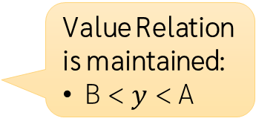
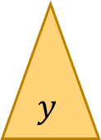
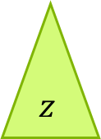
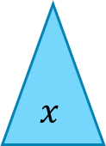

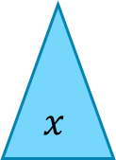
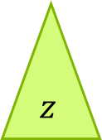
Rotation Operation
There are two basic rotation: Rotate Right and Rotate Left
It operates on a root of a subtree
Does not BST violate value constraint
After rotation:
B is a new root
Height of y stays the same
Height of x decreases
Height of z increases
Rotate Right at A
A
B
Value Relation is maintained:
B < $y$ < A
Move B up as the new root of the subtree
Move A to be the right child of B
Move y to be the left child of A
Subtree x and z stay the same
B
A
$$z$$
$$x$$
$$x$$
$$y$$
Before rotation:
A is the root of a subtree
B, the left child of A, must exist
x, y and z are some (maybe empty) subtrees
$$y$$
$$z$$

Slide 12
Mirror between left and right
Rotate Left is just the reverse of the rotate right
After rotation:
A is the new root
Height of y stays the same
Height of x increases
Height of z decreases
Rotate Left at B
A
Move A up as the new root of the subtree
Move B to be the left child of A
Move y to be the right child of B
Subtree x and z stay the same
B
B
A
$$z$$
$$x$$
$$x$$
$$y$$
Before rotation:
B is the root of a subtree
A, the right child of B, must exist
x, y and z are some (maybe empty) subtrees
$$y$$
$$z$$

Slide 13


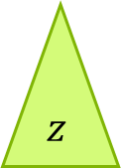
Rotation Code
node* rotate_left_child(node * r) {
node *new_root = r->left;
r->set_left(new_root->right);
new_root->set_right(r);
new_root->right->set_height();
new_root->set_height();
return new_root;
}
A
Take a root of a subtree
return the new root of the subtree
B
$$z$$
$$x$$
$$y$$
node* rotate_right_child(node * r) {
node *new_root = r->right;
r->set_right(new_root->left);
new_root->set_left(r);
new_root->left->set_height();
new_root->set_height();
return new_root;
}

Slide 14












When to use Rotation
Rotate Right
A
B
B
$$z$$
Rotate Left
A
$$x$$
Rotate Right reduces the height of left subtree of the left child
  We use it when the node is left heavy, i.e., balance value is -2, and this left heavy is caused by having too deep left subtree of the left child while having too shallow right subtree of the root
$$x$$
$$y$$
$$y$$
$$z$$
The result is balanced
Balance value violation
Do Rotate Right at 4
6
6
6
-2
-2
-1
4
10
4
10
2
10
-1
-1
0
0
2
2
$$z$$
1
$$x$$
4
0
0
1
1
$$x$$
$$y$$
$$y$$
$$z$$
Add node 1

Slide 15






When one Rotation Right does not solve the problem
Rotate Right move the left subtree of the left child up
This does not help when the cause of left heavy is NOT the left subtree of the left child but rather the right subtree
  When the balance value of the left child is not of the same sign as the balance value of the root
Fix by first make the left subtree heavy, using rotate left at the left subtree and then do the rotate right at the root
-2
2
4
2
1
1
2
$$z$$
$$x$$
4
0
0
$$x$$
3
3
$$y$$
$$y$$
$$z$$
The node 3, the cause of imbalance, is still at the same depth
-2
-2
0
4
4
3
1
Rotate Left at 2
-1
Rotate Right at 4
1
0
This is called double rotation
2
3
2
4
0
0
3
2

Slide 16






What About Rotate Left?
Rotate Right
A
B
B
$$z$$
Rotate Left
A
$$x$$
$$x$$
$$y$$
$$y$$
$$z$$
Rotate Left is The mirror case of the Rotate Right
Use when it is right heavy
Double Rotation when right heavy (balance =2) with
the right child has a balance value of -1
Balance value violation
Do Rotate Left at 6
The result is balanced
2
2
0
6
6
8
0
1
1
0
0
4
8
8
6
10
$$x$$
$$z$$
0
0
10
$$z$$
$$y$$
10
$$x$$
$$y$$
Remove 4

Slide 17
Rotation Summary
node * rebalance(node * r) {
if (r == NULL) return r;
int balance = r->balance_value();
if (balance == -2) {
if (r->left->balance_value() == 1)
r->set_left(rotate_right_child(r->left));
r = rotate_left_child(r);
} else if (balance == 2) {
if (r->right->balance_value() == -1)
r->set_right(rotate_left_child(r->right));
r = rotate_right_child(r);
}
r->set_height();
return r;
}
Rebalance according to the balance value of the node
Balance Value | Case | Example | Fix
-2 (Left Heavy) | Balance Value of Left Child is -1 |  | Rotate Right at the node
 | Balance Value of Left Child is +1 |  | Rotate Left at the left child then Rotate Right at the node
+2 (Right Heavy) | Balance Value of Right Child is +1 |  | Rotate Left at the node
 | Balance Value of Right Child is -1 |  | Rotate Right at the right child then Rotate Left at the node

Slide 18
Integrate with Insert and Erase
Insert by recursion
After modification, call rebalance
  This re-calculate balance value and do the rotation if necessary
node * rebalance(node * r) {
if (r == NULL) return r;
int balance = r->balance_value();
if (balance == -2) {
if (r->left->balance_value() == 1)
r->set_left(rotate_right_child(r->left));
r = rotate_left_child(r);
} else if (balance == 2) {
if (r->right->balance_value() == -1)
r->set_right(rotate_left_child(r->right));
r = rotate_right_child(r);
}
r->set_height();
return r;
}
node* insert(const ValueT& val, node *r, node * &ptr) {
if (r == NULL) {
mSize++;
ptr = r = new node(val,NULL,NULL,NULL);
} else {
int cmp = compare(val.first, r->data.first);
if (cmp == 0) ptr = r;
else if (cmp < 0) {
r->set_left(insert(val, r->left, ptr));
} else {
r->set_right(insert(val, r->right, ptr));
}
}
r = rebalance(r);
return r;
}

Slide 19
Example
45
2
55
0
20
49
70
add 15
Check balance at 15: 0 (OK)
Check balance at 14: 1 (OK)
Check balance at 9: 1 (OK)
Check balance at 20: -2 (Not OK)
  Rotate left at 9
  Rotate right at 20
Check balance at 2: (OK)
Check Balance at 45: (OK)
1
9
21
48
53
56
88
3
14
46
50
15
45
2
55
0
14
49
70
1
9
20
48
53
56
88
3
15
21
46
50

Slide 20
Erase
node *erase(const KeyT &key, node *r) {
if (r == NULL) return NULL;
int cmp = compare(key, r->data.first);
if (cmp < 0) {
r->set_left(erase(key, r->left));
} else if (cmp > 0) {
r->set_right(erase(key, r->right));
} else {
if (r->left == NULL || r->right == NULL) {
node *n = r;
r = (r->left == NULL ? r->right : r->left);
delete n;
mSize--;
} else {
node * m = r->right;
while (m->left != NULL) m = m->left;
std::swap(r->data.first, m->data.first);
std::swap(r->data.second, m->data.second);
r->set_right(erase(m->data.first, r->right));
}
}
r = rebalance(r);
return r;
}
Also use recursion and call rebalance after a node is erased

Slide 21
The Node Class
class node {
//...
int get_height(node *n) {
return (n == NULL ? -1 : n->height);
}
void set_height() {
int hL = get_height(this->left);
int hR = get_height(this->right);
height = 1 + (hL > hR ? hL : hR);
}
int balance_value() {
return get_height(this->right) –
get_height(this->left);
}
void set_left(node *n) {
this->left = n;
if (n != NULL) this->left->parent = this;
}
void set_right(node *n) {
this->right = n;
if (n != NULL) this->right->parent = this;
}
};
Additional Height Value stored in each node
  Update after insert / erase only along the path
  set_left and set_right link child node
  set_height recalculates height from its children’s height, it is used in rebalance
class node {
friend class map_avl;
protected:
ValueT data;
node *left;
node *right;
node *parent;
int height;
node() :
data( ValueT() ), left( NULL ), right( NULL ), parent( NULL ), height(0) { }
node(const ValueT& data, node* left, node* right, node* parent) :
data ( data ), left( left ), right( right ), parent( parent ) {
set_height();
}
//...
};

Slide 22
Example Sequence of Operation
Start with a blank tree
Add 1
Add 2
Add 5 → rotate at 1
Add 7
Add 3
Delete 1 → rotate at 2
Add 1
1
1
1
2
2
2
2
5
5
2
2
1
5
1
5
1
5
5
2
7
2
7
5
7
3
7
3
7
3
1
3
Add 4 → double rotation (rotate left at 2 → rotate right at 5)
Add 9
Add 8 → double rotation at 7
5
5
3
3
3
3
3
2
7
3
7
2
5
2
5
2
5
2
5
2
5
1
3
2
4
1
4
7
1
4
7
1
4
7
1
4
7
1
4
8
4
1
9
9
8
7
9
8
9
Delete 2 → Rotate at 3
Delete 3
Delete 4
Delete 1 → Rotate at 5
3
5
5
5
5
8
1
5
3
8
4
8
1
8
8
5
9
4
8
1
4
7
9
1
7
9
7
9
7
9
7
7
9

