Slide 1
Priority Queue
Featuring Binary Heap
Nattee Niparnan

Slide 2
Overview
Simple Implementation of priority_queue
Quick intro to Graph and Tree
Binary Heap
priority_queue with Binary Heap

Slide 3
priority_queue
Queue by value
Max-in-First-Out
int main() {
priority_queue<int> pq;
pq.push(4);
pq.push(20);
pq.push(3);
while (pq.empty() == false) {
cout << pq.top() << endl;
pq.pop();
}
}
20
4
3

Slide 4
V0.1, priority_queue by vector
namespace CP {
template <typename T>
class priority_queue
{
protected:
std::vector<T> v;
public:
bool empty() { return v.empty(); }
bool size() { return v.size(); }
void push(const T &e) { v.push_back(e); }
T top() { return *std::max_element(v.begin(),v.end()); }
void pop() { v.erase(std::max_element(v.begin(),v.end()));}
};
}
Use vector to store data
Push = simply push_back
Top, pop = find the max value and return/erase
max_element return iterator to max element

Slide 5

max_element
iterator max_element(iterator first, iterator last)
{
if (first == last) return last;
iterator largest = first;
++first;
for (; first != last; ++first)
if (*largest < *first)
largest = first;
return largest;
}
O(n)
V0.1 complexities
push O(1) *amortized
top() $Θ$(n)
pop() $Θ$(n)

Slide 6
V0.2 faster pop, top (and push??)
namespace CP {
template <typename T>
class priority_queue {
protected:
std::vector<T> v;
public:
bool empty() { return v.empty(); }
size_t size() { return v.size(); }
T& top() { return v[v.size()-1]; }
void pop() { v.erase(v.end()-1); }
void push(const T& e) {
// do something
}
};
}
v0.1 has many drawback
Consecutive call of top is slow (it shouldn’t)
Both pop and top works almost the same
v0.2 focus on slower push while keeps pop, top fast
Make the vector sorted
Max will be at the back
Fast pop, top

Slide 7
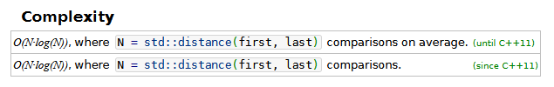
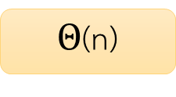
v0.2 push
Maintain that the vector is sorted at every push
void push(const T& e) {
v.push_back(e);
std::sort(v.begin(), v.end());
}
Why Big-Theta, not Big O?
O(n log n)
void push(const T& e) {
auto it = v.begin();
while (it < v.end() && *it <= e)
it++;
v.insert(it,e);
}
Why cannot use Big-Theta?
$Θ$(n)
void push(const T& e) {
v.insert(std::upper_bound(v.begin(),v.end(),e),e);
}
O(n)
Upper bound is O( log n)

Slide 8
Which one is better?
v0.1 fast push
v0.2 fast pop, top
Depends on which operation we use most often
The real version works like v0.2, we maintain some rules of the data that is stored in the vector such that
We know where max is (for fast top)
Much faster push, a little bit slower pop
Using structure call Binary Heap

Slide 9
Graph and Tree
Quick introduction

Slide 10
Graph
Discrete Math Graph
A math model that describe entities and connectivity between them
Mo Chit
Asok
Siam
Tha Phra
Sala Daeng
Lak Song
Bang Wa
Kheha

Slide 11
Graph Model
Graph consists of two things
Nodes (vertex, vertices) are things we want to connect
Edges are pairs, each pair is a connectivity between two node
Graph G = (V,E) where V is a set of nodes and E is a set of edges
Mo Chit
V = { “Mo Chit”, “Siam”, “Asok”, “Sala Daeng”, “Tha Phra”, “Lak Song”, “Bang Wa”, “Kheha” }
(“Mo Chit”, “Asok”)
(“Tha Phra”, “Mo Chit”)
E = { (“Mo Chit”, “Asok”), (“Mo Chit”, “Siam”), (“Tha Phra”, “Mo Chit”), (“Sala Daeng”, “Tha Phra”)
… }
Siam
Asok
Tha Phra
Sala Daeng
Lak Song
Bang Wa
(“Asok”, “Kheha”)
Kheha

Slide 12
Tree
A special kind of graph
Has N nodes and N-1 Edges
Every nodes must be connected (we can start from any node and can walk through edge to reach any node)
Is a tree
Not Tree
(too many edges)
Not Tree
(too many nodes)
Not Tree
(not connected)

Slide 13
Rooted Tree
Root is A
Depth 0
A
Depth 1
B
C
Depth 2
Tree where one node is defined as a root
For an edge in a rooted tree, a node that is closer to the root is called parent while the other node is called child
Ancestor of node A = parent of parent .... of A
Descendant of node A = child of child .... of A
Root is usually drawn at the top and is consider as the starting point
Root is at level 0 (depth 0)
Children of root are drawn at the same level at level 1 (depth 1)
Children of children of root are at level 2 (depth 2)
D
E
F
G
Depth 3
H
I
J
K
A is the parent of B and C
B is the parent of D and E
K is a child of G
H, I and J are children of D
B is an ancestor of D, H, I and J
K is a descendant of G, C, and A

Slide 14
Complete Binary Tree
Binary Tree = a tree that every node has at most 2 children
Complete tree = the tree must be filled with every possible node at every level (except the deepest level which must be filled as far to the left as possible)
Blank tree is consider a complete binary tree
OK
OK
Not binary
Not complete (at depth 1)
OK

Slide 15
Exercise
Hint: The answer is unique (There are exactly 1 way to draw a complete binary tree of size k)
Draw a Complete Binary Tree that has 4, 5, 8, 10 nodes
0 nodes (blank tree)
1 nodes (only root)
4 nodes
5 nodes
2 nodes
3 nodes
8 nodes
10 nodes

Slide 16
Special Property of a complete binary tree
There is exactly one way to go from any node to any node
Maximum depth is log₂ n where n is the number of nodes
Because we require completeness and we have 2 possible children

Slide 17
Binary Heap
Using Complete Binary Tree to make priority_queue

Slide 18
Binary Heap
75
We use Complete Binary Tree to store data
A value is stored at the node
When data is modified (via push or pop), we must maintain these rules
Tree must always be Complete Binary Tree
For any node, its value must be more than that of its children
50
65
40
3
4
10
35
36
2

Slide 19
Getting Maximum Data
Root contains highest value (because of rules 2.)
Top() just simply return root
9
6
2
1
-5

Slide 20
Adding data to Binary Heap
75
Maintain Binary Heapness
structure of data
Value of data
Structure rules says where the new node should be
Next to right-most child of the deepest level
But if we put the new data there, the value rules might be broken
Fix it
50
65
40
3
4
10
35
36
2
60
push(60)

Slide 21
Fix from adding a new node
Fix:
Check where we just add a node, if value rules is broken, swap with parent
After swap, re-check with new parent
Keep doing until correct or at root
75
OK, stop
50
Wrong, swap
65
40
3
4
10
Wrong, swap
35
36
2
60
Value rules: parent more than children
See that, after each swap, the blue swapped node does not violate value rules with its new children

Slide 22
Delete maximum data
75
Similar to push, we will try to maintain structure first
Delete will remove root, find something to replace
Use the lowest, right-most node
Value rules might be broken
Fix it
60
65
40
50
4
10
35
36
2
3

Slide 23
Fix from deleting root node
3
Fix:
Start at replaced root, if value rules is broken, swap with maximum child
After swap, re-check with new children
Beware! There is a case where we might have only one child
Keep doing until correct or has no child
Wrong, swap with 65
60
65
Wrong, swap with 10
40
50
4
10
No child, stop
35
36
2
Value rules: parent more than children
See that, after each swap, the blue swapped node does not violate value rules with its parent and children

Slide 24
Analysis
How fast is each push, pop
Push
Add to a vector is O(1) amortized
Fixing value rules is O(h) where h is the maximum number of depth of the tree (we call this value tree height)
Notice that tree height is O(lg n)
Pop
Fixing value rules is O(h) where h is the maximum number of depth of the tree (we call this value tree height)
O(log n)
O(log n)

Slide 25
CP::priority_queue

Slide 26
How to store a tree?
0
75
Use dynamic array
Each node can be labelled from 0 to n-1
Root is at 0
Left child of node i is at (i*2)+1
Right child of node i is at (i*2)+2
Parent of node i is at (i-1)/2
1
2
50
13
3
4
5
6
40
3
1
10
7
8
9
35
36
2
0 | 1 | 2 | 3 | 4 | 5 | 6 | 7 | 8 | 9
75 | 50 | 13 | 40 | 3 | 1 | 10 | 35 | 36 | 2

Slide 27
Layout
template <typename T,typename Comp = std::less<T> >
class priority_queue {
protected:
T *mData;
size_t mCap;
size_t mSize;
Comp mLess;
void expand(size_t capacity) {}
void fixUp(size_t idx) {}
void fixDown(size_t idx) {}
public:
//-------------- constructor ---------------
priority_queue(priority_queue<T,Comp>& a);
priority_queue(const Comp& c = Comp() );
priority_queue<T,Comp>& operator=(priority_queue<T,Comp> other);
~priority_queue();
//------------- capacity function ----------
bool empty() const;
size_t size() const;
//----------------- access -----------------
const T& top();
//----------------- modifier ---------------
void push(const T& element);
void pop();
};
Same as CP::vector
Will talk about later
Fix value rules

Slide 28
Constructor
priority_queue(const Comp& c = Comp() ) :
mData( new T[1]() ),
mCap( 1 ),
mSize( 0 ),
mLess( c )
{ }
Using list initialize
See that mData is dynamic array in the same way as vector
mLess is something that is just either copied or default initialize
Will talk about it later
priority_queue(priority_queue<T,Comp>& a) :
mData(new T[a.mCap]()),
mCap(a.mCap),
mSize(a.mSize),
mLess(a.mLess)
{
for (size_t i = 0; i < a.mCap;i++)
mData[i] = a.mData[i];
}

Slide 29
Destructor and Copy Assignment Operator
~priority_queue() {
delete [] mData;
}
Using standard copy-and-swap idiom
priority_queue<T,Comp>& operator=(priority_queue<T,Comp> other) {
using std::swap;
swap(mSize,other.mSize);
swap(mCap,other.mCap);
swap(mData,other.mData);
swap(mLess,other.mLess);
return *this;
}

Slide 30
Push
See that the right-most child of the deepest level is at mData[mSize-1] and the new node should be at mData[mSize]
We do the same thing as vector’s push_back
Then fix the value rule
void expand(size_t capacity) {
T *arr = new T[capacity]();
for (size_t i = 0;i < mSize;i++) {
arr[i] = mData[i];
}
delete [] mData;
mData = arr;
mCap = capacity;
}
Same as CP::vector
void push(const T& element) {
if (mSize + 1 > mCap)
expand(mCap * 2);
mData[mSize] = element;
mSize++;
fixUp(mSize-1);
}

Slide 31
Fix Up
void fixUp(size_t idx) {
T tmp = mData[idx];
while (idx > 0) {
size_t p = (idx - 1) / 2;
if ( tmp < mData[p] ) break;
mData[idx] = mData[p];
idx = p;
}
mData[idx] = tmp;
}
0
75
1
2
50
65
3
4
5
6
40
3
4
10
7
8
9
10
35
36
2
60
void fixUp(size_t idx) {
while (idx > 0) {
size_t p = (idx - 1) / 2;
if ( mData[idx] < mData[p] ) break;
T tmp = mData[p];
mData[p] = mData[idx];
mData[idx] = tmp;
idx = p;
}
}
Instead of actual swap, we perform insert and find appropriate position at the same time

Slide 32
Fix Up
void fixUp(size_t idx) {
T tmp = mData[idx];
while (idx > 0) {
size_t p = (idx - 1) / 2;
if ( tmp < mData[p] ) break;
mData[idx] = mData[p];
idx = p;
}
mData[idx] = tmp;
}
0
75
tmp
60
1
2
50
65
60
3
4
5
6
40
3
p
4
10
50
7
8
9
10
35
36
2
60
3
idx
mData
0 | 1 | 2 | 3 | 4 | 5 | 6 | 7 | 8 | 9 | 10
75 | 50 | 13 | 40 | 3 | 1 | 10 | 35 | 36 | 2 | 60
60
50
3

Slide 33
mLess
int main() {
less<int> x;
greater<int> y;
int a = 10;
int b = 3;
cout << x(a,b) << endl;
cout << y(a,b) << endl;
}
priority_queue allows a custom comparator
Custom comparator X
We must be able to X(a,b) where X will compare a and b and return true only when a is less than b
X is a variable that implement operator()

Slide 34
mLess
Initialize at constructor as variable mLess to be of type Comp in template
Any comparison of our data (type T) must be done by mLess
void fixUp(size_t idx) {
T tmp = mData[idx];
while (idx > 0) {
size_t p = (idx - 1) / 2;
if ( mLess(tmp,mData[p]) ) break;
mData[idx] = mData[p];
idx = p;
}
mData[idx] = tmp;
}
template <typename T,typename Comp = std::less<T> >
class priority_queue {
//...
T *mData;
size_t mCap;
size_t mSize;
Comp mLess;
//...
priority_queue(const Comp& c = Comp() ) :
mData( new T[1]() ),
mCap( 1 ),
mSize( 0 ),
mLess( c )
{ }

Slide 35
Pop
void fixDown(size_t idx) {
T tmp = mData[idx];
size_t c;
while ((c = 2 * idx + 1) < mSize) {
if (c + 1 < mSize && mLess(mData[c],mData[c + 1]) ) c++;
if ( mLess(mData[c],tmp) ) break;
mData[idx] = mData[c];
idx = c;
}
mData[idx] = tmp;
}
void pop() {
mData[0] = mData[mSize-1];
mSize--;
fixDown(0);
}
While loop check if we have at least one child
c is the index of highest value child
Must consider the case where we have only one child
Exercise: read the rest yourself

Slide 36





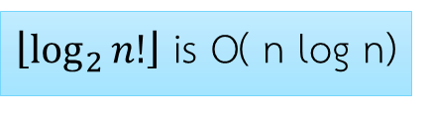




Construct PQ from n data
priority_queue(std::vector<T> &v,const Comp& c = Comp() ) :
mData( new T[v.size()]() ), mCap( v.size() ), mSize( 0 ), mLess( c ) {
for (size_t i = 0;i < mSize;i++) push(v[i]);
}
10
10
10
15
1
1
5
5
10
1
5
7
5
7
5
10
5
5
1
1
10
1
5
7
1
1
15
1
7
$$≤\left\lfloor \log_{2}{1}\right\rfloor$$
$$≤\left\lfloor \log_{2}{2}\right\rfloor$$
$$≤\left\lfloor \log_{2}{3}\right\rfloor$$
$$≤\left\lfloor \log_{2}{4}\right\rfloor$$
$$≤\left\lfloor \log_{2}{4}\right\rfloor$$
15
20
15
20
Total $≤ \left\lfloor \log_{2}{1}\right\rfloor +\left\lfloor \log_{2}{1}\right\rfloor +…+\left\lfloor \log_{2}{n}\right\rfloor$
$≤ \left\lfloor \log_{2}\left(1×2×3×…×n\right)\right\rfloor =\left\lfloor \log_{2}{n!}\right\rfloor$
10
5
10
15
10
5
10
15
$\left\lfloor \log_{2}{n!}\right\rfloor$ is O( n log n)
1
7
20
1
7
5
1
7
20
2
1
7
5
2
$$≤\left\lfloor \log_{2}{5}\right\rfloor$$
$$≤\left\lfloor \log_{2}{6}\right\rfloor$$

Slide 37
Better Method
priority_queue(std::vector<T> &v,const Comp& c = Comp() ) :
mData( new T[v.size()]() ), mCap( v.size() ), mSize( v.size() ), mLess( c ) {
for (size_t i = 0;i < mSize;i++) mData[i] = v[i];
for (int i = mSize/2-1;i >= 0;i--) fixDown(i);
}
0
Consider each node to be a Binary Heap
Fix down from back to front
75
99
1
2
40
1
65
99
99
3
4
5
6
10
3
3
40
6
3
99
65
7
8
9
10
11
3
40
6
9
3
2
1
99

Slide 38
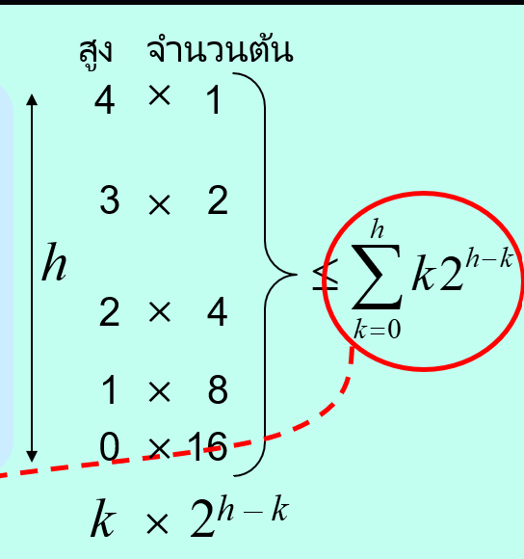

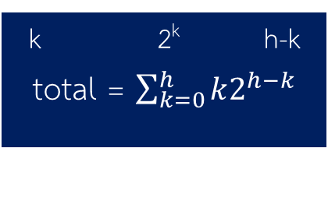



How fast?
Total node = 31
Tree height = log₂ 31 = 4
Depth
0
1
2
3
4
nodes
1
2
4
8
16
Max fix per node
4
3
2
1
0
Binary Tree Property:
There are at most 2^{k} nodes at depth k
For a three of height h, at depth k, fix down need at most h-k iterations
k 2^{k} h-k
total = $\sum_{k=0}^{h}{k2^{h−k}}$
$$=2^{h}\sum_{k=0}^{h}{k2^{−k}}$$
$$<2^{h}\sum_{k=0}^{∞}{k2^{−k}}$$
This is 2
$$=2^{h}2=2^{h+1}$$
$=2^{\log_{2}{n}+1}=O(n)$

