Slide 1
Application of heap
Huffman Code

Slide 2
Let’s look
Let’s say we want to compress file without losing any information
Let M be the data that we want to compress. Let its size be 100000 characters. M contains only character a to character e.
Let E be M after compression.

Slide 3
Normally, 1 character needs 16 bit to store.
100000 character needs 100000x16 bits.
It is useful to know how to reduce the number of bits while maintaining the same information.

Slide 4
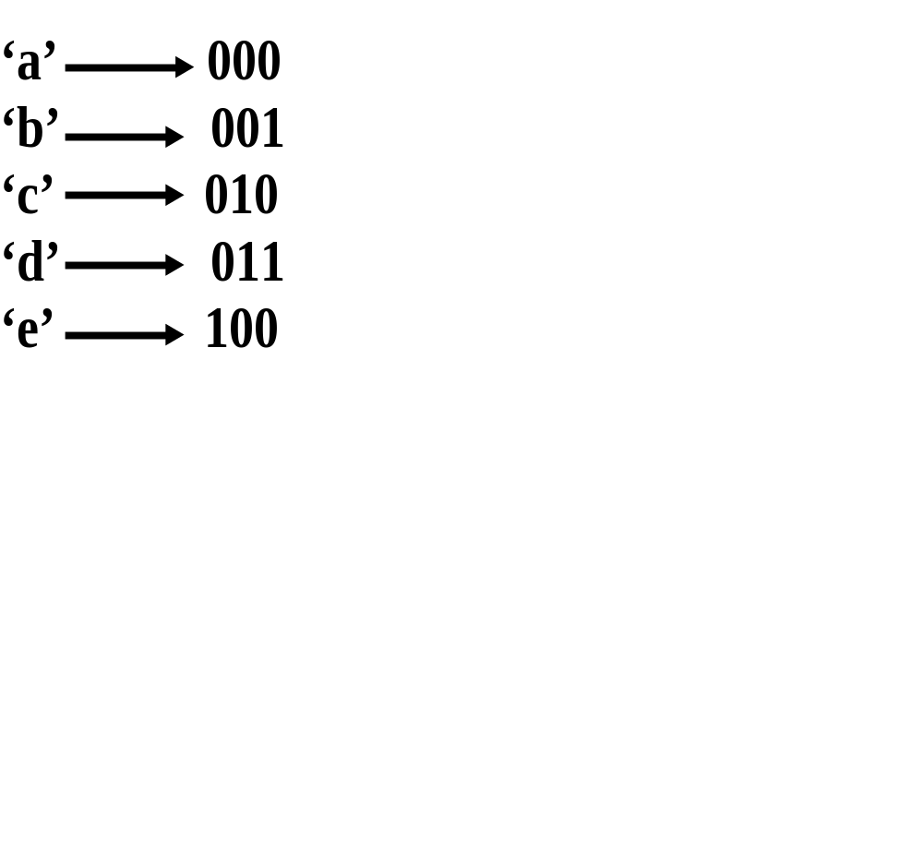
Try this
The number of bits reduce to 300,000
Notes:
Because we know that there are few characters, we can encode them the way we want.

Slide 5
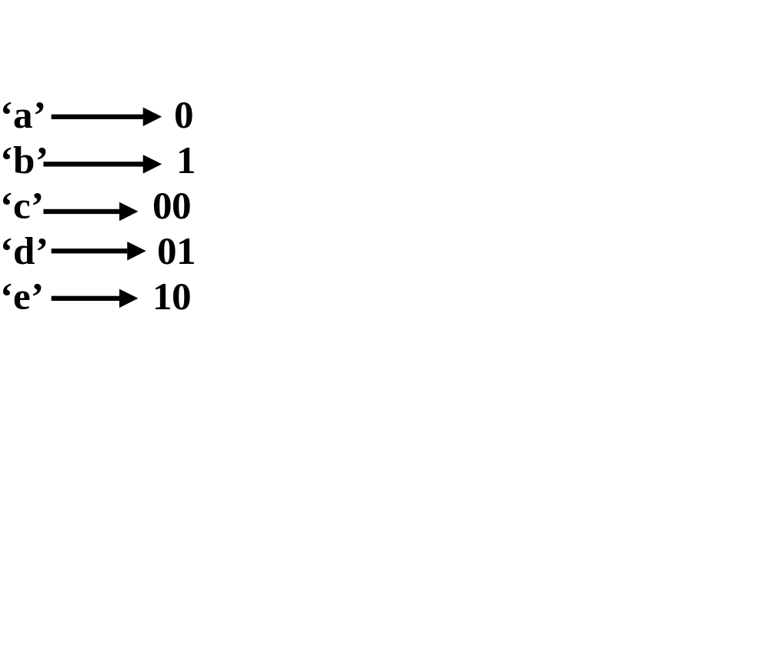
Can it be reduced even more?
The number of bits now <=300,000
But 001010 can mean either
Aababa or cbda. Rather ambiguous.
Notes:
This way we can compress more, but we can’t get the original message back because the resulting number is ambiguous.

Slide 6
How do we prevent ambiguity
use prefix-free encoding.
By creating a binary tree
  Left branch is 0.
  Right branch is 1.
  Character is at the leaves.

Slide 7
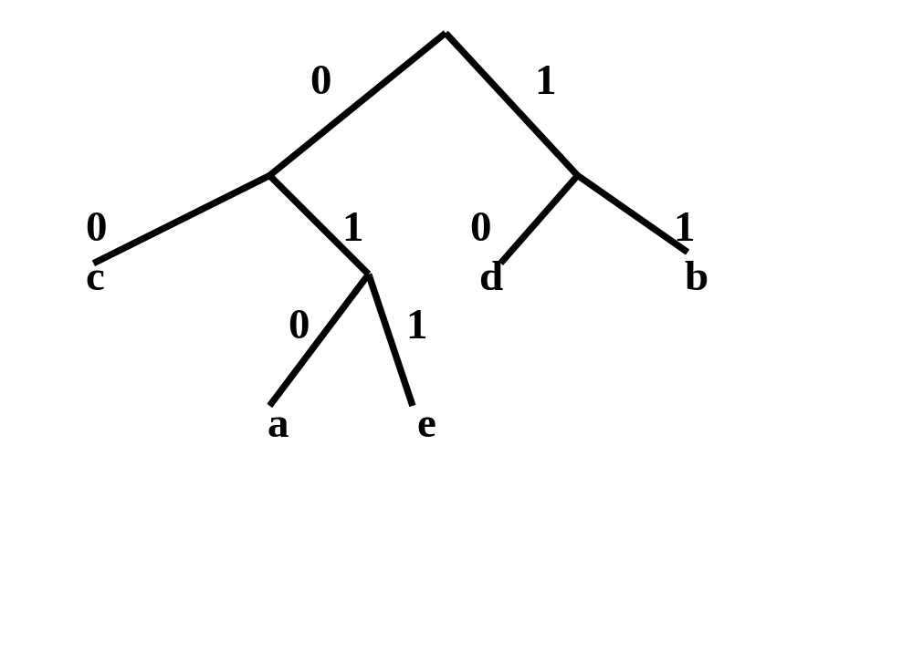
Therefore, there is no two characters on the same path (from root)
a = 010
b = 11
c = 00
d = 10
e = 011

Slide 8
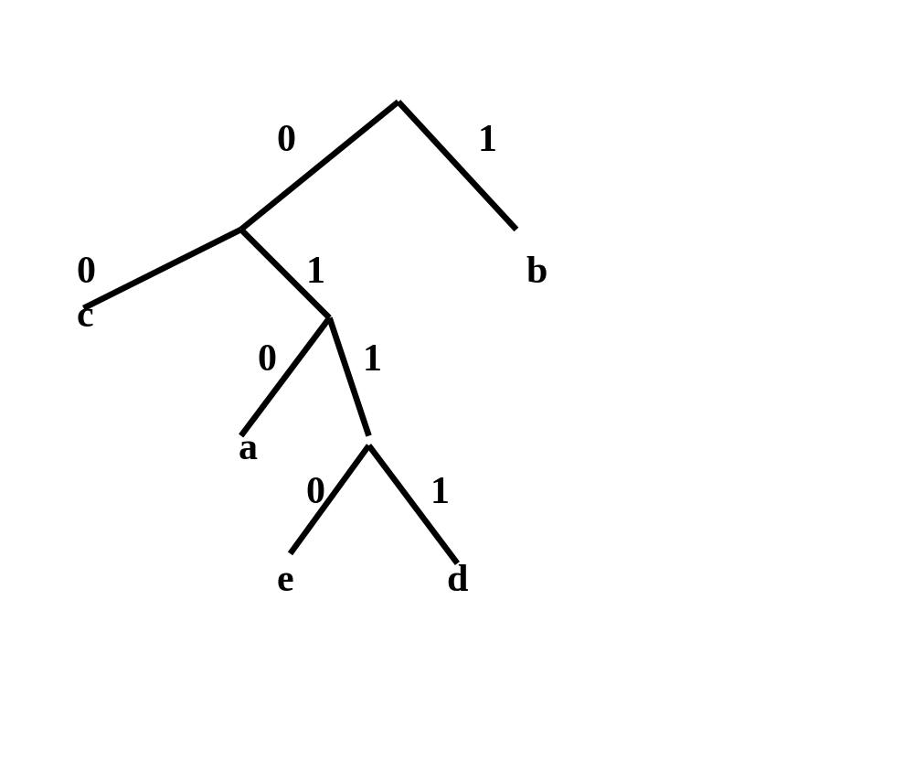
alternatives?
Which scheme is best?
Ans: frequently appear character
should have small number of bits.
Notes:
This is a legal tree too. But which tree is better?
If a character is in our message frequently, we want that character to be represented by as few bits as possible.

Slide 9
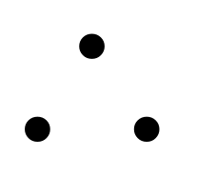
Create Huffman tree
This is a binary tree of codes. but it is built using the frequency of characters in the message.
Characters with high frequency will take less bits.

Slide 10
let us use the following example.
A has 5000
B has 10000
c has 20000
d has 31000
e has 34000

Slide 11
Put pair (character, frequency) into Priority Q
Priority Q that we use, we will have the lowest frequency as most important!
Each node of our priority Q has left, right, parent of its own.
In our example, the initial queue is ordered such that -> (a:5000) (b: 10000) (c: 20000) (d: 31000) (e: 34000)
Now let us build Huffman tree.

Slide 12
Remove the two items with smallest frequency from the queue. The first one becomes the left branch, the second one becomes the right branch.
The sum of their frequency is stored in the new root.
15000
0
1
a
b
Then we put the result back into the priority queue. The queue will now be ( :15000) (c: 20000) (d: 31000) (e: 34000)
A tree here

Slide 13
Remove the first two elements and do the same again.
35000
0
1
15000
c
0
1
a
b
When we put this tree back into the queue, we get ->
(d: 31000) (e: 34000) ( : 35000)

Slide 14
Remove the two front elements and do the same again.
65000
0
1
d
e
This becomes a new tree.
When we put this tree back into the queue, we get ->
( : 35000) ( : 65000)

Slide 15
We do the same again.
100000
0
1
65000
35000
0
1
0
1
15000
c
d
e
0
1
priority Q will become (: 100000)
a
b
Notes:
Now we get the huffman tree.

Slide 16
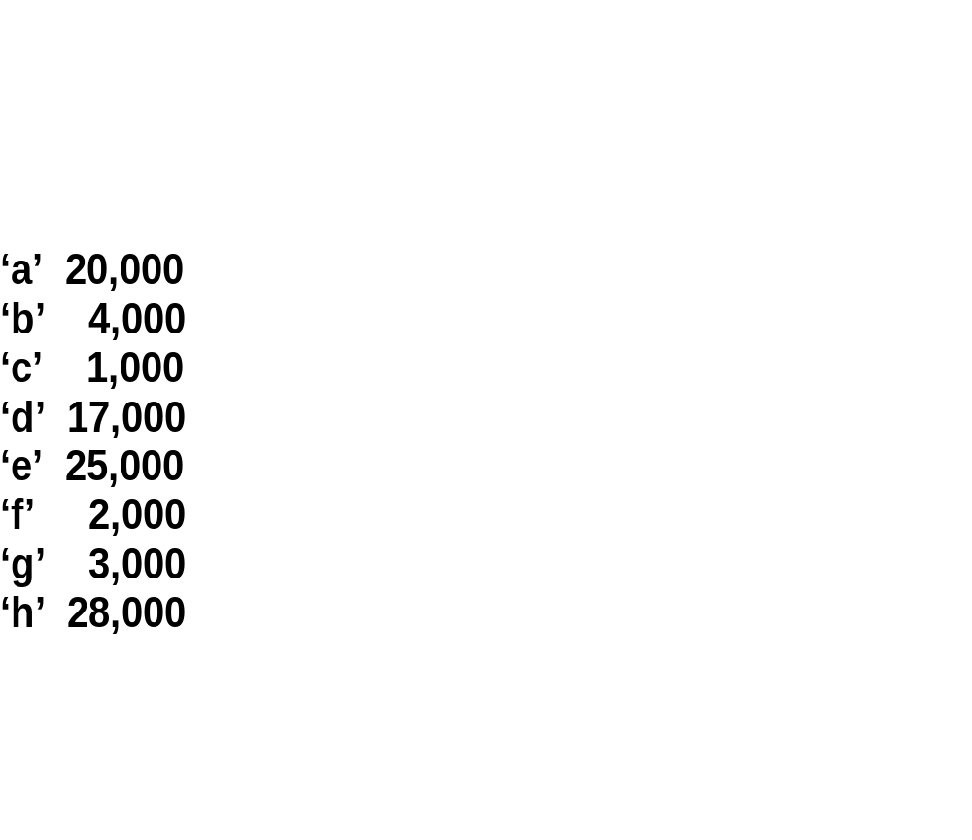
Try creating a tree with this example.

