Slide 1
Linked List
Faster Insert & Erase but slower access
Nattee Niparnan

Slide 2
Overview
Vector takes O(n) in insert/erase at position specified by an iterator
But it is very fast to access any member, O(1)
List gives better performance on insert/erase as O(1), providing that we have iterator to the position of insertion/erase
Achieved by storing data into a node and each node use a pointer to identify the next element
Access to any elements is O(n), if we don’t have an iterator to that element
Use more memory than vector

Slide 3
(Simplified) Illustration
node
list
5
vector
mSize
mCap
mData
mHead
mSize
4
5
4
node
node
1
data
next
10 | 3 | 1 | 5
10
node
3

Slide 4
List vs Vector
List
Vector
Allocate each data separately
Each data points where is the next data
Very fast insert/erase (just change some pointer)
Very slow access because we don’t know where k-th element is
Allocate data as a consecutive block
Very fast to access any element
Very slow Insert/erase requires every element after point of insertion

Slide 5
v0.1 node
template <typename T>
class node {
public:
T data;
node *next;
node() :
data( T() ), next( NULL ) { }
node(const T& data, node* next) :
data ( T(data) ), next( next ) { }
};
Simple object that stores a data and a link to another node
NULL is a special value for any pointer that points to nowhere
Draw as a ground
node
data
next
3

Slide 6
Pointer to Node
int main() {
CP::node<int> *p = NULL;
p = new CP::node<int>(10,NULL);
CP::node<int> *q;
q = new CP::node<int>(20,NULL);
p->next = q;
q->next = new CP::node<int>(30,NULL);
}
Working with linked list needs a pointer to a node
p
data
next
10
20
30
What is the result of ?
q
p = p->next->next;
q = p;
q = q->next;

Slide 7
v0.1 Simple (Singly) Linked List
template <typename T>
class list {
protected:
class node {
friend class list;
public:
T data;
node *next;
node() :
data( T() ), next( NULL ) { }
node(const T& data, node* next) :
data ( T(data) ), next( next ) { }
};
protected:
node *mFirst;
size_t mSize;
public:
list() : mFirst( NULL ), mSize( 0 ) { }
~list() { clear(); }
//... more function
};
Node is an inner class
mFirst
mSize
0

Slide 8
Insertion
For clarity, node will be drawn as light green box
x
mSize
mFirst
4
20
3
16
77
d
99
CP::node<int> *x = mFirst->next->next;
CP::node<int> *d = new CP::node<int>(99,NULL);
mFirst->next->next = d;
d->next = x;
To insert a value 99 before value 16, Let x be a pointer that point to the node of 16
Create a new node d containing a data to be inserted
Change pointer of a node before x (which point to x) to point to d instead
Make pointer of d points to x

Slide 9
Erase
x
mSize
mFirst
4
20
3
16
77
CP::node<int> *x = mFirst->next->next;
mFirst->next->next = x->next;
delete x;
To delete a value 16, in the node pointed by x
Change pointer of a node before x (which point to x) to point to the node that x points to instead
Don’t forget to delete x

Slide 10
Problem with SLL
Erase/insert at iterator X is hard
If we have an iterator point to X, we cannot easily go to the node before X
Cannot go backward
Need to start from mFirst and move on
Adding data to the end takes long time
We have to get iterator that points to the last element (which is O(n))

Slide 11
Finding node before X
node *p = mFirst;
while (p != NULL && p->next != x) p = p->next;
x
mSize
mFirst
4
20
3
16
77
p

Slide 12
v0.2 Doubly Linked List
prev
data
next
10
Each node has 2 pointers
next and prev
Can now move forward and backward
Now, if X is a pointer to a node, we can easily go to node before X and then erase or insert
mSize
mFirst
3
20
16
77

Slide 13
Insert in Doubly Linked List
x
mSize
mFirst
3
20
16
77
CP::node<int> *tmp = new CP::node<int> (99,NULL,NULL);
tmp->next = x;
tmp->prev = x.prev;
x->prev->next = tmp;
x->prev = tmp;
99
tmp

Slide 14
Erase in Doubly Linked List
x
mSize
mFirst
3
20
16
77
x->prev->next = x->next;
x->next->prev = x->prev;
delete x;

Slide 15
Problem solved
Erase/insert at iterator X is now easy
But, adding data at the end (push_back) is still hard
Need to get X to point to the last element
push_back is popular in real world
Right now we have only push_front (fast addition to the first)
Also some minor issue about code cleanliness
Insert/erase the first/last node

Slide 16
v0.3 Circular Singly Linked List
Use mLast instead of mFirst
Fast access to both first and last element
mSize
mFirst
4
20
3
16
77
mSize
mLast
CP::node<int> *first = mLast->next;
4

Slide 17
v0.4 Circular Doubly Linked List
Special linking to last element
Fast access to both first and last element
Can now easily insert at the end
CP::node<int> *last = mFirst->next->prev;
mSize
mFirst
3
20
16
77

Slide 18
More Circular Example
Singly
Doubly
mSize
mLast
mSize
mFirst
0 node
0
0
mSize
mLast
mSize
mFirst
1 node
1
1
20
77

Slide 19
Minor problem
// assume that s points to the second node
CP::node<int> *tmp = new CP::node<int>(99,NULL,NULL);
tmp->next = s;
tmp->prev = s->prev;
s->prev->next = tmp;
s->prev = tmp;
Code is not really clean because of the first element (or the last element)
Consider insert at the first node and insert at the second node of Doubly Linked List
Assume we have a pointer to that node
// assume that f points to the first node
CP::node<int> *tmp =
new CP::node<int>(99,NULL,NULL);
tmp->next = f;
tmp->prev = f.prev;
mFirst = tmp;
f->prev = tmp;
Because first node is different
mSize
mFirst
20
16
77
3

Slide 20
Special First Node Problem
First node (and last node) is different from other nodes in both singly or doubly linked list
For circular singly and circular doubly, each node look the same but we also have to adjust the mFirst (or mLast)
This affects both insert and erase
Also need to deal when mFirst is NULL (when mSize == 0)
//circular doubly linked list
void push_front(const T& e) {
if (mSize == 0) {
mFirst = new node(e,NULL,NULL);
mFirst->next = mFirst;
mFirst->prev = mFirst;
} else {
node* tmp = new node(e,mFirst->prev,mFirst);
mFirst->prev->next = tmp;
mFirst->prev = tmp;
mFirst = tmp;
}
}

Slide 21
Another Example
//circular doubly linked list
void remove(const &T e) {
node *p = mFirst;
for (size_t i = 0;i < mSize;i++, p=p->next) {
if (p->data == e) {
p->next->prev = p->prev;
p->prev->next = p->next;
if (p == mFirst) {
mFirst = p->next;
}
delete p;
mSize--;
break;
}
}
if (mSize == 0) mFirst = NULL;
}
Remove for circular doubly linked list
Remove is find and then erase

Slide 22
Linked List with Header
Singly
Doubly
mSize
mFirst
mSize
mFirst
normal
0
0
mSize
mLast
mSize
mFirst
circular
0
0
Add a special node that will not be used to stored data

Slide 23
Simpler Code with header
Header simplify code
Because mFirst always points to the header (mFirst never is NULL)
void push_front(const T& e) {
node* f = mFirst->next;
node* tmp = new node(e,f,mFirst);
mFirst->next = tmp;
f->prev = tmp;
}
void remove(const T& e) {
node *p = mFirst->next;
while (p != mHeader && p->data != e)
p = p->next;
if (p != mHeader) {
p->next->prev = p->prev;
p->prev->next = p->next;
mSize--;
}
}
mSize
mFirst
4
32
2

Slide 24
Variant Summary
Circular makes accessing first and last element fast
Doubly makes accessing previous element fast
Also making erase at node p easy if we have pointer to p
Need more space for prev pointer
Header makes code simpler
Need more space for header node

Slide 25
Final Version
CP::list is “circular doubly linked list with header”
Simple code for insert/erase
Use most space (two pointers per nodes, need header nodes)
Can push_back, pop_back, push_front, pop_front
Also need custom iterator class
Iterator just store a pointer to a node
We cannot directly use a pointer to a node (node*) because we need to override some operator (--, ++ and something else)

Slide 26
Layout
template <typename T>
class list {
protected:
class node {
friend class list;
public:
T data;
node *prev, *next;
//some functions
};
class list_iterator {
friend class list;
protected:
node* ptr;
public:
//some functions && operators
};
public:
typedef list_iterator iterator;
protected:
node *mHeader; // pointer to a header node
size_t mSize;
public:
//funcions
};
Inner class is a class inside another class
Inner class can access any members of outer class
Outer class cannot access protected or private of the inner class
Friend class allow other class to access

Slide 27
Doubly Linked List Node
class node {
friend class list;
public:
T data;
node *prev;
node *next;
node() :
data( T() ), prev( this ), next( this ) { }
node(const T& data,node* prev, node* next) :
data ( T(data) ), prev( prev ), next( next ) { }
};
Inner class can use template T of the outer class

Slide 28
Constructor
// default constructor
list() : mHeader( new node() ), mSize( 0 ) { }
// copy constructor
list(const list<T>& a) : mHeader( new node() ), mSize( 0 ) {
for (auto &x : *this) {
push_back(x);
}
}
list<T>& operator=(list<T> other) {
using std::swap;
swap(this->mHeader, other.mHeader);
swap(this->mSize, other.mSize);
return *this;
}
~list() {
clear();
delete mHeader;
}

Slide 29
Small Functions
//------------- capacity function -------------------
bool empty() const { return mSize == 0; }
size_t size() const { return mSize; }
//----------------- access -----------------
T& front() { return mHeader->next->data; }
T& back() { return mHeader->prev->data; }
//----------------- modifier -------------
void push_back(const T& element) {
insert(end(),element);
}
void push_front(const T& element) {
insert(begin(),element);
}
void pop_back() {
erase(iterator(mHeader->prev));
}
void pop_front() {
erase(begin());
}
Task is delegated to insert and erase
Need iterator

Slide 30
Iterator
class list_iterator {
friend class list;
protected:
node* ptr;
public:
list_iterator() : ptr( NULL ) { }
list_iterator(node *a) : ptr(a) { }
list_iterator& operator++() {
ptr = ptr->next;
return (*this);
}
list_iterator& operator--() {
ptr = ptr->prev;
return (*this);
}
Has custom constructor that takes node pointer

Slide 31
Iterator
class list_iterator {
friend class list;
protected:
node* ptr;
public:
list_iterator operator++(int) {
list_iterator tmp(*this);
operator++();
return tmp;
}
list_iterator operator--(int) {
list_iterator tmp(*this);
operator--();
return tmp;
}
operator++() is an operator for ++it
operator++(int) is a syntax for it++
operator++(int) delegates to operator++()
Same for operator--

Slide 32
Iterator
class list_iterator {
friend class list;
protected:
node* ptr;
public:
T& operator*() { return ptr->data; }
T* operator->() { return &(ptr->data); }
bool operator==(const list_iterator& other) {
return other.ptr == ptr;
}
bool operator!=(const list_iterator& other) {
return other.ptr != ptr;
}
Nothing special here
Just syntax

Slide 33
Other small function
mSize
mFirst
4
32
2
iterator begin() {
return iterator(mHeader->next);
}
iterator end() {
return iterator(mHeader);
}
void clear() {
while (mSize > 0) erase(begin());
}
ptr
ptr
end()
begin()
mSize
mFirst
0
ptr
ptr
end()
begin()

Slide 34
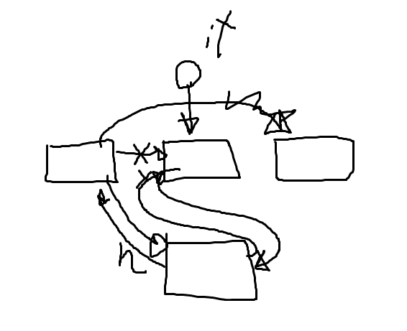
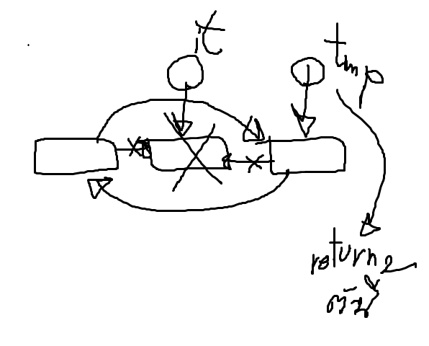
Insert & Erase
iterator insert(iterator it,const T& element) {
node *n = new node(element,it.ptr->prev, it.ptr);
it.ptr->prev->next = n;
it.ptr->prev = n;
mSize++;
return iterator(n);
}
iterator erase(iterator it) {
iterator tmp(it.ptr->next);
it.ptr->prev->next = it.ptr->next;
it.ptr->next->prev = it.ptr->prev;
delete it.ptr;
mSize--;
return tmp;
}
Header make insert/erase very simple

