Slide 1
std::set
Storing “distinct” element with fast look up
Nattee Niparnan

Slide 2
Set
Storing distinct data of same type
The data type must be comparable, i.e., we can tell if a is more or less than b
Somewhat slow insert
Fast look up
Fast erase
Iterator starts from “minimum element” and goes in increasing value direction
Can be used to (somewhat) fast sorting

Slide 3
Basic
#include <iostream>
#include <set>
using namespace std;
int main() {
set<int> s = {4,1,3,2,1,1,3,4};
cout << "Size of s is " << s.size() << endl;
s.insert(10);
s.insert(5);
s.erase(3);
cout << "member of s: ";
for (auto it = s.begin(); it != s.end(); it++)
cout << *it << " ";
}
Notice that s does not include duplicate elements
Also see that when we iterate, member is sorted
This is distinct characteristic of set
Size of s is 4
Member of s: 1 2 4 5 10

Slide 4
Somewhat slow insert, iterate but fast find
We will see this in the detail around last part of this course
For now, please believe that
If there is N elements in the set
Insert take times directly proportional to log(N)
Each it++ or it-- take times directly proportional to log(N)
Each find takes times directly proportional to log(N)

Slide 5
Demo Comparing Vector & Set
See set-2.cpp and set-3.cpp

Slide 6
Set iterator
#include <iostream>
#include <set>
using namespace std;
int main() {
set< pair<string,int> > s = { {"somchai",5},
{"abc",6}, {"abcd",-3}, {"somchai",-4},
{"z",0}, {"z", -1}, {"z",9} };
for (auto &x : s) {
cout << x.first << "," << x.second << endl;
}
cout << "-- find -- " << endl;
auto it = s.find( {"z",-1});
cout << (*it).first << "," << (*it).second << endl;
it--;
it--;
cout << it->first << "," << it->second << endl;
it++;
cout << it->first << "," << it->second << endl;
}
We cannot do s.begin() + x
Because, going to the next element (which is the successor) in set is not as fast as vector, c++ forbids begin() + x
We cannot compare by > or <
We can still use it++ or it-- to go to the next or previous (successor or predecessor) or x
abc,6
abcd,-3
somchai,-4
somchai,5
z,-1
z,0
z,9
-- find --
z,-1
somchai,-4
somchai,5

Slide 7
Additional Function
set.lower_bound
set.upper_bound
set.count

Slide 8
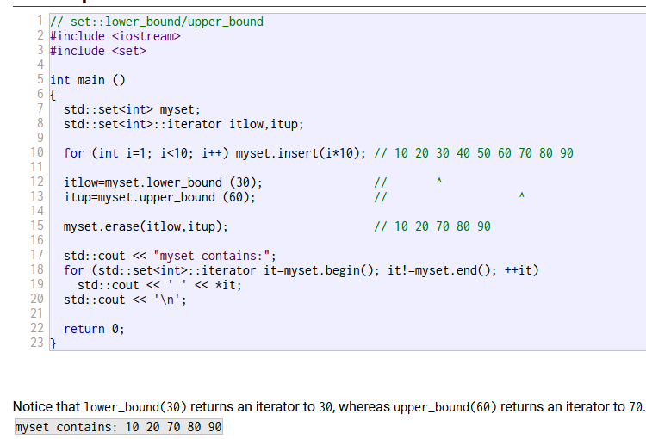

Slide 9
std::map
Association data structure with same property as set
Nattee Niparnan

Slide 10
Map
Is very similar to Python’s dict in usage
Is internally implemented as a set with “pair” data type
Same properties, same limitations as set but more convenience to use as associative data structure
Associative (mapping) between a Key Type and a Mapped Type

Slide 11
Basic
#include <iostream>
#include <map>
using namespace std;
int main() {
//map between "Key Type" string and "Mapped Type" int
map<string,int> m;
m["somchai"] = 10;
m["somying"] = -5;
cout << "Size = " << m.size() << endl;
//accessing unseen Key create a map with default value
cout << "m[\"xxx\"] = " << m["xxx"] << endl;
//each element is a pair of Key Type and Mapped Type
for (auto it = m.begin(); it != m.end();it++) {
cout << it->first << " is mapped to " << it->second << endl;
}
//this will create mapping "abc" to 0 first and then increase it
m["abc"]++;
cout << "now size = " << m.size() << endl;
for (auto &x : m) {
cout << x.first << " is mapped to " << x.second << endl;
}
}
Size = 2
m["xxx"] = 0
somchai is mapped to 10
somying is mapped to -5
xxx is mapped to 0
now size = 4
abc is mapped to 1
somchai is mapped to 10
somying is mapped to -5
xxx is mapped to 0

Slide 12
Checking if map has this key?
Key 99 is mapped to nattee
exists
#include <iostream>
#include <map>
using namespace std;
int main() {
//map between "Key Type" string and "Mapped Type" int
map<int,string> m;
m[1] = "somchai";
m[99] = "nattee";
int k = 99;
map<int,string>::iterator it;
if ((it = m.find(k)) != m.end()) {
cout << "Key " << it->first << " is mapped to " << it->second << endl;
} else {
cout << "Key " << k << " is not exists in m." << endl;
}
//this is not the correct way to check if key exists why??
if (m[k] != "") {
cout << "exists" << endl;
} else {
cout << "does not exists" << endl;
}
}
Use find()

Slide 13
Requirement of std::set and std::map
Set data type and map Key Type must be comparable
We must be able to compare order of two element
Type that we can use directly
int, bool, float, string, double, char… and most of other numerical data type
Pair can also be used if both the type of first and second are comparable
Pair compare first then second

Slide 14
Practice reading c++ docs
Both map and set has insert and erase function
What is the return value of both function of each data structure?
For set<int> s, we can do s.erase(20)
For map<string,bool> m, can we do m.erase(“Somchai”) ??
If we wish to erase element from index 3 to index 4096 in a vector
Is there any function from vector that we can easily use?

Slide 15
Problem
Pair Sum
Given an array of integers, our task is to find whether there exists a pair of elements in the array such that their summation equal to X
Input:
Array of integer (our main array) <-- this is a large array
M values of X, for each value X, we have to determine if a pair whose sum equal to X exists.
Output:
For each value of X, print “YES” if we found such pair; print “NO” otherwise

