Slide 1
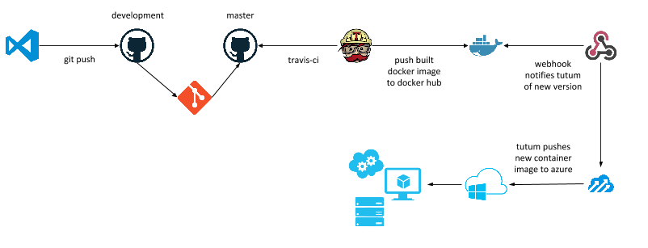



/fuse-template-v1.git
/my-app.git
CI/CD Pipeline
BUILD Containers
Application Containers
GitLab SCM
Config
DEV Containers
Application Containers
Config
./workspace/my-app
INT Containers
Application Containers
Config
QA Containers
Developer Laptop
Open Shift Cluster

