Slide 1
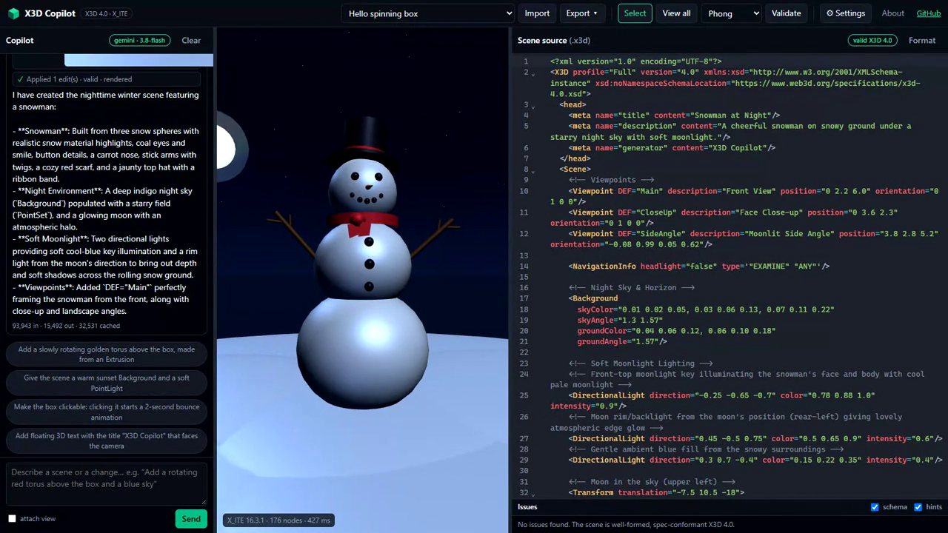

Closing the Loop
AI that writes X3D 4.0 scenes, and cannot ship an invalid one
260
nodes of the X3D 4.0 object model, read by the AI through a tool instead of guessed from memory
3
independent validators on every edit: official XML Schema, spec-derived linter, X_ITE runtime
Snowman from one sentence, then details, moon shadows and a click behaviour. Every step validated; eleven planted errors repaired in one request.
1
screenshot: the AI looks at its own render before it answers
Prompt
Look up spec
Edit scene
Validate
Screenshot
Answer
Result: standards-conformant 3D content by construction. Runs entirely in the browser, open source (MIT), works with Gemini or Claude using your own key.
The model can only act through tools; validation reports feed back until the scene is valid
albertojaspe.net/x3d-copilot
github.com/ajaspe/x3d-copilot
Video: youtu.be/ll1CE0XaRjo
Alberto Jaspe-Villanueva
KAUST · Web3D 2026, AI & Web3D Innovation Competition
Notes:
2-minute fast-forward. Start the video when you begin speaking; it is muted and runs 79 seconds. Script in talk.md.

