Slide 1
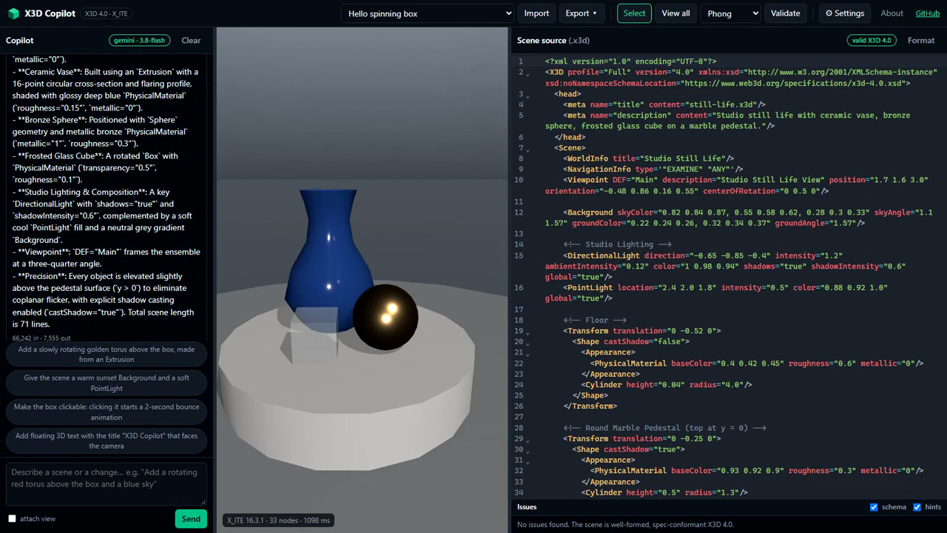

X3D Copilot
Describe a 3D scene in plain words. Get a valid X3D 4.0 scene, live in your browser.
WHAT IT IS
A 3D editor that runs in the browser. Live view, source editor, drag objects, import glTF or OBJ, export X3D. Nothing to install.
An AI co-author. Just say what you want: “a snowman at night”, “make the hat jump when clicked”.
A referee that never sleeps. Every change, yours or the AI's, is checked against the X3D 4.0 standard before you see it.
HOW IT WORKS
1
You ask in plain words, for a new scene or a change to the one on screen.
2
The AI reads the X3D specification and edits the scene through tools; it never writes blind.
In the clip: an AI-built still life, a snowman from one sentence, moon shadows, a click that makes the hat hop, the solar system, dragging objects, physically based materials, and a scene with eleven errors repaired in one request.
3
The standard checks the result: schema, semantic rules and the 3D runtime. The AI must fix every error before it answers.
Try it now: albertojaspe.net/x3d-copilot
Code (MIT): github.com/ajaspe/x3d-copilot
Video: youtu.be/ll1CE0XaRjo
Bring your own Gemini or Claude key for the AI.
4
The AI looks at the render and replies. You keep editing by hand, by dragging, or by chat.
Alberto Jaspe-Villanueva King Abdullah University of Science and Technology (KAUST) · AI & Web3D Innovation Competition, Web3D 2026
Notes:
Two-minute fast-forward. Click the video as you start speaking; it is muted and runs 105 seconds. Full script in talk.md.

