Slide 1
SAT
A statically typed procedural language
Anoop Jatavallabha Vijayakumar
Syed Zafar Shah
Tharun Niranjan Gomudurai Pandian
Group 14

Slide 2


Features
Integer, Boolean Datatype
Arithmetic, Relational Operators
Decision and Iteration statements
Scoping
Assignment Statement
Data Structure- Stack
Recursion

Slide 3




SAT Source code
Intermediate Byte Code
Runtime
Output

Slide 4
DESIGN OF LANGUAGE
Static typed system
Static scope
C like syntax

Slide 5
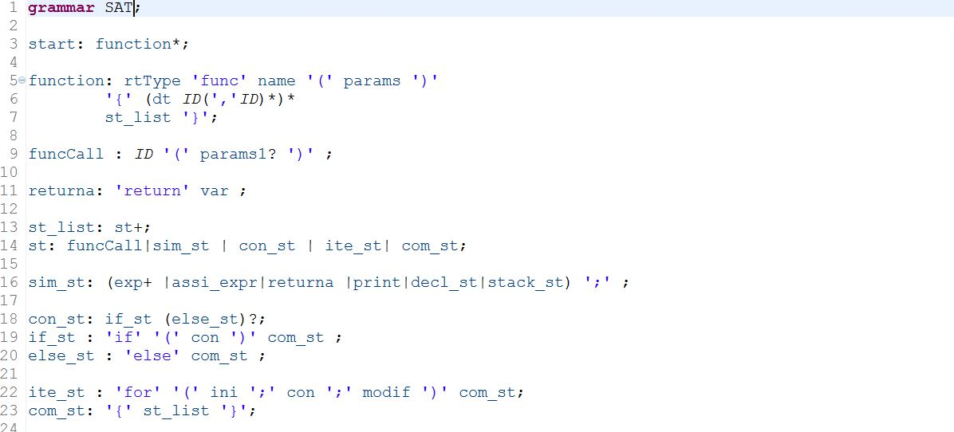
Grammar

Slide 6
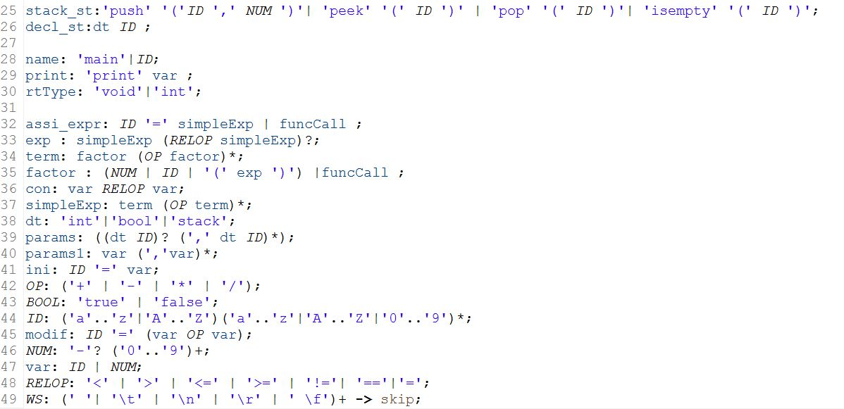
Grammar

Slide 7
LANGUAGE CONSTRUCTS
Operators and primitive types
'+' | '-' | '*' | '/‘
Int, Boolean
Supports “stack” data structure
Push
Pop
Peek
isEmpty
Parameterized functions
Supports integer and void as return type
Accepts parameters

Slide 8
LANGUAGE CONSTRUCTS
Assignment expression
Variables can be assigned values directly and also function
return values
Supports decision constructs
“if – else” statement
Supports nested conditions
void func greatestThree(a,b,c){ if(a>=b){ if(a>=c){ return a; } else{ return c; } } else{ if(b>=c){ return b; } else{ return c; } } } void func main(){ output = greatestThree(5,7,8); print output; }

Slide 9
LANGUAGE CONSTRUCTS
Scoping
Distinguishes variables across functions
Supports iterative constructs
“for” statement
Supports nested function
void func factorial(int x){ int fact,i; fact=1; n=x;
for(i=1;i<=n;i=i+1){ fact=fact*i; } return fact; }
void func main(){ result = factorial(5); print result; }

Slide 10
LANGUAGE CONSTRUCTS
Supports recursive function call
void func expo(int b,int e){ if(e == 0){ return 1; } e=e - 1; output=b* expo(b,e); return output; } void func main(){ result = expo(2,3); print result; }

Slide 11
ANTLR
Parser generator
Parse tree as a result of interpreting a grammar
Builds and walks parse tree

Slide 12
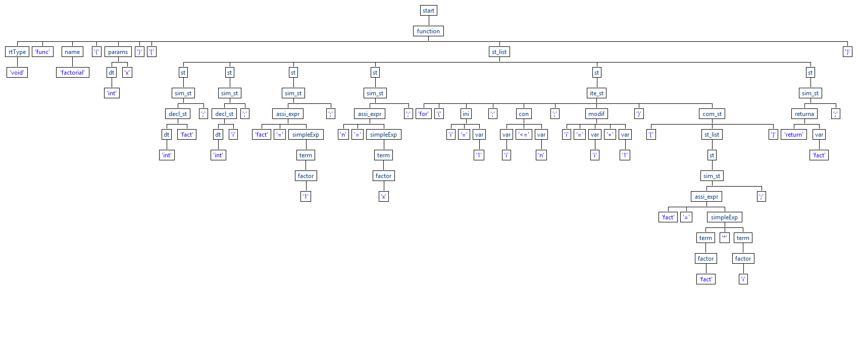

Slide 13
Instruction set
Operators | Instruction
+ | ADD
- | SUB
* | MUL
/ | DIV
= | ASSIGN
== | EQUAL
Operators | Instruction
>= | GEQ
< | LESSER
<= | LEQ
% | MOD
!= | NEQUAL
> | GREATER
Other instructions
FSTART | SPEEK
FEND | SEMPTY
PRINT | FAILGOTO
PUSH | RETURN
STACK | SPOP
SPUSH

Slide 14
Runtime Environment
Call Stack – This is the stack where values gets pushed and popped from.
SymbolTable
Implemented as a HashMap. <key, value> = <function_name> <function_object>
Function Object: Function name, Start Line Number, Environment Table, Lines of Code.
Environment Table: HashMap <key, value> = <variable_name, variable_value>
Every time function is called, activation record is created.
Activation Record is implemented as a list which contains line_num of the caller, Function Object
Environment pointer
Points to the current activation record.

Slide 15
NESTED IF Greatest of three numbers
FSTART greatestThree a,b,c PUSH a PUSH b GEQ FAILGOTO 15 PUSH a PUSH c GEQ FAILGOTO 12 RETURN a PUSH FALSE FAILGOTO 13 RETURN c PUSH FALSE FAILGOTO 13 PUSH b PUSH c GEQ FAILGOTO 22 RETURN b PUSH FALSE FAILGOTO 23 RETURN c FEND PUSH output CALL greatestThree 5,7,8 ASSIGN PRINT output
void func greatestThree(a,b,c){ if(a>=b){ if(a>=c){ return a; } else{ return c; } } else{ if(b>=c){ return b; } else{ return c; } } } void func main(){ output = greatestThree(5,7,8); print output; }

Slide 16
FOR LOOP Factorial
FSTART factorial x PUSH fact PUSH 1 ASSIGN PUSH n PUSH x ASSIGN PUSH i PUSH 1 ASSIGN PUSH i PUSH n LEQ FAILGOTO 26 PUSH fact PUSH fact PUSH i MUL ASSIGN PUSH i PUSH i PUSH 1 ADD ASSIGN PUSH FALSE FAILGOTO 10 RETURN fact FEND ​ PUSH result CALL factorial 5 ASSIGN PRINT "FACT(5):" PRINT result
void func factorial(int x){ int fact,i; fact=1; n=x;
for(i=1;i<=n;i=i+1){ fact=fact*i; } return fact; }
void func main(){ result = factorial(5); print result; }

Slide 17
RECURSION Exponentiation
FSTART expo b,e PUSH e PUSH 0 EQUAL FAILGOTO 8 RETURN 1 PUSH FALSE FAILGOTO 0 PUSH e PUSH e PUSH 1 SUB ASSIGN PUSH output PUSH b CALL expo b,e MUL ASSIGN RETURN output FEND ​ PUSH result CALL expo 2,10 ASSIGN PRINT result
void func expo(int b,int e){ if(e == 0){ return 1; } e=e - 1; output=b* expo(b,e); return output; } void func main(){ result = expo(2,3); print result; }

Slide 18
DEMO

Slide 19
Thank You

