Slide 1
Classroom Booking System
[CS223] Software Engineering Course Project
Ajat Prabha (B16CS002)
Saksham Banga (B16CS042)
Under Guidance of:
Dr. Chiranjoy Chattopadhyay

Slide 2
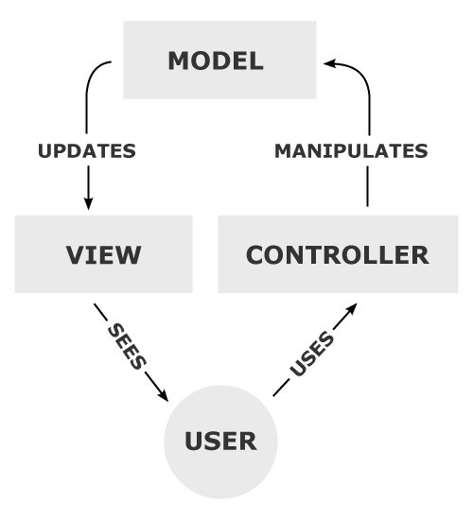
MVC Paradigm
Provides clear separation of concerns for business logic and presentation.
Helps make code modular and maintainable.
Adding features is very convenient.

Slide 3
Templatized Code (down to core)
class Model<T>
Admin("Admin", "user", "admin@iitj.ac.in", "admin@123").save();
Or
temp = new Slot(requestedBy, room, startTime, endTime, reason, approved);
return temp->save();
Enables object saving, deleting, etc very easy.
Convenient file handling
Provides easy search throughout the application
One interface between all Classrooms and Database(File System)
Thus the model class acts as the dynamic loader and the file handler for all types of classes

Slide 4
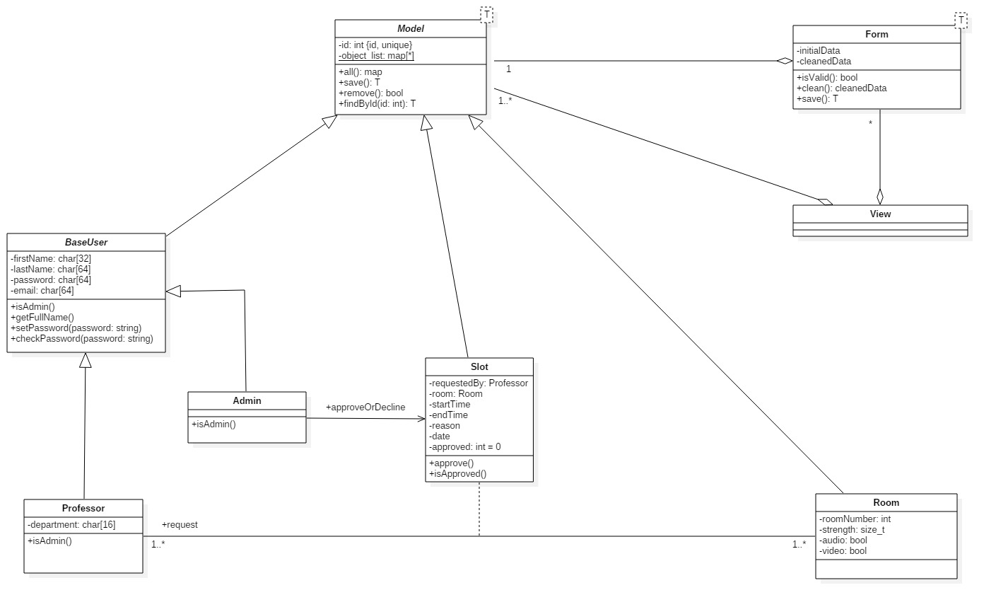
Class Diagram

Slide 5
List of Use-cases implemented
Admin Panel View Use-cases
List Unseen Slot Requests
Display Room Details
Delete Room
Update Room Details
Create Professor/Admin
Delete Professor/Admin
Faculty Panel View Use-cases
Update User
Delete Slot
Update Slot
Create Slot
Slots status list
Empty Class List

Slide 6
Database Lifecycle
Model<T>
object
.save()
.remove()
objectList
readFromFile
writeToFile

Slide 7
Templatized Code (down to core)
class ModelForm<T> : public Form
void RoomCreateUpdateForm::clean() {
if (!instance) {
for (auto &i : Room::all()) {
if (i.second.getRoomNumber() == roomNumber)
addError("A room with this room number
already exists.");
}
}
}
And
Room &RoomCreateUpdateForm::save() {
Room *temp;
temp = new Room(roomNumber, strength, audio, video);
if (instance) {
int id = instance->getId();
instance->remove();
temp->setId(id);
}
temp->save();
return *temp;
}
Provides a dynamic and robust validation method
Managing errors is easy
Easily create and update Model<T> instances through this class

Slide 8
Templatized Code (down to core)
Mixins
Provides easy hooks to add objects into another class
Methods can be overridden for custom behaviour
Types:
MultipleObjectMixin<T>
SingleObjectMixin<T>
template<class T>
vector<T> &MultipleObjectMixin<T>::getQueryset() {
vector<T> objects{};
return objects;
}
And
template<class T>
T &SingleObjectMixin<T>::getObject() {
return object;
}

Slide 9
Templatized Code (down to core)
Generic Class Based Views
Example:
class SlotNotificationListView : public ListView<Slot>
vector<Slot> &SlotNotificationListView::getQueryset() {
for (auto &i : objectList) {
if (i.second.getRequestedBy() ==
static_cast<Professor &>(*context.user))
objects.push_back(i.second);
}
return objects;
}
void SlotNotificationListView::display() {
for (auto &slot : getQueryset()) {
cout << slot.getId() << ". "
<< slot.getRoom().getRoomNumber();
}
For easily providing CRUD features to views
Provides a systematic approach to implementing views
Views are templatized for easy addition of Model<T> instance logic
Types:
CreateView<T>
UpdateView<T> uses SingleObjectMixin<T>
DetailView<T> uses SingleObjectMixin<T>
DeleteView<T> uses SingleObjectMixin<T>
ListView<T> uses MultipleObjectMixin<T>

Slide 10
Design Patterns Used
Singleton Class
Example:
int main() {
Application app = Application::getInstance();
app.start();
return 0;
}
class Application
Private constructor
class Controller
Private constructor

Slide 11
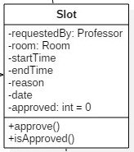
Association Class
class Slot : public Model<Slot>
Example:
Used in class SlotNotificationListView for ProfessorPanelView
Used in class UnseenSlotRequestListView for AdminPanelView
Contains information for both Professor and Room
Additional association data is also stored
Start/End Time
Reason
Date
Approval status, etc.

Slide 12
Utility Classes
class Input
Provides input methods throughout the application
Regular expression based input validation
class DateTime
Able to detect leap years
Can compare two date instances for equality and inequality
class ViewPattern
Used by Controller class to maintain Views
class Context
Passed along while calling a view to pass stateful information
class Response
Used to return contextual information back from a View
string Input::getEmail() {
regex emailRegex(R"((\w+)(\.|_)?(\w*)@(\w+)(\.(\w+))+)");
return regexInputValidate(emailRegex, "Enter a
valid email!");
}

Slide 13
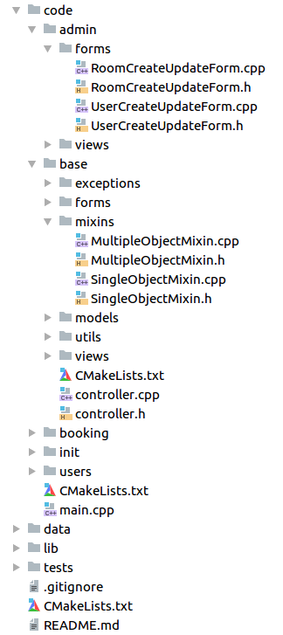
`base` directory compiled into static library
Directory under `code/base` has been compiled as a library and used in main source code and tests
Provides portability and out-of-the-box usage
BaseLib.a file can be linked to an executable

Slide 14
Testing

Slide 15
Statistics of Tests performed
Nature | Unit Tests | System Tests
Failed | 3 | 0
Total | 53 | 18
% Failure | 5.66 | 0
All the above errors were resolved during the allotted enhancement period.
However, the issue of Exiting system abruptly is not resolved after enhancement.

Slide 16
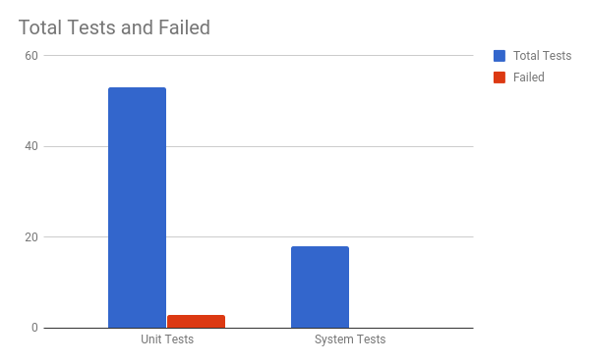
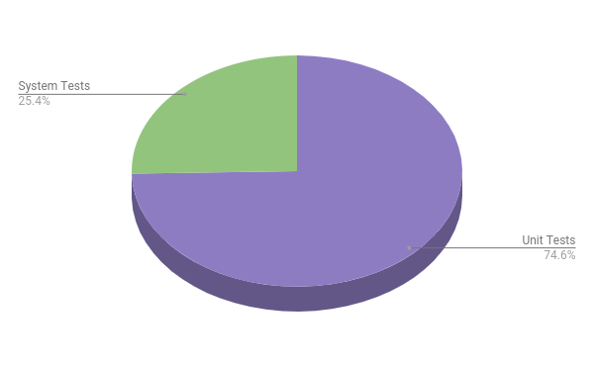

Slide 17
Automated Testing
Example:
class Mock : public Model<Mock> { };
TEST_F(ModelTestFixture,
testSizeZeroAfterSaveAndDelete) {
Mock object = Mock();
object.save();
ASSERT_EQ(Mock::all().size(), 1);
object.remove();
ASSERT_EQ(Mock::all().size(), 0);
}
Did automated testing using Google’s Google-Test Suite unit testing framework
Followed Test-Driven-Development (TDD)

Slide 18
Errors not resolved
If the Application is abruptly closed from the terminal itself, the model instances edited after the application started, would not be saved to file and hence the track would be lost.
This can be resolved if file handling is invoked every time a new object is created/updated/deleted but it decreases the efficiency of the application since files are read/written entirely.
Alternative: using a SQL database for dynamic updates
If the Application is abruptly closed from the terminal itself, the model instances edited after the application started, would not be saved to file and hence the track would be lost.
This can be resolved if file handling is invoked every time a new object is created/updated/deleted but it decreases the efficiency of the application since files are read/written entirely.
Alternative: using a SQL database for dynamic updates

Slide 19
Cross Testing
Group 11: Sports Equipment Management

Slide 20
List of Use-cases tested
Login
Issue Equipment
Check Availability
Verification
Check Dues
Return Equipment
Update Database
Pay dues
Add Equipment
View List of Equipments
By equipment Category
By outstanding filter

Slide 21
Statistics of Tests performed
Nature | Unit Tests | System Tests
Failed | 3 | 1
Total | 52 | 9
% Failure | 5.7 | 11.1
No major error (eg wrong application of business rules etc.) was observed, however minor input/output error handling was not done during testing phase

Slide 22
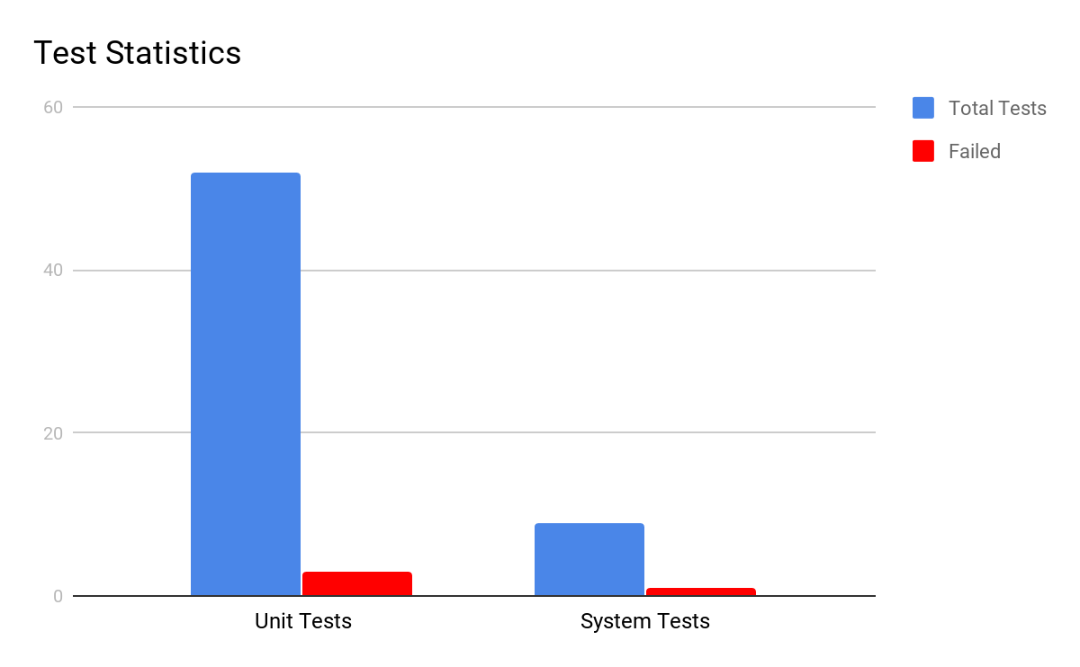

Slide 23
Conclusion
A stand alone, stable C++ application for Classroom Booking System is developed.
The application, was prepared keeping all steps of Software Engineering in mind ie. Software Requirements Analysis, Implementation, Testing, Refactoring and Maintainability.
Thus the application is now ready to be released.

Slide 24
Code Demo

Slide 25
Thank You!

