Slide 1
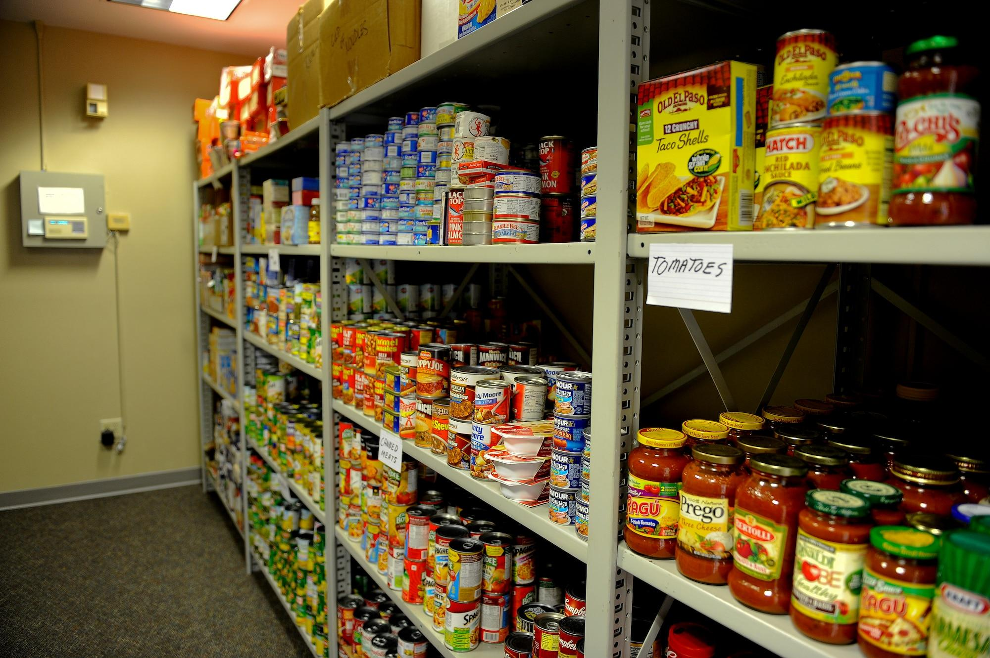
Social Services
By: Mary Moor, Alexa Gonzalez, William Carr, Julius Leone
01

Slide 2
Social Services Project
Project Overview
UML and Sequence Diagrams
Functionality

Slide 3
Project Overview
Goal
Connect users with local businesses and organizations that offer products and food in a specific area - particularly for people facing food insecurity or other challenges accessing essential goods and services.
Key features included user registration and authentication, search and filtering options, a mapped-based interface, and donations and volunteer options.
Connect providers with those in need and help providers bring in docations.
Allow recipients to search for providers that have what they need, donors to donate to providers, providers to update their inventory, and users to login to understand the number of people looking for food in the area and find the distance between then and providers with necessary items.
To benefit stakeholders including recipients, donors, and providers by making it easier to find needed goods, know what items are in short supply, and track inventory and donations.

Slide 4
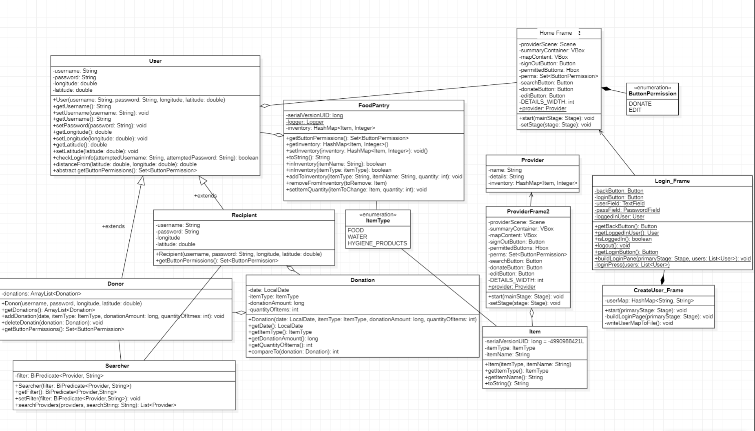
Class UML Diagram

Slide 5
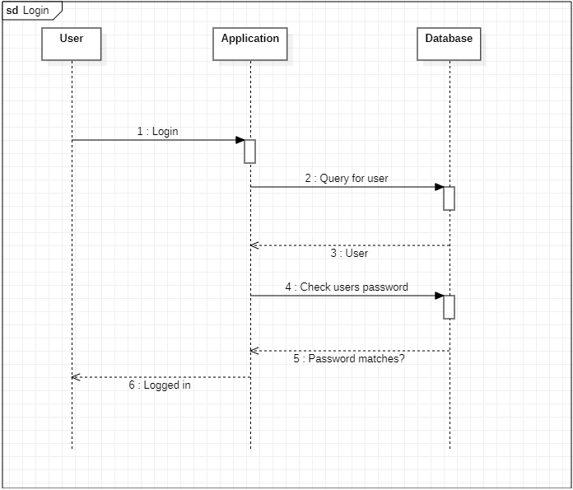
Sequence Diagram
Notes:
1. The user initiates the login process by entering their credentials (username and password) in the login page and clicking the "login" button.
2. The application receives the login request and sends a query to the database to find the user with the given username.
3. The database searches for the user and returns the user object to the application.
4. The application checks if the password entered by the user matches the password stored in the user object retrieved from the database.
5. If the passwords match, the application logs the user in and displays the main page of the application. If the passwords don't match, the application displays an error message and prompts the user to try again.
6. The user is now logged in and can use the application.

Slide 6
How each functionality is demonstrated

Slide 7
Polymorphic Collections
How did you use them in your application?
The FoodPantry class uses a HashMap called inventory to store the items along with their quantity. The HashMap can store objects of type Item as keys and Integer as values. Since Item is the superclass of all item types, it can be used to store objects of different item types.
What code demonstrates how you handled different object types?
The inInventory() method is overloaded to search for an item either by name or by type. It checks if an item is in the inventory and has a stock greater than 0. If the item is found, it returns true; otherwise, it returns false.
The addToInventory() method adds an item to the inventory. If the inventory already contains the item, the quantity is incremented by the amount passed to the method.
The removeFromInventory() method removes an item from the inventory.
The setItemQuantity() method sets the quantity of an item.
How did you avoid coupling to superclasses?
To avoid coupling to superclasses with polymorphic collections, we can define an interface that exposes only the necessary methods, and use it to access the objects. In this case, the Provider interface is used to access the FoodPantry object. The Provider interface declares methods to access the inventory, name, and details of the provider. The FoodPantry class implements the Provider interface, so the methods defined in the interface can be used to access the FoodPantry object without knowing its specific type.

Slide 8
Abstract Classes and Interfaces
Where were interfaces used? Did you have to use interfaces for your project?
The Provider interface is used to define the methods that must be implemented by the classes that implement it. In this case, FoodPantry class implements the Provider interface, which requires it to implement the getButtonPermissions() method. An interface is used to provide a contract between different classes, and it is useful in cases where different classes need to have the same methods but different implementations.
Where did you use abstract classes?
Abstract class User is used to represent a standard user, and it is extended by the FoodPantry class. An interface Provider is also implemented by the FoodPantry class.
Why did you use them?
The User abstract class is used as a parent class for the FoodPantry class to inherit its properties such as username, password, longitude, and latitude. An abstract class is used to provide a common structure and implementation to the classes that inherit it. In this case, it is used to enforce the required properties that every user should have.
What were the advantages/disadvantages of using interfaces?
The advantages of using interfaces are that it allows for multiple inheritance, where a class can implement multiple interfaces, and it provides a contract that specifies the methods that a class must implement. The disadvantage is that it can lead to code duplication, where multiple classes implement the same interface with similar code. In the given code, interfaces are used to enforce the required methods that must be implemented by classes that implement the interface.

Slide 9
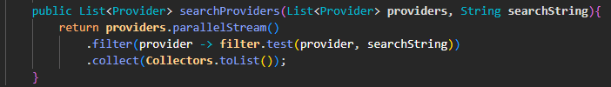
Lambda Expressions
The class "Searcher" has a private field called "filter" of type "BiPredicate<Provider, String>". The class has a constructor that takes a BiPredicate as a parameter and sets the filter field to that value. It also has getters and setters for the filter field.
The method searchProviders takes a List of providers and a search string as parameters. The method uses the parallelStream() method of the List to filter the list of providers based on the BiPredicate filter using a lambda expression. The lambda expression takes a provider and a search string as parameters and calls the "test" method of the BiPredicate filter with those parameters. Finally, it returns a new List containing only the providers that match the search parameters.

Slide 10
JavaFX GUI (Most challenging aspect of GUI)
Since we had so many different frames, making sure they all worked together to make a cohesive application and not just individual frames.
Some of us had problems with JavaFX and without having that working, it was really hard to test code and make sure it functioned.
Making a large scale application and not just simplistic GUIs and starting an application from scratch without any given instructions.

Slide 11

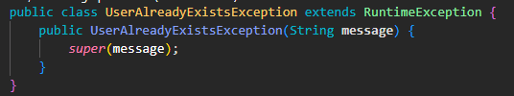
Customized Error Handling
Where did you use it?
CreateUser_Frame

Slide 12
File Input/ Output
What were your file input/output strategies?
Using the .txt file to store usernames and passwords. The CreateUser_Frame class give the user the option to add their username/password to the .txt.
When logging in, the .txt file is read to see if that user exists, if they do it then checks that the password matches what is on file.
Where did you use serialization?
Serialization is used in UserBase to save the HashMaps of donors, recipients, and foodPantrys to disk. When the program starts, it reads the serialized data from disk and deserializes it back into the HashMaps. The serialized data is stored in files with the extensions .ser in a directory called ser.

Slide 13
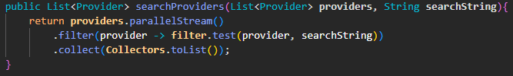
Streams

Slide 14
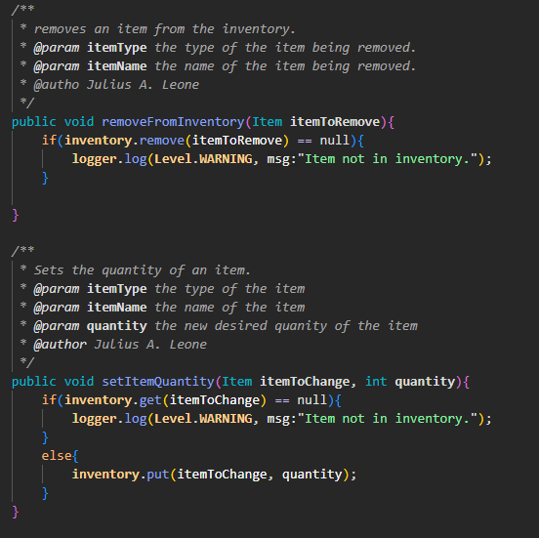
Use of logging
How and where did you use logging?
FoodPantry Class
Why did you implement it this way?
The reason the logger is implemented this way is to provide a mechanism for monitoring the behavior of the FoodPantry class. By using the logger to write log messages, it is possible to track when certain methods are called and to monitor the state of the inventory. This can be useful for debugging and troubleshooting issues that arise with the FoodPantry class.

Slide 15
Threads
How did you use multithreading in the project?
On the HomeFrame we have a list of the items in the inventory, this updates as new/ recent donations are added into the system.
Our goal was to implement a recent donations feed, but we had a difficult time implementing this with JavaFX issues and Git conflicts.
In the future, we are going to implement this, especially in the production stages of this project.

Slide 16
Group Contributions
Will | Mary | Alexa | Julius
GUIDriver HomeFrame Login_Frame FoodPantry CreateUser_Frame ButtonPermission ProductType Abstract Classes and Interfaces User Streams Logging Serialization ButtonPermission | Login_Frame Class UML Diagram Sequence Diagram Requirements Document Presentation | ItemType ProviderFrame ProviderFrame2 Class UML Diagram Requirements Document Presentation | Polymorphic Collections Lambda Expressions Abstract Classes and Interfaces Serialization Logging Streams Donation Donor FoodPantry GUIDriver Item Provider Recipient Searcher User UserBase

