Slide 1
Fraud Detection using Supervised Learning Classification
Ajay Krishnan
Babloo Kumar S
Gopi Selvaraj
Panduranga A
Rabi Bastin J

Slide 2
Problem Definition
The objective of this project is to develop a robust and accurate fraud detection model using supervised learning classification techniques. The model should be able to classify transactions or activities into two categories: "fraudulent" and "non-fraudulent," based on historical data and relevant features.
The dataset provided for this project contains historical transaction data, where each transaction is described by a set of features. These features includes such as transaction amount, transaction date and time, user information, and other relevant details. Additionally, each transaction is labeled as either "fraudulent" or "non-fraudulent.“

Slide 3
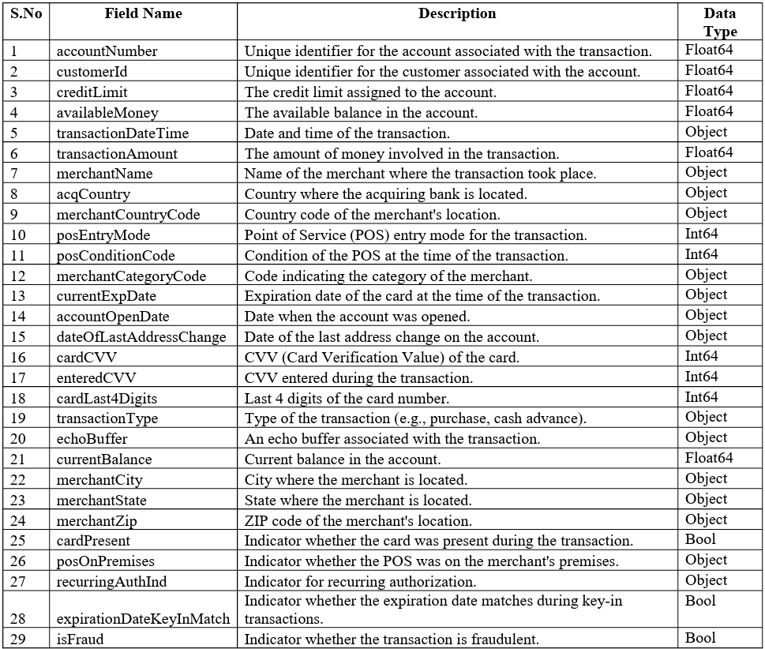
About Dataset

Slide 4
Shape and Spread of Target Variable
The Dataset has 7 Lakhs + Observation and 29 Columns, The Complexity in finding the solution to the problem based on the Chosen Sampling Techniques (Stratified & Smote Sampling)
When Calculating the Proportion to Target Variables Major Class of Fraud Transaction is False Minor Class of Fraud Transaction is True with ratio of 98.5 : 1.5

Slide 5
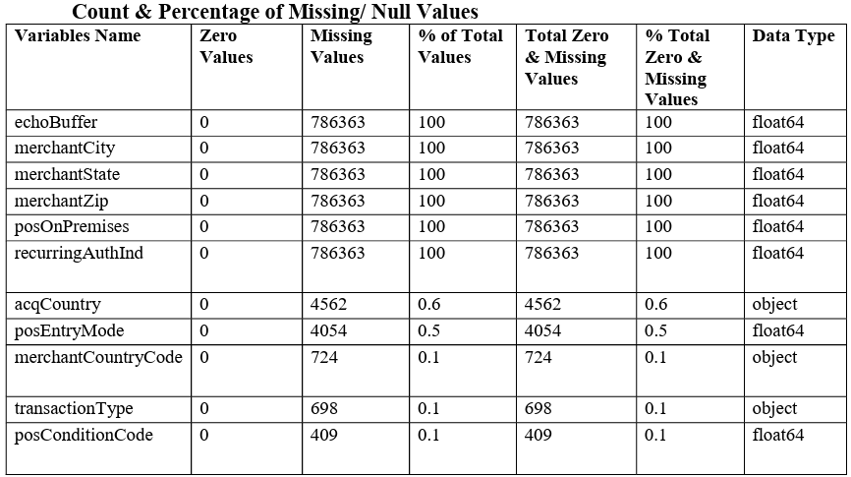
Pre Processing Data Analysis

Slide 6
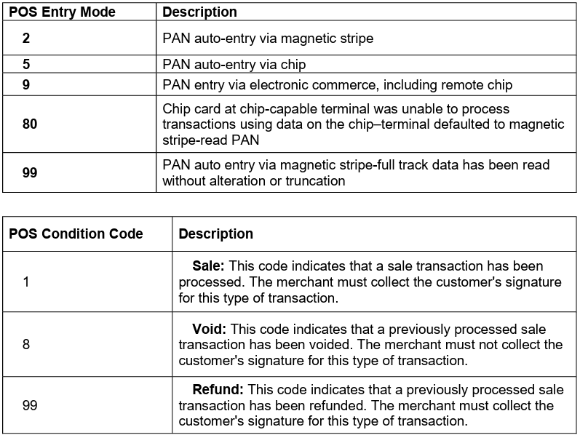
Data Preparation
Only posEntryMode & posConditionCode are in the from discrete number however the data types is in float hence changed to Object.

Slide 7
Dropping Variables
Dropping columns with 100% null values, which includes 'echoBuffer,' 'merchantCity,' 'merchantState,' 'merchantZip,' 'posOnPremises,' and 'recurringAuthInd’.
Excluding the following variables from the dataset as they are irrelevant to the target and may introduce confusion during model building: 'merchantName,' 'accountNumber,' 'customerId,' 'cardLast4Digits,' 'transactionDateTime,' 'cardCVV,' 'enteredCVV,' 'currentExpDate,' 'dateOfLastAddressChange,' and 'accountOpenDate.

Slide 8
Missing Value Imputation
Imputing the Missing Values for categorical data type with mode.

Slide 9
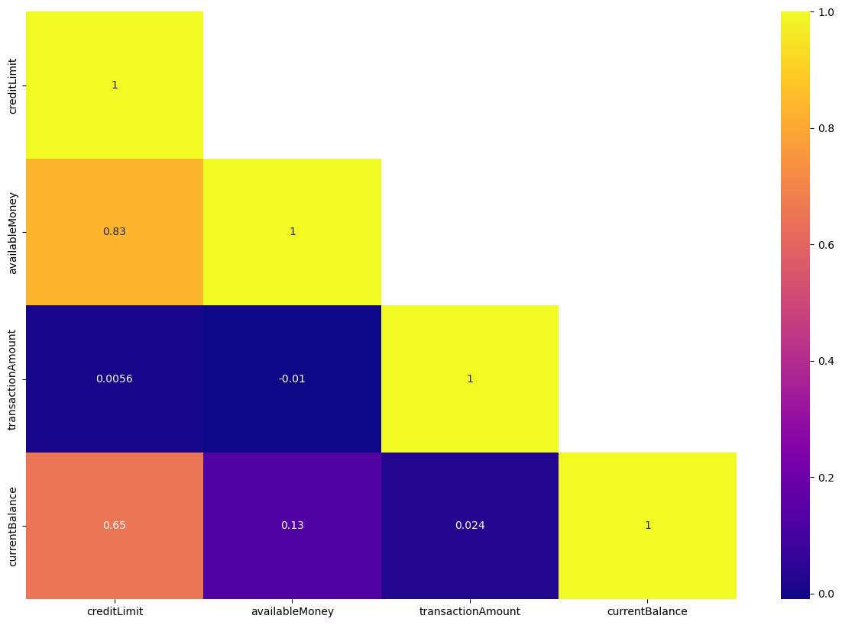
Exploratory Data Analysis
Correlation of numerical variables:

Slide 10
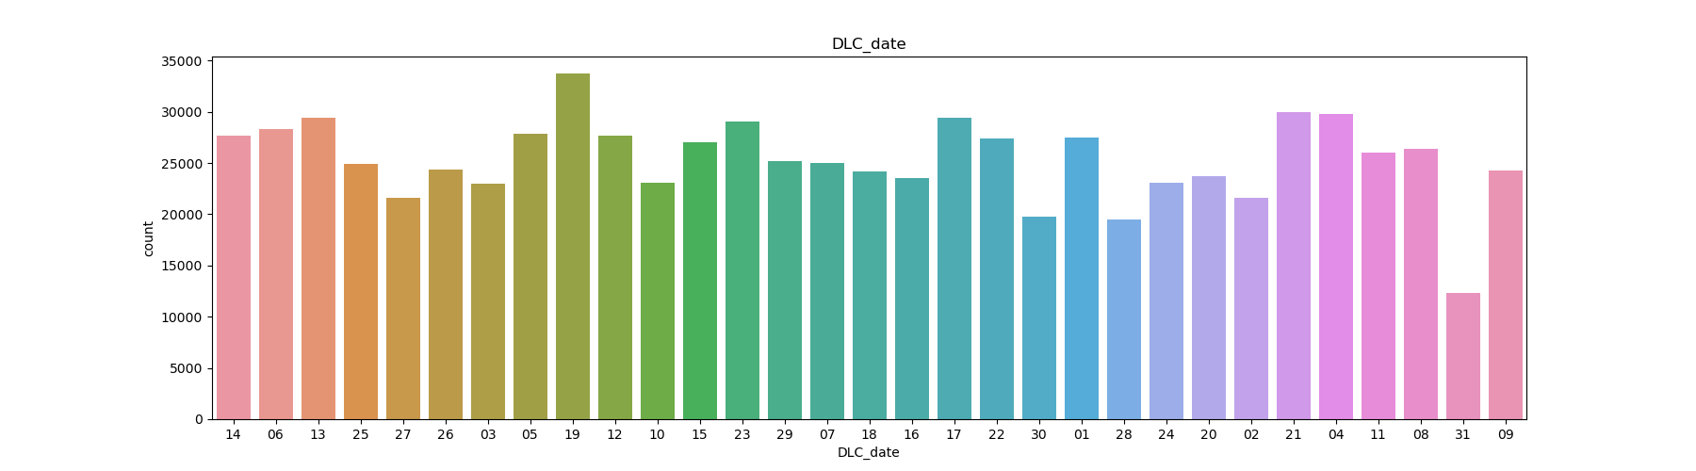
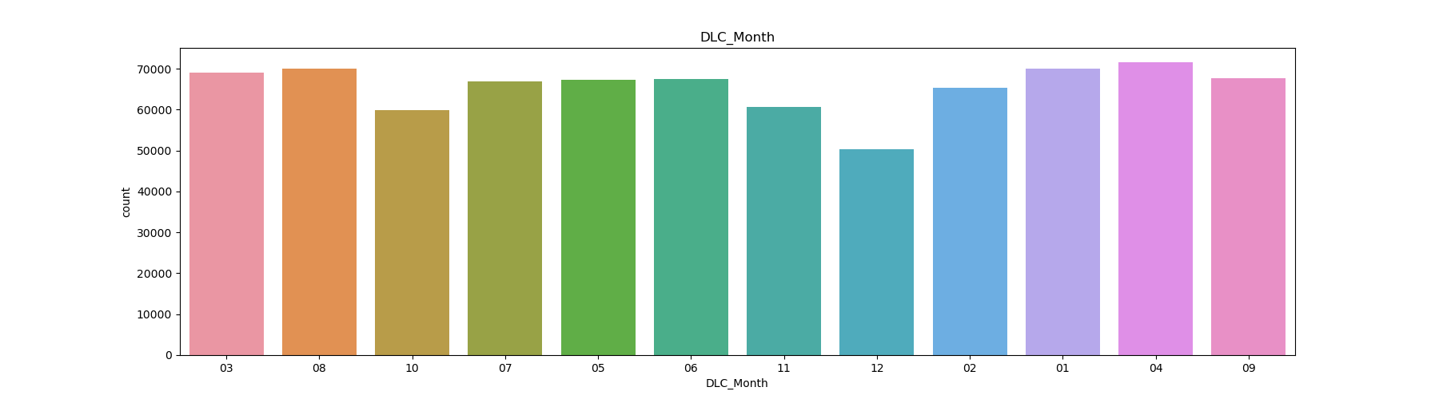
Univariate Analysis:

Slide 11
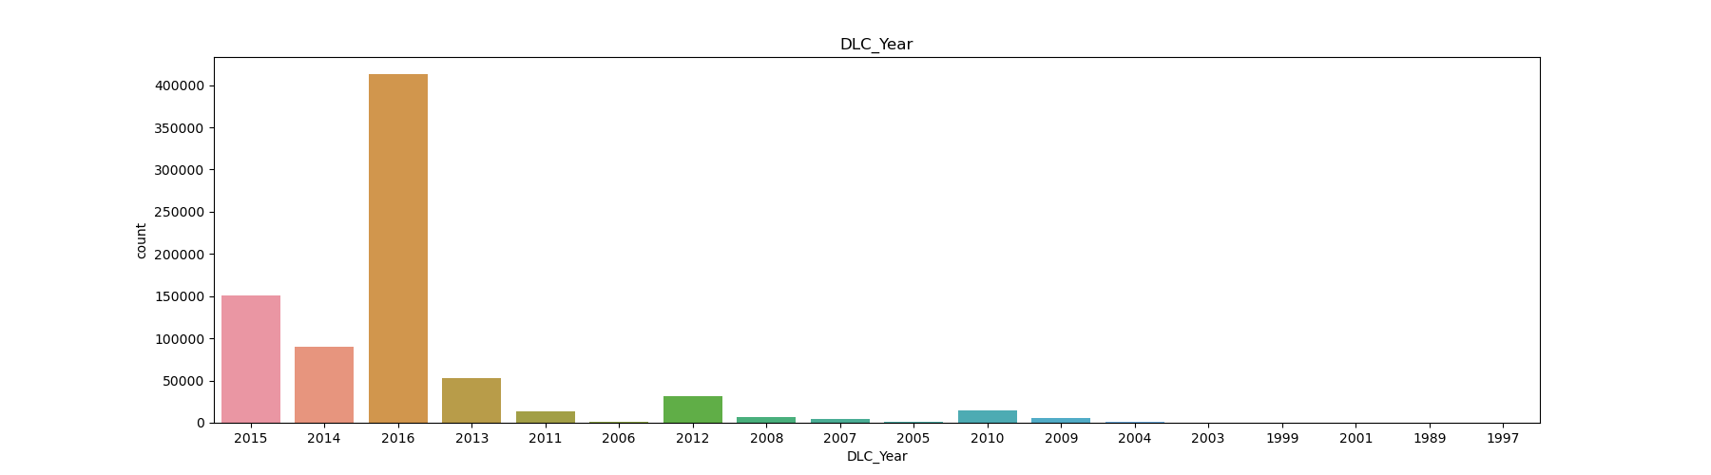
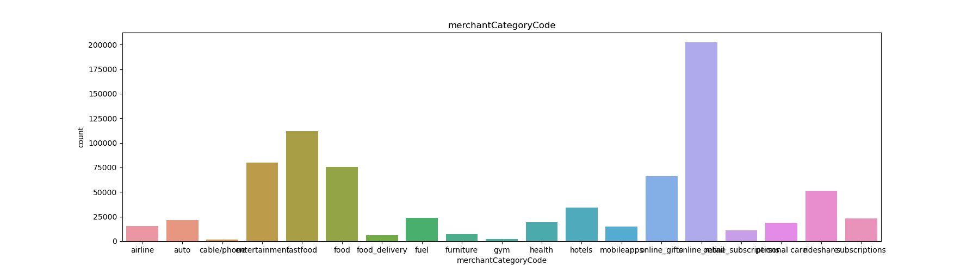

Slide 12
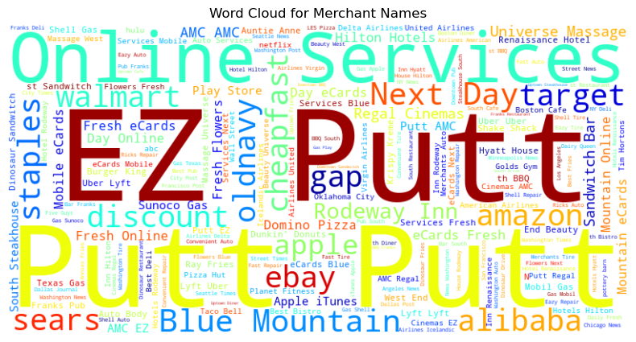
Merchant Names:

Slide 13
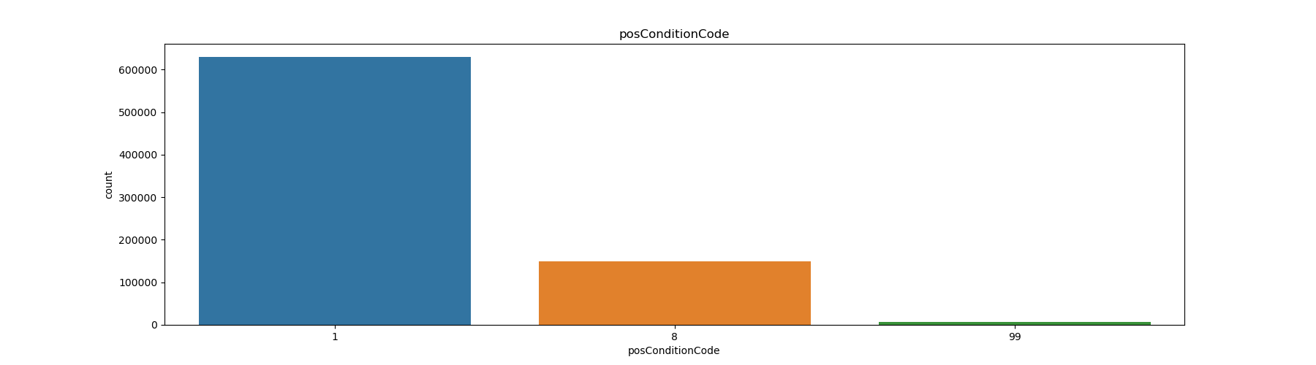
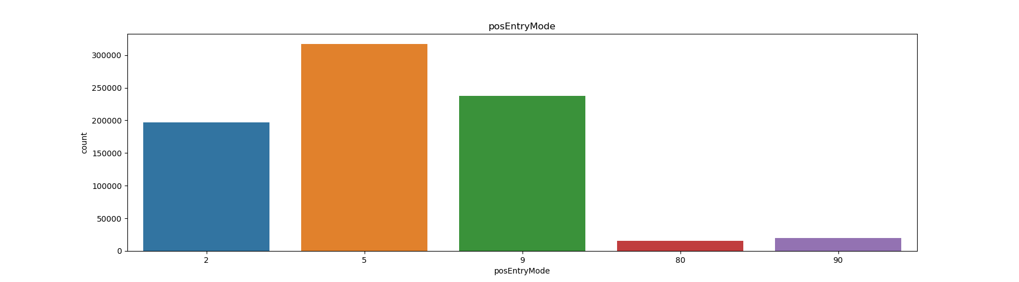
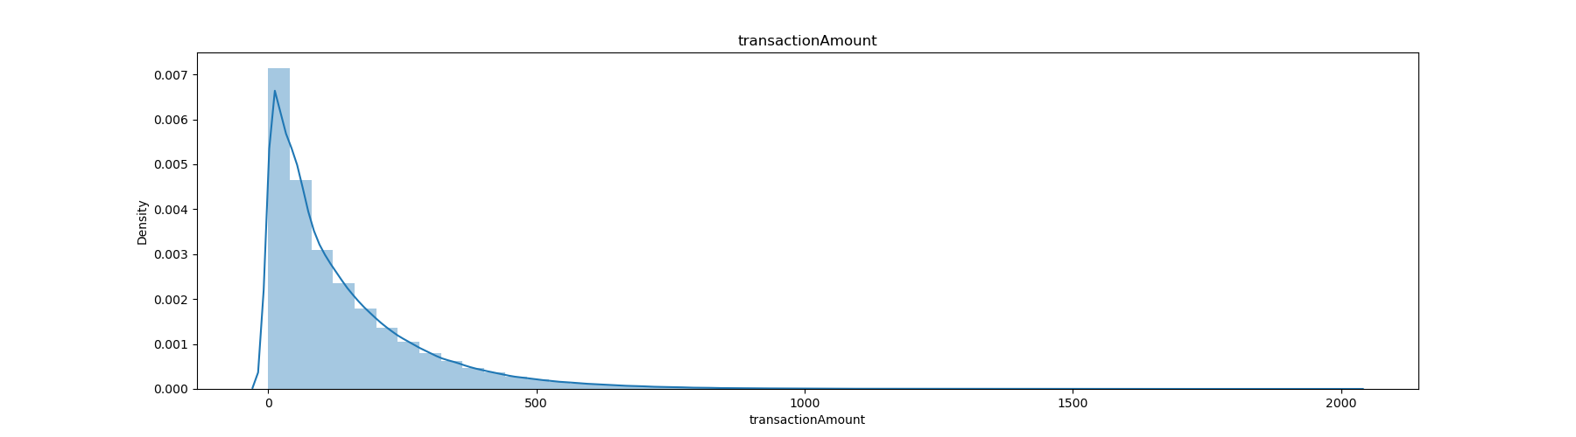

Slide 14
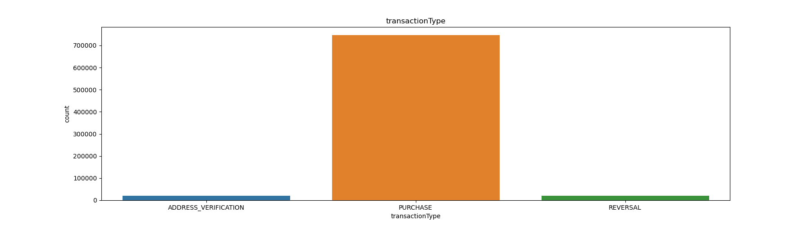
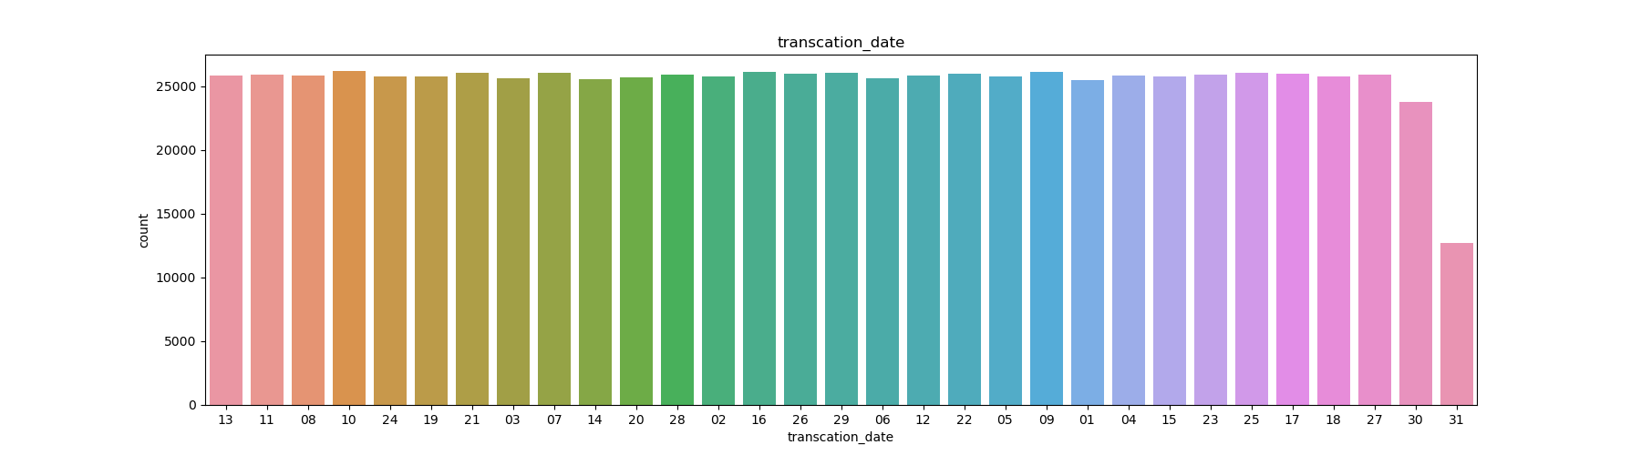
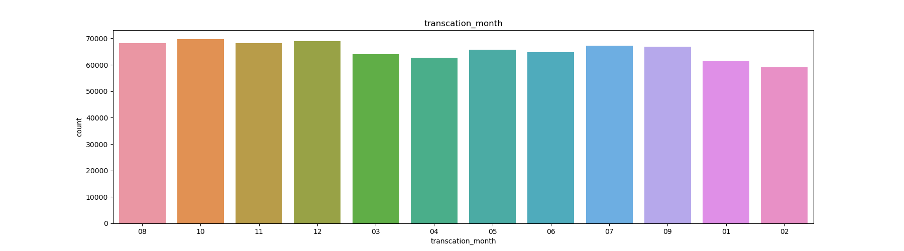

Slide 15
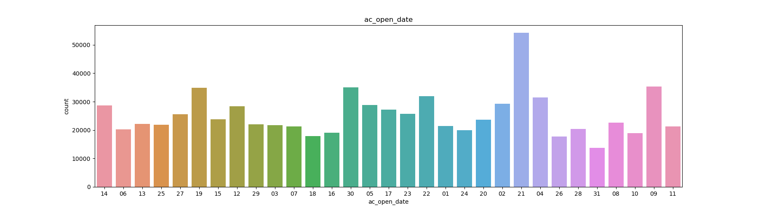
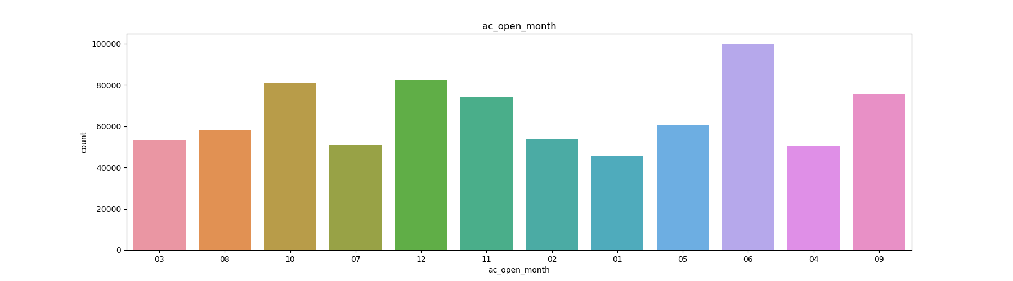
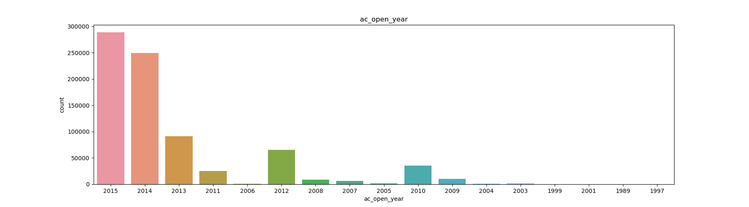

Slide 16
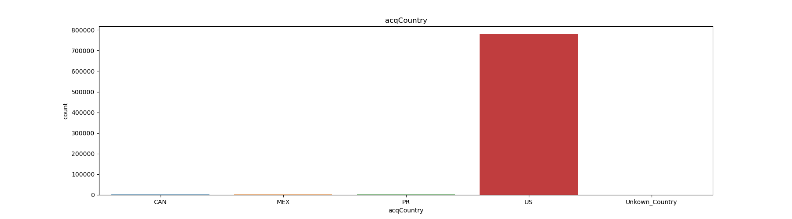
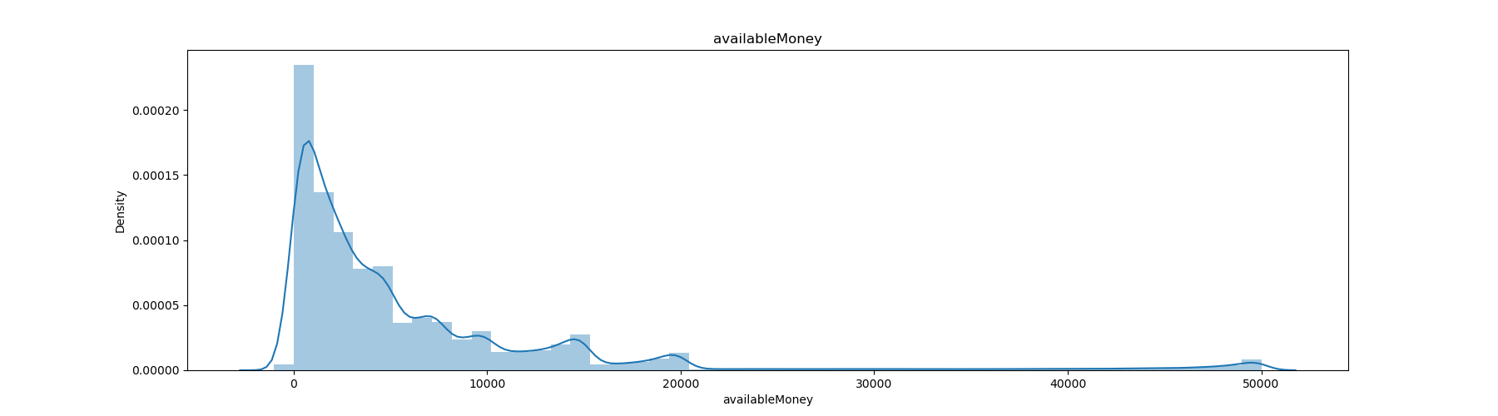
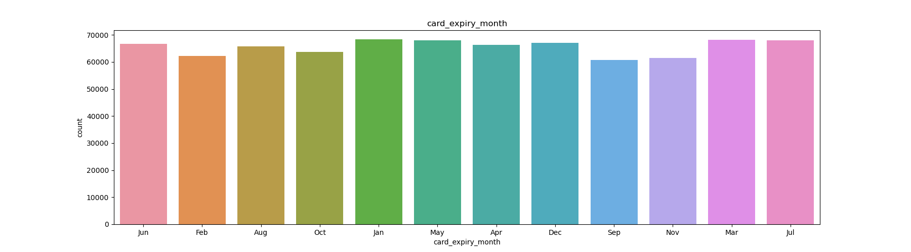

Slide 17
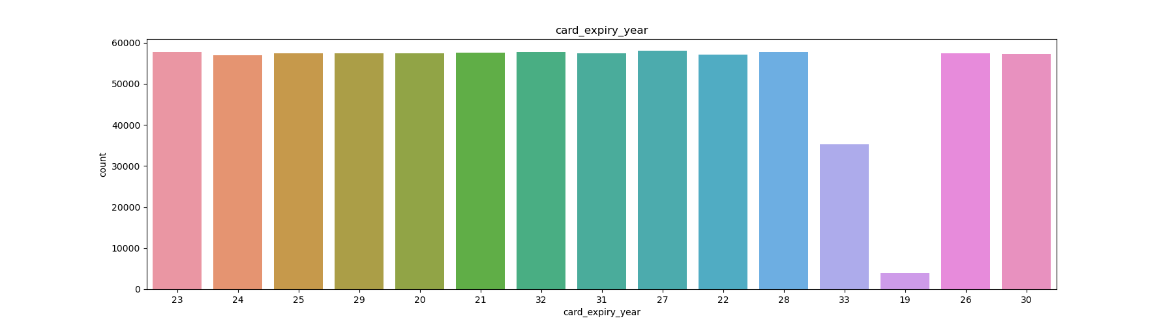
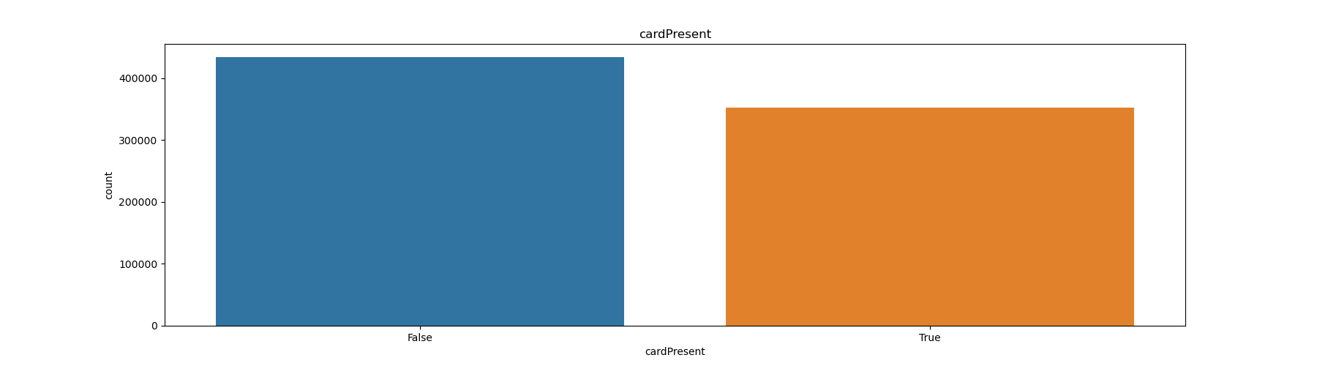
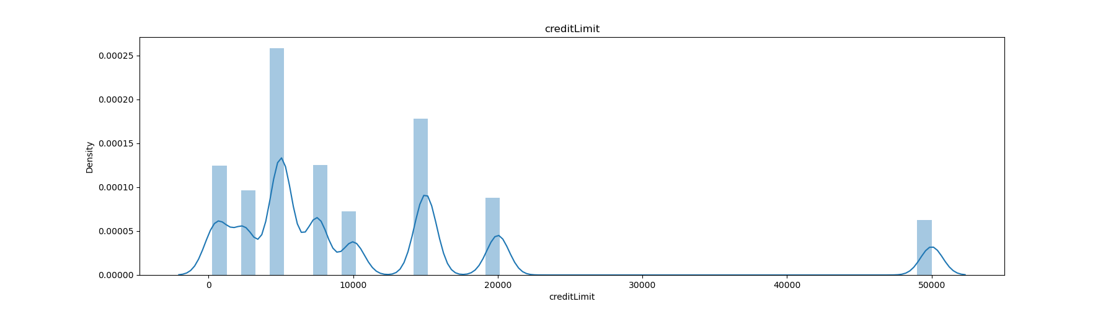

Slide 18
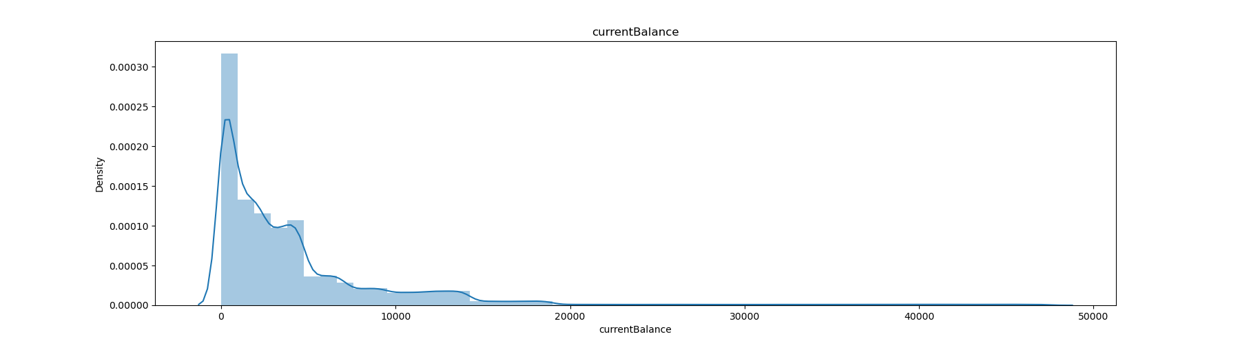
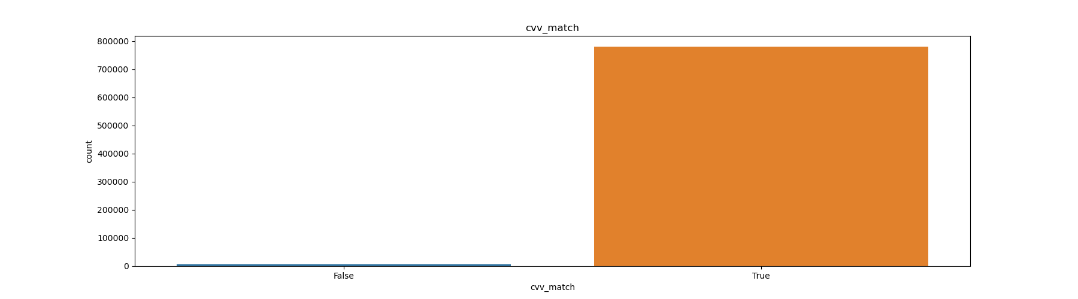

Slide 19
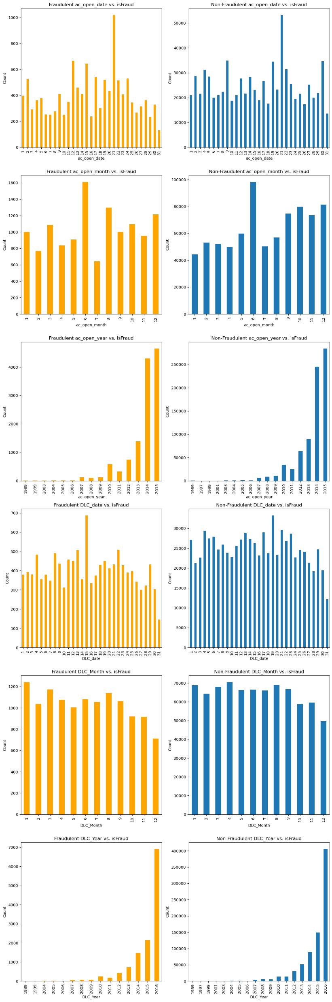
Bivariate Analysis:

Slide 20
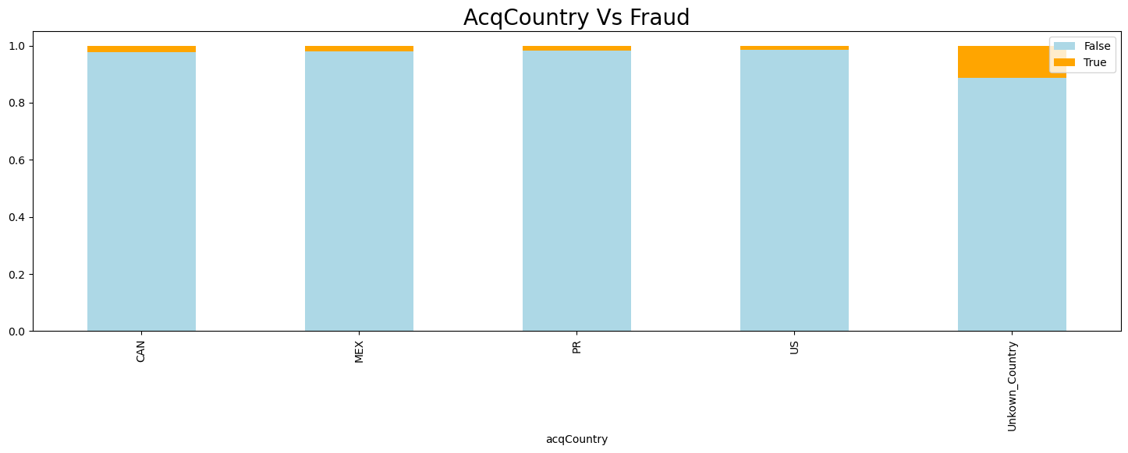
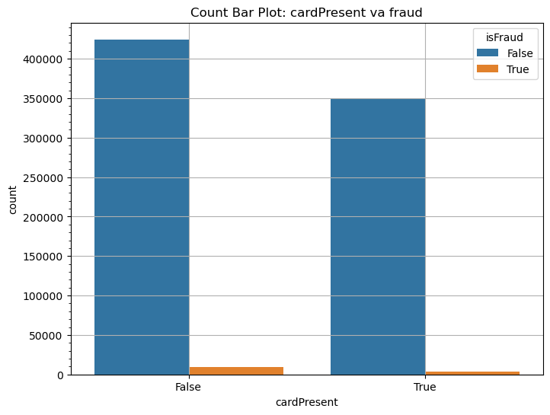

Slide 21
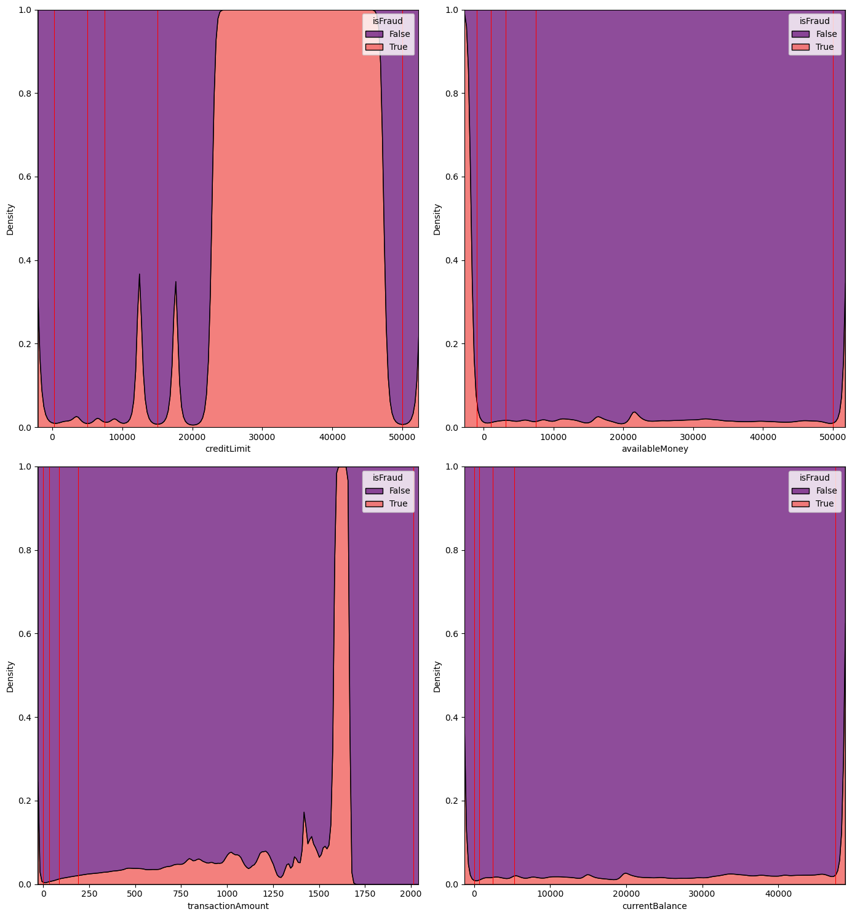

Slide 22
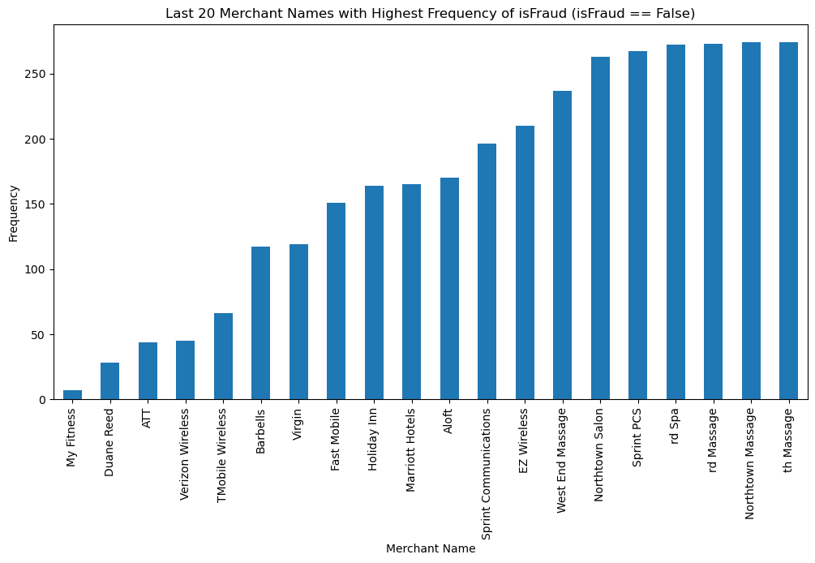

Slide 23
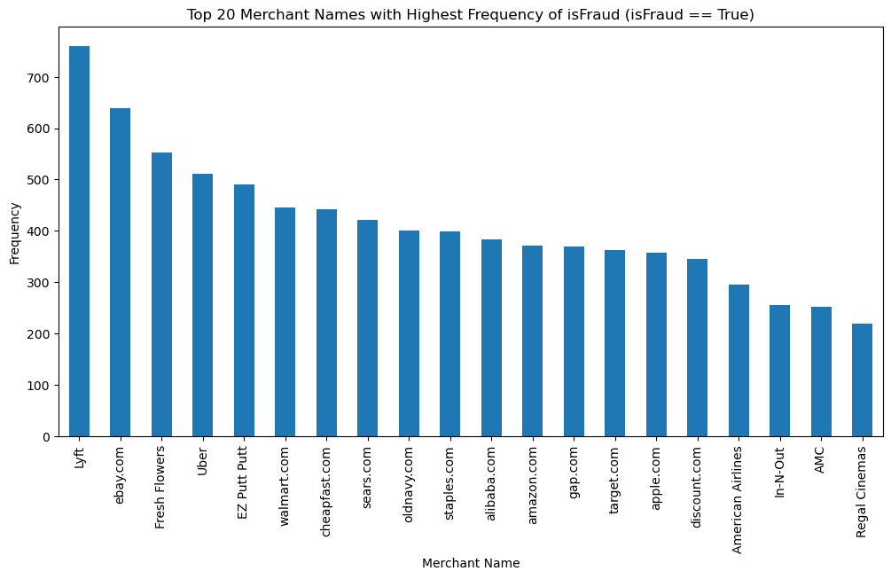

Slide 24
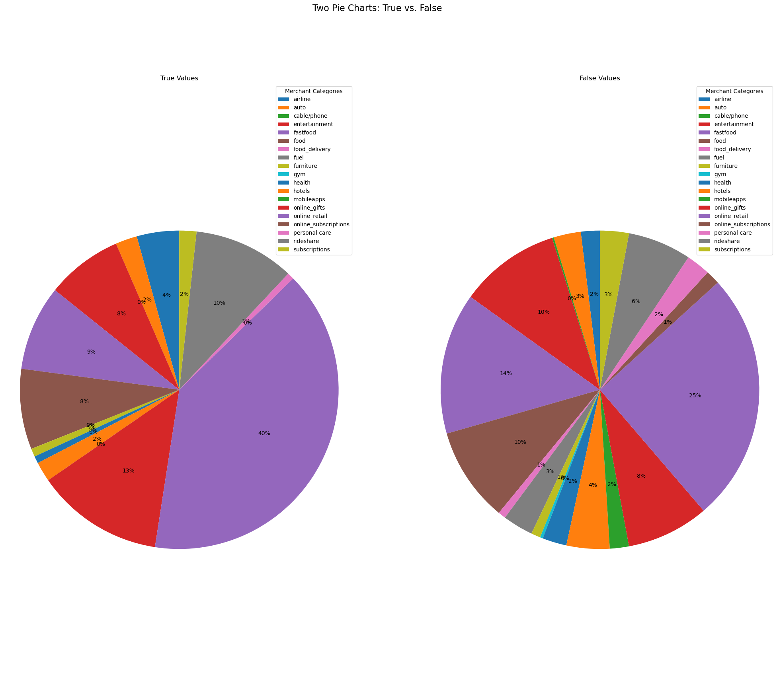

Slide 25
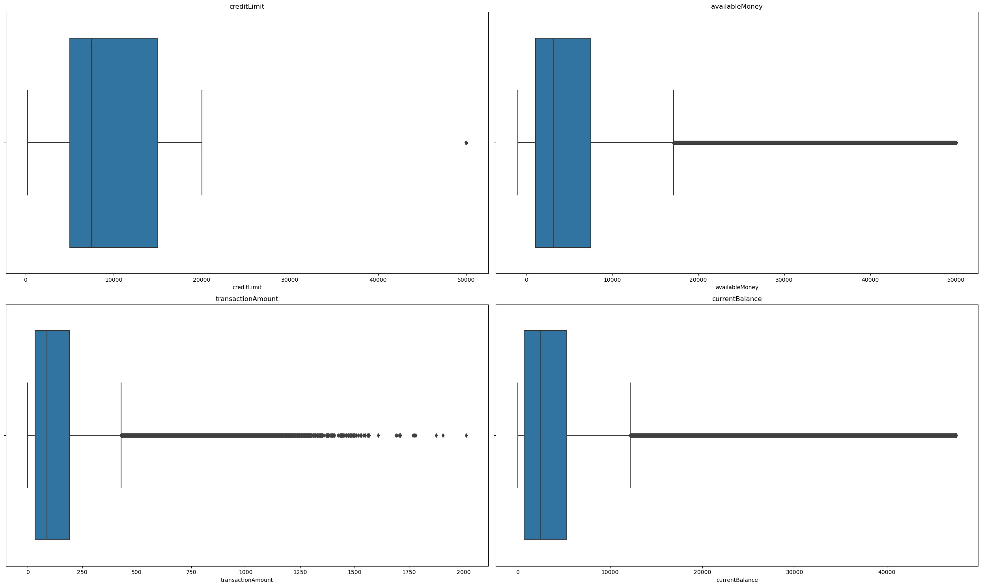
Visualizing outliers in numerical variable:

Slide 26
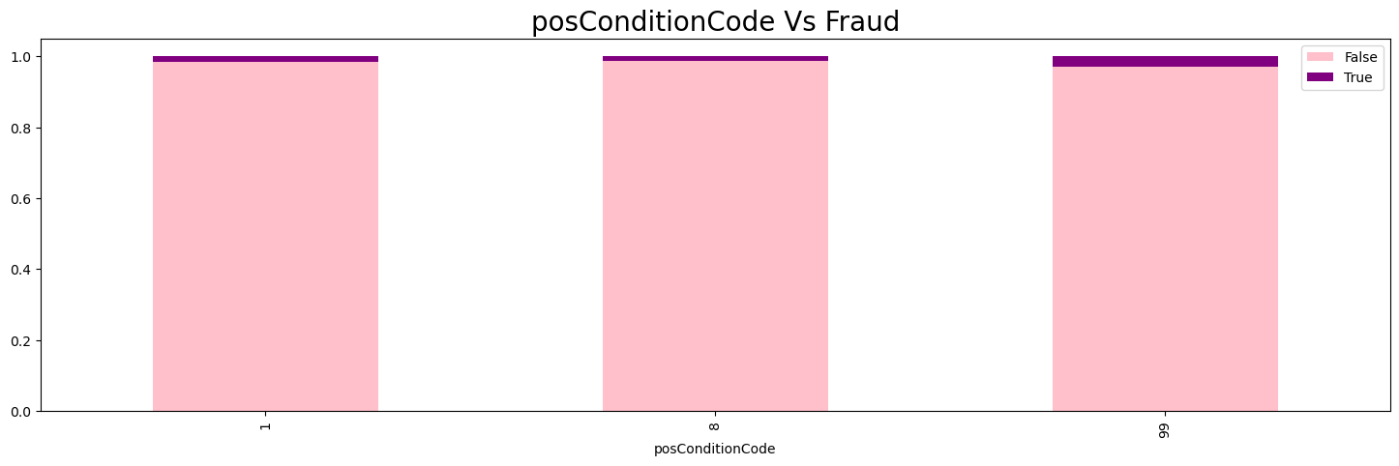
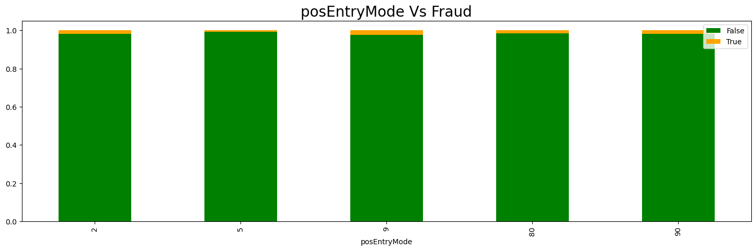

Slide 27
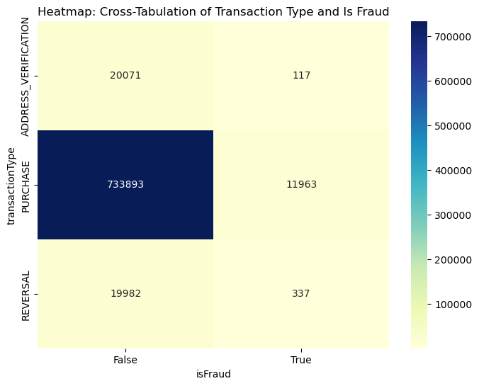

Slide 28
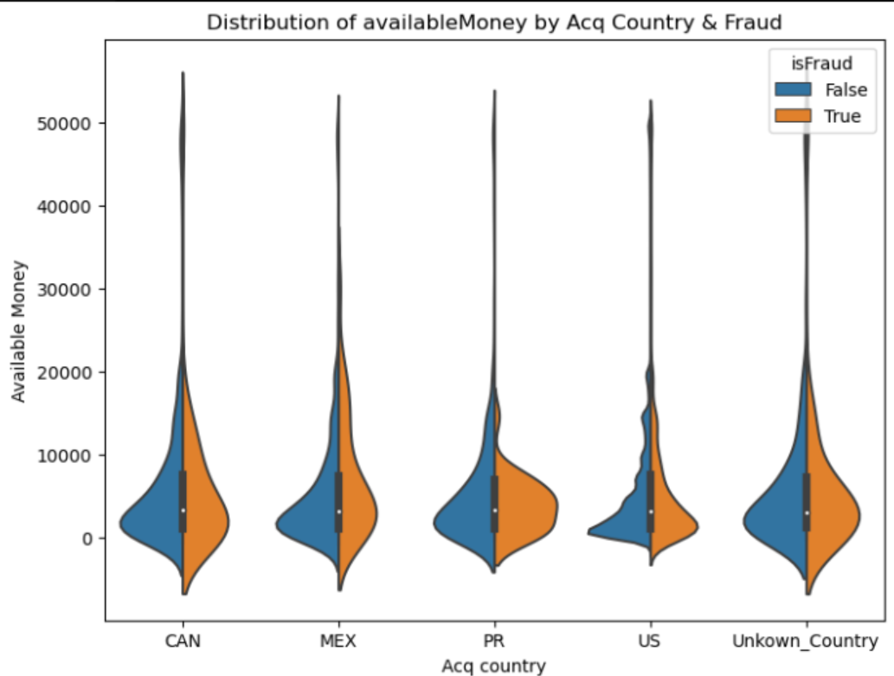
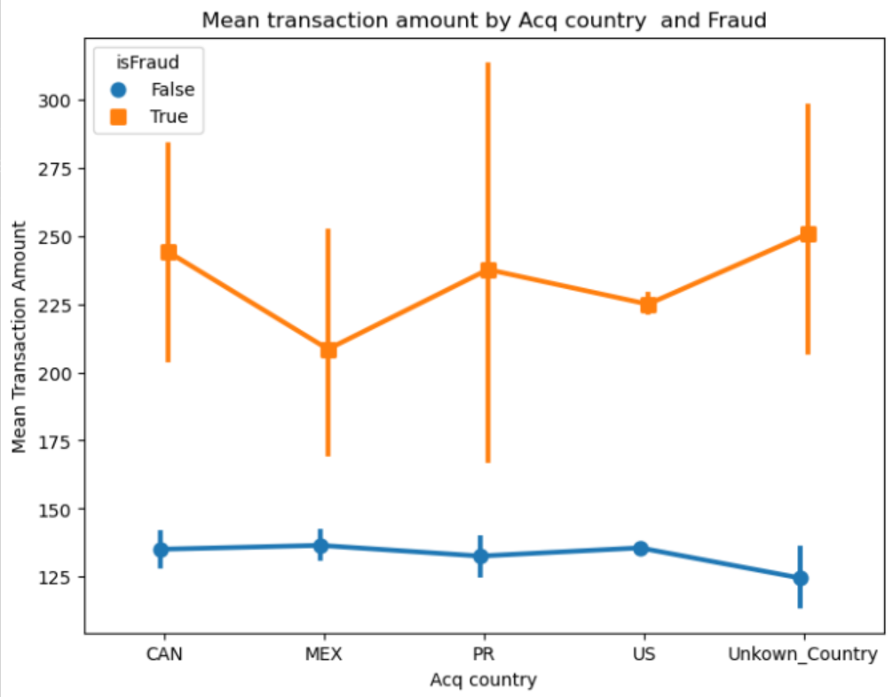
Multivariate Analysis

Slide 29
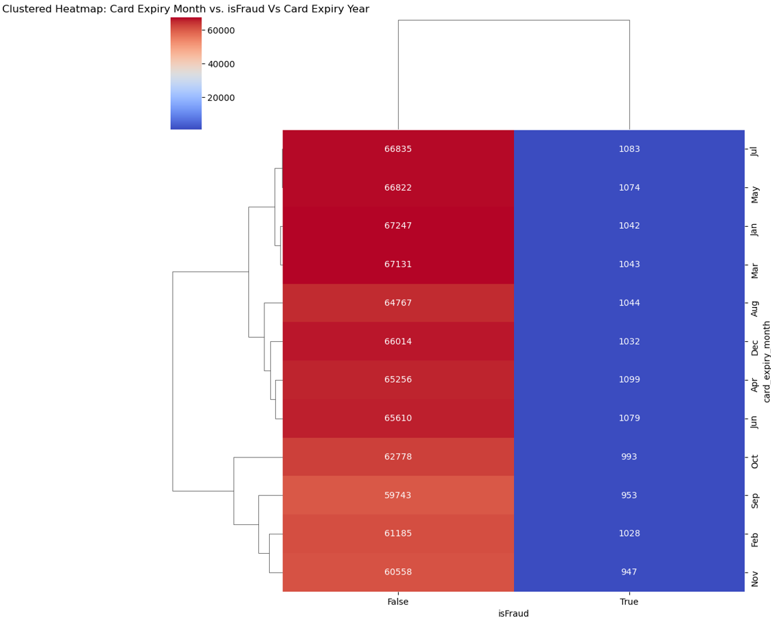

Slide 30
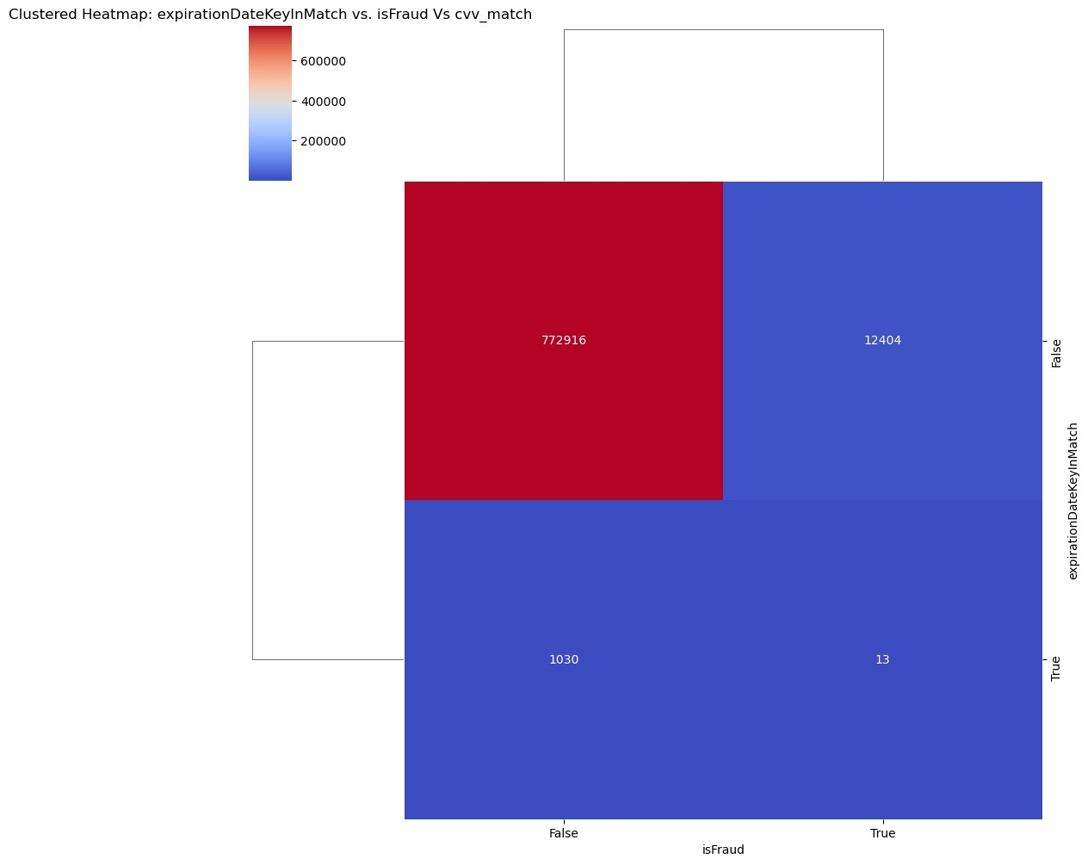

Slide 31
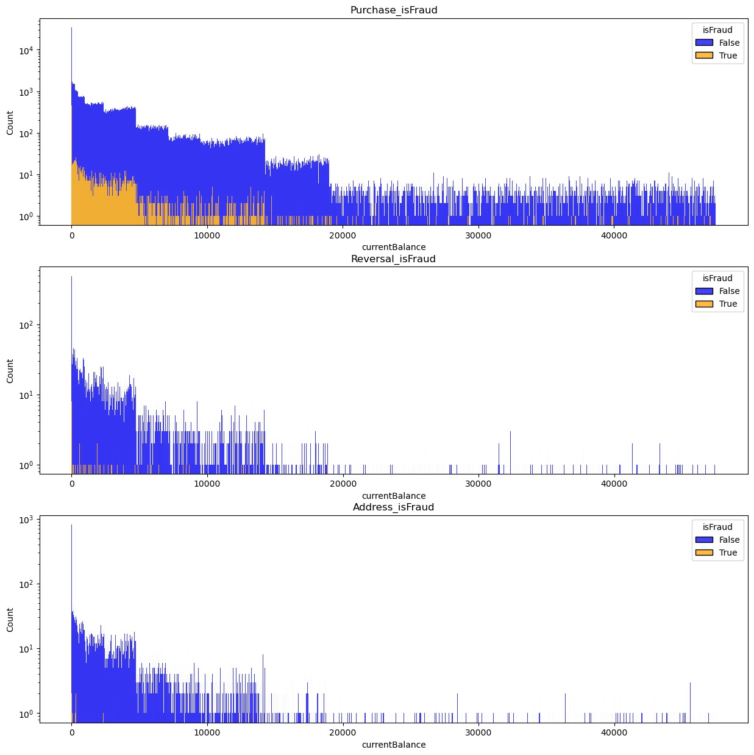

Slide 32
Algorithms, Solution and Conclusions
Stratified Sampling
Since our Data Set is Very Large classification data is an imbalanced data, it is desirable to sample the dataset into Sampling Datasets in a way that preserves the same proportions of examples in each class as observed in the Original Dataset. This is called a Stratified Sampling.
Once the Sample is taken from various random state of 3 this Sample will be used for

Slide 33
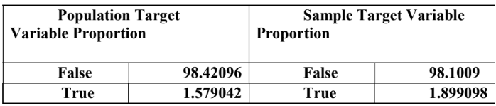
Algorithms, Solution and Conclusions
Stratified Sampling

Slide 34
Algorithms, Solution and Conclusions
Model
The Modeling is the core of any machine learning project. This step is responsible for the results that should satisfy or help satisfied the project goals.
Building a model in machine learning is creating a mathematical representation by generalizing and learning from training data.

Slide 35
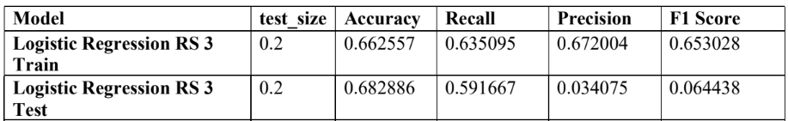
Algorithms, Solution and Conclusions
Performance Score Table for each Model

Slide 36
Algorithms, Solution and Conclusions
Key Inference
The model is able to identify over half of all fraudulent transactions.
The model produces a significant number of false positives, which means that it predicts that
many non-fraudulent transactions are fraudulent.
…continued

Slide 37
Algorithms, Solution and Conclusions
The model performs better on the test set than on the train set, which suggests that it is not overfitting the train data.
Overall, the performance scores suggest that the model could be used to identify fraudulent
transactions, but it should be used with caution due to the high number of false positives.

Slide 38
Algorithms, Solution and Conclusions
Future Action Points:
We Are Going to Implement Different Missing Values Method and Test our Model and Compare the Performance for Each Model
We Are Going to Transform the Data after Split and Compare the Performance of the Model
…continued

Slide 39
Algorithms, Solution and Conclusions
We are Going to Implement various Algorithm and Ensemble Techniques & Stacking Methods to train the Model Better. (Such as with & Without SMOTE & DT, RFC, KNN, Naïve bays)
We will add Hypermeter and fine tune the model & Compare the Performance of Each Model
Once the Optimum Model is Identified we are going to test it with unseen data and compare the performance

Slide 40
Thanks!

