Slide 1

OPTICAL CHARACTER RECOGNITION
By
Mr. Deepak Kumar Padhy Roll-CSE200810123
Mr. Sivaji Sahoo Roll-CSE200810128
Under the guidance of
Mr. Ajay Anand

Slide 2
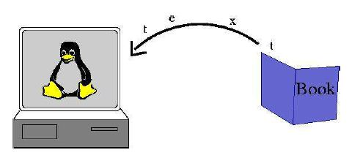
CONTENTS
INTRODUCTION
SCOPE AND OBJECTIVE
BLOCK DIAGRAM
HOW DOES IT WORK
ENHANCEMENT TECHNIQUES
APPLICATIONS
FUTURE WORKS
CONCLUSION

Slide 3
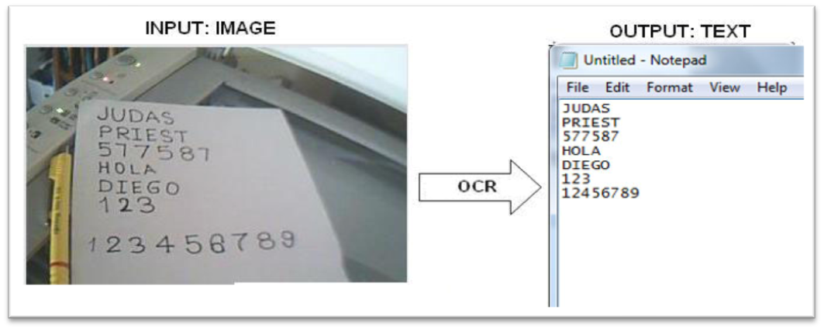
INTRODUCTION
Also referred to as Optical Character Reader
Optical character recognition(OCR) is the mechanical or electronic translation of images of handwritten, typewritten or printed text (usually captured by a scanner) into machine-editable text.
Notes:
As you read these words on your computer screen, your eyes and brain are carrying out optical character recognition without you even noticing! Your eyes are recognizing the patterns of light and dark that make up the characters (letters, numbers, and things like punctuation marks) printed on the screen and your brain is using those to figure out what I'm trying to say (sometimes by reading individual characters but mostly by scanning entire words and whole groups of words

Slide 4
SCOPE & OBJECTIVE
Documents containing only printed text will be
recognized and not the hand-written text. And,
to simplify the process, we will limit the analysis
to single font type and no modifiers should be used.
The project involves recognition of characters
and words in scanned printed Oriya documents.

Slide 5
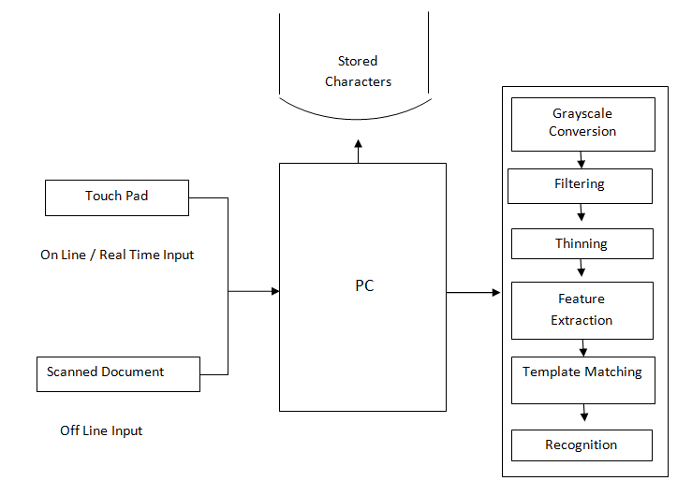
BLOCK DIAGRAM

Slide 6
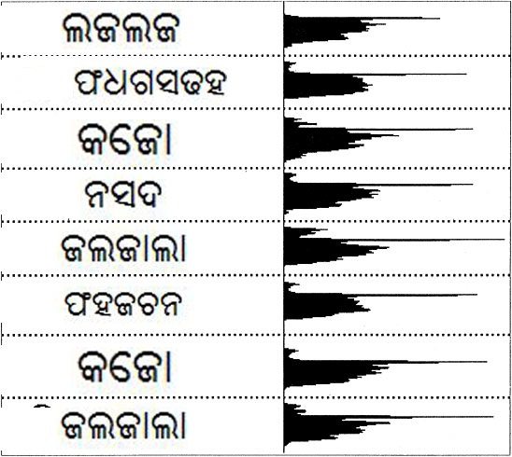
HOW DOES IT WORK
Line Detection
Word Detection
Template Matching

Slide 7
HOW DOES IT WORK
Line Detection
←Sample Text
← Extracted Line 1
← Extracted Line 2

Slide 8
HOW DOES IT WORK
Word Detection
←Sample Line
← Extracted Words

Slide 9
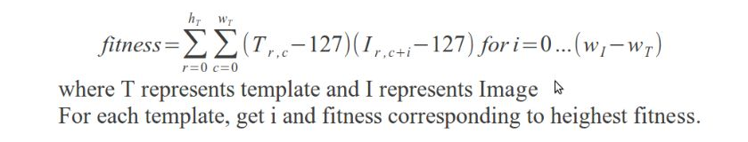
HOW DOES IT WORK
ଗ
←Template
ଖ`
ଗ
←Sample
Characters

Slide 10
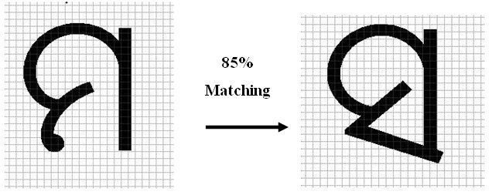
HOW DOES IT WORK
Matrix Matching

Slide 11
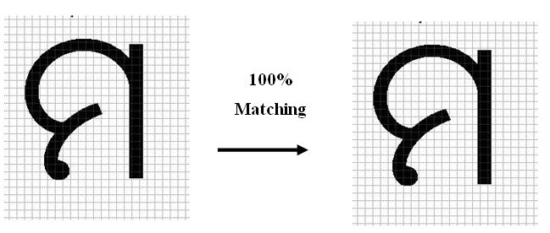
HOW DOES IT WORK
Matrix Matching

Slide 12

ENHANCEMENT TECHNIQUES
Rotation
Scaling

Slide 13
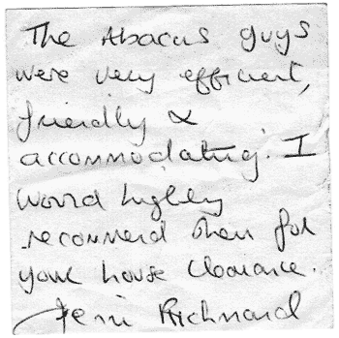
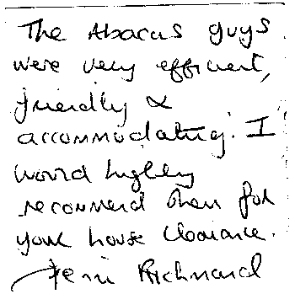
ENHANCEMENT TECHNIQUES
Thresholding

Slide 14
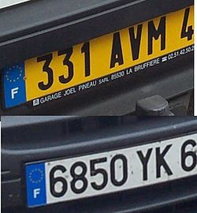
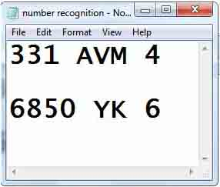
APPLICATIONS
  Automatic Plate Recognition
  Legal
  Libraries
  Banking
  Healthcare

Slide 15
FUTURE WORK TO BE DONE
To work for the recognition of composite characters
Implementation of curve detection algorithms which will enhance us to recognize the handwritten characters

Slide 16
CONCLUSION
The primary goal of this project is to recognize
the oriya characters and foster the translation
of documents such as books, novels or legal
papers printed in oriya language into an
editable digital library that could be used for
various purposes.

Slide 17
THANK YOU

