Slide 1
JAVA
Abhinay.G

Slide 2
COURSE CONTENT
WHAT IS JAVA?
WHY JAVA?
FEATURES OF JAVA
VERSIONS OF JAVA
HISTORY OF JAVA
INSTALLATION OF EDITPLUS
INSTALLATION OF JDK SOFTWARE
INSTALLATION OF ECLLIPSE,STS,INTELLIJ IDEA
PROGRAM INTERNALS
PROGRAM STRUCTURE

Slide 3
COURSE CONTENT
JDK,JRE,JVM
BREIF EXPLANATION ABOUT JVM
PATH AND CLASSPATH
ENVIRONMENT VARIABLES SETUP
PROGRAMING USING NOTEPAD
PROGRAMMING USING EDITPLUS
WHY IDE?
JAVA RELEASES?
JAVA USAGE

Slide 4
DATATYPES
BYTE
SHORT
INTEGER
FLOAT
DOUBLE
BOOLEAN
CHAR
STRING

Slide 5
COMMENTS IN JAVA
Single
Multi line

Slide 6
NAMING CONVENTIONS IN JAVA
CLASS
VARIABLE
METHOD
PACKAGE
ENUM
INTERFACE

Slide 7
CONDITIONAL STATEMENTS
IF
IF ELSE
IF ELSE IF ELSE
NESTED IF
LADDER IF

Slide 8
LOOPING STATEMENTS
For
while
Do-while

Slide 9
VARIABLES
Static Variables
Non Static variables (Instance variables)
Local variables

Slide 10
METHODS
Methods with return type without parameters
Methods With return type with parameters
Methods without return with parameters
Methods without return type without parameters

Slide 11
TYPES OF METHODS
Static Methods
Non Static Methods

Slide 12
BLOCKS
STATIC BLOCKS
NON STATIC BLOCKS

Slide 13
CONSTRUCTOR
WHAT IS CONSTRUCTOR?
TYPES OF CONSTRUCTOR?
DEFAULT CONSTUCTOR?
NO ARG CONSTRUCTOR
PARAMETERIZED CONSTRUCTOR?
CONSTRUCTOR OVERLOADING
CONSTRUCTOR CHAINING

Slide 14
OBJECT ORIENTED PROGRAMING CONCEPTS
WHAT IS OOP?
WHY OOP?
CLASS
OBJECT
ENCAPSULATION
INHERITANCE
POLYMORPHISM
ABSTARCTION
MESSAGE PASSING

Slide 15
INHERITANCE
SINGLE INHERITANCE
MULTILEVEL INHERITANCE
MULTIPLE INHERITANCE
HIRARICAL INHERITANCE
HYBRID INHERITANCE

Slide 16
DIFFERENT TYPES OF CLASSES
INTERFACE
ABSTRACT CLASS
CONCRETE CLASS
FINAL CLASS
INNER CLASS
ANNONYMOUS INNER CLASS
ENUM
ANNOTATIONS

Slide 17
POLYMORPHISM
COMPILE TIME PLOYMORPHISM
RUN TIME POLYMORPHISM

Slide 18
ACCESS MODIFIERS
Public
Private
Protected
Default

Slide 19
EXCEPTION HANDLING
WHAT IS EXCEPTION?
HOW TO HANDLE EXCEPTION?
TYPES OF EXCEPTION?
UNCHECKED EXCEPTION
CHECKED EXCEPTION
EXCEPTION HIERARCHY
ERROR

Slide 20
MULTITHREADING
WHAT IS MULTI THREADING
LIFE CYCLE OF THREAD
THREAD SHEDULER
SLEEPING A THREAD
THREAD PRIOPRITY
DEAMON THREAD
THREAD POOL
THREAD GROUP

Slide 21
JAVA 5 FEATURES
FOR EACH
VARARGS
STATIC IMPORT
AUTO BOXING AND AUTO UNBOXING
ENUM
COVARINAT RETURN TYPE
ANNOTATIONS
GENERICS

Slide 22
JAVA 7 FEATURES
STRING IN SWITCH STATEMENT
BINARY LITERAL
THE TRY-WITH-RESOURCE
CATCHING MULTIPLE EXCEPTIONS BY SINGLE CATCH
UNDERSCORES IN NUMERIC LITERALS

Slide 23
JAVA 8 FEATURES
DATA/TIME API
LAMBDA EXPRESSIONS
METHOD REFERENCES
FUNCTIONAL INTERFACE
STREAM
BASE64 ENCODE DECODE
DEFAULT METHOD
FOR EACH METHOD
COLLECTORS

Slide 24
JAVA 8 FEATURES
STRING JOINER
OPTIONAL CLASS
NASHORN JAVASCRIPT
PARALLEL ARRAY SORTING
TYPE INFERNCE
METHOD PARAMETER REFLECTION

Slide 25
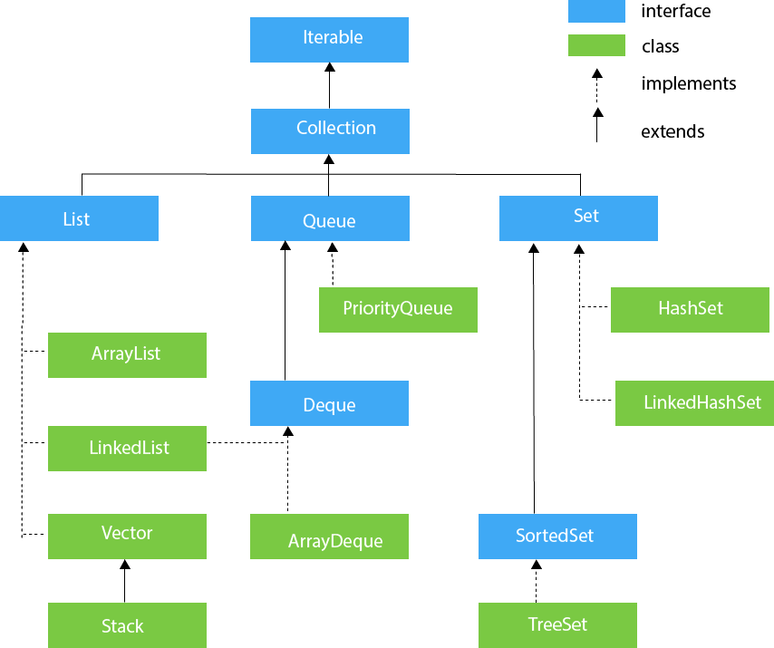
COLLECTIONS

