Slide 1

Title
Real -Time/Field-Based Research Project Review-2 Presentation
by
Name: M.AJAY KUMAR,G.ASHWITH,S.S. ABHIRAM
Roll No:23B81A05K4,23B81A05L0,23B81A05N9
Section:CSE-D
Batch No:02
Dept:CSE
CVR College of Engineering

Slide 2
Abstract
🎯PROJECT AIM:To develop a secure, transparent, and efficient online voting system using blockchain technology that ensures vote integrity, accessibility, automation, and tamper-proof recording, thereby replacing outdated traditional systems and building trust in digital elections.
Proposes a blockchain-based e-voting system to overcome the drawbacks of traditional voting methods.
Utilizes decentralization to prevent single points of failure and manipulation.
Employs encryption to secure voter data and ensure privacy.
Integrates smart contracts for automated vote validation and counting.
Ensures tamper-proof and verifiable voting records.
Enhances transparency and trust in the electoral process.
Enables remote participation, increasing voter accessibility.
Reduces human error and improves overall election efficiency.

Slide 3
Problem definition
Traditional and electronic voting systems face issues of security, transparency, and limited accessibility. Existing solutions lack public trust due to risks of fraud, tampering, and poor verifiability. This project proposes a blockchain-based e-voting system to provide a secure, transparent, and accessible platform that ensures vote integrity and builds voter confidence.
E-VOTING THROUGH BLOCKCHAIN AIMS TO SOLVE THESE CHALLENGES BY:
1️⃣ Security
2️⃣ Tamper-proof
3️⃣ Transparency
4️⃣ Voter Authentication
5️⃣ Remote Accessibility
6️⃣ Automated Vote Counting
7️⃣ Trust
8️⃣ Scalability
9️⃣ Cost Efficiency

Slide 4
Software Requirement Specification
✅ Functional Requirements
1️⃣ User Authentication
2️⃣ Vote Casting
3️⃣ Vote Validation
4️⃣ Blockchain Integration
5️⃣ Result Calculation
6️⃣ Voter Interface
⚙️ Non-Functional Requirements
1️⃣ Security
2️⃣ Scalability
3️⃣ Usability
4️⃣ Reliability
5️⃣ Transparency
6️⃣ Performance

Slide 5
Outline
1.Proposed methodology
(Architecture/Model/DFDs/ Algorithms)
2.System design
Structural diagrams (Class, Object, Component, Deployment)
Behavioral diagrams( Use case, sequence, collaboration ,activity, state chart diagrams)
3. Implementation – Module description
4. Coding
5. Results ( Expected output)
Status of Paper publication :(submitted/ not submitted)
Status of Project documentation: (Percentage of Project report writing completed: )
References

Slide 6
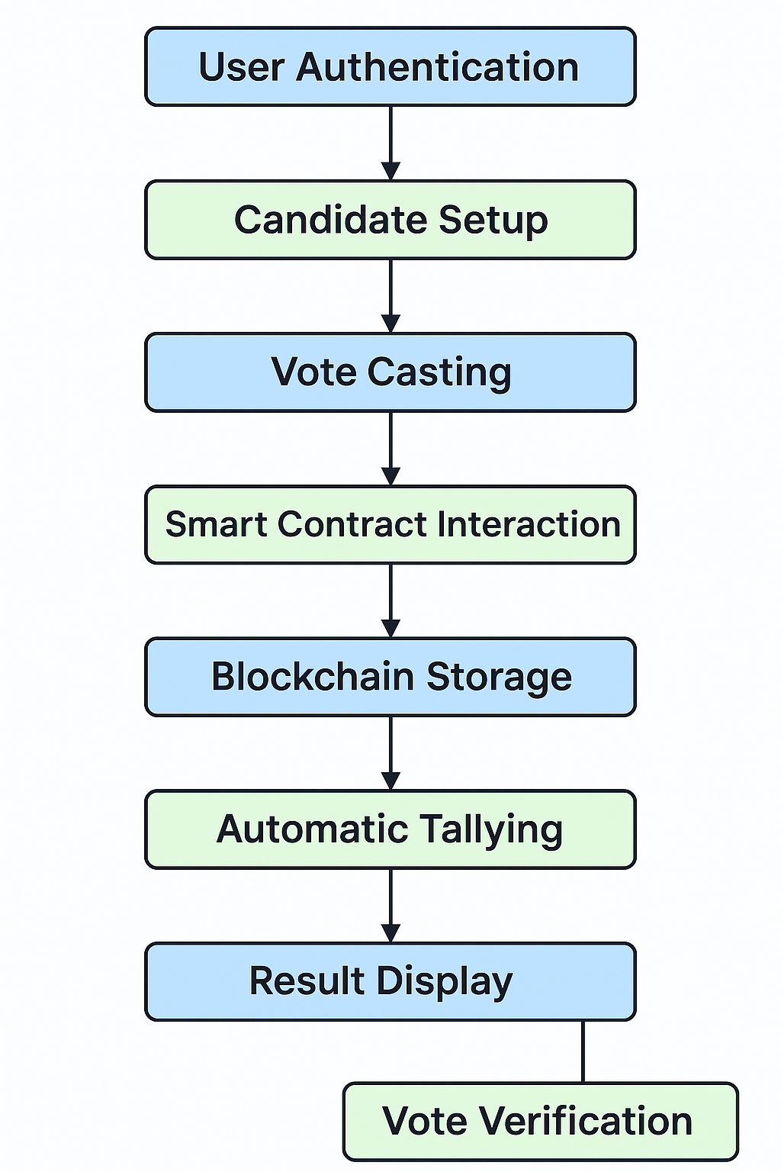
1.Proposed methodology

Slide 7
1.Proposed methodology
🧾 User Authentication
Users connect their MetaMask wallet to securely log in and verify identity.
🗳️ Candidate Setup
Admin configures and manages candidate profiles through the frontend.
✅ Vote Casting
Authenticated users select a candidate and submit their vote via the interface.
🔗 Smart Contract Interaction
Votes are processed through Ethereum smart contracts ensuring automation and validation.
📦 Blockchain Storage
Each vote is encrypted, timestamped, and immutably stored on the blockchain.
📊 Automatic Tallying
Smart contracts tally votes in real-time, reducing manual errors.
🖥️ Result Display
Live results are displayed transparently to users through the UI.
🔍 Vote Verification
Voters can verify their transaction on the blockchain for transparency and trust.

Slide 8
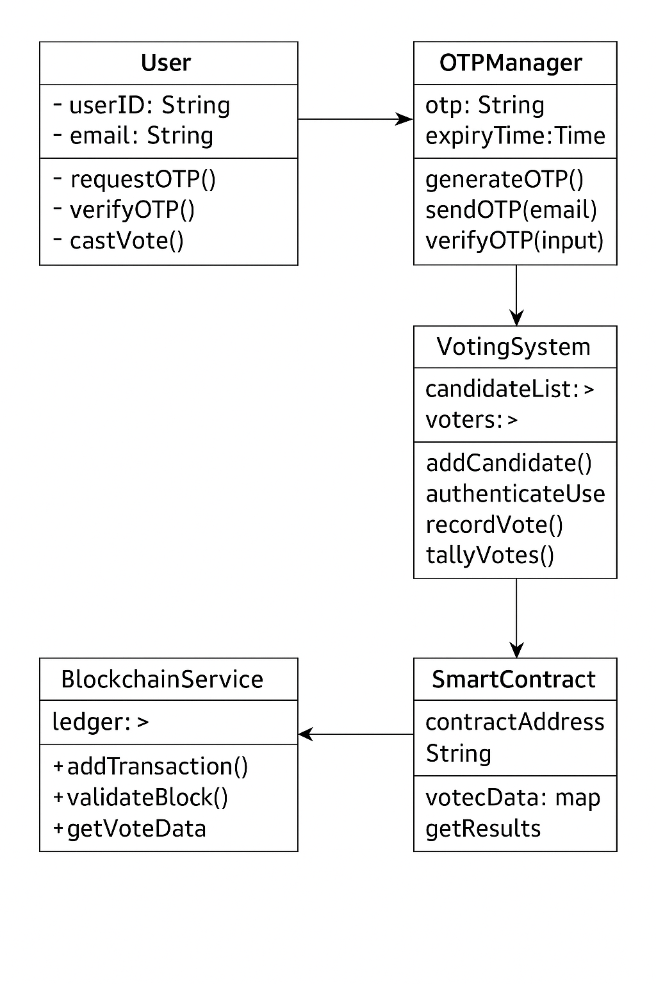
2.System design
Class Diagram:
User: Represents a voter. Requests and verifies OTP for authentication. Casts a vote after verification.
• OTPManager: Generates and sends OTPs via email. Ensures OTPs expire and verifies them before allowing voting.
• VotingSystem: Manages voter and candidate lists. Authenticates voters and records valid votes. Tallies final results.
• SmartContract: Contains the logic for secure voting. Accepts and validates vote transactions. Stores results transparently.
• BlockchainService: Records votes immutably. Validates blocks and stores vote data securely. Supports audit and retrieval.
• Interactions:
  - User ↔ OTPManager: Identity verification via email-based OTP.
  - OTPManager ↔ VotingSystem: Access to voting after successful verification.
  - VotingSystem ↔ SmartContract: Submits and validates votes.
  - SmartContract ↔ BlockchainService: Ensures secure, tamper-proof storage.

Slide 9
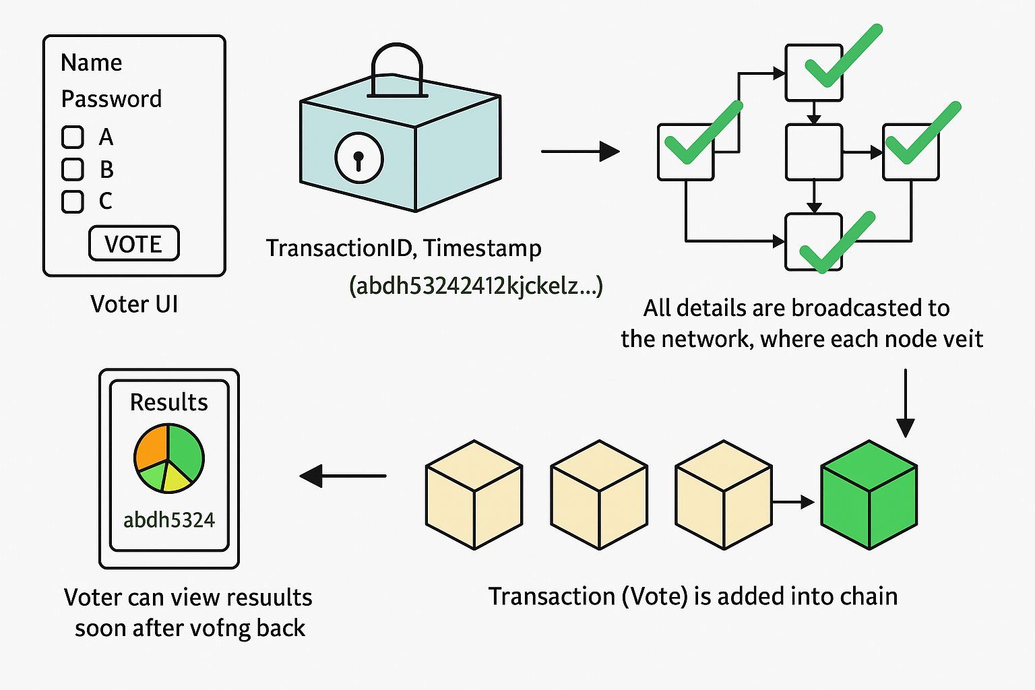
2.System design
ARCHITECTURE DIAGRAM:

Slide 10
3. Implementation – Module description
User Authentication Module
Integrates blockchain wallet (e.g., MetaMask) for secure access
Implements OTP validation via email for added privacy
Prevents unauthorized and duplicate logins
Voting Module
Presents a secure, easy-to-use voting interface
Allows users to select and submit votes
Ensures one-time vote casting per authenticated user

Slide 11
3. Implementation – Module description
Smart Contract Module
Contains logic for vote validation and storage
Enforces voting rules (e.g., one vote per wallet)
Automatically rejects invalid or tampered votes
Blockchain Integration Module
Connects frontend with blockchain network
Stores votes as immutable transactions
Ensures data integrity and tamper resistance

Slide 12
3. Implementation – Module description
Result Calculation and Display Module
Tallies votes using smart contracts
Displays real-time or final results
Allows users to verify vote inclusion anonymously

Slide 13
4. Coding
Technologies Used
Frontend Development
  HTML, CSS, JavaScript.Tailwind
  React.js (for building dynamic user interfaces)
  Web3.js (for interacting with the Ethereum blockchain)
Blockchain Platform
  Ethereum (preferred for its smart contract functionality)
  MetaMask (browser extension for wallet integration)
Backend Development:(Smart contracts)
  Solidity (language used to write smart contracts)
  Remix IDE or Hardhat (for writing, testing, and deploying contracts)
Email Service
  Firebase Authentication: Supports sending email-based OTPs (via email link sign-in or verification emails).

Slide 14
5. Results ( Expected output)
E-VOTING THROUGH BLOCKCHAIN Solves the Challenges and produces these results:
✔️ Fast Results
✔️ Reduces Cost
✔️ Prevents Duplicate Voting
✔️ Real-Time Monitoring
✔️ Enhances Voter Confidence
✔️ Accessible Voting
✔️ Reduces Human Error
✔️ Transparency
✔️ Immutability
✔️ Decentralization
✔️ Security
✔️ Accuracy
✔️ Trust
✔️ Tamper-proof
✔️ Efficient

Slide 15
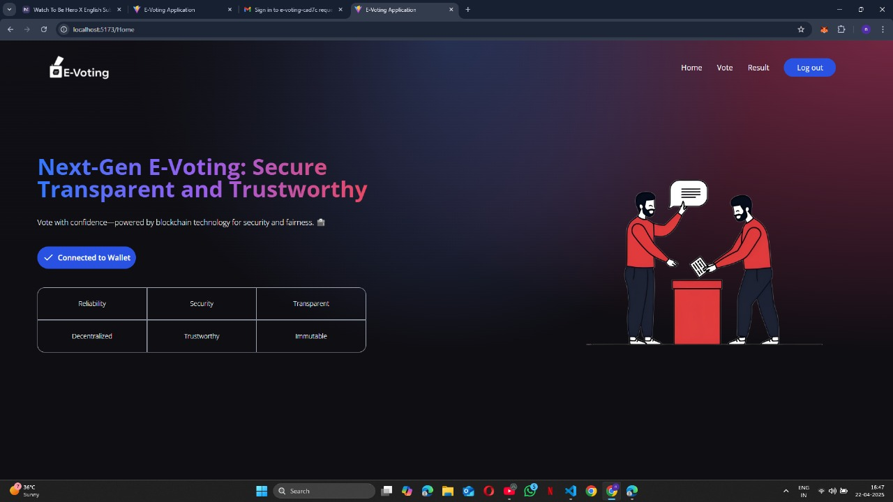
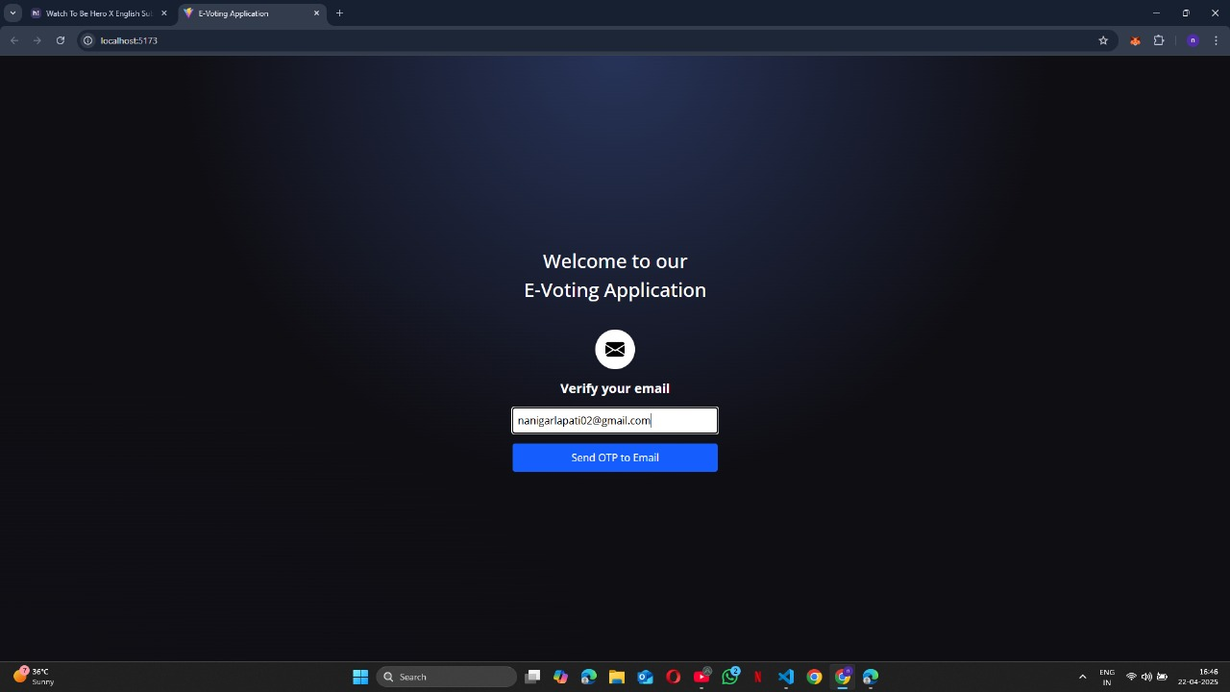
5. Results ( Expected output)

Slide 16
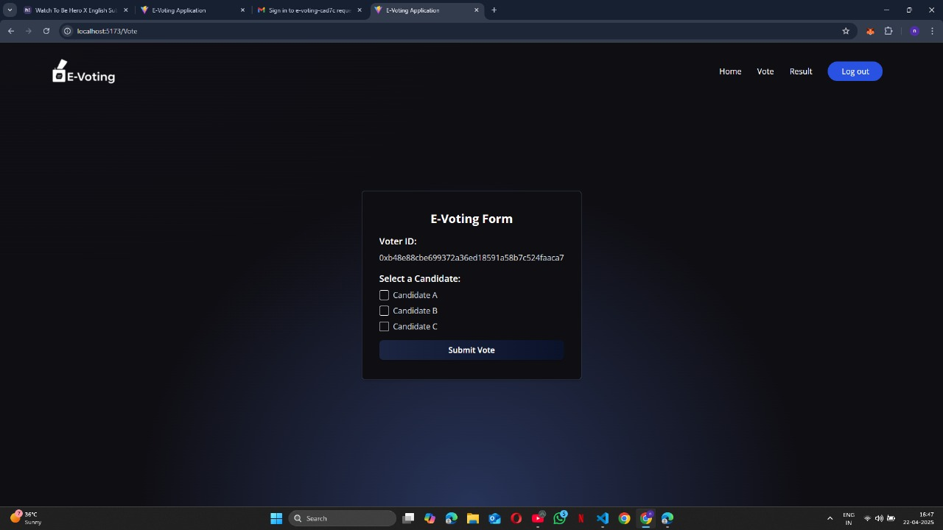
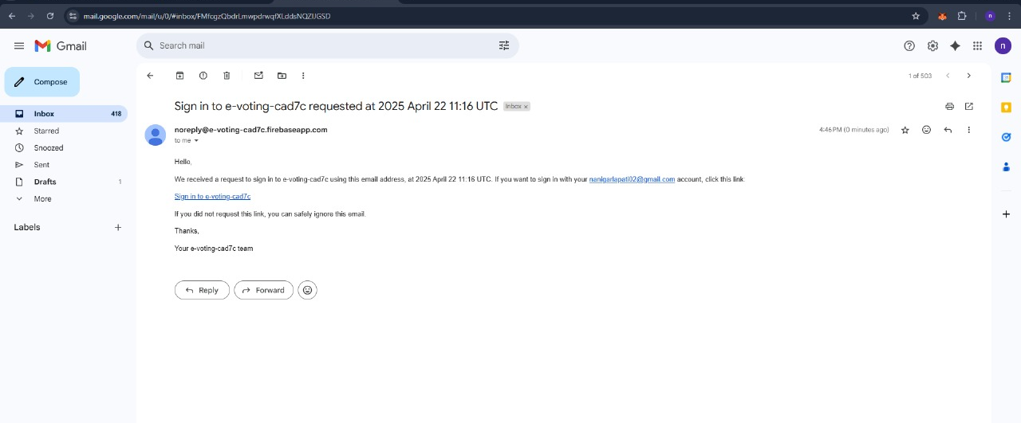
5. Results ( Expected output)

Slide 17
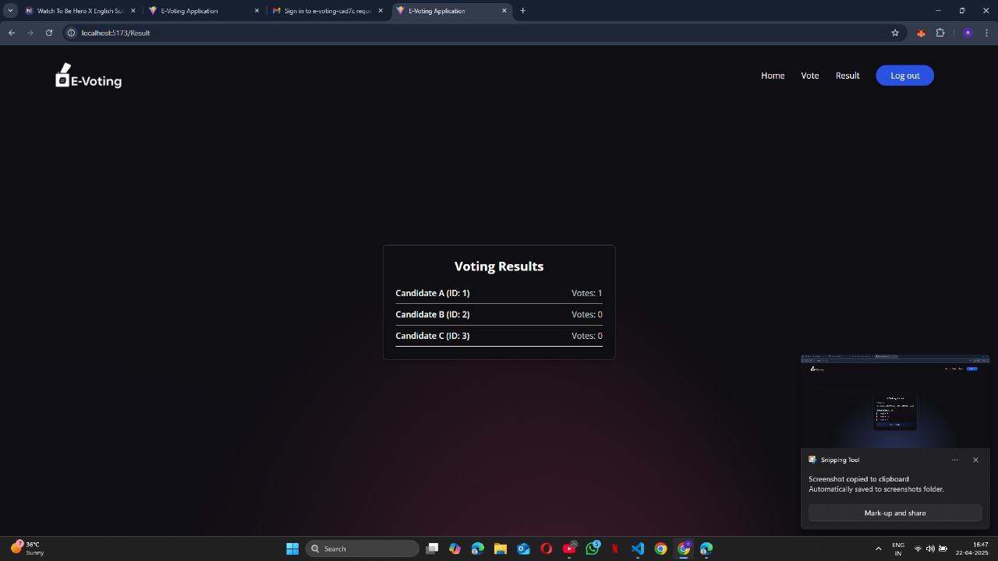
5. Results ( Expected output)

Slide 18
References
"A systematic review of challenges and opportunities of blockchain for E-voting." Symmetry 12.8 (2020): 1328.
https://www.mdpi.com/2079-9292/13/1/17
"A systematic review of challenges and opportunities of blockchain for E-voting." Symmetry 12.8 (2020): 1328.
https://www.mdpi.com/2073-8994/12/8/1328
"Blockchain-based e-voting system." 2018 IEEE 11th international conference on cloud computing (CLOUD). IEEE, 2018.
https://ieeexplore.ieee.org/abstract/document/8457919/
"Analysis of blockchain solutions for E-voting: a systematic literature review." IEEE Access 10 (2022): 70746-70759.
https://ieeexplore.ieee.org/abstract/document/9812616/
"E-voting meets blockchain: A survey." IEEE Access 11 (2023): 23293-23308.
https://ieeexplore.ieee.org/abstract/document/10061373/

