Slide 1

AI-Based E-Commerce Recommendation System with Analytics Dashboard and Chatbot Support
CVR COLLEGE OF ENGINEERING
(An UGC Autonomous Institute, Accredited by NAAC with ‘A’ Grade)
Department of CSE
B. Tech CSE-D III Year II Semester
Industrial Oriented Mini Project
PROJECT SUPERVISOR:
Suhail Afroz,Associate Professor,
CSE Department
Presented By:-
M.Ajay Kumar , 23B81A05K4
G.Chandu , 23B81A05L2
T.Karthik Reddy ,23B81A05M2
III B.Tech (CSE-D) Industrial Oriented Mini Project (IOMP) Presentation Review-2,
CSE Dept, CVR college of Engineering

Slide 2
Abstract
This project presents an AI-Based E-Commerce Recommendation System with an Analytics Dashboard and Chatbot Support to overcome the limitations of traditional platforms that mainly offer basic features like product listing and checkout without advanced personalization or intelligent interaction. The system integrates machine-learning-based recommendations, interactive analytics, and an ai-driven chatbot to improve user experience.
It follows a modular multi-tier architecture consisting of a modern frontend, secure backend, and a Python-based machine learning microservice. By analyzing user behavior and purchase history, the system generates personalized recommendations, visualizes sales insights through a dashboard, and provides chatbot assistance, resulting in a scalable and intelligent e-commerce platform.
III B.Tech (CSE-D) Industrial Oriented Mini Project (IOMP) Presentation Review-2,
CSE Dept, CVR college of Engineering

Slide 3
Introduction
E-commerce platforms play a vital role in modern digital commerce.
Many existing platforms provide limited personalization and generic product recommendations.
Customer support systems in traditional platforms are often basic and less interactive.
The rapid growth of user data and advancements in artificial intelligence create opportunities for intelligent solutions.
There is a need for systems that can analyze user behavior and generate meaningful insights.
This project proposes an AI-powered e-commerce system integrating recommendation engines, analytics dashboards, and chatbot support.
The system aims to enhance customer experience and support data-driven business decision-making.
III B.Tech (CSE-D) Industrial Oriented Mini Project (IOMP) Presentation Review-2,
CSE Dept, CVR college of Engineering

Slide 4
Problem Statement
Existing e-commerce platforms rely on generic, non-personalized recommendation systems that fail to reflect individual user preferences, resulting in reduced customer engagement and satisfaction. They also lack real-time analytics and actionable insights, limiting the ability to make timely, data-driven decisions. Customer support is often restricted to basic rule-based systems that cannot effectively handle complex queries. Additionally, poor integration between recommendation systems, analytics, and support services further reduces the overall efficiency and cohesiveness of the platform.
III B.Tech (CSE-D) Industrial Oriented Mini Project (IOMP) Presentation Review-2,
CSE Dept, CVR college of Engineering

Slide 5
Literature Review and Objective
S.No | Authors & Research Work | Implication / Limitation | Major Research Gap Identified
[1] | Neelima Jain, Abid Hussain – Hybrid ML Approach for E-Commerce Recommendation | Hybrid models improve recommendation accuracy and personalization. | Limited focus on real-time analytics integration and system-level implementation.
[2] | Adomavicius & Tuzhilin – Next Generation of Recommender Systems | Emphasizes personalization, scalability, and hybrid recommendation techniques. | Does not address unified integration with dashboards and chatbot systems
[3] | Ahmed Hassan – Recommendation using Reinforcement Learning and NLP | RL and NLP improve adaptive recommendations and customer interaction. | Lacks complete full-stack deployment and business analytics integration.
[4] | Rajpurkar et al. – SQUAD: Machine Comprehension Dataset | Establishes foundation for NLP-based intelligent chatbots capable of understanding user intent. | Not specifically applied to e-commerce conversational support systems
[5] | Feldman & Sanger – Text Mining Handbook | Explains integration of analytics, backend systems, and intelligent data processing. | Does not provide a unified AI-driven e-commerce implementation combining recommendation and chatbot modules

Slide 6
Literature Review and Objective
Objectives:-
Design an AI-based personalized product recommendation system
Analyze user behavior and purchase history for predictive insights
Develop an interactive analytics dashboard for visualization
Integrate an NLP-based chatbot for intelligent customer support
Build a scalable and secure full-stack e-commerce platform
III B.Tech (CSE-D) Industrial Oriented Mini Project (IOMP) Presentation Review-2,
CSE Dept, CVR college of Engineering

Slide 7
Existing Systems
E-commerce platforms such as Amazon, Flipkart, and eBay provide online product browsing, cart management, and checkout services.
Most systems use collaborative filtering or rule-based recommendation techniques, offering limited personalization
Analytics dashboards in many platforms mainly provide static sales reports rather than real-time interactive insights.
Customer support is typically handled through FAQ-based or rule-driven chatbots, which have limited ability to understand complex user queries.
III B.Tech (CSE-D) Industrial Oriented Mini Project (IOMP) Presentation Review-2,
CSE Dept, CVR college of Engineering

Slide 8
Functional And Non-Functional Requirements:
Functional Requirements
Non-Functional Requirements
User authentication and authorization
Product browsing, searching, and ordering
Personalized product recommendations
Sales and customer analytics visualization
Chatbot-based product search and query handling
System scalability and performance
Data security and secure authentication
High availability and reliability
Responsive and user-friendly interface
Maintainability and modular design
III B.Tech (CSE-D) Industrial Oriented Mini Project (IOMP) Presentation Review-2,
CSE Dept, CVR college of Engineering

Slide 9
Hardware & Software Requirements
Hardware Requirements
Software Requirements
Frontend: React.js, HTML5, CSS3, JavaScript, Tailwind CSS
Backend: Node.js, Express.js, REST APIs, JWT Authentication
Database: MongoDB, Mongoose ORM
Machine Learning: Python, Flask, Scikit-learn, Pandas, NumPy
Visualization: Chart.js
AI Chatbot (Flask, Groq API)
Browser (Google Chrome, Edge)
▪ Processor (Intel i3 or above)
▪ RAM (4 GB minimum, 8 GB recommended)
▪ Storage (10 GB free disk space)
▪ Internet Connection (required for system access and chat features)
▪ Display Device (Laptop or Desktop)
III B.Tech (CSE-D) Industrial Oriented Mini Project (IOMP) Presentation Review-2,
CSE Dept, CVR college of Engineering

Slide 10
Proposed Methodology
The system follows a modular multi-tier architecture.
The frontend layer handles user interaction and data visualization.
The backend layer manages authentication, product services, order processing, and API communication.
A separate machine learning microservice processes user data to generate recommendations and predictive analytics.
The chatbot module processes user prompts by connecting to a Groq API-based AI model to retrieve relevant responses; if a query is not handled through predefined rules or intent recognition, and in severe cases, it escalates the issue to the admin, while handling other errors by displaying appropriate messages.
This layered design ensures scalability, maintainability, and efficient system performance.
III B.Tech (CSE-D) Industrial Oriented Mini Project (IOMP) Presentation Review-2,
CSE Dept, CVR college of Engineering

Slide 11
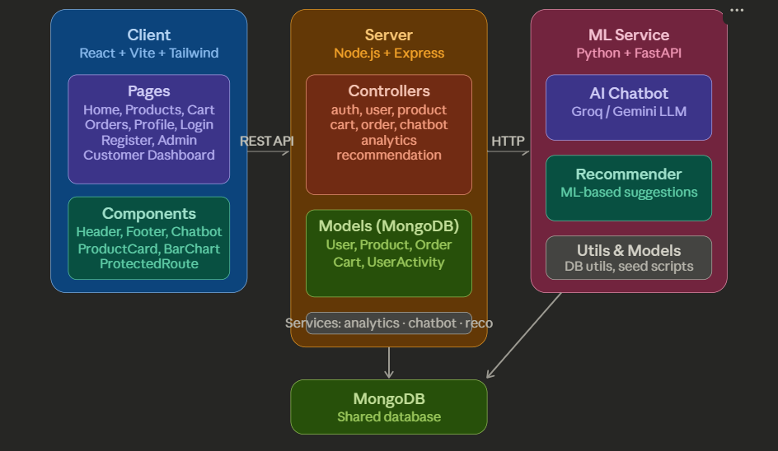
Proposed Methodology
III B.Tech (CSE-D) Industrial Oriented Mini Project (IOMP) Presentation Review-2,
CSE Dept, CVR college of Engineering

Slide 12
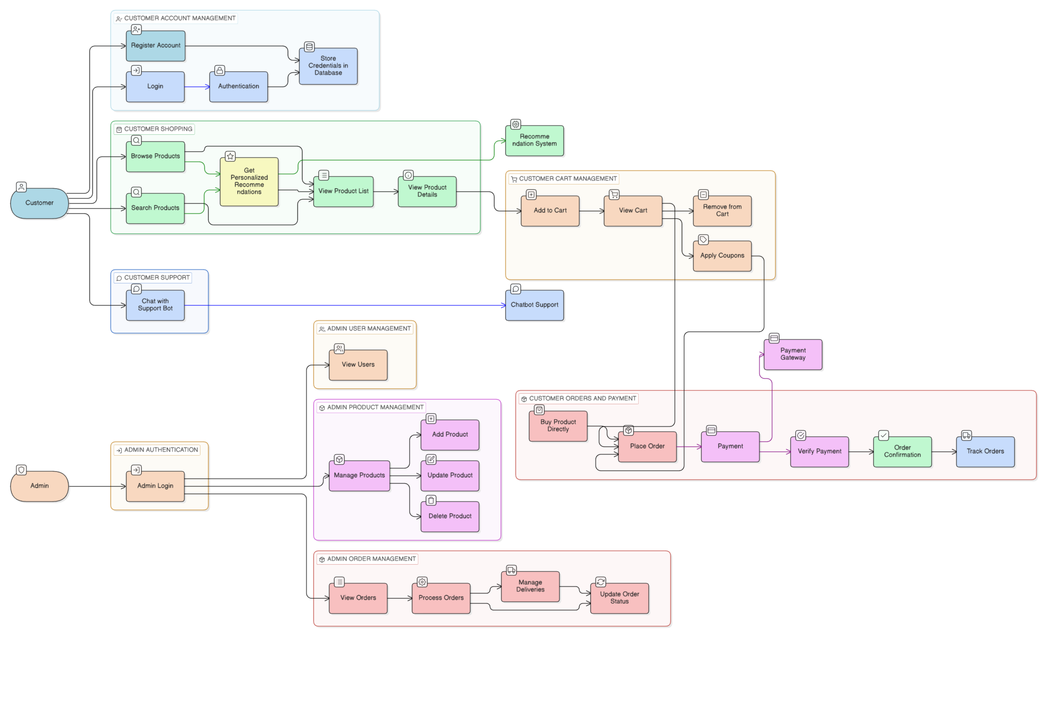
System Architecture :

Slide 13
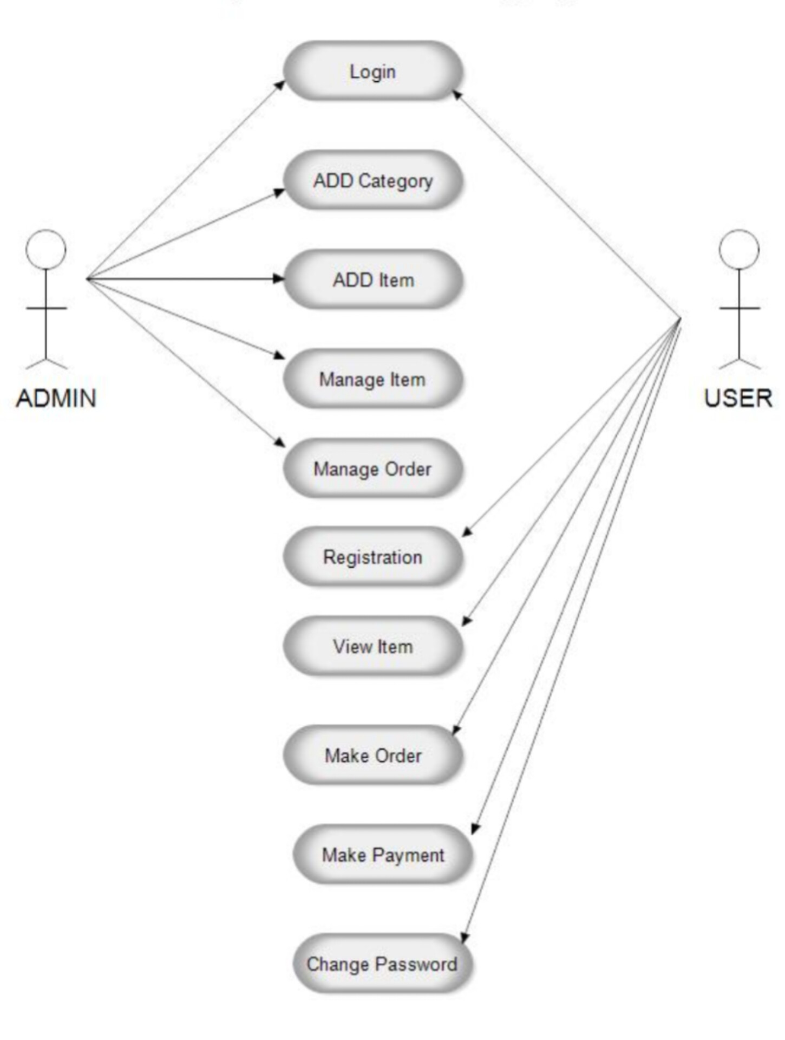
Use case Diagram
III B.Tech (CSE-D) Industrial Oriented Mini Project (IOMP) Presentation Review-2,
CSE Dept, CVR college of Engineering

Slide 14
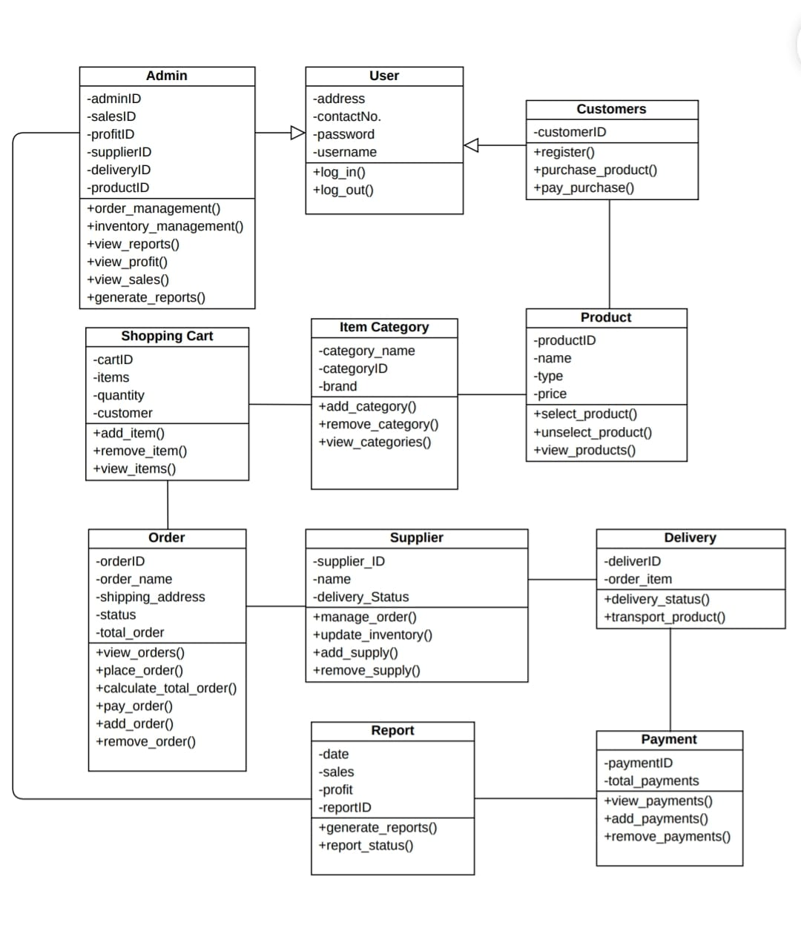
Class Diagram

Slide 15
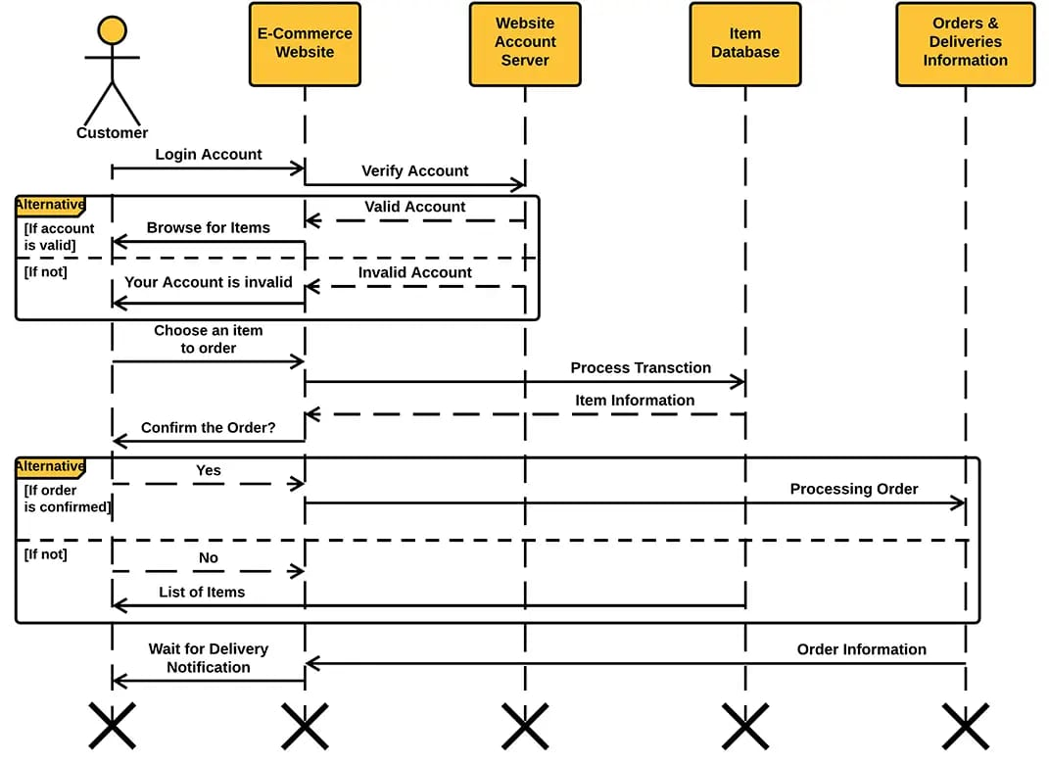
Sequence Diagram

Slide 16
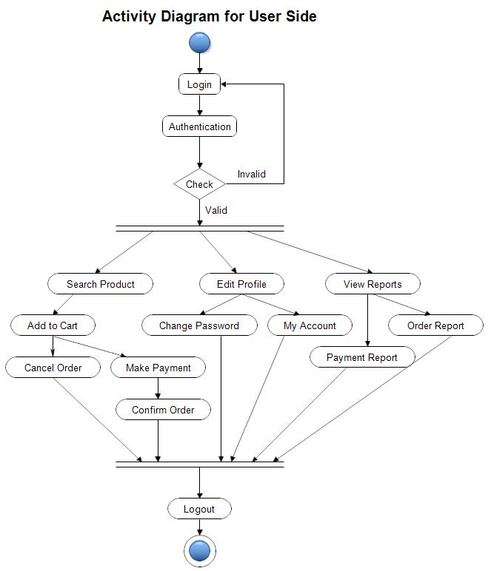
Activity Diagram (User Side):

Slide 17
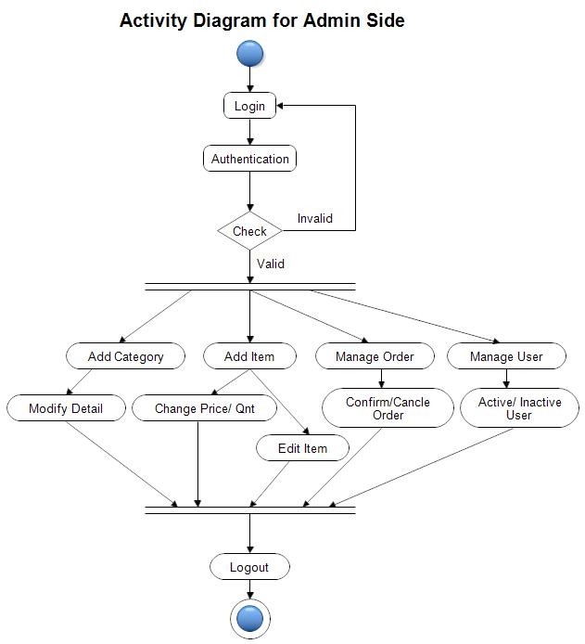
Activity Diagram (Admin Side):

Slide 18
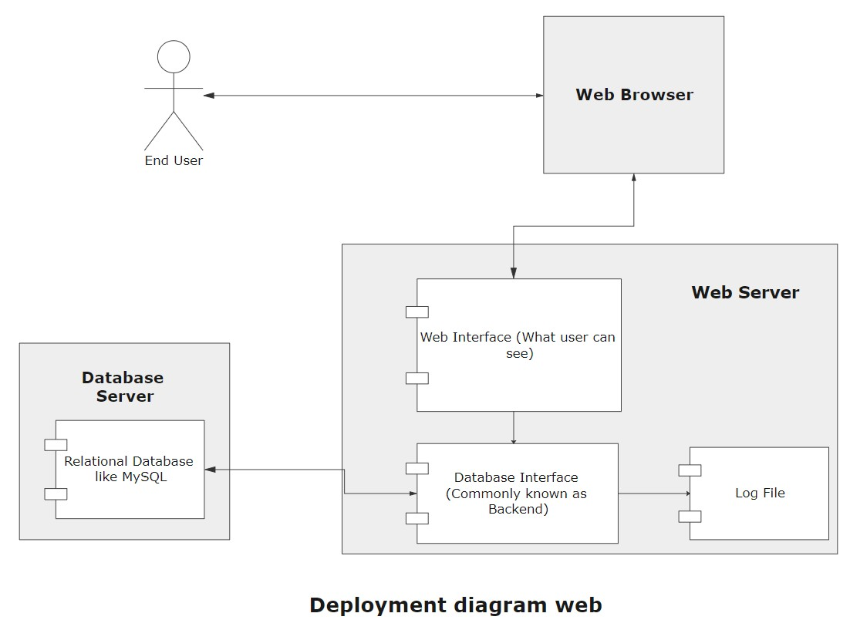
Deployment Diagram
III B.Tech (CSE-D) Industrial Oriented Mini Project (IOMP) Presentation Review-2,
CSE Dept, CVR college of Engineering

Slide 19
Implementation – Module Description
Frontend Module (Client)
Developed using React + Vite + Tailwind CSS.
Implements UI pages such as Home, Products, Cart, Orders, Profile, Login/Register, and Admin Dashboard.
Uses reusable components like Header, Footer, ProductCard, BarChart, and Chatbot interface.
Communicates with backend services via REST APIs for dynamic data rendering.
III B.Tech (CSE-D) Industrial Oriented Mini Project (IOMP) Presentation Review-2,
CSE Dept, CVR college of Engineering

Slide 20
Implementation – Module Description
Backend Module (Server)
Built using Node.js + Express to handle business logic and API routing.
Implements controllers for authentication, user management, product handling, cart, orders, chatbot, analytics, and recommendations.
Ensures secure communication, request handling, and integration with database and ML services.
III B.Tech (CSE-D) Industrial Oriented Mini Project (IOMP) Presentation Review-2,
CSE Dept, CVR college of Engineering

Slide 21
Implementation – Module Description
Recommender System Module:
Uses ML algorithms to analyze user behavior and purchase history.
Generates personalized product suggestions.
Improves user engagement and conversion rates.
Chatbot Module (AI Integration):
Processes user prompts and connects to Groq API-based AI model (LLM).
Generates dynamic and context-aware responses.
If a query is not resolved through rule-based logic or intent recognition, severe cases are escalated to the admin.
III B.Tech (CSE-D) Industrial Oriented Mini Project (IOMP) Presentation Review-2,
CSE Dept, CVR college of Engineering

Slide 22
Implementation – Module Description
Database Module(MongoDB):
  Uses MongoDB for storing structured and semi-structured data
  Defines models such as User, Product, Order, Cart, and UserActivity.
  Supports efficient querying, scalability, and real-time data updates
Machine Learning Service Module (ML Service)
  Processes user data to generate recommendations and predictive analytics.
Communicates with backend via HTTP for seamless integration
Implemented using Python + FastAPI for high-performance APIs.
III B.Tech (CSE-D) Industrial Oriented Mini Project (IOMP) Presentation Review-2,
CSE Dept, CVR college of Engineering

Slide 23
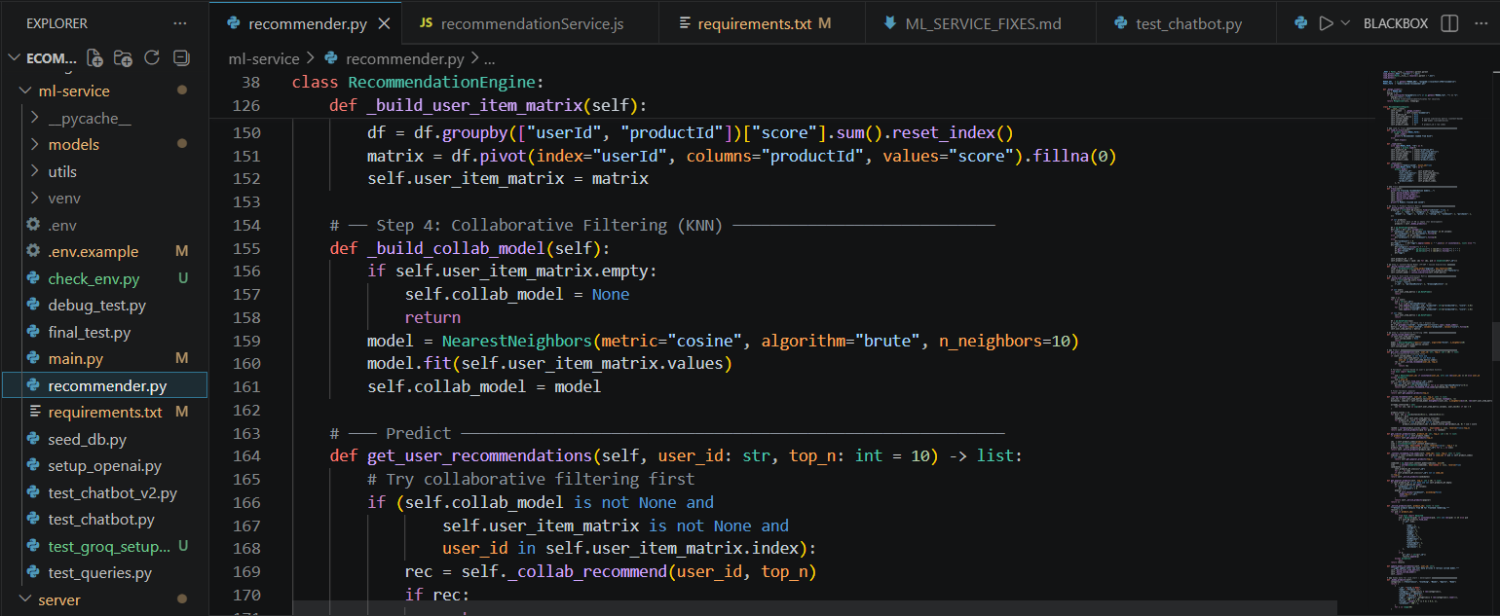
Coding
Hybrid Recommendation Engine
The recommendation engine uses a hybrid approach combining content-based and collaborative filtering to generate personalized suggestions. It analyzes product features and user behavior, and falls back to popular products when data is insufficient.
III B.Tech (CSE-D) Industrial Oriented Mini Project (IOMP) Presentation Review-2,
CSE Dept, CVR college of Engineering

Slide 24
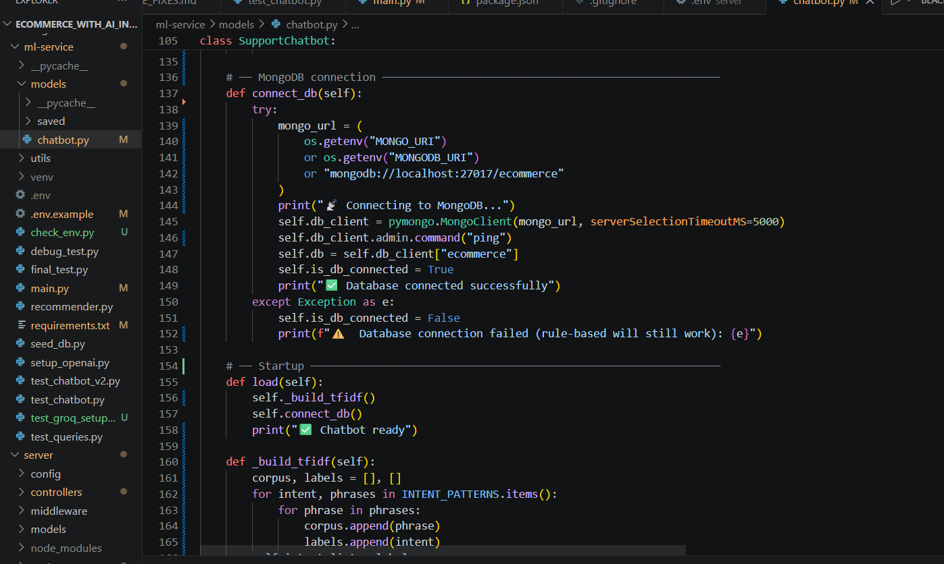
Coding
Chatbot Processing and Response Mechanism:
The chatbot converts user messages into structured queries using a Groq-based AI model and retrieves data from MongoDB. If no results are found, it falls back to rule-based or AI-generated responses. Unresolved or severe queries are escalated to the admin with a support ticket.
III B.Tech (CSE-D) Industrial Oriented Mini Project (IOMP) Presentation Review-2,
CSE Dept, CVR college of Engineering

Slide 25
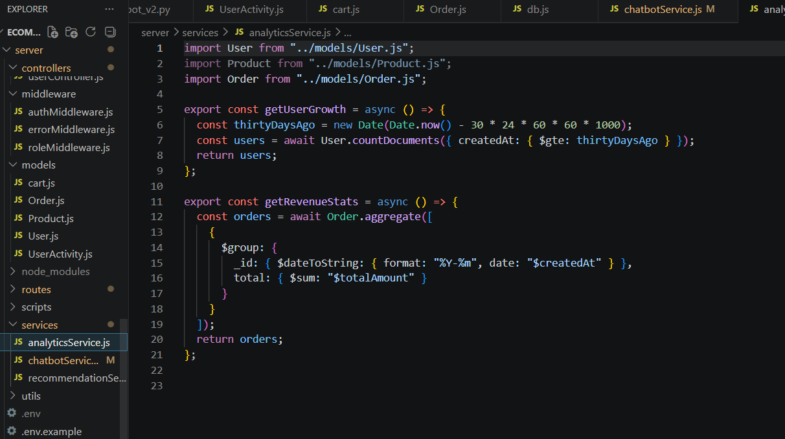
Coding
Analytics Module Functions
The analytics module computes key business metrics such as user growth and revenue trends. The getUserGrowth function calculates the number of users registered in the last 30 days, providing insights into recent platform growth. The getRevenueStats function uses aggregation to group orders by month and compute total revenue, enabling analysis of sales performance over time
III B.Tech (CSE-D) Industrial Oriented Mini Project (IOMP) Presentation Review-2,
CSE Dept, CVR college of Engineering

Slide 26
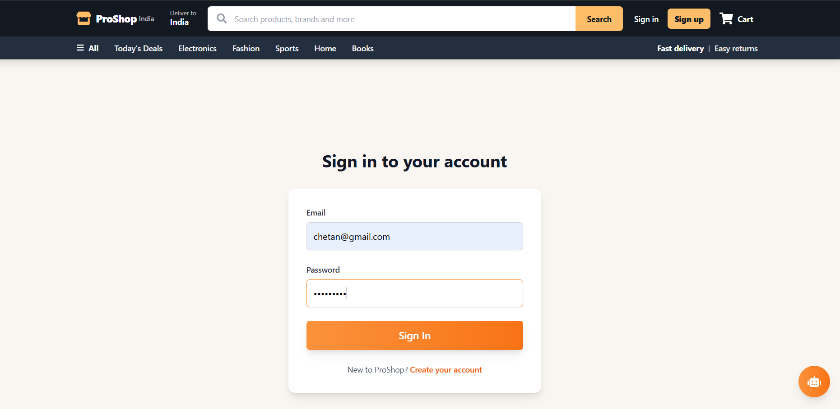
Results (Expected output)
Login System :
III B.Tech (CSE-D) Industrial Oriented Mini Project (IOMP) Presentation Review-2,
CSE Dept, CVR college of Engineering

Slide 27
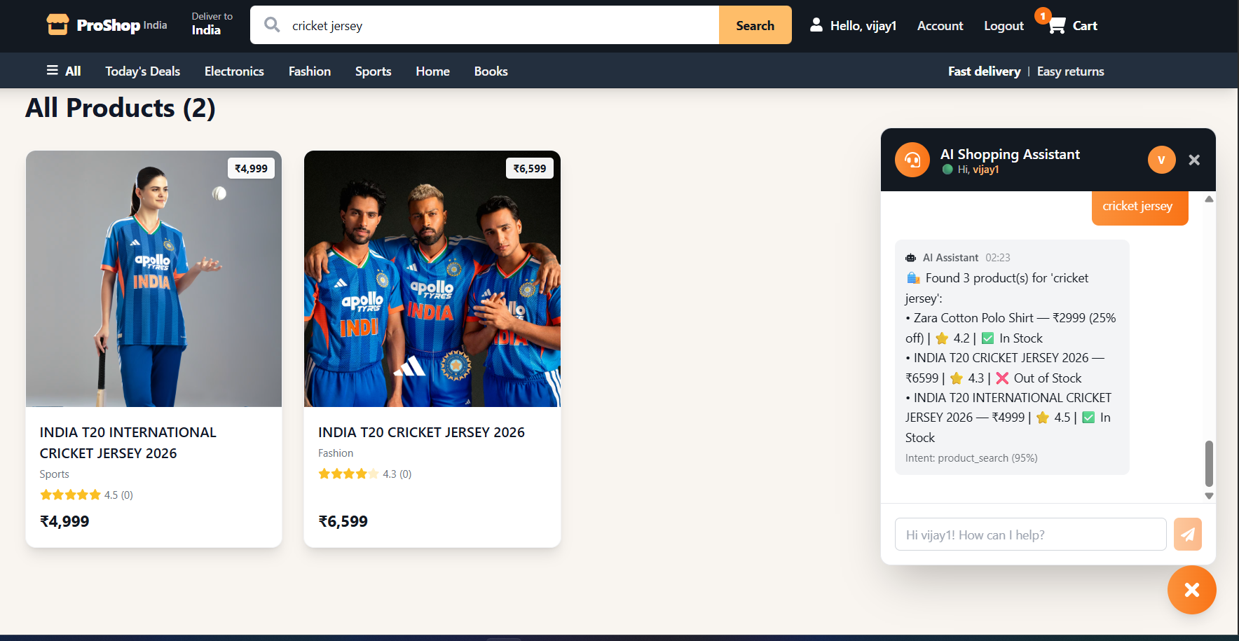
Results (Expected output)
Personalized Customer Chatbot:
III B.Tech (CSE-D) Industrial Oriented Mini Project (IOMP) Presentation Review-2,
CSE Dept, CVR college of Engineering

Slide 28
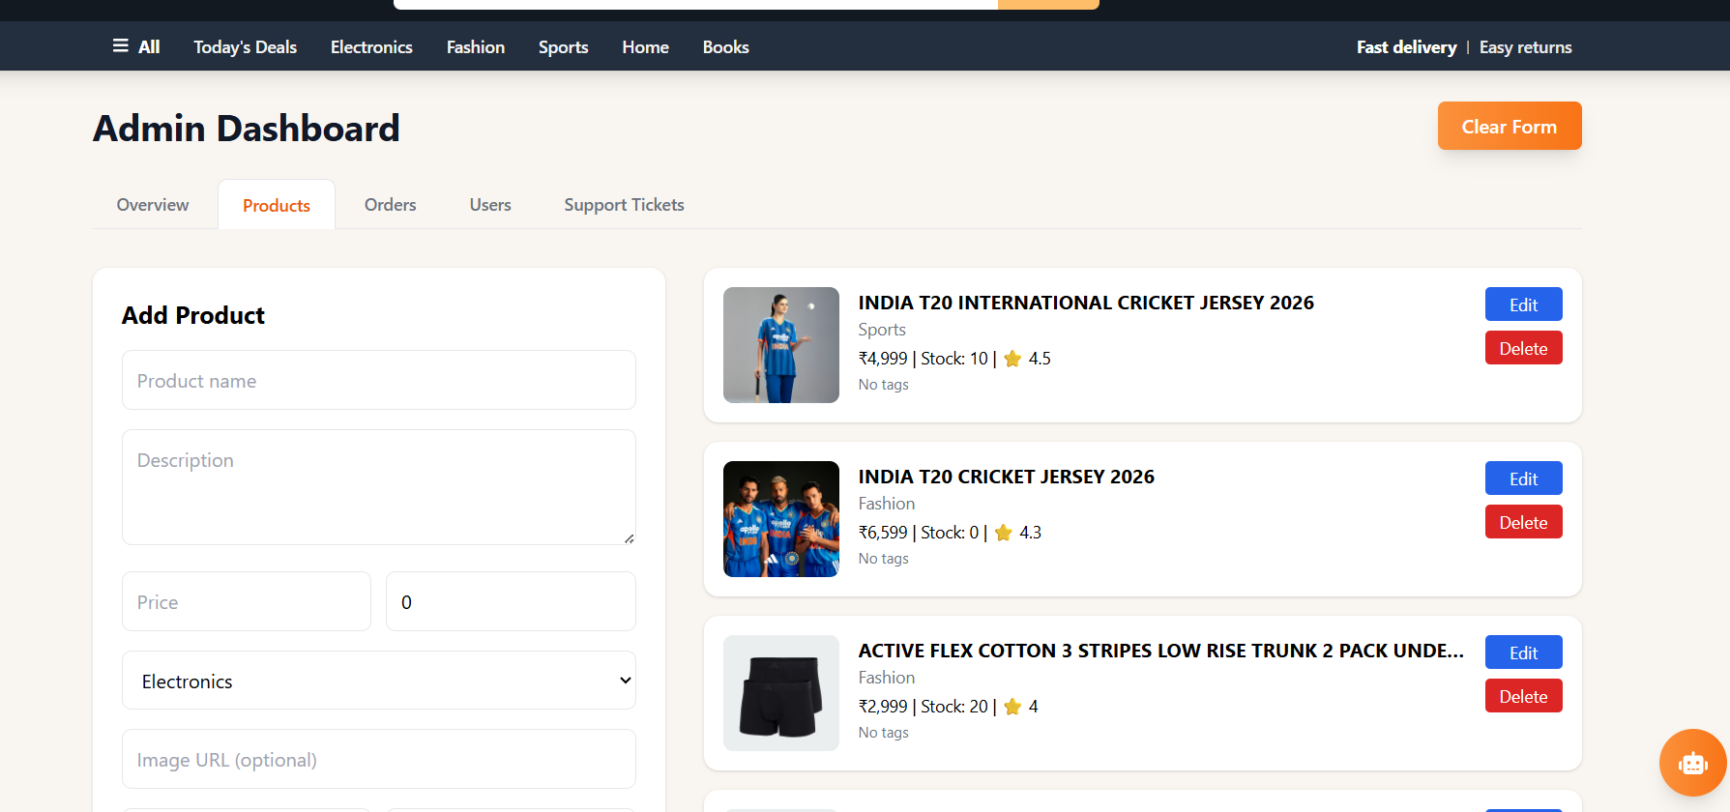
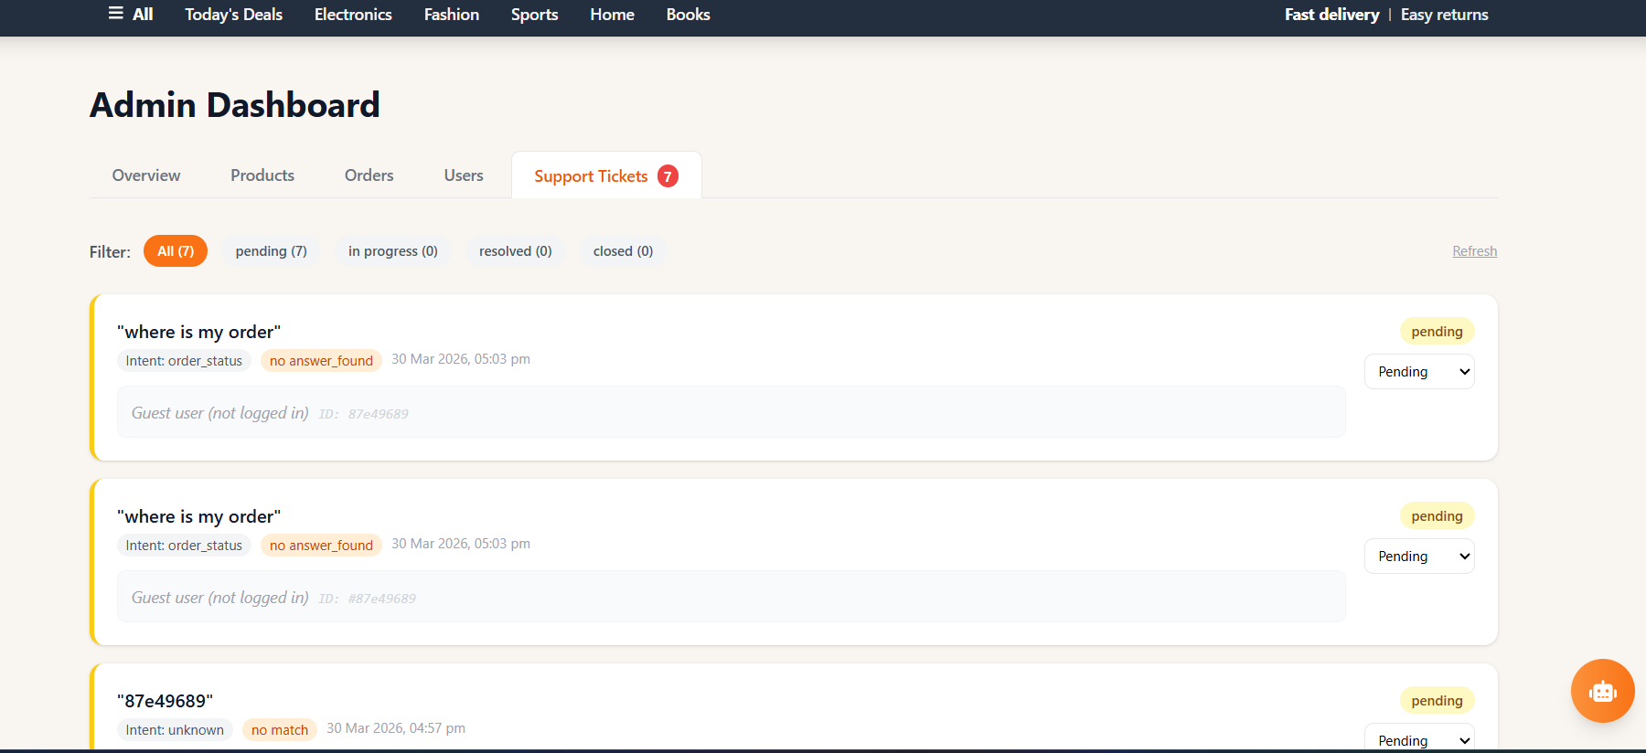
Results (Expected output)
Admin Dashboard:
III B.Tech (CSE-D) Industrial Oriented Mini Project (IOMP) Presentation Review-2,
CSE Dept, CVR college of Engineering

Slide 29
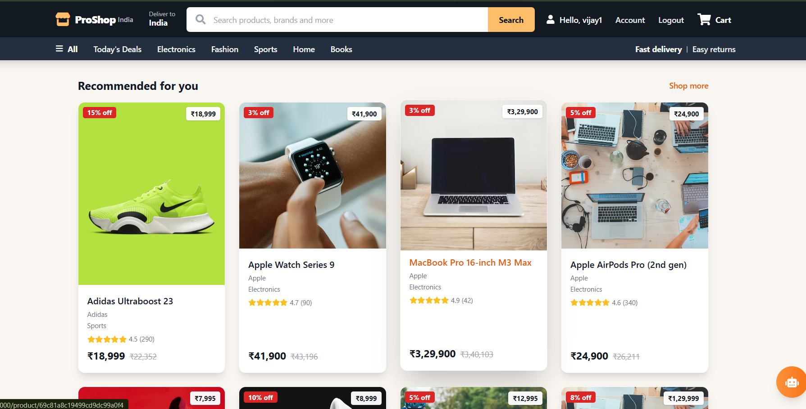
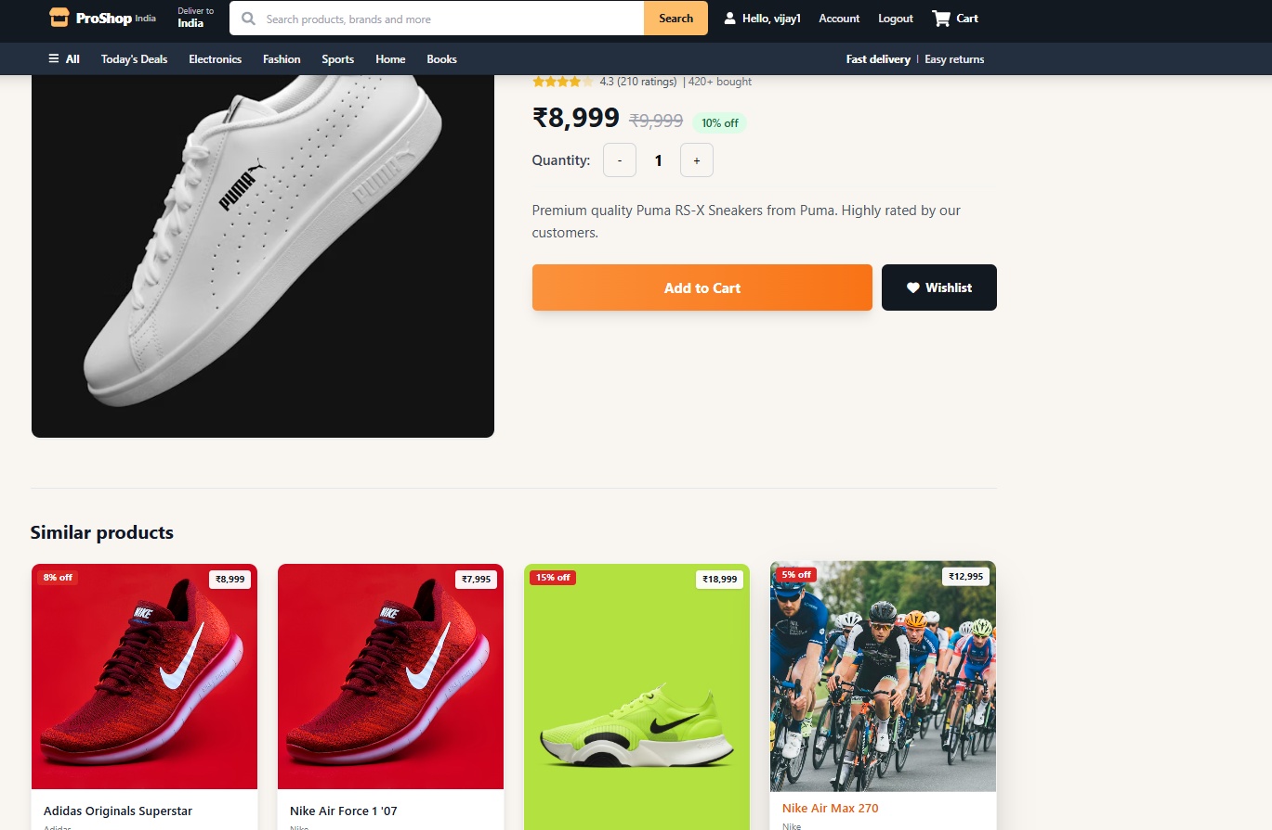
Results (Expected output)
Recommendations:
III B.Tech (CSE-D) Industrial Oriented Mini Project (IOMP) Presentation Review-2,
CSE Dept, CVR college of Engineering

Slide 30
Conclusion
It provides personalized recommendations based on user behavior and preferences.
Integration of real-time analytics enables better and faster data-driven
decision-making.
The AI-powered chatbot (Groq-based) enhances user interaction by handling
dynamic queries efficiently.
Escalation mechanisms ensure critical issues are directed to the admin when required.
The modular multi-tier architecture ensures scalability, flexibility, and maintainability.
Overall, the system improves customer experience, engagement, and business
efficiency.

Slide 31
Future Course of Actions
Future enhancements of the system may include:
Deep learning-based recommendation models
Real-time streaming analytics
Voice-enabled chatbot support
Integration with cloud-based deployment and auto-scaling
Advanced fraud detection and sentiment analysis
III B.Tech (CSE-D) Industrial Oriented Mini Project (IOMP) Presentation Review-2,
CSE Dept, CVR college of Engineering

Slide 32
References
[1] N. Jain and A. Hussain, “A Hybrid Machine Learning Approach for Improving E-Commerce Recommendation Systems Using Python,” International Journal of Scientific Research in Science and Technology. [Online]. Available: https://www.ijsrst.technoscienceacademy.com/index.php/home/article/view/IJSRST251263
[2] G. Adomavicius and A. Tuzhilin, “Toward the Next Generation of Recommender Systems: A Survey of the State-of-the-Art and Possible Extensions,” IEEE Transactions on Knowledge and Data Engineering, 2005. [Online]. Available: https://homepages.dcc.ufmg.br/~nivio/cursos/ri13/sources/recommender-systems-survey-2005.pdf
[3] A. Hassan, “Personalized Product Recommendation Systems in E-commerce – A Hybrid Approach Using Reinforcement Learning and NLP.” [Online]. Available: https://ramlai.com/index.php/ramlai/article/view/35
[4] G. Adomavicius and A. Tuzhilin, “Recommendation Technologies: Survey of Current Methods and Possible Extensions.” [Online]. Available: https://archive.nyu.edu/jspui/handle/2451/14144
[5] A. Wroblewska et al., “Multi-modal Embedding Fusion-based Recommender,” arXiv preprint. [Online]. Available: https://arxiv.org/abs/2005.06331
[6] R. Feldman and J. Sanger, The Text Mining Handbook: Advanced Approaches in Analyzing Unstructured Data. Cambridge University Press.
[7] P. Rajpurkar, J. Zhang, K. Lopyrev, and P. Liang, “SQuAD: 100,000+ Questions for Machine Comprehension of Text,” arXiv preprint.

Slide 33
THANK YOU

