Slide 1

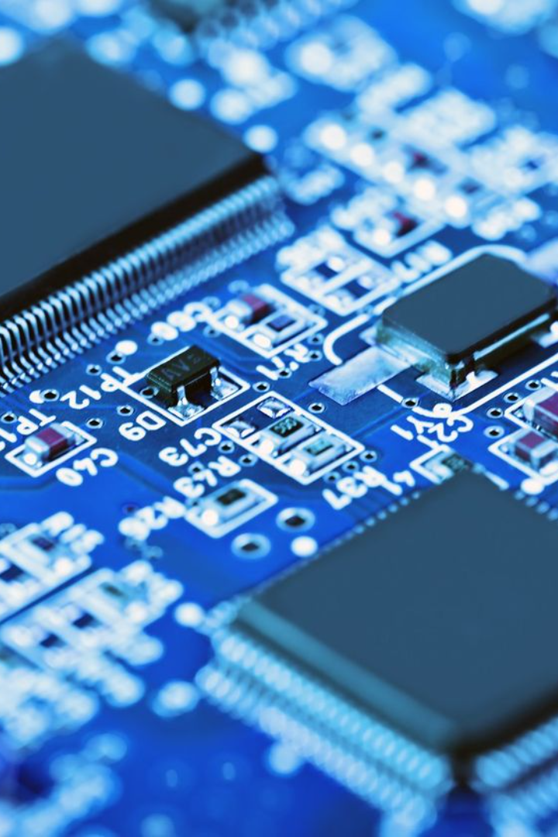
In Depth about Diodes
A diode is a two-terminal electronic component that conducts current primarily in one direction. Let's dive deep into how diodes work and their various applications.
By:
N. Ajay Kumar
23R21A05D0
CSE-C

Slide 2
Definition of Diode
A diode is a semiconductor device that allows current to flow in one direction while blocking it in the opposite direction. It acts as a one-way valve for electric current.

Slide 3

How Diodes Work
1
Forward Bias
2
Reverse Bias
When the voltage across the diode is positive, it conducts current freely, allowing electrons to move from the n-type to the p-type region.
When the voltage across the diode is negative, it blocks the flow of current, creating a depletion region where no electrons can pass through.

Slide 4
Types of Diodes
Zener Diode
Light-Emitting Diode (LED)
Schottky Diode
A diode designed to operate in reverse breakdown region, allowing precise voltage regulation.
A diode with a low forward voltage drop and fast switching speed, used in high-frequency applications.
A diode that emits light when current passes through it, used in various lighting applications.

Slide 5
Applications of Diodes
Rectification
Converts alternating current (AC) to direct current (DC).
Clipping
Removes portions of input signal above or below a certain threshold.
Clamping
Shifts the entire waveform up or down to a certain voltage level.
Switching
Transitions between conducting and non-conducting states rapidly.

Slide 6
Advantages of Diodes
1
Simple Structure
2
Low Cost
3
Efficient
Diodes are small and have a simple structure, making them easy to manufacture and integrate into circuits.
Due to their simple structure and widespread use, diodes are inexpensive compared to other electronic components.
Diodes have low power dissipation and high efficiency, making them ideal for energy-saving applications.

Slide 7
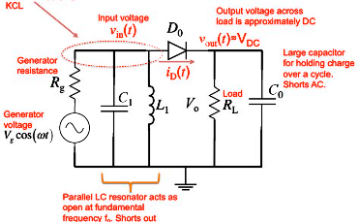
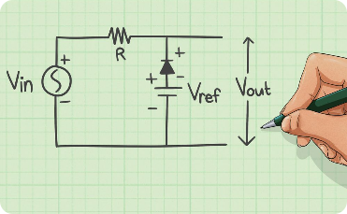
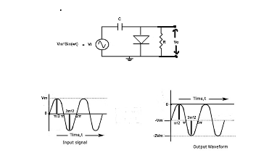
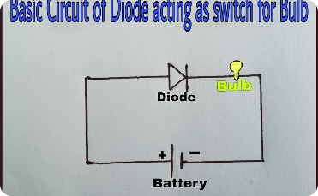
Common Diode Circuits
Rectifier Circuit
Clipper Circuit
Clamper Circuit
Switch Circuit
Converts AC to DC by allowing current to flow in only one direction.
Removes portions of an input waveform that exceed certain voltage levels.
Shifts the entire waveform up or down to a certain voltage level.
Controls the flow of current based on the presence or absence of a control signal.

Slide 8

Conclusion
Diodes are fundamental components in modern electronics with a wide range of applications. Their unique properties make them invaluable in rectification, clipping, clamping, and switching circuits.

Slide 9
THANK YOU

